Slide 1

Exploratory Data Analysis of the Historical English Premier League Table
Abhishek Shukla

Slide 2
We’ll begin by loading libraries followed by the data:
library(plyr)
library(dplyr)
library(ggplot2)
megatable <- read.csv("EPL_historical_table.csv“)
Let’s start by looking at a summary of our data:
summary(megatable)

Slide 3
Pos Team Pld W D
Min. : 1.00 Length:466 Min. :38.00 Min. : 1.00 Min. : 3.00
1st Qu.: 6.00 Class :character 1st Qu.:38.00 1st Qu.:10.00 1st Qu.: 8.00
Median :11.00 Mode :character Median :38.00 Median :13.00 Median :10.00
Mean :10.64 Mean :38.57 Mean :14.16 Mean :10.24
3rd Qu.:16.00 3rd Qu.:38.00 3rd Qu.:17.00 3rd Qu.:12.00
Max. :22.00 Max. :42.00 Max. :29.00 Max. :18.00
L GF GA GD Pts
Min. : 0.00 Min. : 20.00 Min. : 15.00 Length:466 Min. : 11.00
1st Qu.:10.25 1st Qu.: 41.00 1st Qu.: 43.00 Class :character 1st Qu.: 42.00
Median :15.00 Median : 48.00 Median : 51.00 Mode :character Median : 50.00
Mean :14.16 Mean : 50.81 Mean : 50.81 Mean : 53.83
3rd Qu.:18.00 3rd Qu.: 58.00 3rd Qu.: 58.75 3rd Qu.: 63.00
Max. :29.00 Max. :103.00 Max. :100.00 Max. :393.00
Year
Min. :1992
1st Qu.:1997
Median :2003
Mean :2003
3rd Qu.:2009
Max. :2014
Summary

Slide 4
filter(megatable, Pts > 100)
Output:
Pos Team Pld W D L GF GA GD Pts Year
19 Middlesbrough 38 10 12 16 51 60 −9 393 1996
20 Portsmouth 38 7 7 24 34 66 −32 191 2009
The above entries are incorrectly being interpreted as part of the value.
Since only two records are affected and we know the bad values only appear once in the dataframe, I’m going to use a simple text replace to fix the values:
megatable$Pts <- sub("393", "39", megatable$Pts)
megatable$Pts <- sub("191", "19", megatable$Pts)
megatable$Pts <- as.numeric(megatable$Pts)
summary(megatable$Pts)
Min. 1st Qu. Median Mean 3rd Qu. Max.
11.00 42.00 50.00 52.66 63.00 95.00
Error Correction

Slide 5
champs <- filter(megatable, Pos == 1)
#This function will arrange our histogram to show clubs in order of total EPL titles won
reorder_size <- function(x)
{
factor(x, levels = names(sort(table(x), decreasing = TRUE)))
}
#Plot EPL titles by club
ggplot(data = champs, aes(reorder_size(Team))) +
geom_bar(width = 0.6, fill = c("red","midnightblue","firebrick","skyblue","black","midnightblue")) +
xlab("") +
ylab("Titles") +
ggtitle("Premier League Titles by Club")
Champions

Slide 6
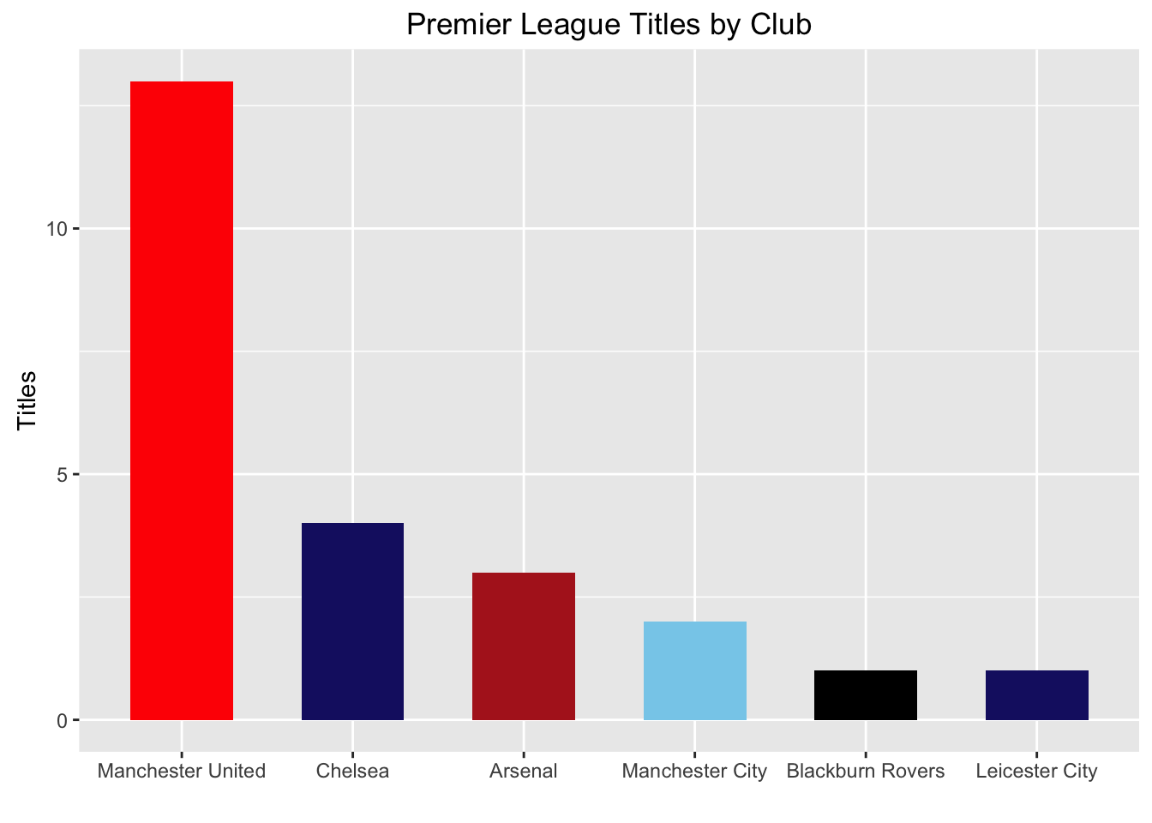

Slide 7
Here’s a breakdown of titles by club
champs %>% count(Team, sort = TRUE)
Team n
<chr> <int>
1 Manchester United 13
2 Chelsea 4
3 Arsenal 3
4 Manchester City 2
5 Blackburn Rovers 1
filter(champs, Pts %in% range(Pts)) %>% knitr::kable()
| Pos|Team | Pld| W| D| L| GF| GA|GD | Pts| Year|
| 1|Manchester United | 38| 21| 12| 5| 76| 44|+32 | 75| 1996|
| 1|Chelsea | 38| 29| 8| 1| 72| 15|+57 | 95| 2004|
Relative Strength

Slide 8
champs$T4Avg <- ddply(filter(megatable, Pos < 5), .(Year), summarise, Avg=round(mean(Pts)))[,2]
champs$GDAvg <- ddply(filter(megatable, Pos < 5), .(Year), summarise, Avg=round(mean(GF-GA)))[,2]
mutate(champs, STR=(Pts-T4Avg)+((GF-GA)-GDAvg)) %>%
select(-GD, -Pos) %>%
arrange(desc(STR)) %>%
top_n(10) %>%
knitr::kable()
Output:
|Team | Pld| W| D| L| GF| GA| Pts| Year| T4Avg| GDAvg| STR|
|Manchester United | 38| 28| 7| 3| 97| 45| 91| 1999| 75| 30| 38|
|Chelsea | 38| 29| 8| 1| 72| 15| 95| 2004| 79| 35| 38|
|Manchester City | 38| 28| 5| 5| 93| 29| 89| 2011| 79| 42| 32|
|Manchester United | 38| 28| 5| 5| 83| 27| 89| 2006| 77| 38| 30|
|Chelsea | 38| 27| 5| 6| 103| 32| 86| 2009| 79| 49| 29|
|Arsenal | 38| 26| 12| 0| 73| 26| 90| 2003| 76| 33| 28|
|Manchester United | 42| 24| 12| 6| 67| 31| 84| 1992| 75| 18| 27|
|Manchester United | 38| 24| 8| 6| 79| 31| 80| 2000| 72| 32| 24|
|Chelsea | 38| 29| 4| 5| 72| 22| 91| 2005| 81| 39| 21|
|Manchester City | 38| 27| 5| 6| 102| 37| 86| 2013| 83| 47| 21|
Relative Strength

Slide 9
Another measure of success in the EPL is top 4 finishes that award a place in the prestigious and lucrative Champion’s League competition.
Let’s see which teams have achieved the most top 4 finishes
topfour <- megatable %>% filter(Pos < 5 & Year > 1994)
ggplot(data = topfour, aes(reorder_size(Team))) +
geom_bar(width = 0.75, fill = "midnightblue") +
xlab("") +
ylab("Top 4 Finishes") +
theme(axis.text.x = element_text(angle=90))
Domestic Wins

Slide 10
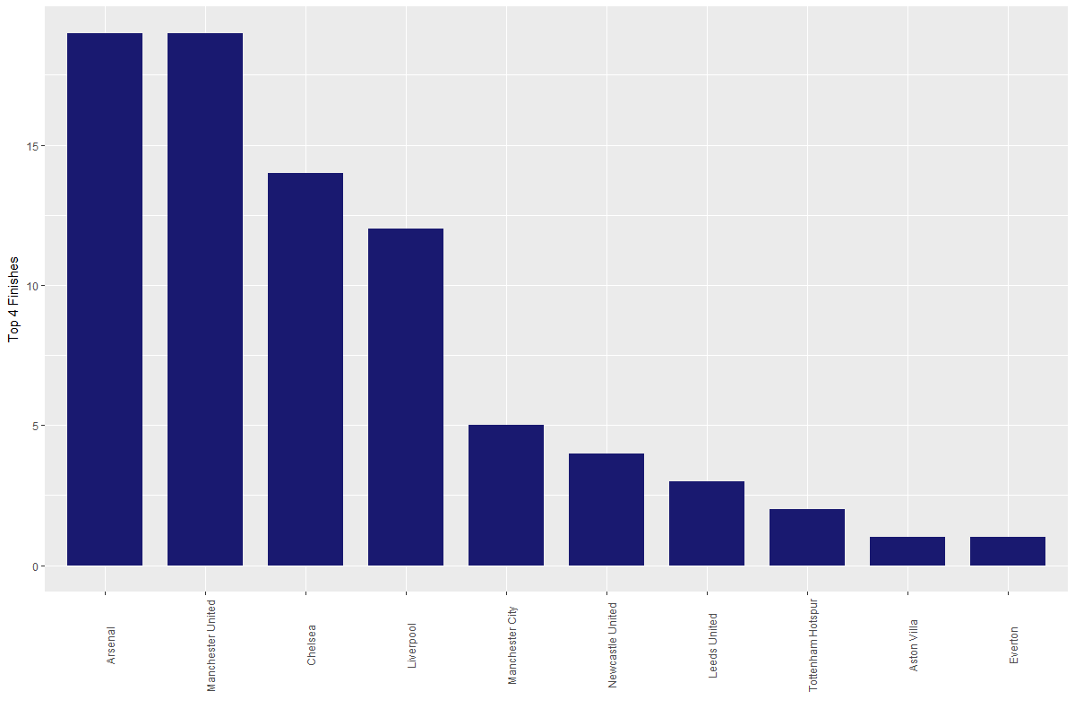

Slide 11
rlgtd <- megatable %>% filter(Year > 1994, Pos > 17)
rlgtd %>% count(Team, sort = TRUE) %>% top_n(5)
Team n
<chr> <int>
1 Birmingham City 3
2 Bolton Wanderers 3
3 Queens Park Rangers 3
4 Sunderland 3
5 West Bromwich Albion 3
Relegated

Slide 12
redemption <- function(team, year) {
next_year = as.integer(year) + 2
if (team %in% megatable[megatable$Year == next_year, "Team"]) {
promoted = 1
}
else {
promoted = 0
}
return(promoted)
}
redeemed <- mapply(redemption, rlgtd[,"Team"], rlgtd[, "Year"])
round(sum(redeemed)/nrow(rlgtd)*100, 2)
Output:
[1] 23.33
So we can see that only 24% of clubs that were relegated immediately regained promotion.
Redeemed

Slide 13
totgoals <- filter(megatable, Year > 1994) %>% group_by(Year) %>% summarise(Tot = sum(GF))
> ggplot(data = totgoals, aes(x = as.numeric(Year), y = Tot)) +
+ geom_bar(stat = "identity", fill = "orange") +
+ geom_hline(yintercept = round(mean(totgoals$Tot)), linetype = 2) +
+ xlab("Year") +
+ ylab("Total Goals") +
+ theme(axis.text.x = element_text(angle = 90, hjust = 0.9)) +
+ scale_x_continuous(breaks = seq(1995,2015)) +
+ ggtitle("Total Goals Scored per Season")
Goals Galore

Slide 14
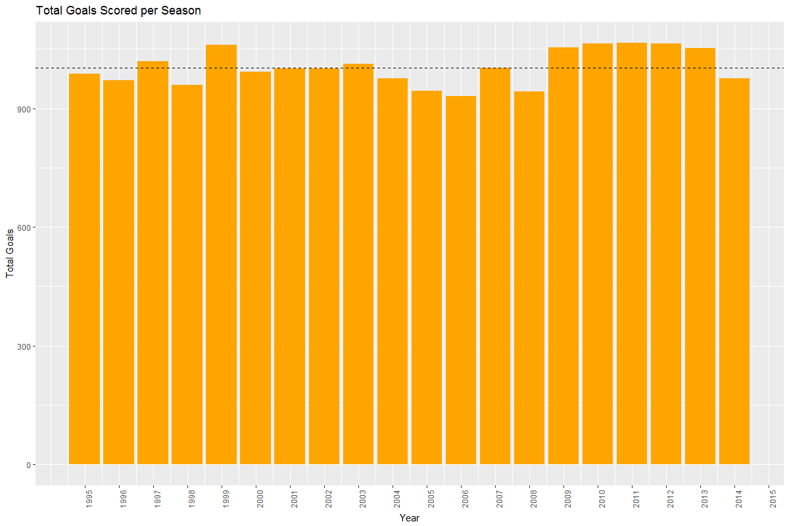

Slide 15
teams <- c("Leicester City",
"Arsenal",
"Manchester United",
"Chelsea",
"Liverpool",
"Southampton",
"Tottenham Hotspur",
"West Ham United")
teamperf <- megatable %>%
filter(Year > 1994, Team %in% teams) %>%
group_by(Team) %>%
summarise(ptsavg=mean(Pts), gfavg=mean(GF)) %>%
arrange(Team)
mcavg <- megatable %>%
filter(Year > 2010, Team == "Manchester City") %>%
group_by(Team) %>%
summarise(ptsavg=mean(Pts), gfavg=mean(GF))
teamperf <- bind_rows(teamperf, mcavg)
teamperf <- teamperf[order(teamperf$Team),]
teams <- append(teams, "Manchester City")
Year of the Fox

Slide 16
Year Team Pts GF PtsAvg GFAvg PtsDiff GFDiff PtsPctChng GFPctChng
2015 Leicester City 81 68 48.33 47.00 32.67 21.00 40.333333 30.882353
2015 Southampton 63 59 47.14 46.43 15.86 12.57 25.174603 21.305085
2015 West Ham United 62 65 47.61 45.89 14.39 19.11 23.209677 29.400000
2015 Tottenham Hotspur 70 69 56.90 54.29 13.10 14.71 18.714286 21.318841
2015 Arsenal 71 65 74.71 70.29 -3.71 -5.29 -5.225352 -8.138462
2015 Liverpool 60 63 67.05 63.67 -7.05 -0.67 -11.750000 -1.063492
2015 Manchester City 66 71 79.60 83.00 -13.60 -12.00 -20.606061 -16.901408
2015 Manchester United 66 49 80.38 75.14 -14.38 -26.14 -21.787879 -53.346939
Chelsea 50 59 73.10 67.14 -23.10 -8.14 -46.200000 -13.796610
Leicester City were the biggest over-performers but Southampton, West Ham United and Tottenham also showed considerable improvement as well.
Year of the Fox

Slide 17
afc <- filter(megatable, Team == "Manchester United")
filter(afc, Pos > 4)
Pos Team Pld W D L GF GA GD Pts Year
7 Manchester United 38 19 7 12 64 43 +21 64 2013
ggplot(data = afc, aes(x = as.numeric(Year), y = GF)) +
geom_line(size = 2.0, alpha = 0.7, color = "firebrick") +
geom_point(size = 1.0) +
xlab("Year") +
ylab("Goals Scored") +
theme(axis.text.x = element_text(angle = 90, hjust = 0.9)) +
scale_x_continuous(breaks = seq(1992,2015)) +
ggtitle("Manchester United's Goals Scored per Season")
Glory Glory Man United

Slide 18
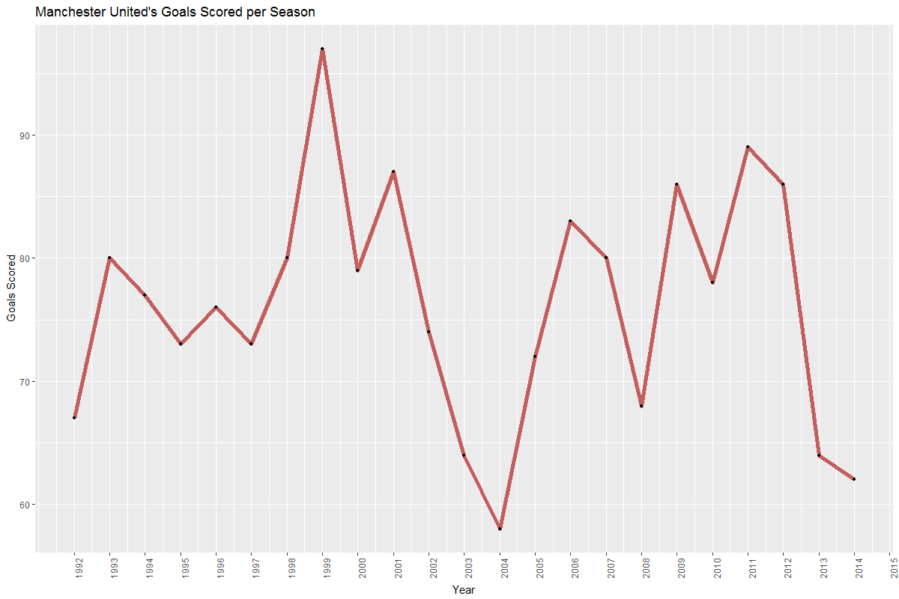

Slide 19
nld <- megatable %>% filter(Team %in% c(“Manchester United", “Chelsea"))
ggplot(data = nld, aes(x = as.numeric(Year), y = Pts)) +
geom_line(size = 2.0, alpha = 0.7, aes(color = Team)) +
geom_point(data = subset(nld, Pos == 1), size = 2.0, alpha = 0.7) +
scale_color_manual(values = c("firebrick","midnightblue")) +
xlab("Year") +
ylab("Points") +
ggtitle(“Manchester United vs. Chelsea EPL Comparison")
Regional Rivals

Slide 20
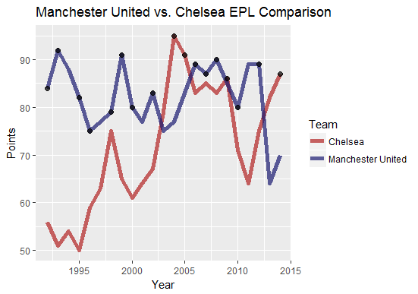

Slide 21


