Slide 1
Report

Slide 2
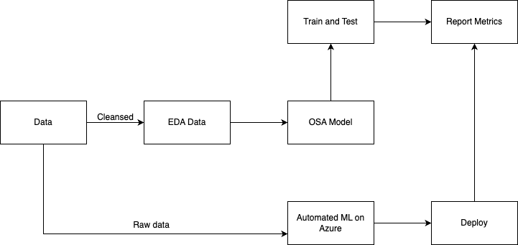
Architecture Flow

Slide 3
Comparison

Slide 4
independent_vars = data[['Avg. Area Income','Avg. Area House Age','Avg. Area Number of Rooms','Avg. Area Number of Bedrooms','Area Population’]]
Avg. Area Income Avg. Area House Age Avg. Area Number of Rooms \ 1303 68091 5 7 1051 75729 5 7 4904 70885 6 7 931 73386 4 7 4976 75046 5 7 ... ... ... ... 4171 56610 4 7 599 70596 6 6 1361 55621 3 6 1547 63044 5 5 4959 75078 7 8 Avg. Area Number of Bedrooms Area Population 1303 3 44557 1051 4 29996 4904 5 38627 931 4 38413 4976 5 34107 ... ... ... 4171 3 25494 599 3 51614 1361 2 63184 1547 4 32725 4959 4 56148 [3000 rows x 5 columns] Mean Squared Error (MSE): 59276979103.47522 R-squared (R2): 0.5335476994048952 OLS Regression Results ======================================================================================= Dep. Variable: Price R-squared (uncentered): 0.965 Model: OLS Adj. R-squared (uncentered): 0.965 Method: Least Squares F-statistic: 1.659e+04 Date: Mon, 29 Jan 2024 Prob (F-statistic): 0.00 Time: 07:56:18 Log-Likelihood: -41403. No. Observations: 3000 AIC: 8.282e+04 Df Residuals: 2995 BIC: 8.285e+04 Df Model: 5 Covariance Type: nonrobust ================================================================================================ coef std err t P>|t| [0.025 0.975] ------------------------------------------------------------------------------------------------ Avg. Area Income 9.7145 0.333 29.161 0.000 9.061 10.368 Avg. Area House Age 5.355e+04 3767.501 14.213 0.000 4.62e+04 6.09e+04 Avg. Area Number of Rooms -3171.5994 4176.542 -0.759 0.448 -1.14e+04 5017.582 Avg. Area Number of Bedrooms 3237.3298 4075.709 0.794 0.427 -4754.142 1.12e+04 Area Population 8.2323 0.411 20.032 0.000 7.427 9.038 ============================================================================== Omnibus: 0.010 Durbin-Watson: 2.002 Prob(Omnibus): 0.995 Jarque-Bera (JB): 0.004 Skew: 0.003 Prob(JB): 0.998 Kurtosis: 3.002 Cond. No. 9.37e+04 ============================================================================== Notes: [1] R² is computed without centering (uncentered) since the model does not contain a constant. [2] Standard Errors assume that the covariance matrix of the errors is correctly specified. [3] The condition number is large, 9.37e+04. This might indicate that there are strong multicollinearity or other numerical problems.

Slide 5
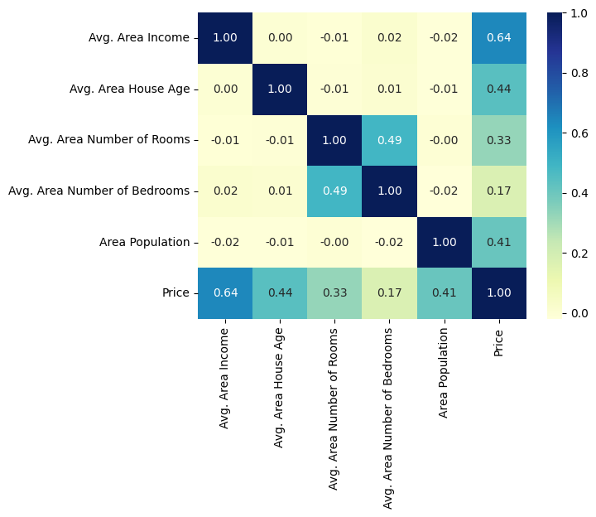

Slide 6
independent_vars = data[['Avg. Area Income', 'Avg. Area House Age']]
Avg. Area Income Avg. Area House Age 1303 68091 5 1051 75729 5 4904 70885 6 931 73386 4 4976 75046 5 ... ... ... 4171 56610 4 599 70596 6 1361 55621 3 1547 63044 5 4959 75078 7 [3000 rows x 2 columns] Mean Squared Error (MSE): 65402859366.56391 R-squared (R2): 0.48534296655405484 OLS Regression Results ======================================================================================= Dep. Variable: Price R-squared (uncentered): 0.960 Model: OLS Adj. R-squared (uncentered): 0.960 Method: Least Squares F-statistic: 3.619e+04 Date: Mon, 29 Jan 2024 Prob (F-statistic): 0.00 Time: 09:26:56 Log-Likelihood: -41601. No. Observations: 3000 AIC: 8.321e+04 Df Residuals: 2998 BIC: 8.322e+04 Df Model: 2 Covariance Type: nonrobust ======================================================================================= coef std err t P>|t| [0.025 0.975] --------------------------------------------------------------------------------------- Avg. Area Income 12.1498 0.286 42.530 0.000 11.590 12.710 Avg. Area House Age 7.509e+04 3545.969 21.175 0.000 6.81e+04 8.2e+04 ============================================================================== Omnibus: 0.585 Durbin-Watson: 2.027 Prob(Omnibus): 0.746 Jarque-Bera (JB): 0.625 Skew: 0.031 Prob(JB): 0.732 Kurtosis: 2.966 Cond. No. 5.27e+04 ============================================================================== Notes: [1] R² is computed without centering (uncentered) since the model does not contain a constant. [2] Standard Errors assume that the covariance matrix of the errors is correctly specified. [3] The condition number is large, 5.27e+04. This might indicate that there are strong multicollinearity or other numerical problems.

Slide 8
independent_vars = data[['Avg. Area Income', 'Avg. Area Number of Rooms']]
Avg. Area Income Avg. Area Number of Rooms 1303 68091 7 1051 75729 7 4904 70885 7 931 73386 7 4976 75046 7 ... ... ... 4171 56610 7 599 70596 6 1361 55621 6 1547 63044 5 4959 75078 8 [3000 rows x 2 columns] Mean Squared Error (MSE): 71624171343.72728 R-squared (R2): 0.43638727872451766 OLS Regression Results ======================================================================================= Dep. Variable: Price R-squared (uncentered): 0.957 Model: OLS Adj. R-squared (uncentered): 0.957 Method: Least Squares F-statistic: 3.307e+04 Date: Mon, 29 Jan 2024 Prob (F-statistic): 0.00 Time: 09:29:12 Log-Likelihood: -41731. No. Observations: 3000 AIC: 8.347e+04 Df Residuals: 2998 BIC: 8.348e+04 Df Model: 2 Covariance Type: nonrobust ============================================================================================= coef std err t P>|t| [0.025 0.975] --------------------------------------------------------------------------------------------- Avg. Area Income 14.0682 0.318 44.201 0.000 13.444 14.692 Avg. Area Number of Rooms 4.28e+04 3354.437 12.759 0.000 3.62e+04 4.94e+04 ============================================================================== Omnibus: 1.854 Durbin-Watson: 2.022 Prob(Omnibus): 0.396 Jarque-Bera (JB): 1.823 Skew: -0.023 Prob(JB): 0.402 Kurtosis: 2.889 Cond. No. 4.78e+04 ============================================================================== Notes: [1] R² is computed without centering (uncentered) since the model does not contain a constant. [2] Standard Errors assume that the covariance matrix of the errors is correctly specified. [3] The condition number is large, 4.78e+04. This might indicate that there are strong multicollinearity or other numerical problems.

Slide 10
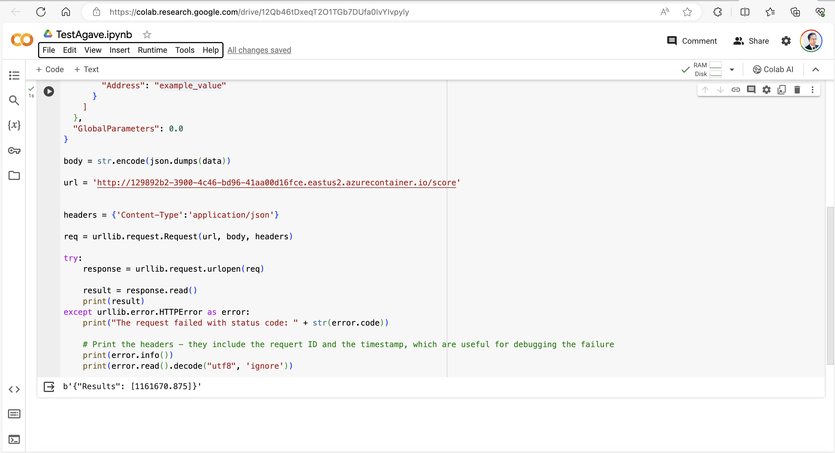
Run results

Slide 11
