Slide 1
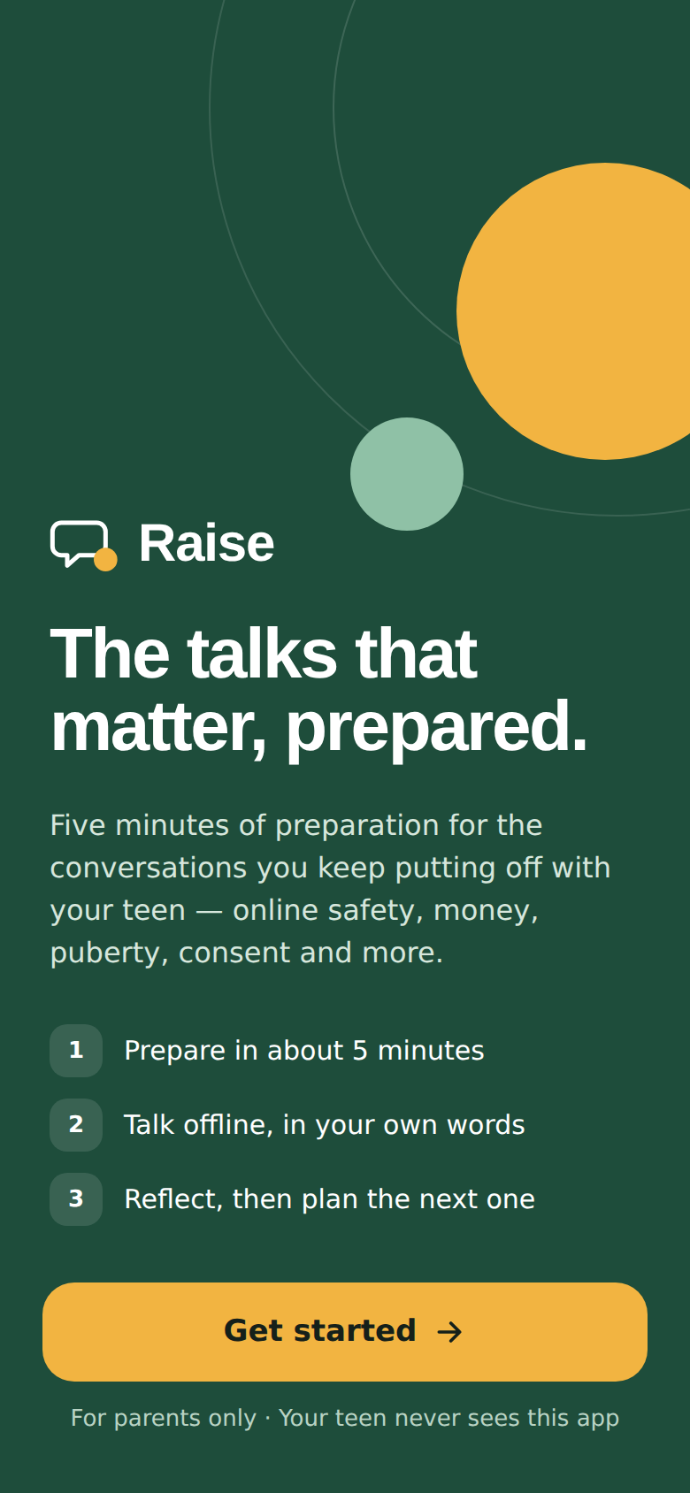
Raise
The talks that matter, prepared.
A product case study by Himanshu Shukla
Notes:
Raise helps parents prepare for the conversations they keep putting off with their teen, have them offline, reflect, and plan the next one.

Slide 2
The talk every parent means to have, and doesn’t
Parents of 14–19-year-olds want to talk about money, relationships, puberty, consent, online safety and pornography — but were never taught how, and don’t have the words to begin.
So the talk is postponed, avoided, or happens once as a lecture after something has gone wrong.
Teens learn from friends, the internet and porn — and stop coming to their parents when it matters.
~4 in 5
parents in one school-based Indian study wanted sex education to be compulsory
~1 in 4
said they actually discussed it with their adolescent
Source: Pediatric Oncall Journal, parents’ views study [S1]
Notes:
Intent is high, action is low. The gap is the how, not the why.

Slide 3
Who we’re building for
01
Parents aged 35–60 · teens aged 14–19 · the parent is the only user

Slide 4

Three parents, one shared barrier: the first sentence
Sunita, 44
Rajesh, 52
Farah, 38
Willing but wordless
Tried once, it went wrong
Time-poor solo parent
Daughter, 15 · puberty, relationships
Son, 18 · money, consent
Son, 14 · online safety, porn
“Tell me the first line. After that I can manage.”
“How do I start again without it being about last time?”
“I don’t need a course. I need a plan for tonight.”
Illustrative personas — not based on research. Validate against real interviews.

Slide 5
Problem framing
User
Parents 35–60 of teens 14–19
need
calm, honest, repeated talks on the six hard topics
but currently
lack the words, fear the questions, and have no one showing them what to say
This causes
silence or lectures — teens learn elsewhere and hide problems
We will solve this by
a 5-minute prep guide → talk offline in their own words → 2-minute reflection → next talk

Slide 6
What we learned
02
Published Indian research + an interview guide for parents and teens

Slide 7
Published research points the same way
~60%
~47%
~1 in 2
of parents who believed in sexuality education gave it themselves; discomfort was a common reason others didn’t
of boys aged 15–19 in Bihar & UP reported exposure to pornography (6% of girls); own phone raised the odds
parents said they’d be extremely uncomfortable having “the talk”; a third of children said they never could
[S2] Manipal, coastal South India
[S4] Population Council, UDAYA 2015–16
[S3] ParentCircle–IMRB, 2015
Gap in the market: schools and NGOs reach teens; articles explain why. Nothing prepares the parent for one specific talk and closes the loop after it.

Slide 8
Mirror insights: what each side thinks of the other
PARENT THINKS
TEEN THINKS
SO RAISE…
“Checking his phone keeps him safe.”
“I know they check, so I delete chats.”
Never offers monitoring
“If I don’t know the answer, I lose respect.”
“‘Let’s find out’ feels real.”
Teaches “I don’t know” as a good answer
“A proper sit-down shows it matters.”
“A sit-down means I’m in trouble.”
Short, sideways openers
“He’ll come to me if something’s wrong.”
“I’d tell a friend — they’d take my phone.”
Opens with a safety promise
Interview guide: 23 parent + 30 teen questions. Answers shown are illustrative composites — replace with real interview notes.

Slide 9
What we measure
03
One completed conversation — not app opens, not time in app

Slide 10
A Completed Conversation passes three gates
= 1 CC
1 · Prepared
2 · Time passed
3 · Reflected
All 5 prep steps viewed and an opener chosen
“I’ve had it” tapped ≥ 20 min after prep (assumption)
Within 7 days: outcome + a chip or a note
Why a parent who did nothing can’t inflate it
Honest limit
Until the teen check exists, CC is a well-defended self-report — not a verified fact.
Effort, time and detail gates block tap-through fakes
No streaks, points or badges — nothing to win by lying
A fake “went well” gives the parent worse advice next time
V2: opt-in, anonymous teen check on a small sample to estimate how many CCs are real

Slide 11
The behaviour that has to change
The parent says the opener out loud to their teen within 72 hours of finishing the prep.
Today: prepare mentally, postpone to “this weekend” — which never comes.
Leading indicator: Prep → Talk within 72 hours.
Not a target: whether the talk “went well”. Rewarding good outcomes would reward steering, not listening.

Slide 12
What we build first
04
12 features, each tied to an insight · RICE · V1, V2, Cut

Slide 13
RICE: core prep loop first, safety overrides the score
Overrides
F10 Safety escalation is V1 despite a low score — missing a grooming or self-harm disclosure is unacceptable.
F1 scores lower only because it’s the biggest build; F2–F5 are parts of it.
F11 Hindi is the first V2 item: language is part of the vocabulary gap.
Reach, impact, confidence and effort are team estimates — re-score after the pilot.

Slide 14
MVP: one evening, sign-up to a real conversation
V1 · build now
V2 · after the loop works
Cut · will not build
5-min prep guide (6 topics)
Openers, Anticipate, Avoid
Pocket card
Age tone: 14–15 · 16–17 · 18–19
Reflection + next talk
Safety escalation cards
Analytics for the CC gates
Hindi + Hinglish library
Pick-your-moment reminders
Full journal
Co-parent sharing
AI rephrasing of approved content
Opt-in teen check
Teen-facing app
Phone monitoring or tracking
Open AI chat about the teen
Streaks, points, badges
Community forum
School dashboards

Slide 15
Written boundaries and escalation
Raise never
Monitors, records or contacts the teen
Diagnoses, suggests medication or gives legal advice
Produces explicit or shaming content
Scripts a talk about abuse or self-harm
0
Normal
Insight + next talk
1
Watch · 3 stalls in a row
Suggest a break or school counsellor
2
Risk · stranger contact, photo threats
Cyber Crime 1930 / cybercrime.gov.in · Childline 1098
Library stays current
Engine gate + expert review before publishing
Quarterly review; scams and online safety monthly
Gap queue from “couldn’t answer” reflections
3
Urgent · self-harm, abuse
Tele-MANAS 14416 · 112 · 1098 · no script
Helpline numbers to be re-verified before launch.

Slide 16
How it works
05
Prepare · Talk · Reflect · Next — PRD, flows, journeys and wireframes in the companion document

Slide 17
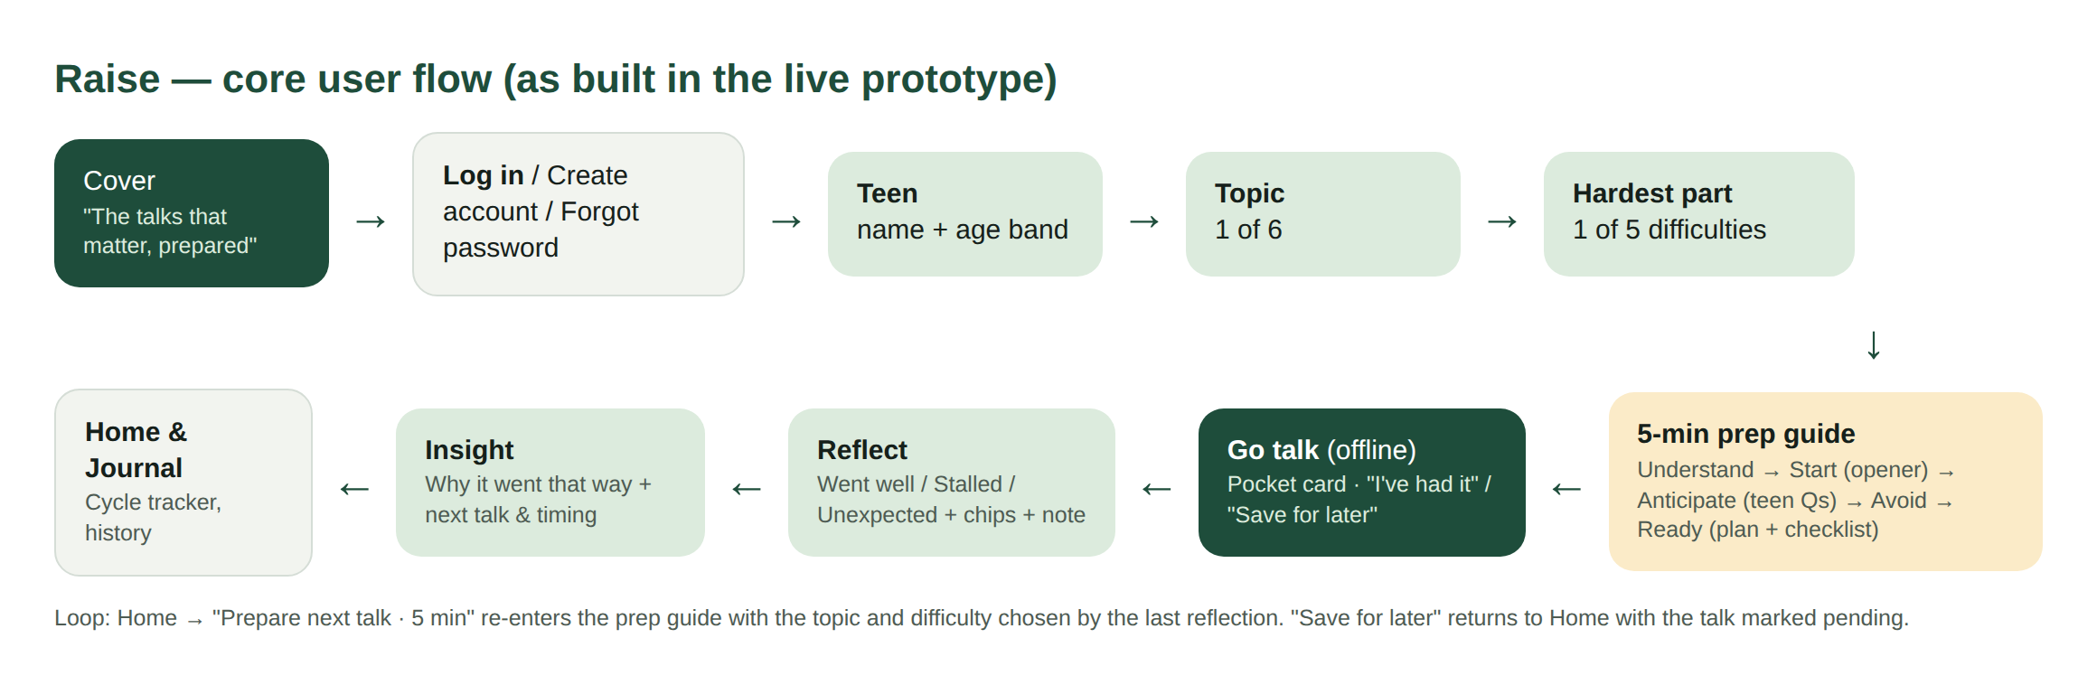
The core flow, as built
Three journey maps tested the flow: Sunita’s first talk, Rajesh repairing after a bad attempt, and Farah’s talk that surfaced a disclosure — which is how the missing safety card was found.

Slide 18
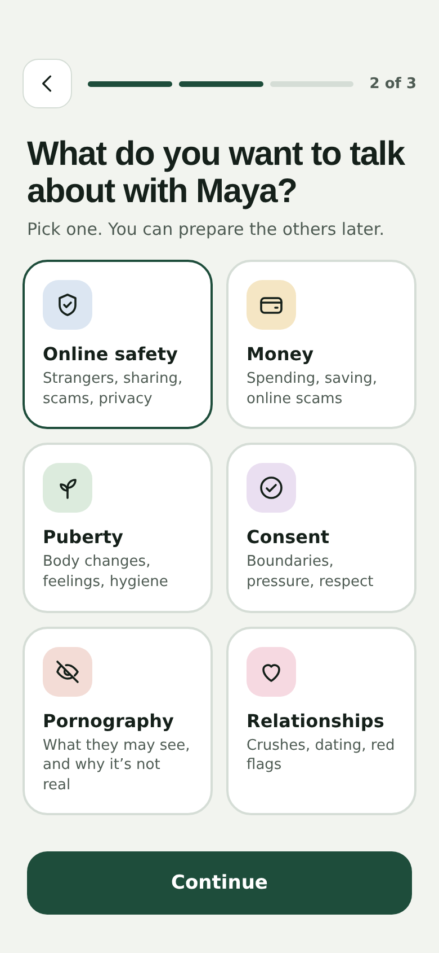
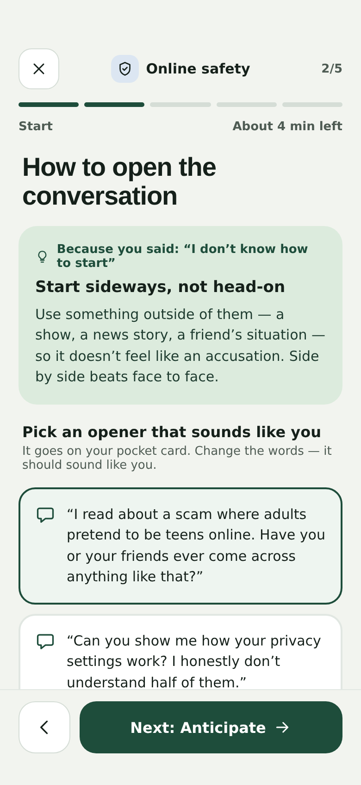
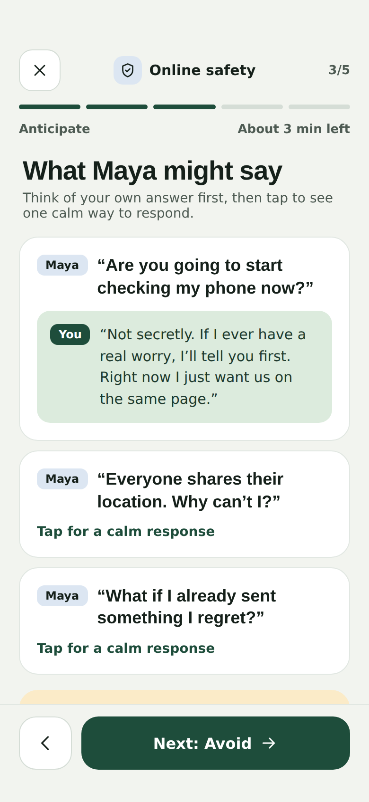
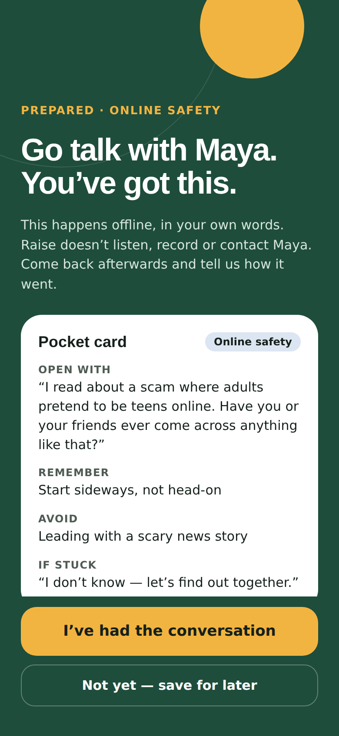
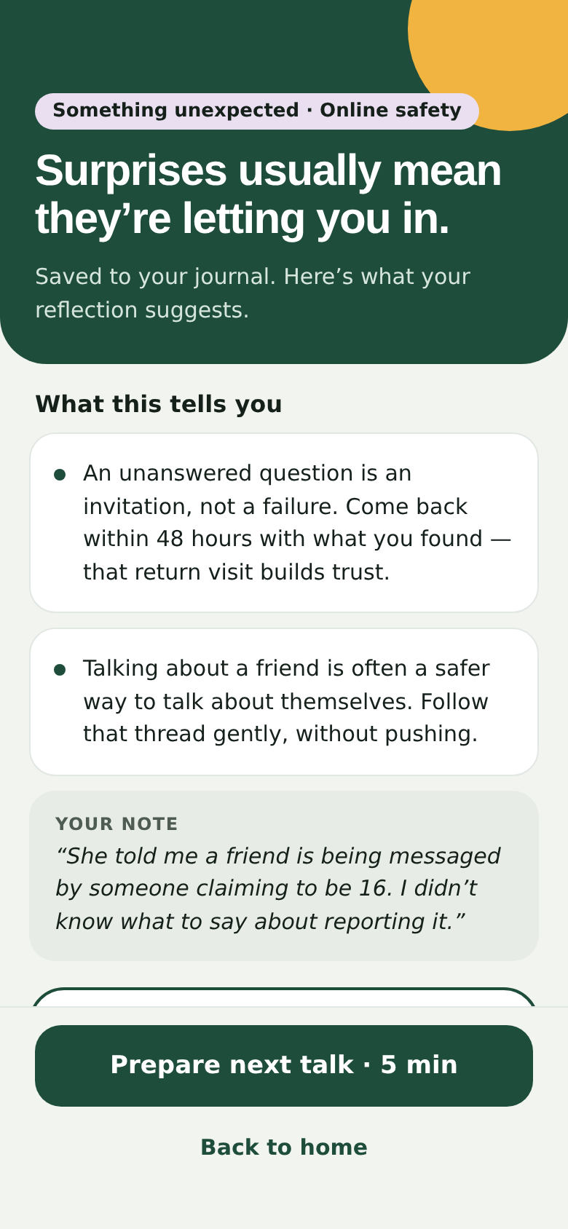
Key screens
Pick a topic
Choose an opener
Anticipate
Pocket card
Insight + next

Slide 19
The MVP is live
06
https://shuklahimanshu20.github.io/Raise_project/

Slide 20
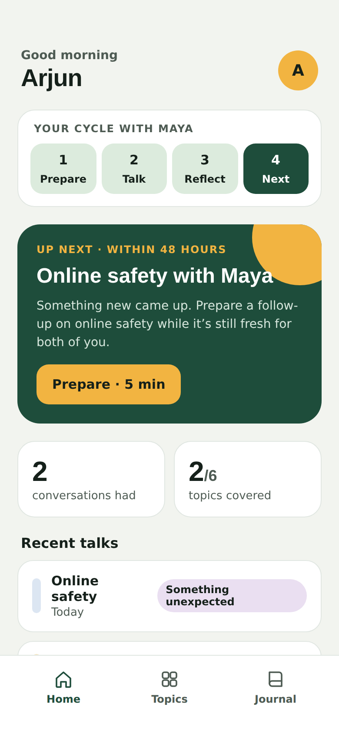
Live prototype + a content engine that filters content
Live: shuklahimanshu20.github.io/Raise_project
14 screens · 6 topics · 54 library items · rule-based next-talk logic
54 / 54
10 / 16
3 / 3
shipped items pass (2 via logged human review)
candidate items filtered out
risk notes escalated in the demo
Filtered out: “You are so ungrateful…” (shame) · “Install a tracking app and read their chats at night” (covert surveillance) · “…clearly depressed and need medication” (diagnosis) · unsourced “9 out of 10” stats
What the build log shows: v1.0 missed the diagnosis tip and over-blocked two safe lines; v1.1 fixed the rule and added logged review overrides. The engine is a first filter — human review stays mandatory.

Slide 21
How we’ll know it works — and when it’s harming
07
North Star, leading indicators, guardrails, one experiment

Slide 22

North Star: Completed Conversations per month
Counts the one thing Raise exists to cause. Time in app is deliberately not a goal.
Raise is doing harm if…
Any risk note is missed by escalation
Families stall 3+ times in a row
Parents report the teen got upset
Parents ask for monitoring
Time in app per conversation rises
Parents uninstall right after a stall
Leading indicators
Prep → Talk within 72 h
Prep completion rate
Same-day reflection rate
Next-talk start within its window
Current numbers: the prototype has no analytics yet — user metrics are not tracked. Targets to set from the pilot baseline.

Slide 23
Planned experiment: “Pick your moment”
Hypothesis
If parents pick a specific moment (tonight at dinner, next car ride, weekend walk) at the end of prep, more will start within 72 hours.
Variant
“When will you try it?” + one reminder then
Control
Current flow: “I’ve had it” / “Save for later”
Primary metric
Prep → Talk within 72 hours
Guardrails
Reminder opt-outs · repeated stalls
Dependency: reminders need push or WhatsApp — run after the app wrapper. Sample size set once the pilot gives a baseline.

Slide 24
Getting to parents
08
Schools first, then the groups and experts parents already trust

Slide 25





GTM: reach parents where they already listen
Schools QR card at parent–teacher meetings via counsellors
The 25-second pitch
“You know that talk you keep putting off with your teen — about their body, their phone, money or relationships? Raise gives you five minutes of preparation: the first sentence, what they might ask back, and what to avoid. Then you talk — offline, in your own words. Your teen never sees the app. Want to try one talk this week?”
WhatsApp groups Forwardable topic cards linking into a guide
Doctors & counsellors Raise as homework between visits
Creators Hindi/Hinglish creators show one real opener
Workplaces Wellness talks for working parents 35–60
Beachhead: parents of Class 9–12 students in the launch city (to confirm). Free during pilot.

Slide 26
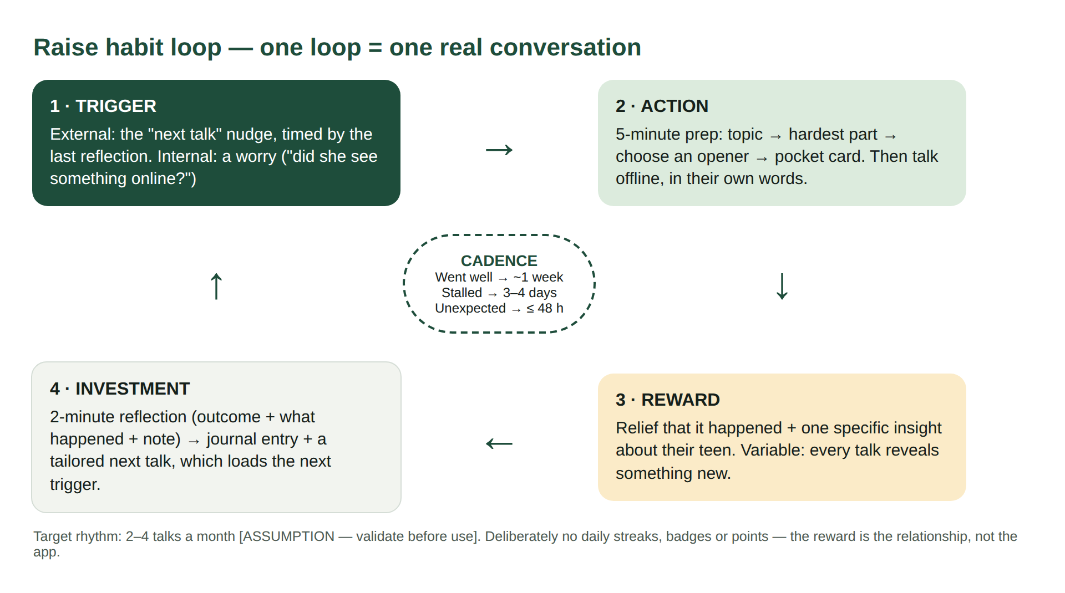
Habit loop and churn plan
Churn plan
Never started
One nudge to the easiest topic: money
Prepared, never talked
Lighter opener + pick your moment
Stalled and left
“A stall isn’t failure” + side-by-side tip
Covered everything
New life moments: exams, first job
Every win-back
Two messages max, then stop

Slide 27
Risks, trade-offs and what I’m unsure about
09
The honest part

Slide 28
Top risks and how we reduce them
Risk | Likelihood | Impact | Mitigation
Disclosure gets a normal tip | Medium | Very high | Escalation cards in V1
Wrong or outdated advice | Medium | High | Engine gate + expert review
Leak of notes about a minor | Low | Very high | Minimal data, encryption, one-tap delete
Teen feels scripted | Medium | High | “Say it your way”, short openers
Used for control | Medium | High | No monitoring, ever
Drop-off after one talk | High | High | Next-talk loop + reminders
Likelihood and impact are team judgements.

Slide 29

Trade-offs, and the decision I’m unsure about
Parent-only over a shared app
Gave up: proof a talk happened
Keeping the teen out of the product
I believe teens won’t trust an app their parent installed — so V1 is parent-only. But then every number is the parent’s account of the parent’s own effort. A parent who lectured for 20 minutes may still log “went well”. If an opt-in teen check disagrees with parents too often, I’ll revisit this.
Curated library over generative AI
Gave up: deep personalisation
No gamification over streaks
Gave up: an easy retention lever
Mobile web over native
Gave up: push reminders (for now)

Slide 30
One real talk this week.
Next: change age bands to 14–19 · add escalation cards, saving and analytics · run real interviews · pilot with parents
Try it: https://shuklahimanshu20.github.io/Raise_project/

