Slide 1
Databases
Seminar 6

Slide 2
Analytical (window) functions
Take an intermediate calculation result column as an argument and return a column.
Сan only be used in the ORDER BY and SELECT clauses, performing the final processing of the logical intermediate result.
Act similar to aggregate functions, but do not reduce the level of detail.
Aggregate data in portions, the quantity and size of which are regulated by a special syntax construct.
function_name(expression) OVER (
[ <PARTITION BY clause> ] -- window
[ <ORDER BY clause> ] -- sorting
[ <ROWS or RANGE clause> ] -- range of the window
) AS attr_name

Slide 3
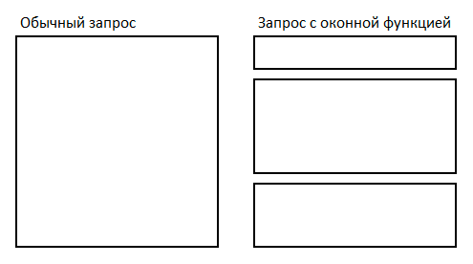
In a normal query, the entire set of rows is processed as a single "whole piece", for which aggregates are considered.
And when using window functions, the query is divided into parts (windows) and its aggregates are already considered for each of the individual parts.
Normal query Query with window function

Slide 4
SELECT
depname,
empno,
salary,
avg(salary) OVER (PARTITION BY depname)
FROM
empsalary;
An example of how to compare the salary of each employee with the average salary of their department:
The first three columns are extracted directly from the emp salary table, and each row in the emp salary table corresponds to one row in the result table.
The fourth column contains the average value calculated for all rows having the same depname value as the current row. (In fact, the average is calculated by the same ordinary, non-windowed avg function, but
the OVER clause turns it into a windowed one, so that its action is limited to the window frames.)
depname | empno | salary | avg
-----------+-------+--------+-----------------------
develop | 11 | 5200 | 5020.0000
develop | 7 | 4200 | 5020.0000
develop | 9 | 4500 | 5020.0000
develop | 8 | 6000 | 5020.0000
develop | 10 | 5200 | 5020.0000
personnel | 5 | 3500 | 3700.0000
personnel | 2 | 3900 | 3700.0000
sales | 3 | 4800 | 4866.6667
sales | 1 | 5000 | 4866.6667
sales | 4 | 4800 | 4866.6667
(10 rows)

Slide 5
The use of OVER
OVER defines the set of rows that the window function will use, including data sorting. (“window")
In the expression that defines the window function, the OVER statement restricts sets of strings with the same values in the field that is being split.
The OVER() statement itself is unlimited and contains all the rows from the result set.
The OVER statement can be used multiple times in a single SELECT, each with its own division and sorting.

Slide 6
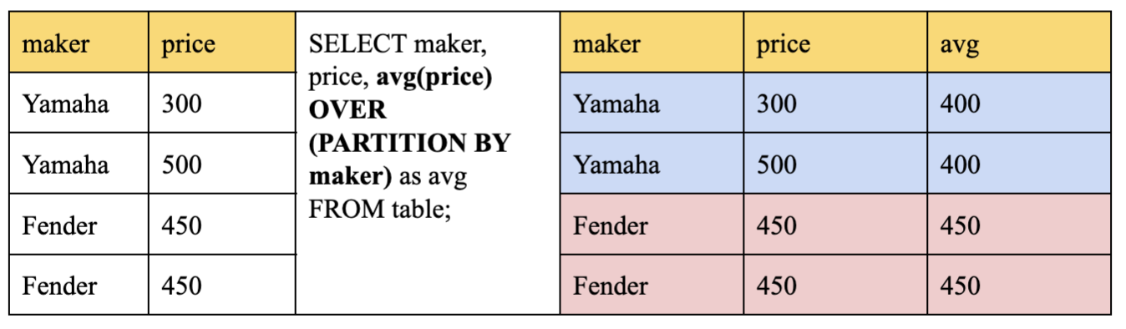
Rules of partitioning
Inside OVER, you must specify the table field on which the “window” will slide and the rule by which the rows will be partitioned:
PARTITION BY: responsible for the partitioning criterion
Logically divides the set into groups according to criteria.
Analytical functions are applied to groups independently.
If you do not specify the partitioning structure, the entire set is considered to be one group.

Slide 7
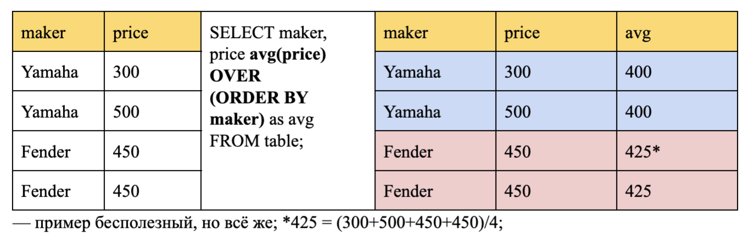
2. ORDER BY: responsible for sorting
Sets the sorting criteria within each group.
Aggregate functions in the absence of the ORDER BY construction are calculated for all rows of the group, and the same value is given for each row, i.e. the function is used as a summary.
If an aggregate function is used with the ORDER BY construct, then it is calculated from the current row and all rows before it, i.e. the function is used as a windowed one (the cumulative total is calculated).

Slide 8
3. ROWS | RANGE: additional restrictions on the range of window rows (the presence of ORDER BY is required):
ROWS (by rows) — allows you to manually define the boundaries of the window for which the value is calculated; can work with PRECEDING/FOLLOWING.
RANGE (based on the values from ORDER BY, a sub-window is formed)— close enough to the previous one, but still not the same (Alexander Faritovich's professional opinion: “I have no idea when this can be used”); But using ‘RANGE CURRENT ROW’ after ORDER BY allows you to get rid of the cumulative total; does not know how to work with PRECEDING/FOLLOWING.
By default, it considers from UNBOUNDED PRECEDING to CURRENT ROW. (UNBOUNDED PRECEDING /FOLLOWING — we consider up to the end / beginning of the window.)
We select the lines within the window, but if necessary, we can manually register the previous / subsequent lines so that it can go beyond the window.

Slide 9
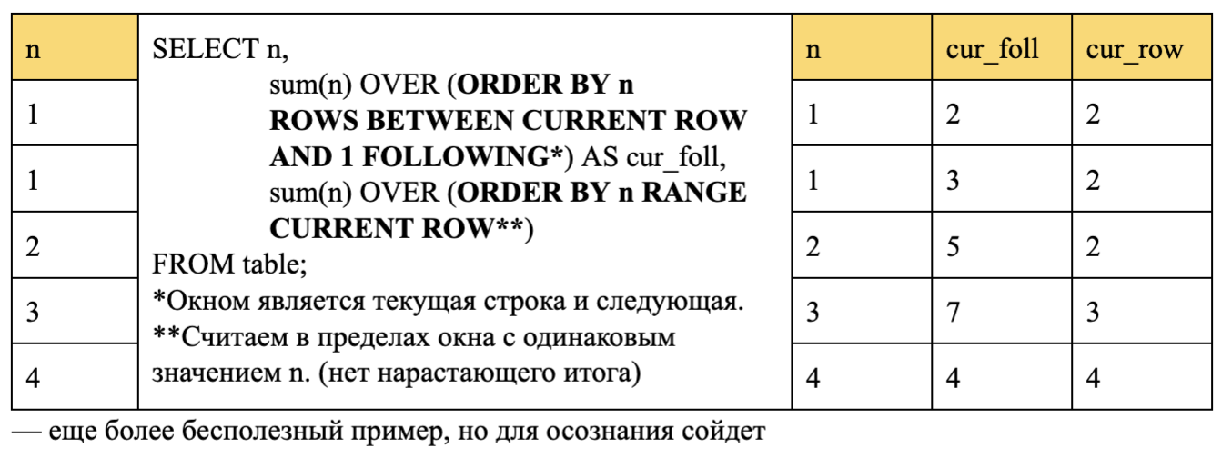
Example for ROWS | RANGE

Slide 10
Classification of windows functions
Aggregating (sum, avg, min, max, count)
Ranking (row_number, rank, dense_rank)
Value (lag, lead, first_value, last_value); value functions are used with field indication.
Ranking functions:
row_number() – the rows of the window are sequentially indexed in increments of 1.
rank() – rank each row of the window with a gap in the indexing when the values are equal.
dense_rank() – the rows of the window are indexed without gaps when the values are equal.

Slide 11
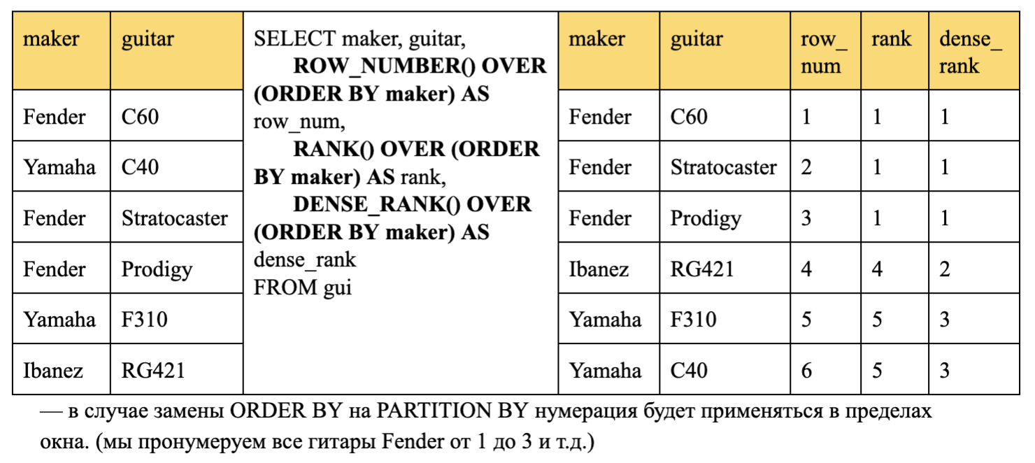
Ranking functions
row_number() – the rows of the window are sequentially indexed in increments of 1.
rank() – rank each row of the window with a gap in the indexing when the values are equal.
dense_rank() – the rows of the window are indexed without gaps when the values are equal.

Slide 12
Value functions
lag(attr, offset (offset), default_value(default value in case our line turns out to be the first)) – the previous value with a shift.
lead(attr, offset, default_value) – the next value with a shift.
first_value(attr) – the first value in the window from the first to the current line.
last_value(attr) – the last value in the window from the first to the current line.

Slide 13
Value functions
SELECT
BusinessEntity,
SalesYear,
CurrentQuota,
LAG(CurrentQuota, 1, 0) OVER (ORDER BY SalesYear) AS PrevQuota,
LEAD(CurrentQuota, 1, 0) OVER (ORDER BY SalesYear) AS NextQuota
FROM
SalesPersonQuotaHistory
WHERE
BusinessEntityID = 275;

Slide 14
Filtering based on the results of calculating the window function
Window functions can used in a query only in the SELECT list and the ORDER BY clause.
In all other cases, including GROUP BY, HAVING and WHERE, window functions cannot be used. This is because logically they are executed after these clauses, as well as after non-windowed aggregate functions, and therefore the aggregate function can be called in the arguments of the windowed one, but not vice versa.
If you need to filter or group rows after calculating window functions, you can use a nested query.

Slide 15
Example: shows only rows with rank < 3
SELECT
depname,
empno,
salary,
enroll_date
FROM (
SELECT
depname,
empno,
salary,
enroll_date,
rank() OVER (PARTITION BY depname ORDER BY salary DESC, empno) AS pos
FROM
empsalary
) AS ss
WHERE
pos < 3;

Slide 16
Named windows
When multiple window functions are calculated in a query for similarly defined windows, it is possible to write a separate OVER clause for each of them. However, this approach would lead to duplication of code, which can inevitably result in errors. Therefore, it is better to define the window in a WINDOW clause and then reference it in the OVER clause.

Slide 17
Example of window functions
SELECT
sum(salary) OVER w,
avg(salary) OVER w
FROM
empsalary
WINDOW
w AS (PARTITION BY depname ORDER BY salary DESC);

Slide 18
Practice
Create a topic_6 schema
Create objects according to the script:
DROP SCHEMA IF EXISTS topic_6 CASCADE;
CREATE SCHEMA topic_6;
DROP TABLE IF EXISTS topic_6.participant;
CREATE TABLE topic_6.participant
(
participant_id INT PRIMARY KEY,
participant_nm VARCHAR(200),
participant_birth_dt DATE,
participant_country_nm VARCHAR(200)
);
DROP TABLE IF EXISTS topic_6.competition;
CREATE TABLE topic_6.competition
(
competition_id INT PRIMARY KEY,
competition_nm VARCHAR(200),
held_dt DATE,
competition_country_nm VARCHAR(100),
result_sorting_type_code VARCHAR(10) CHECK (result_sorting_type_code IN ('ASC', 'DESC'))
);

Slide 19
Practice
3. Insert data into tables according to the script given by the professor. The result_sorting_type_code field determines which type of sorting should be used to rank the results of participants in the competition from worst to best
4. Get the top 1 result for each competition
5. For each competition, display the prizes
6. For each unused place, print the deviation from the best result
7. For each competition, display all participants who are younger than the winner
8. For each competition, for each participant, display the result of the participant, the result of the previous participant, the next participant, as well as the difference between them
9. For each competition, get the number of unique contestants without using GROUP BY
DROP TABLE IF EXISTS topic_6.competition_result;
CREATE TABLE topic_6.competition_result
(
competition_id INT REFERENCES topic_6.competition (competition_id),
participant_id INT REFERENCES topic_6.participant (participant_id),
participant_result_amt NUMERIC(20, 2)
);

Slide 20
Practice
9. For each competition, get the number of unique contestants without using GROUP BY
10. Display statistics for each competition: specify which of the participants was the winner in the format "Took place X", "Did not get the prize"
11. Create a table with statistics for all competitions: display each participant, their date of birth, their result, the best result in the competition, the name of the participant with the best result, the deviation of the participant's result from 1st place, the average result in the competition, the deviation of the participant's result from the average, the minimum result in the competition, the name of the participant with the minimum result

