Slide 1
Databases
Seminar 8
Transactions

Slide 2
Theoretical background
A transaction is an object that groups a sequence of operations that must be performed as a whole.
Ensures the transition of the database from one integral state to another.
A transaction is an object that groups a sequence of operations that must be performed as a whole.

Slide 3
Theoretical background
Ensures the transition of the database from one integral state to another.
run a query to the product table and check the availability of goods in stock;
add an order to the invoice table;
update the goods table by subtracting the ordered quantity of goods from the quantity of goods available;
update the sales table by adding the cost of the order to the sales volume of the employee who accepted the order;
update the table of offices by adding the cost of the order to the sales volume of the office in which this employee works.

Slide 4
Theoretical background
Transactions ensure the integrity of the database under the conditions:
Parallel data processing
Physical disk failures
Emergency power failure
And others

Slide 5
Theoretical background
Transactions have 4 characteristics that satisfy the ACID paradigm:
Atomic
Consistent
Isolated
Durable

Slide 6
Atomicity
A transaction must be an atomic (indivisible) unit of work;
Either all operations included in the transaction must be performed, or none of them;
Therefore, if it is impossible to perform all operations, all the changes made must be canceled.:
Commit – making a transaction
Rollback – cancellation of the transaction

Slide 7
Consistency
Upon completion of the transaction, all data should remain in a consistent state
When executing a transaction, you must follow all the rules of a relational DBMS:
Checks for compliance with restrictions (domains, uniqueness indexes, foreign keys, checks, rules, etc.)
Updating indexes;
Executing Triggers
And others

Slide 8
Isolation
Data changes performed within a transaction must be isolated from all changes performed in other transactions until the transaction is committed.;
There are different levels of isolation – to achieve a compromise between the degree of parallelization of work with the database and the rigor of the principle of consistency:
The higher the isolation level, the higher the degree of data consistency;
The higher the isolation level, the lower the degree of parallelization and the lower the degree of data availability.
Standard classification of problems with isolation levels:
P1: dirty read – "dirty" reading
P2: non-repeatable read – non-repeatable read
P3: phantom read – phantom reading

Slide 9
P1 (dirty read)
Transaction T1 makes changes to a number of tables.
T2 reads this row after making changes to T1, but before committing T1.
If T1 is canceled, then the data read by T2 will be incorrect.
-- T1
UPDATE Users
SET AGE = 21
WHERE Id = 1;
ROLLBACK;
-- T2
SELECT Age
FROM Users
WHERE Id = 1;

Slide 10
P2 (non-repeatable read)
Transaction T1 reads a series.
Transaction T2 then makes changes to this row or deletes it.
If T1 then counts the same row again, it will get a new result compared to the first reading.
-- T1
SELECT *
FROM Users
WHERE Id = 1;
-- T2
UPDATE Users
SET AGE = 21
WHERE Id = 1;
COMMIT;

Slide 11
P3 (phantom)
Transaction T1 reads a set of rows N satisfying some condition.
After that, T2 executes SQL queries that create new rows that satisfy this condition.
If T1 repeats the query with the same condition, it will get a different set of rows.
-- T1
SELECT *
FROM Users
WHERE Age BETWEEN 10 AND 30;
-- T2
INSERT INTO Users (Name, Age)
VALUES (‘Bob’, 27);
COMMIT;

Slide 12
Durability
If a transaction has been completed, its result should be saved in the system, despite the system failure.;
If the transaction has not been completed, its result may be completely canceled following a system failure.

Slide 13
Transaction Control Language
BEGIN TRANSACTION transaction_mode [, ...]
ISOLATION LEVEL { SERIALIZABLE | REPEATABLE READ | READ COMMITTED | READ UNCOMMITTED }
READ WRITE | READ ONLY
[NOT] DEFERRABLE

Slide 14
Transaction Control Language
BEGIN / START
COMMIT
ROLLBACK

Slide 15
Transaction Control Language
SAVEPOINT name
ROLLBACK TO SAVEPOINT name
RELEASE SAVEPOINT name

Slide 16
Transaction boundaries
BEGIN;
INSERT ...;
UPDATE ...;
DELETE ...;
ROLLBACK;
BEGIN;
INSERT ...;
UPDATE ...;
DELETE ...;
COMMIT;

Slide 17
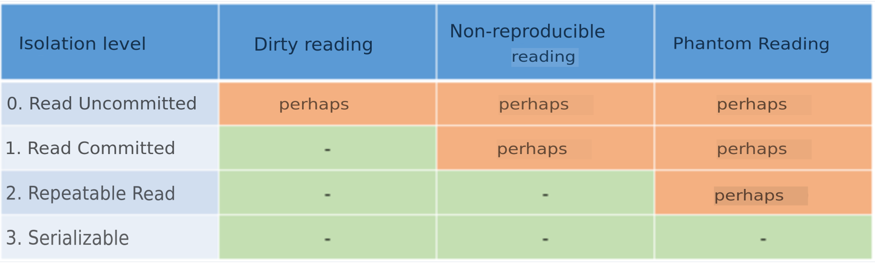
ANSI SQL Transaction Isolation Levels
In an ideal world, parallel transactions are isolated (they get along perfectly with each other in the database), but in the real world this is impossible. The characteristic of the correspondence of the base to the isolation property is called the isolation level. Allocate 4 levels of isolation:

Slide 18
ANSI SQL Transaction Isolation Levels
READ UNCOMMITTED: Helps to deal with lost updates when the same data block is changed by multiple transactions.
READ COMMITTED: helps to deal with reading "dirty" data changed later by a rolled-back transaction
REPEATABLE READ: helps to deal with changes in data when the same block of data is read repeatedly within the same transaction
SERIALIZABLE: similar to REPEATABLE READ, but applicable to INSERT, not UPDATE

Slide 19
PostgreSQL access control.
Role – set of DB users
Can own objects in the database
May have certain access to some database objects without being their owner
Can grant access to some objects in the database to other roles
Can grant membership in the role of another role

Slide 20
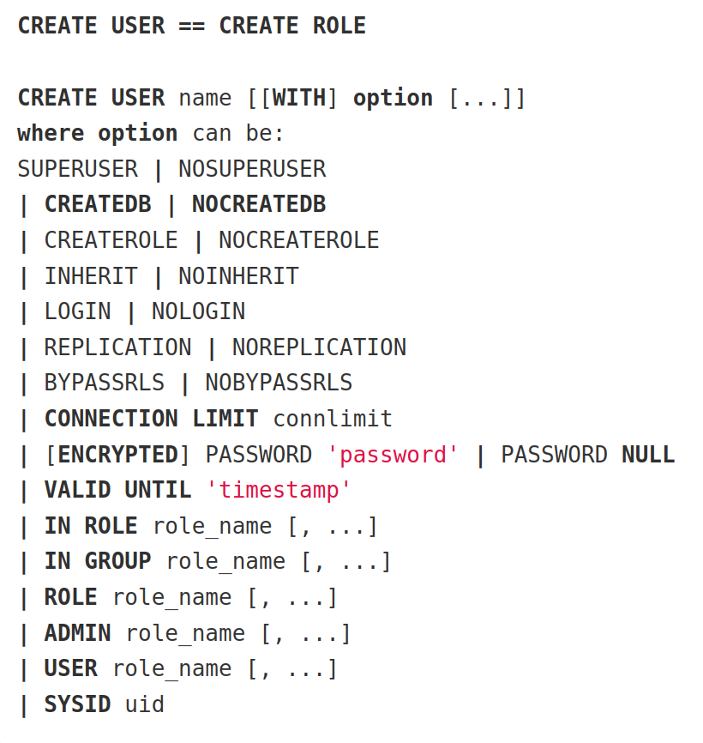
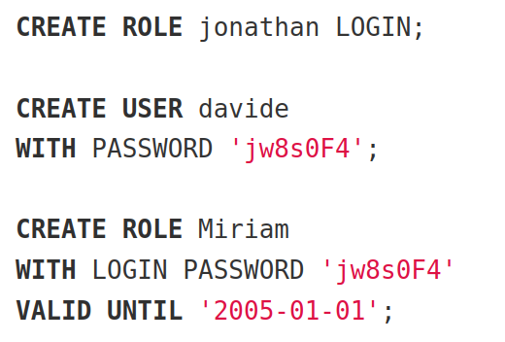
Creating a user

Slide 21
Data Control Language (DCL)
Allows you to configure access to objects
Supports 2 types of actions:
GRANT – granting access to an object
REVOKE – revoke access to the object

Slide 22
Rights that can be granted to an object:
SELECT
INSERT
UPDATE
DELETE
TRUNCATE
REFERENCESE
TRIGGER
CREATE
CONNECT
TEMPORARY
EXECUTE
USAGE

Slide 23
GRANT ON TABLE
GRANT {{SELECT | INSERT | UPDATE | DELETE | TRUNCATE |
REFERENCES | TRIGGER}
[, ...] | ALL [PRIVILEGES]}
ON {[ TABLE] table_name [, ...]
| ALL TABLES IN SCHEMA schema_name [, ...]}
TO role_specification [, ...] [WITH GRANT OPTION]

Slide 24
REVOKE ON TABLE
GRANT ALL PRIVILEGES ON kinds TO manuel;
REVOKE ALL PRIVILEGES ON kinds FROM manuel;
GRANT SELECT ON kinds TO manuel WITH GRANT OPTION;
REVOKE [GRANT OPTION FOR]
{{SELECT | INSERT | UPDATE | DELETE | TRUNCATE |
REFERENCES | TRIGGER}
[, ...] | ALL [PRIVILEGES]}
ON {[TABLE] table_name [, ...]
| ALL TABLES IN SCHEMA schema_name [, ...]}
FROM {[GROUP] role_name | PUBLIC} [, ...]
[CASCADE | RESTRICT]
Note: If we want to take the grant option from manuel, then we need to use CASCADE to take the rights from everyone to whom he granted the rights. Otherwise, if you try to revoke the rights from manuel, the request will fall with an error.

Slide 25
Usage examples
CREATE USER davide WITH PASSWORD 'jw8s0F4';
GRANT CONNECT ON DATABASE db_prod TO davide;
GRANT USAGE ON SCHEMA my_schema TO davide;
GRANT ALL PRIVILEGES ON ALL TABLES IN SCHEMA my_schema
TO davide;

