Slide 1
Databases
Seminar 2

Slide 2
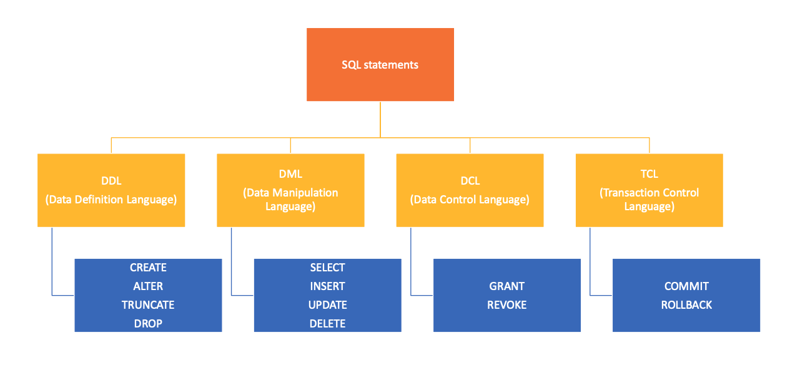
SQL Statements

Slide 3
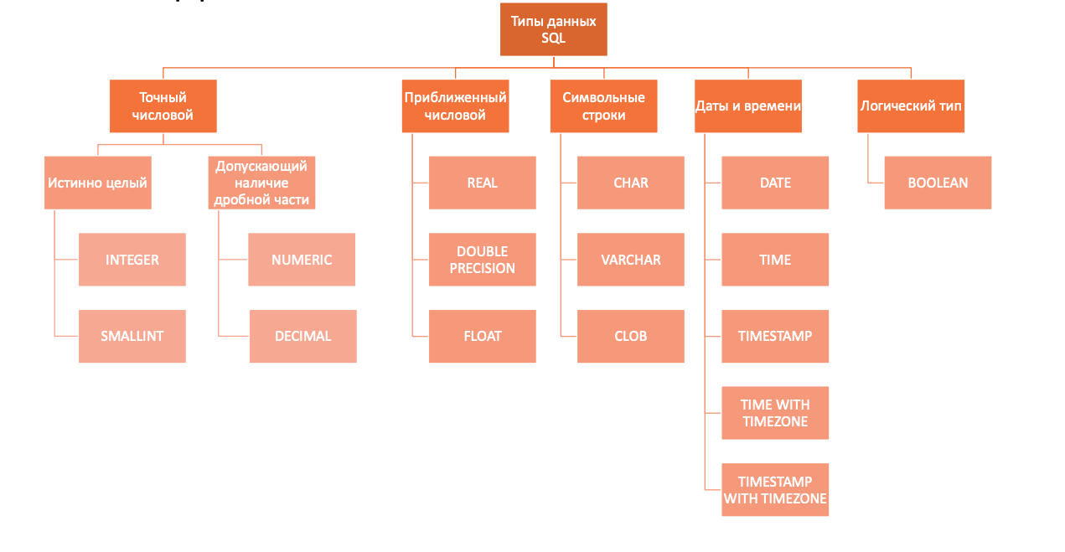
SQL Data Types
SQL Data Types
Exact numeric
Approximate numerical
Character strings
Date and time
logical type
TEXT

Slide 4
Data Defenition Language
CREATE – creation of objects in the database
CREATE [TEMPORARY] TABLE [IF NOT EXISTS] tbl_name(
col_name_1 datatype_1,
col_name_2 datatype_2,
...
col_name_N datatype_N
);

Slide 5
Data Defenition Language
2. ALTER - modification of objects
ALTER TABLE table_name ADD column_name datatype;
ALTER TABLE table_name DROP column_name;
ALTER TABLE table_name RENAME column_name TO new_column_name;
ALTER TABLE table_name ALTER column_name TYPE datatype;
...

Slide 6
Data Defenition Language
3. DROP – deleting objects
DROP TABLE [IF EXISTS] table_name;
4. TRUNCATE – deleting the contents of the database object (data is deleted as a whole piece, cannot be deleted by condition)
TRUNCATE TABLE table_name;

Slide 7
Data Manipulation Language
1. SELECT – selects data that meets the specified conditions
2. INSERT – adds new data
3. UPDATE – changes (updates) existing data
UPDATE table_name
SET update_assignment_comma_list
WHERE conditional_experssion;
4. DELETE – deletes existing data (data is deleted line by line – you can set a condition, "roll back" deletion)
DELETE
FROM table_name
[WHERE conditional_expression];

Slide 8
Table Join Operations
Connection operations are divided into 3 groups:
CROSS JOIN - Cartesian product of 2 tables
INNER JOIN - joining 2 tables by condition. The resulting selection will include only those records that satisfy the connection condition
OUTER JOIN - joining 2 tables by condition. The resulting selection may include records that do not satisfy the connection condition:
LEFT (OUTER) JOIN - all rows of the "left" table are included in the final selection
RIGHT (OUTER) JOIN - all rows of the "right" table are included in the final selection
FULL (OUTER) JOIN - all rows of both tables are included in the final selection

Slide 9
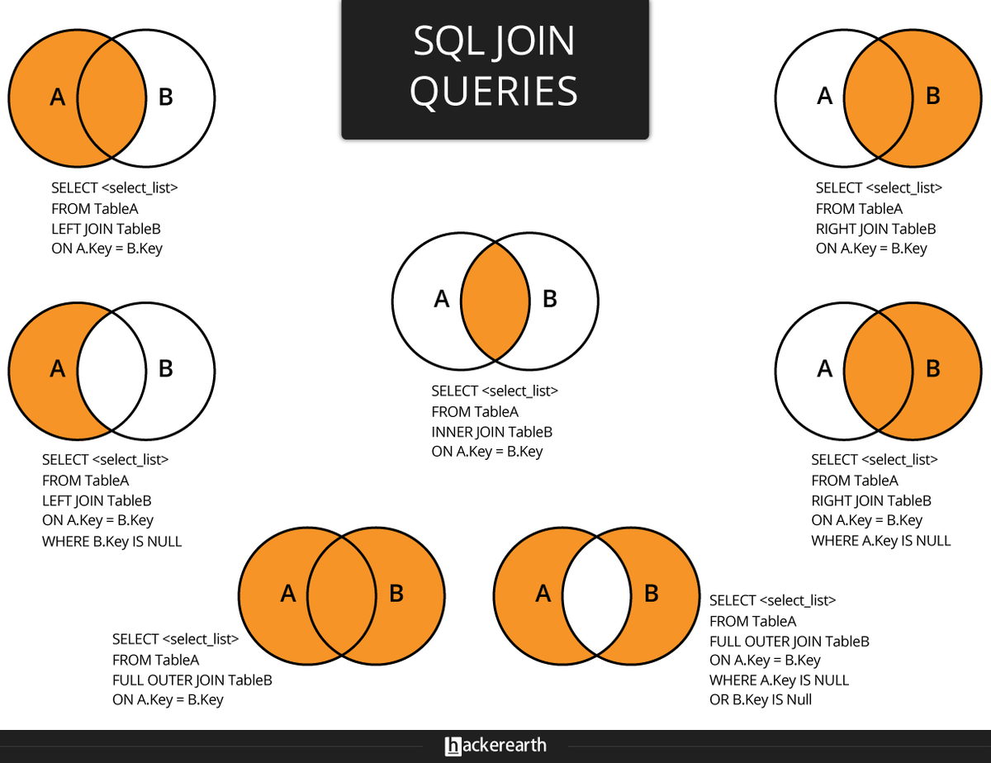

Slide 10
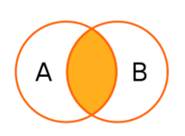
Inner Join
joins 2 tables
symmetrical (the order of the tables is not important)
Algorithm:
Each row of the first table is compared with the rows in the second table.
For each row the join condition is checked.
If the Join condition is met, a row is added to the result.

Slide 11
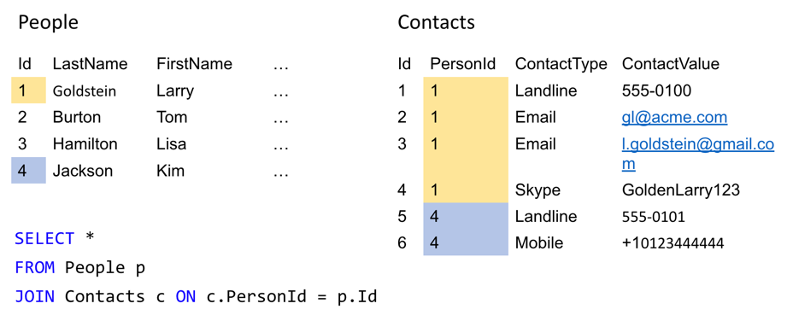
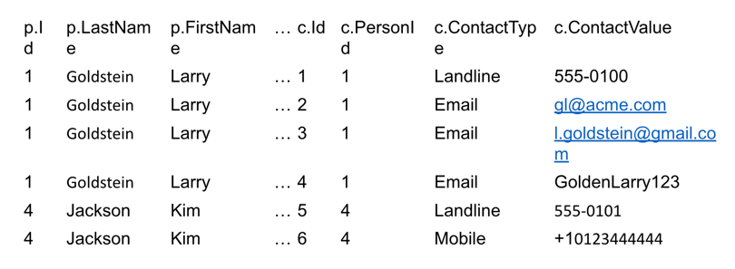
Inner Join Example
Result:

Slide 12
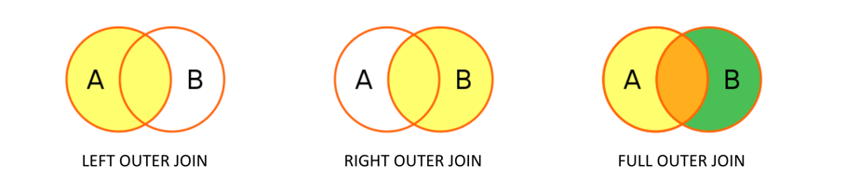
Outer Join
Joins 2 tables
The result includes all rows from one of the tables

Slide 13
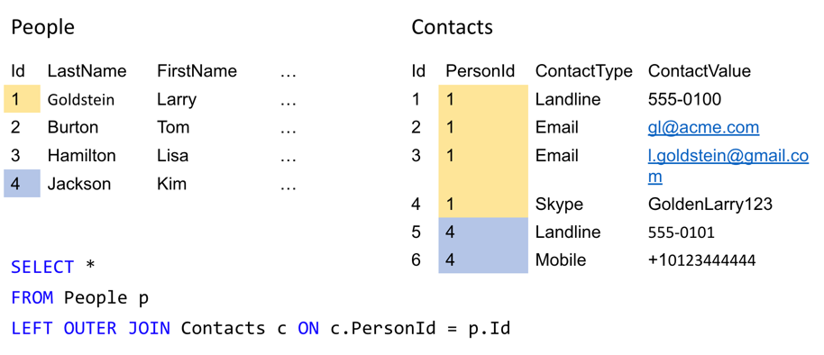
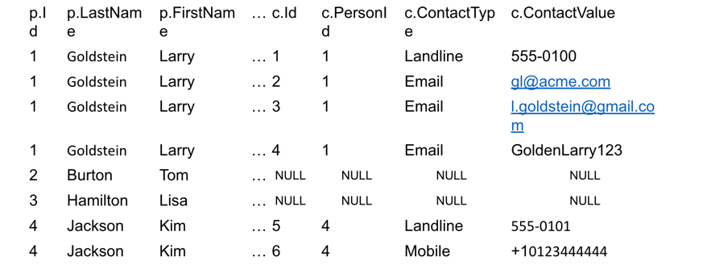
Left Outer Join Example
Result:

Slide 14
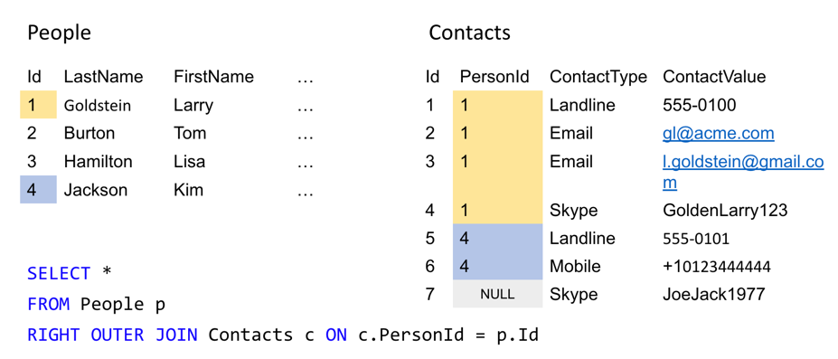
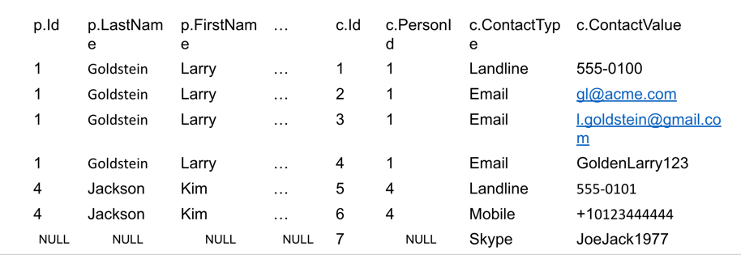
Right Outer Join Example
Result:

Slide 15
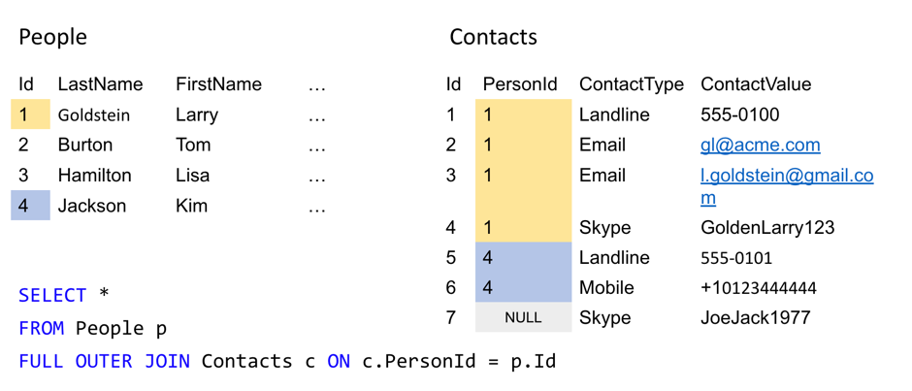
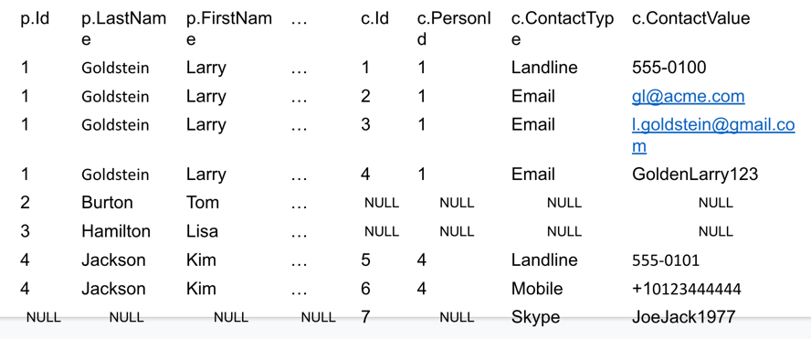
Full Outer Join Example
Result:

Slide 16
Table Join Operations
If join condition includes columns with the same names then it can be abbreviated with USING:
ON left_table.a = right_table.a AND left_table.b = right_table.b
USING (a, b)
A shorter way of writing the same expression uses NATURAL:
SELECT select_list
FROM T1 NATURAL JOIN T2
The principle of expressions with NATURAL:
Similar to USING with the indication of all columns of the same name
If there are no columns with the same name, then ON TRUE is the same

Slide 17
Keys
A potential key is a subset of the attributes of a relationship that meets the requirements of uniqueness and minimality:
Uniqueness: there are no two tuples of a given relationship in which the values of this subset of attributes match;
Minimality: a smaller tuple of attributes satisfying the uniqueness condition is missing from the potential key;
Types:
simple (consists of exactly one attribute)
composite (consists of two or more attributes)
Example of a composite key:
CREATE TABLE flight_schedule ( departure timestampt, gate, pilot
UNIQUE(departure, gate),
UNIQUE(departure, pilot) );

Slide 18
Primary and Alternative Keys
Primary keys (PK) are any of the potential keys selected as the primary key. Generally the primary key is chosen so that it
takes up less memory
will not lose its uniqueness over time. (a potential key always exists, even if it includes all the attributes of the relationship).
Alternative keys are potential keys that were not selected as primary keys.
Types of keys:
natural (based on an already existing field)
intelligent (based on a natural key with an added additional field)

Slide 19
Surrogate Keys
A surrogate key is an additional service field that is added to the already existing information fields of the table, the only purpose of which is to serve as a primary key. (the value is generated artificially).
Let R1 and R2 be two variable relations, not necessarily different. The foreign key FK (Foreign key) in R2 is a subset of the attributes of the R2 variable such that the following requirements are met:
In the relation variable R1 there is a potential PK key such that PK and FK match exactly up to the renaming of attributes (FK from R2 is PK from R1)
At any given time, each value of FK in the current value of R2 is identical to the value of PK in some tuple in the current value of R1. In other words, at any given time, the set of all values of FK in R2 is a subset of the values of PK in R1.
The parent (main/target) relation is the R1 relation containing the potential key.
The child (subordinate) relationship is the R2 relationship, which contains a reference to the entity in which the attributes we need are located. (containing a foreign key)

Slide 20
Creating Keys: Primary Key
CREATE TABLE PERSON (
ID INTEGER PRIMARY KEY,
LAST_NAME VARCHAR(255) NOT NULL,
FIRST_NAME VARCHAR(255) NOT NULL,
AGE INTEGER );
ALTER TABLE PERSON ADD PRIMARY KEY (ID);
------------------------------------------
CREATE TABLE PERSON (
ID INTEGER,
LAST_NAME VARCHAR(255),
FIRST_NAME VARCHAR(255) NOT NULL,
AGE INTEGER,
CONSTRAINT PK_Person PRIMARY KEY (ID, LAST_NAME) );
ALTER TABLE PERSON
ADD CONSTRAINT PK_Person PRIMARY KEY (ID, LAST_NAME);
ALTER TABLE PERSON DROP CONSTRAINT PK_Person;

Slide 21
Creating Keys: Foreign Key
CREATE TABLE ORDER (
ORDER_ID INTEGER,
ORDER_NUMBER INTEGER NOT NULL,
ERSON_ID INTEGER,
PRIMARY KEY (ORDER_ID),
CONSTRAINT FK_PersonOrder FOREIGN KEY (PERSON_ID) REFERENCES PERSON(PERSON_ID) );
ALTER TABLE ORDER ADD CONSTRAINT FK_PersonOrder FOREIGN KEY (PERSON_ID) REFERENCES PERSON(PERSON_ID); ALTER TABLE ORDER DROP CONSTRAINT FK_PersonOrder;
-----------------------------------------
CREATE TABLE ORDER (
ORDER_ID INTEGER PRIMARY KEY,
ORDER_NUMBER INTEGER NOT NULL,
PERSON_ID INTEGER REFERENCES PERSON(PERSON_ID) );
ALTER TABLE ORDER ADD FOREIGN KEY (PERSON_ID) REFERENCES PERSON(PERSON_ID);

Slide 22
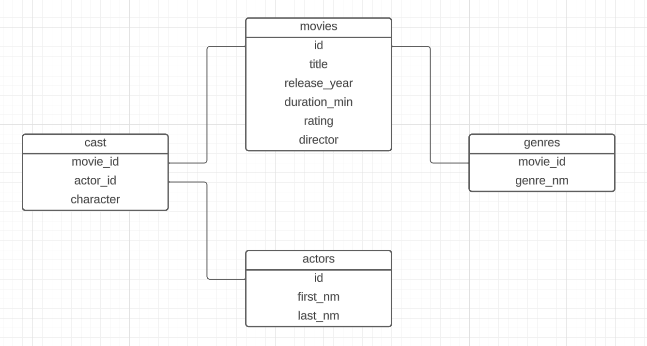
Practice
Create the following tables. What primary and foreign keys are needed here? Create them.
Create an id column of the serial type. What is the name of this type of key?
Tables:
Movies: id title release_year duration_min rating director
Actors: id first_nm last_nm
Cast: movie_id actor_id character_nm
genres movie_id genre_nm

Slide 23
Practice
1. Fill in the movies table with 3 text lines.
2. Add a new comment field to the movies table.
3. Write a request to update the field with a comment.
You must specify your own comment for each line.
Think about how to do this with a single UPDATE operation, rather than five different requests.
4. Delete one of the rows of the table to choose from.
5. Clear the table using the DDL group operator.
6. Fill in the table again and pay attention to the IDs. Clean it completely again.
7. Delete a column with a comment from the table.

Slide 24
Practice
8. Start insertion operations from a separate file
9. Find all the films of the Crime genre. Print the title of the film, the year of release and the rating
10. Find the IDs of the actors for whom there is no information about the films in which they starred
11. What is the name of the actor who played 'Harry Potter’?
12. Output all films of the 90s genres Drama and Romance
13. For each genre, find the number of films and the average rating
Sort by descending average rating, if the number of films is equal in descending order

Slide 25
Practice
14. For each actor, print the number of films in which he played (maybe 0).
Sort the number of movies in descending order
15. Find all the movies that Jake Gyllenhaal has played in. Print the name of the movie,
the year of release and the duration. Sort by increasing the length of the movie
16. Bring out all the movies with the actor who played 'Captain Jack Sparrow’
17. For each movie, output its genres separated by commas as a string
(for example, using STRING_AGG)
If the genre is not specified for the movie, output -.
18. Find all the actors who played with Leonardo DiCaprio.
Optional: display the films in which they played together.

