Slide 1
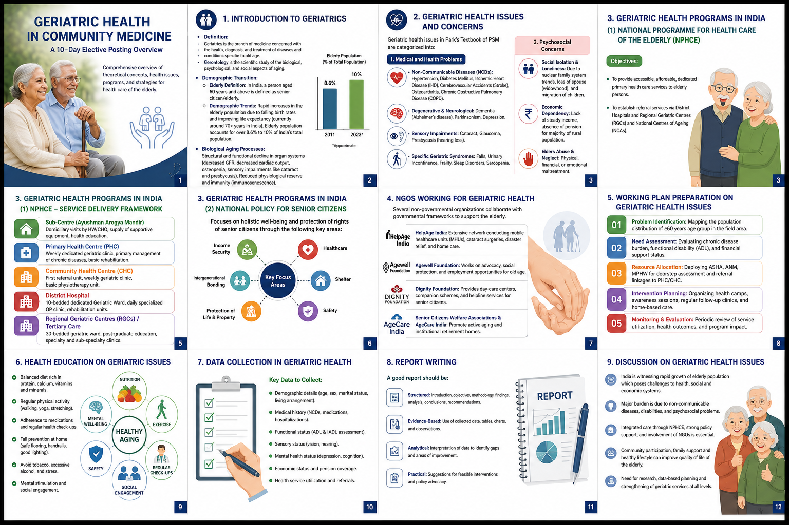
GERIATRIC HEALTH IN COMMUNITY MEDICINE
12-slide overview for a PSM elective posting based on the uploaded chat/PDF content
Health Care of the Elderly
PSM Elective Posting • Health Care of the Elderly (Geriatrics)

Slide 2
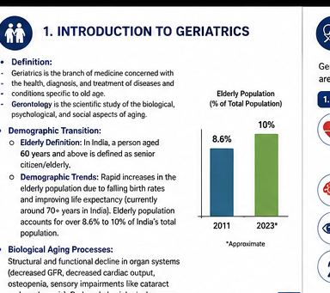
1. Introduction to Geriatrics
2
Core concepts, demographic transition and biological ageing
G
Geriatrics
Key demographic & ageing points
Branch of medicine concerned with the health, diagnosis and treatment of diseases and conditions specific to old age.
Rapid growth of the elderly population is linked to falling birth rates and improving life expectancy.
Elderly population: over 8.6%–10% of India’s total population (as stated in the source).
Ageing involves structural and functional decline: ↓ GFR, ↓ cardiac output, osteopenia and sensory impairment.
Reduced physiological reserve and immunity (immunosenescence).
G
Gerontology
Scientific study of the biological, psychological and social aspects of aging.
60
Elderly in India
A person aged 60 years and above is defined as a senior citizen/elderly.
PSM Elective Posting • Health Care of the Elderly (Geriatrics)

Slide 3
2. Geriatric Health Issues & Concerns
3
Medical, functional and psychosocial dimensions
1
Non-communicable diseases
4
Geriatric syndromes
Hypertension, diabetes mellitus, IHD, stroke, osteoarthritis and COPD.
Falls, urinary incontinence, frailty, sleep disorders and sarcopenia.
2
Degenerative & neurological
5
Social isolation & loneliness
Dementia (Alzheimer’s disease), Parkinsonism and depression.
Associated with nuclear family trends, widowhood and migration of children.
3
Sensory impairments
6
Economic dependency & abuse
Cataract, glaucoma and presbycusis (hearing loss).
Lack of steady income/pension and risk of physical, financial or emotional maltreatment.
PSM Elective Posting • Health Care of the Elderly (Geriatrics)

Slide 4
3. Geriatric Health Programmes in India
4
NPHCE service-delivery framework
1
Sub-Centre / Ayushman Arogya Mandir
Domiciliary visits by HW/CHO; supportive equipment; health education.
2
Primary Health Centre (PHC)
Weekly dedicated geriatric clinic; chronic disease management; basic rehabilitation.
3
Community Health Centre (CHC)
First referral unit; weekly geriatric clinic; basic physiotherapy.
4
District Hospital
10-bedded dedicated geriatric ward; daily specialised OP clinic; rehabilitation.
5
Regional Geriatric Centre / Tertiary Care
30-bedded geriatric ward; postgraduate education; specialty and sub-specialty clinics.
PSM Elective Posting • Health Care of the Elderly (Geriatrics)

Slide 5
4. National Policy for Senior Citizens
5
Key focus areas for senior-citizen wellbeing
Intergenerational bonding
Income security
Healthcare
SENIOR CITIZEN WELLBEING
Shelter
Safety
Protection of life & property
The source emphasises income security, healthcare, shelter, safety, protection of life and property, and intergenerational bonding.
PSM Elective Posting • Health Care of the Elderly (Geriatrics)

Slide 6
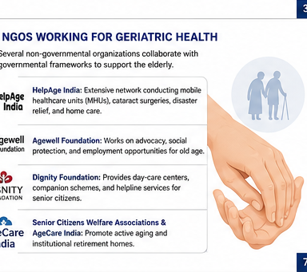
5. NGOs Working for Geriatric Health
6
Community and institutional support described in the source
★
HelpAge India
★
Dignity Foundation
Mobile healthcare units, cataract surgeries, disaster relief and home care.
Day-care centres, companion schemes and helpline services.
★
Agewell Foundation
★
Senior Citizens Welfare Associations & AgeCare India
Advocacy, social protection and employment opportunities for older adults.
Promote active ageing and institutional retirement homes.
PSM Elective Posting • Health Care of the Elderly (Geriatrics)

Slide 7
6. Working Plan for Community Geriatric Health
7
From problem identification to intervention
01
Problem identification
Map distribution of people aged ≥60 years in the field area.
02
Need assessment
Assess chronic disease burden, functional disability (ADL) and financial support.
03
Resource allocation
Deploy ASHA, ANM and MPHW for doorstep assessment and referral linkages.
04
Intervention strategy
Mobile clinics, NCD screening camps and assistive devices such as walking sticks/hearing aids.
PSM Elective Posting • Health Care of the Elderly (Geriatrics)

Slide 8
7. Community Research & Assessment Tools
8
Study designs, ethics and standardised scales
CS
Cross-sectional survey
A
Socio-demographic profile
Measures prevalence of chronic conditions, disability and depression.
Age, sex, literacy, marital status, living arrangements and income/pension source.
K
Katz ADL Index
CO
Cohort study
Bathing, dressing, toileting, transferring, continence and feeding.
Explores longitudinal decline in functional capacity or cognitive deterioration.
L
Lawton IADL
E
Ethical considerations
Telephone, shopping, food preparation, housekeeping, laundry, transport, medicines and finances.
Informed consent; proxy consent when appropriate; confidentiality; minimise physical discomfort.
G
GDS-15 & MMSE
Depression screening with GDS-15; cognitive impairment/dementia screening with MMSE.
PSM Elective Posting • Health Care of the Elderly (Geriatrics)

Slide 9
8. Research Paper: Introduction, Aims & Objectives
9
Building the foundation of a community-based geriatric study
I
Introduction
O
Objectives
• Background of population ageing globally and nationally • Justification based on gaps in local data on morbidity or functional status
1. Determine prevalence of common morbidities among the elderly. 2. Evaluate functional status using the Katz ADL scale. 3. Frame the study around locally relevant geriatric health needs.
A
Aim
Assess the health status and functional independence of elderly individuals in a rural/urban field practice area.
PSM Elective Posting • Health Care of the Elderly (Geriatrics)

Slide 10
9. Material, Methods & Data Analysis
10
A practical community-based cross-sectional study framework
1
Study design
4
Data processing
Participants
Community-based cross-sectional study.
Microsoft Excel / SPSS.
Data collection
2
Setting & population
5
Descriptive statistics
Field practice area; individuals aged ≥60 years residing there for ≥6 months.
Percentages, mean and standard deviation.
Analysis
Findings
3
Sampling & tool
6
Inferential statistics
Sample size using n = Z²pq/d²; systematic random or cluster sampling; pre-tested semi-structured schedule.
Chi-square test for association; p < 0.05.
PSM Elective Posting • Health Care of the Elderly (Geriatrics)

Slide 11
10. Data Presentation, Discussion & Conclusion
11
Turning collected evidence into an actionable report
D
Data presentation
R
Recommendations
Present demographic attributes and morbidity prevalence using percentages, means and standard deviations.
• Strengthen outreach services under NPHCE • Regular screening camps at Ayushman Arogya Mandirs • Establish local geriatric support groups
↔
Discussion
Compare findings with national data (LASI report) and other Indian studies, e.g., hypertension or disability prevalence.
★
A good report should be
Structured • Evidence-based • Analytical • Practical Use collected data, tables/charts and observations to identify gaps and propose feasible interventions.
✓
Conclusion
Summarise key findings, especially high disease burden and functional dependence where supported by the study.
PSM Elective Posting • Health Care of the Elderly (Geriatrics)

Slide 12
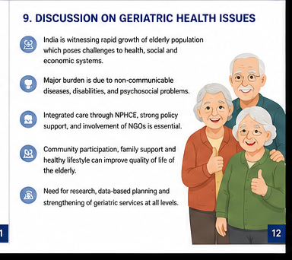
11. Finalization & Key Takeaways
12
Completing the logbook presentation
R
References
Use Vancouver-style formatting. The source gives: Park K. Park’s Textbook of Preventive and Social Medicine. 27th ed. Jabalpur: Banarsidas Bhanot; 2023.
F
Finalization
Format the manuscript and slides for the final logbook presentation.
✓
Core message
Geriatric care requires integrated medical, functional, psychosocial and community-level support.
Thank you
PSM Elective Posting • Health Care of the Elderly (Geriatrics)

