Slide 1
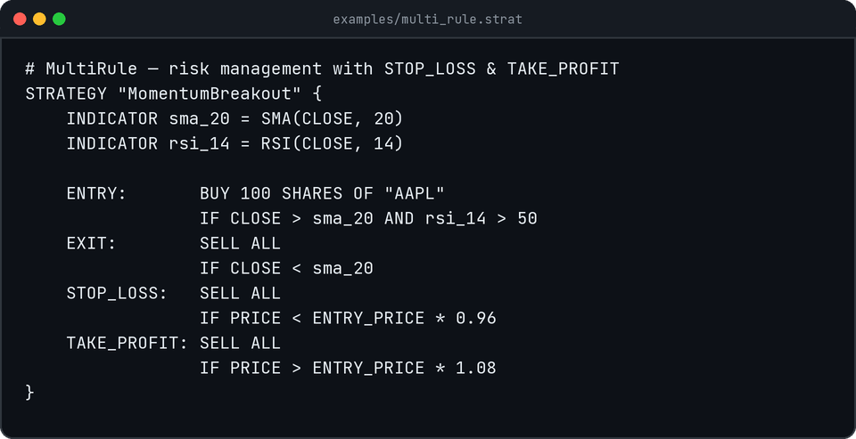
COMPILER DESIGN LABORATORY · BCSE307P
SwayaLang
A Domain-Specific Language & Compiler for Stock-Trading Strategies
GitHub Repository: https://github.com/shuklaswayam/SwayaLang
● PHASE 2: CORE IMPLEMENTATION
● 63/63 TESTS PASSING
STUDENT REG. NO. INSTITUTION
Swayam Shukla 24BCE0751 SCOPE, VIT Vellore
PHASE 2 REVIEW OBJECTIVES & DELIVERABLES
▸ Front-to-back compilation: .strat specification executes against real historical data.
▸ Scoped Symbol Table: Parent-pointer tree with strict cross-strategy scope isolation.
▸ Semantic Analysis: Two-type system (NUMERIC, BOOLEAN) with 4 compile-time error traps.
▸ Intermediate Representation: Three-Address Code (TAC) with short-circuit branching.
▸ Backtest Execution Engine: Quantitative proof of correctness (win rate, return %, drawdown).
COMPLETE COMPILER PIPELINE OPERATIONAL
Source (.strat) → Tokens → AST → Scoped SymTab → Semantics → TAC Quadruples → Interpreter & Backtest
SWAYALANG // COMPILER DESIGN LAB (BCSE307P) — REVIEW 2
01 / 14

Slide 2
MILESTONE COMPARISON
02 / 14
Phase 1 (Prototype) vs. Phase 2 (Core Implementation)
Transforming a preliminary syntactic prototype into an end-to-end executable compiler toolchain.
LEXER & PARSER
Full LL(1) Grammar
30 Token Types & AST Hierarchy
SCOPED SYMBOL TABLE
Hierarchical Scopes
Global Builtins + Strategy Scopes
SEMANTIC VALIDATION
Type & Invariant Checks
NUMERIC/BOOLEAN & 4 Error Traps
EXECUTION ENGINE
Backtest Simulation
TAC Quadruples + 63 Passing Tests
01 Lexical Analysis
✕ Phase 1: Basic keyword/literal token scanning without line/col tracking.
✓ Phase 2: Maximal-munch DFA scanner, 30 token types, exact (line, col) tracking, LexError recovery with source position highlighting.
02 Syntax Analysis & AST
✕ Phase 1: Single-strategy prototype parser handling basic ENTRY rule.
✓ Phase 2: Full LL(1) recursive-descent parser, multi-strategy files, indicator decls, ENTRY/EXIT/STOP_LOSS/TAKE_PROFIT rules, precedence climbing.
03 Symbol Table Management
✕ Phase 1: Not implemented (grammar prototype only).
✓ Phase 2: Hierarchical parent-pointer symbol table (Global + Strategy child scopes), scope isolation guarantees, forward reference support.
04 Semantic Analysis & Typing
✕ Phase 1: Not implemented.
✓ Phase 2: Two-type system (NUMERIC, BOOLEAN), indicator signature & period validation, compile-time detection of undeclared vars, /0, invalid periods.
05 Intermediate Code (IR)
✕ Phase 1: Not implemented.
✓ Phase 2: Three-Address Code (TAC) Quadruples with temporaries (t0..tn), jump labels (L0..Ln), and boolean short-circuit branching.
06 Execution Engine & Testing
✕ Phase 1: Manual testing, 27 prototype unit tests.
✓ Phase 2: Bar-by-bar interpreter, vector math (SMA/EMA/RSI), portfolio state machine, backtest report, 63 automated tests (100% pass rate).
SWAYALANG // COMPILER DESIGN LAB (BCSE307P) — REVIEW 2
02 / 14

Slide 3
SYSTEM ARCHITECTURE
03 / 14
Compiler System Architecture: Staged Pipeline
Strict module boundaries and unidirectional dataflow from source text to backtest analytics.
COMPLETED
COMPLETED
PHASE 2
PHASE 2
PHASE 2
PHASE 2
PHASE 2
01
Lexer
lexer.py
.strat → Tokens
02
Parser
parser.py
Tokens → AST
03
Symbol Table
symbol_table.py
AST → Scoped Table
04
Semantic Analyzer
semantic.py
Type & Domain Checks
05
IR Generator
ir.py
AST → TAC Quadruples
06
Interpreter
interpreter.py
TAC + Data → Trades
07
Reporter
interpreter.py
Trades → Analytics
GUARANTEE 1: STRICT UNIDIRECTIONAL FLOW
Each module consumes solely the output of the prior stage with zero cross-module state leakage or hidden dependencies.
GUARANTEE 2: HEADLESS TESTABILITY
The parser operates on in-memory tokens; semantic analysis requires no market data; every phase is tested in absolute isolation.
GUARANTEE 3: COMPILE-TIME VS. RUNTIME DECOUPLING
The symbol table records compile-time formulas and types; the interpreter binds dynamic prices and live rolling indicators.
SWAYALANG // COMPILER DESIGN LAB (BCSE307P) — REVIEW 2
03 / 14

Slide 4
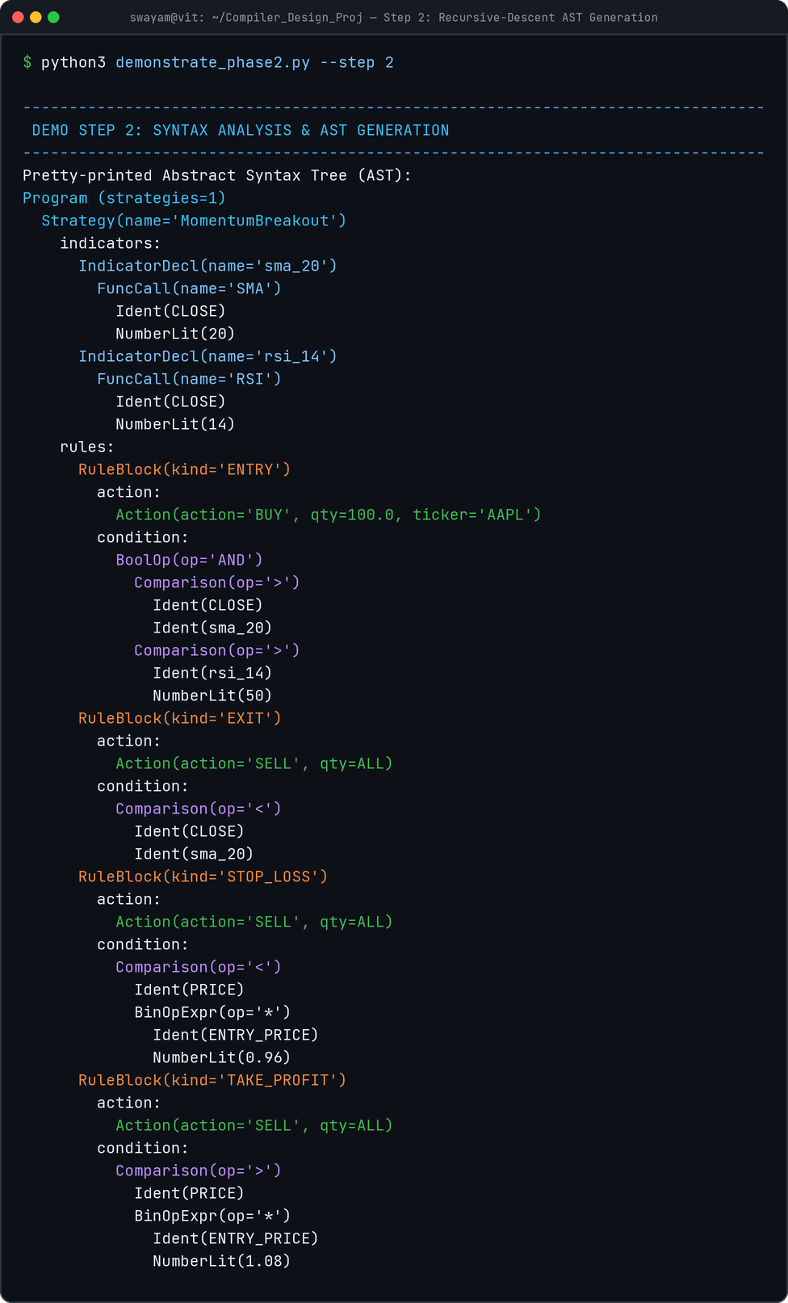
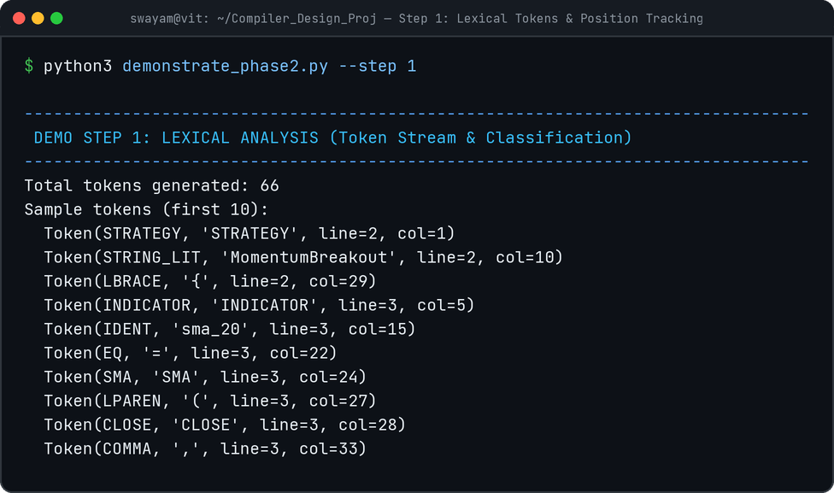
FRONT-END ENGINEERING
04 / 14
Lexical Analysis & Recursive-Descent AST
Deterministic maximal-munch scanner and LL(1) recursive-descent parser producing frozen AST nodes.
FRONT-END ARCHITECTURE & DESIGN HIGHLIGHTS
• 30 Distinct Token Types: Keywords, price fields (CLOSE, OPEN, PRICE), operators, and delimiters.
• Exact Source Position: Every token retains (line, column) origin for precise diagnostics.
• Precedence Climbing: Resolves arithmetic (*, /, +, -) and boolean (AND, OR) without left-recursion.
• Immutable Typed AST: Built with Python @dataclass(frozen=True) rooted at ASTNode base.
SWAYALANG // COMPILER DESIGN LAB (BCSE307P) — REVIEW 2
04 / 14

Slide 5
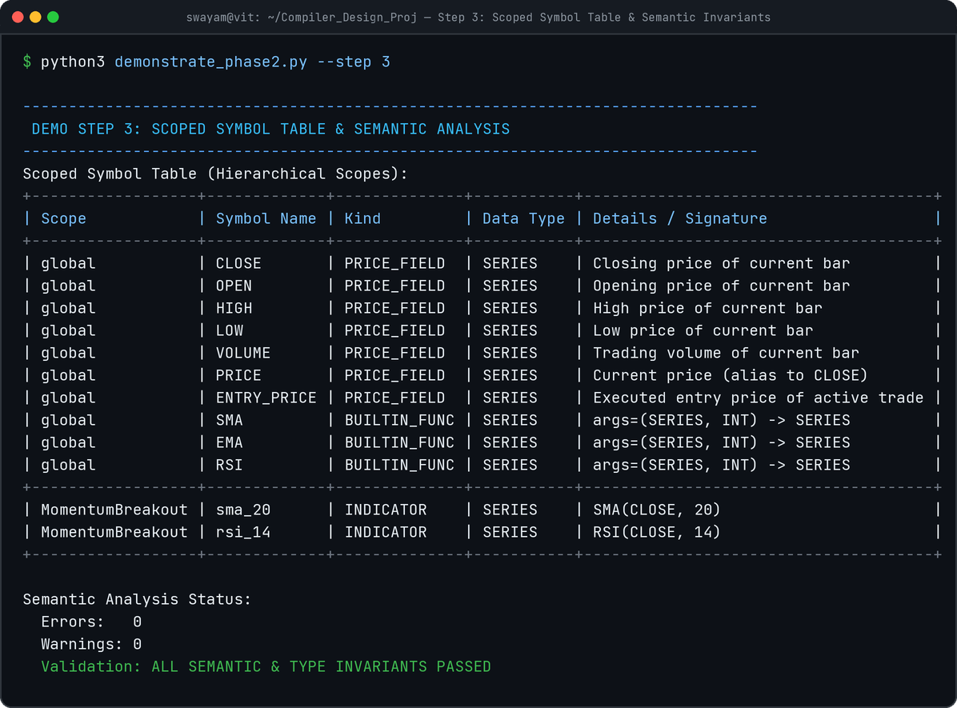
SYMBOL TABLE MANAGEMENT
05 / 14
Hierarchical Scopes & Lexical Scoping Guarantees
Parent-pointer tree enforcing cross-strategy scope isolation and built-in symbol resolution.
LEXICAL SCOPING MODEL & HIERARCHY
▸ Root Global Scope
Pre-populated with built-in indicator signatures: SMA(series, period), EMA(series, period), RSI(series, period), and 7 price series identifiers (CLOSE, OPEN, HIGH, LOW, VOLUME, PRICE, ENTRY_PRICE).
▸ Strategy Child Scopes
Each STRATEGY block instantiates its own dedicated Scope object pointing to Global as its parent. Stores declared indicators (e.g. sma_20, rsi_14).
▸ Scope Isolation Guarantee
Scope lookup walks strictly outward to the parent Global scope, never sideways to siblings. Identifiers in Strategy A cannot leak into Strategy B.
▸ Forward References Supported
A pre-pass over indicator declarations populates strategy symbols before rule analysis, allowing rules to reference indicators declared anywhere in the block.
SWAYALANG // COMPILER DESIGN LAB (BCSE307P) — REVIEW 2
05 / 14

Slide 6
SEMANTIC ANALYSIS
06 / 14
Static Type Inference & Indicator Validation
Statically verifying domain constraints and expression type consistency before code generation.
01 Two-Type System
NUMERIC vs. BOOLEAN
• NUMERIC: Price series, scalar numbers, and arithmetic (+, -, *, /).
• BOOLEAN: Relational comparisons (>, <, >=, <=, ==) and logical operators (AND, OR).
• Strict Type Safety: Prevents illegal expressions such as (CLOSE > 100) + 5 at compile time.
02 Indicator Signature Checks
Arity & Argument Type Enforcement
• Function Existence: Must resolve to BUILTIN_FUNC in Global Scope (SMA, EMA, RSI).
• Arity Verification: Requires exactly 2 arguments (series, period).
• Type Integrity: Arg 1 must be a PRICE_SERIES; Arg 2 must be an integer literal > 0.
03 Identifier Resolution
Hierarchical Scope Walking
• Every variable reference in condition trees is resolved against strategy Scope.
• Unresolved identifiers raise immediate SemanticError with exact source coordinates.
• Shadowing Prevention: Reserved series cannot be overridden as variable names.
04 Static Dead-Code Warnings
Unused Indicator Tracking
• After AST traversal, any declared indicator with zero symbol lookups is flagged.
• Emits non-fatal compile-time warnings: [WARNING] Unused indicator 'x'.
• Preserves compilation pipeline while notifying the trader of redundant computations.
SWAYALANG // COMPILER DESIGN LAB (BCSE307P) — REVIEW 2
06 / 14

Slide 7
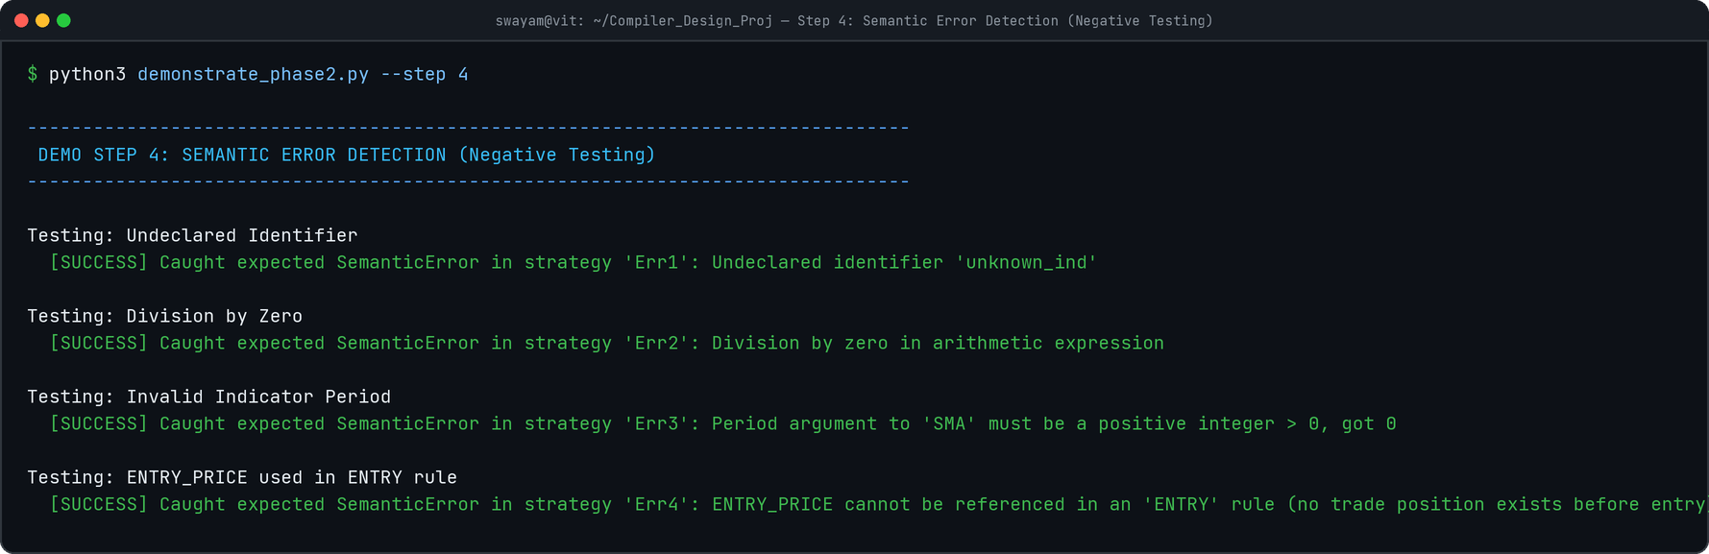
NEGATIVE ERROR TESTING
07 / 14
Compile-Time Semantic Error Detection
Trapping domain-specific illegal constructs at compile-time with source-anchored diagnostics.
Undeclared Identifier
Typo / Missing Binding
Catches missing indicator declarations or misspelled variables before execution.
Division by Zero
Literal Zero Divisor
Statically evaluates literal divisors (expr / 0) preventing runtime crash.
Invalid Period
Window Period <= 0
Enforces mathematical indicator constraints (e.g. SMA(CLOSE, 0) rejected).
ENTRY_PRICE in ENTRY
Premature Trade State
Disallows referencing trade entry price before a position is actually opened.
SWAYALANG // COMPILER DESIGN LAB (BCSE307P) — REVIEW 2
07 / 14

Slide 8
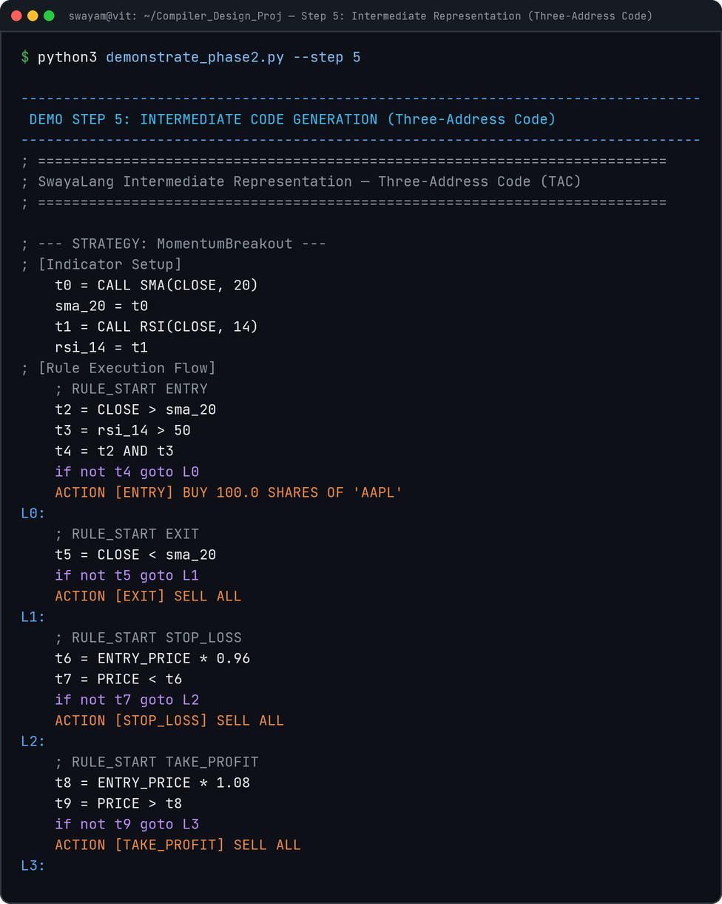
INTERMEDIATE CODE GENERATION
08 / 14
Three-Address Code (TAC) Quadruples & Control Flow
Lowering hierarchical AST logic into a linear, machine-independent execution stream.
TAC QUADRUPLE SPECIFICATION & SHORT-CIRCUIT FLOW
▸ Quadruple Structure
Instructions emitted as (op, arg1, arg2, result). Linearizes nested arithmetic and boolean expressions bottom-up.
▸ Register & Label Pools
Monotonically increasing TempPool emits virtual registers t0, t1, t2...; LabelPool emits branch targets L0, L1, L2...
▸ Short-Circuit Boolean Lowering
Boolean AND and OR expressions are lowered using conditional branch quadruples (if not t GOTO Lx), skipping evaluation of secondary operands when false.
▸ First-Class Trading Actions
Dispatches high-level order directives directly in the instruction stream: ACTION [ENTRY] BUY 100.0 SHARES OF 'AAPL'.
SWAYALANG // COMPILER DESIGN LAB (BCSE307P) — REVIEW 2
08 / 14

Slide 9
RUNTIME & EXECUTION ENGINE
09 / 14
Tree-Walking Interpreter & Mathematical Engine
Dynamic environment binding and vector technical indicator calculation algorithms.
01 Dynamic Environment Binding
Bar-by-Bar Runtime State
• At every historical bar, a fresh Environment mapping is initialized with current bar prices (OPEN, HIGH, LOW, CLOSE, VOLUME).
• Dynamic Variable Binding: ENTRY_PRICE is dynamically bound only when an open position exists.
• Temporaries and indicator calculations are cached per bar to avoid redundant re-evaluations.
02 Vector Technical Indicators
High-Performance Incremental Math
• SMA (Simple Moving Average): Sliding-window arithmetic mean with O(1)-amortized deque running sum.
• EMA (Exponential Moving Average): Multiplier k = 2/(N+1), seeded with N-bar SMA window.
• RSI (Relative Strength Index): Wilder's exponential smoothing tracking average gains and losses.
03 Portfolio State Machine
Realistic Order Simulation
• Tracks cash balance, active Position (NONE, LONG, SHORT), and realized profit & loss.
• Order Dispatched on Signals: BUY, SELL, STOP_LOSS, TAKE_PROFIT.
• Sizing Rules: Fixed share quantity or full liquidation (SELL ALL).
04 Quantitative Correctness Oracle
End-to-End Compiler Validation
• The interpreter serves as an executable specification test for every earlier compiler stage.
• A semantic or IR lowering defect manifests immediately as an anomalous trade or metric.
• Ensures formal mathematical rigor across the entire language toolchain.
SWAYALANG // COMPILER DESIGN LAB (BCSE307P) — REVIEW 2
09 / 14

Slide 10
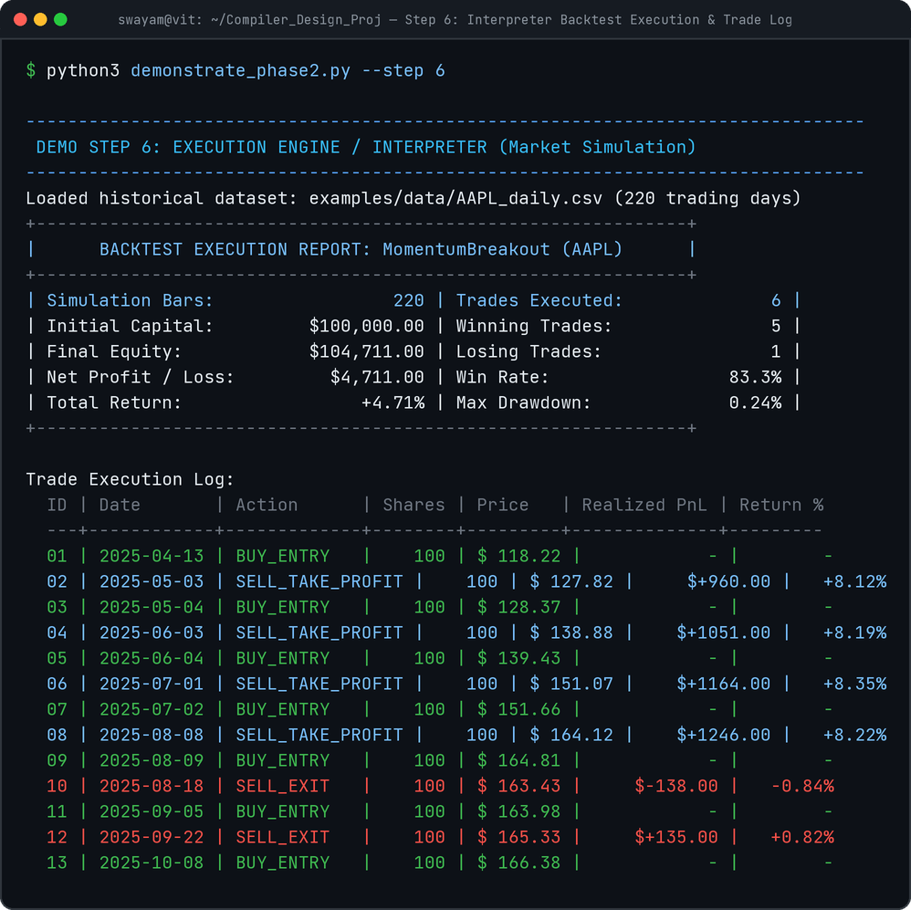
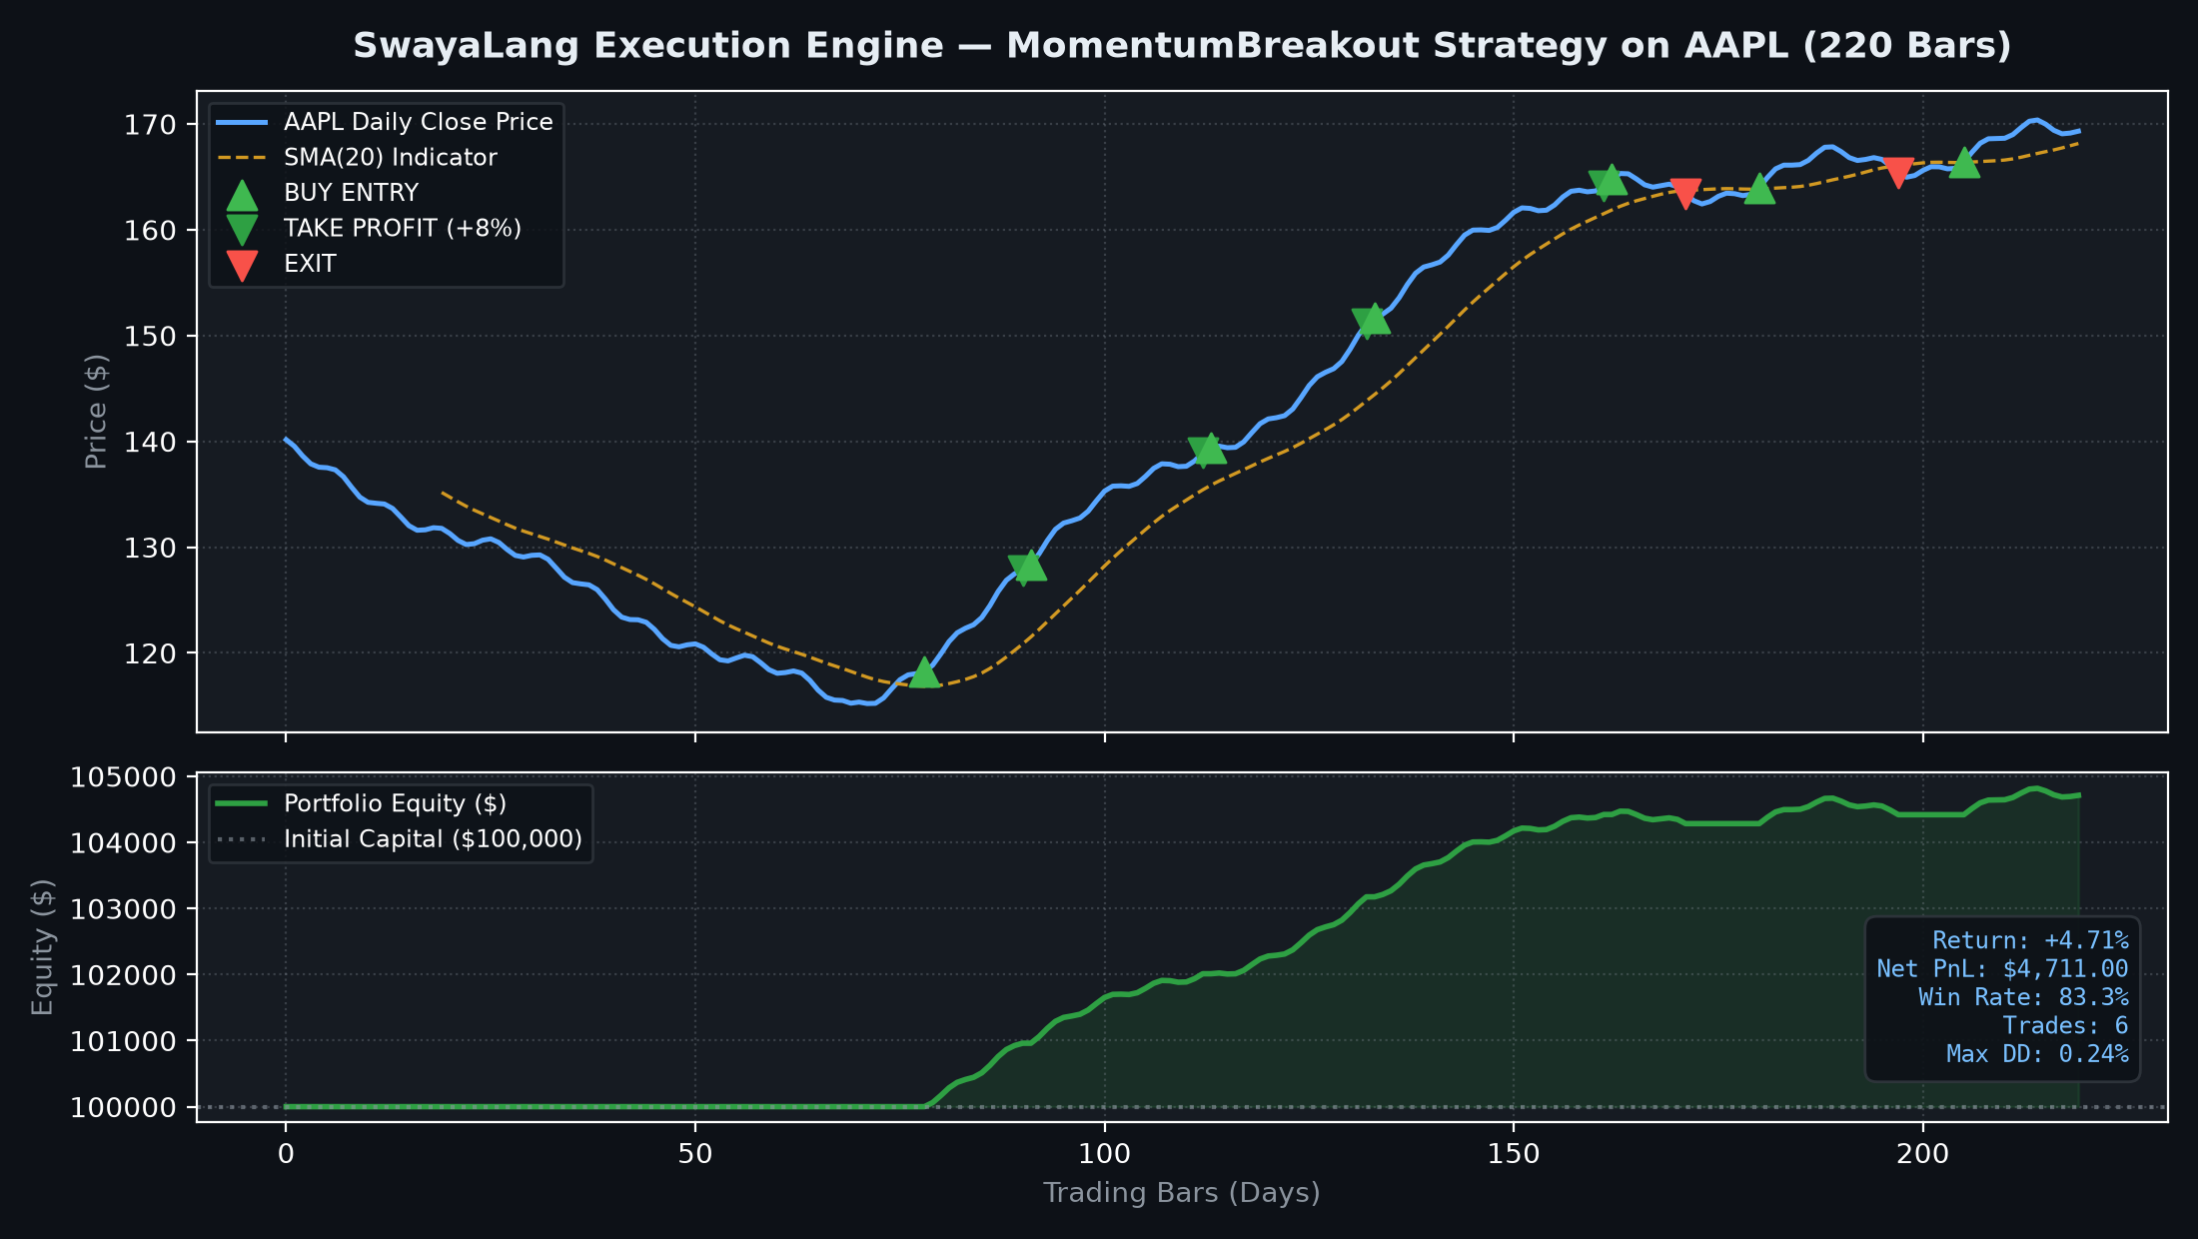
SIMULATION & BACKTESTING
10 / 14
Backtest Execution Engine & Visual Performance
Executing compiled strategy against real historical AAPL data (220 trading bars).
SWAYALANG // COMPILER DESIGN LAB (BCSE307P) — REVIEW 2
10 / 14

Slide 11
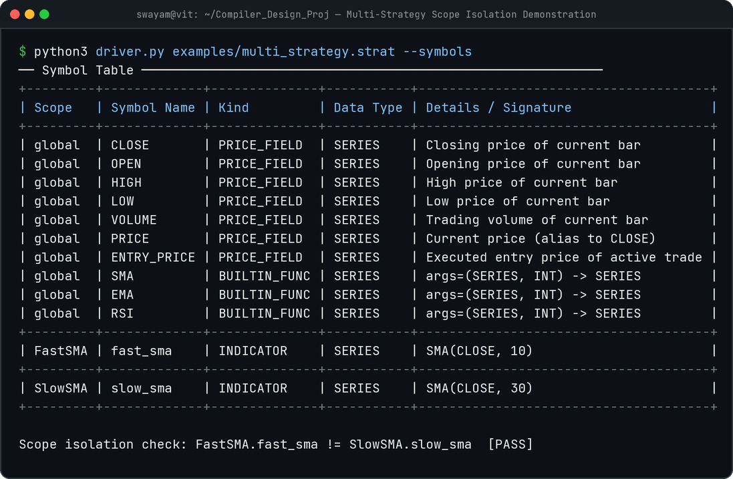
SCOPE ISOLATION DEMONSTRATION
11 / 14
Multi-Strategy Compilation & Lexical Scope Isolation
Compiling multi-strategy files with identical variable names in separate scopes.
MULTI-STRATEGY COMPILATION ARCHITECTURE
▸ Multi-Strategy Source Support
A single SwayaLang (.strat) file can define multiple distinct STRATEGY declarations (e.g. FastSMA and SlowSMA in multi_strategy.strat).
▸ Independent Child Scopes
Each strategy definition receives an isolated child scope rooted in the Global Scope. Local symbols are scoped strictly to their respective strategies.
▸ Lexical Collision Prevention
Both FastSMA and SlowSMA can declare independent indicator variables without namespace pollution or cross-strategy state bleeding.
▸ End-to-End Independent Execution
The interpreter walks each StrategyNode independently, producing separate trade logs, portfolio metrics, and equity curves.
SWAYALANG // COMPILER DESIGN LAB (BCSE307P) — REVIEW 2
11 / 14

Slide 12
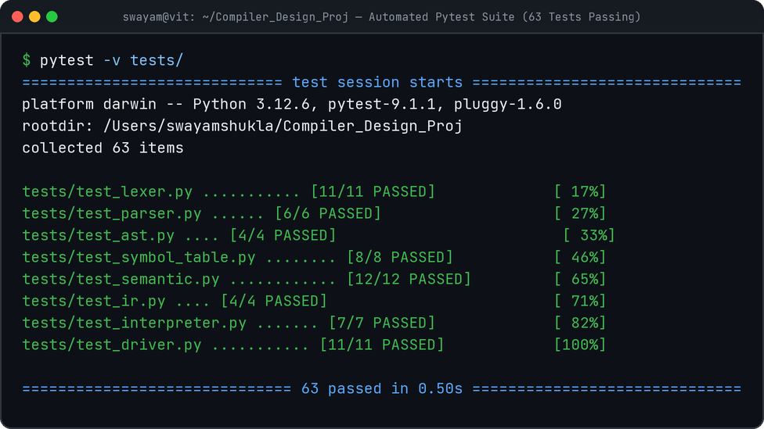
VERIFICATION & TESTING
12 / 14
Demonstration & Verification — 63 Tests Passing
Exhaustive automated testing across all 8 compiler and runtime modules (100% pass rate).
test_lexer.py (11 Cases)
Token classification, line/col accuracy, LexErrors
test_parser.py (6 Cases)
LL(1) grammar, operator precedence, syntax errors
test_ast.py (4 Cases)
AST node creation, frozen immutability, pretty-print
test_symbol_table.py (8 Cases)
Parent-pointer scopes, define/resolve, isolation
test_semantic.py (12 Cases)
Indicator signatures, 2-type rules, 4 error traps
test_ir.py (4 Cases)
TAC quadruples, pools, short-circuit branch flow
test_interpreter.py (7 Cases)
Vector math (SMA/EMA/RSI), portfolio transitions
test_driver.py (11 Cases)
End-to-end CLI flags, exit codes, output dumps
SWAYALANG // COMPILER DESIGN LAB (BCSE307P) — REVIEW 2
12 / 14

Slide 13
ENGINEERING CHALLENGES
13 / 14
Principal Engineering Challenges & Innovations
Key architectural hurdles resolved during Phase 2 compiler implementation.
Challenge 1: Compile-Time Declaration vs. Runtime State
Indicators are declared once in source code (e.g. SMA(CLOSE, 20)) but must be evaluated incrementally across hundreds of bars.
Resolution: Kept the symbol table strictly compile-time (storing function signature and formula), while the interpreter instantiates stateful running-sum deques and smoothing accumulators at runtime.
Challenge 2: Contextual Keywords vs. Identifier Scoping
Price fields like CLOSE and PRICE act as reserved keywords in indicators but values in arithmetic expressions, creating shadowing risks.
Resolution: Classified them as dedicated PRICE_FIELD tokens in the lexer (never IDENTIFIER), preventing accidental user shadowing (e.g. INDICATOR CLOSE = ...) at the grammar level.
Challenge 3: Linearizing Booleans with Short-Circuiting
Evaluating compound expressions (AND, OR) naively would trigger costly indicator evaluations even when the left operand is false.
Resolution: Lowered boolean combinators into conditional branch quadruples (if not t GOTO Lx), providing genuine short-circuit evaluation directly at the TAC intermediate representation.
Innovation: End-to-End Backtest as Verification Oracle
Compiler unit tests often stop at AST or TAC shape matching, missing subtle runtime semantic discrepancies.
Resolution: Closed the loop with a simulated trading engine over real market data. Any semantic or IR code generation error immediately manifests as an invalid trade log or math anomaly.
SWAYALANG // COMPILER DESIGN LAB (BCSE307P) — REVIEW 2
13 / 14

Slide 14
ROADMAP & EXECUTION TIMELINE
14 / 14
Project Roadmap & Phase 3 Execution Timeline
Structured milestones from core implementation to code optimizations and final deliverables.
Phase 1
COMPLETED
Phase 2
REVIEW 2
Phase 3
FINAL REVIEW
Problem Definition & Front-End Prototype
Core Compiler & Execution Engine
Code Optimization & Visualization
✓ Formal EBNF grammar design & project scaffold
✓ Hand-written maximal-munch scanner & LL(1) parser
✓ Immutable AST node hierarchy & pretty-printer
✓ Prototype driver script & 27 unit tests passing
✓ Scoped Symbol Table across multi-strategy files
✓ Semantic Analyzer with 2-type system & 4 error traps
✓ Three-Address Code (TAC) with short-circuit branching
✓ Bar-by-bar Interpreter & vector indicator algorithms
✓ Portfolio state machine & historical backtesting
✓ 63 automated pytest cases (100% pass rate)
▸ Constant Folding: Evaluate literal sub-expressions at compile time (CLOSE / (10 - 8) → CLOSE / 2)
▸ Common Subexpression Elimination (CSE): Deduplicate identical indicator calculations across rules
▸ Automated Equity Curve Plotting: Exporting matplotlib charts alongside JSON trade logs
▸ Interactive Strategy Web Dashboard & Benchmarks
▸ Final Comprehensive Project Report
SWAYALANG // COMPILER DESIGN LAB (BCSE307P) — REVIEW 2
14 / 14

