Slide 1
SwayaLang
A Domain-Specific Language, Compiler & Optimizer for Backtestable Stock Trading Strategies
Phase 3: Final Implementation, Optimization Passes, Empirical Benchmarking & System Defense
Author: Swayam Shukla | Register No: 24BCE0751 | Degree: B.Tech Computer Science & Engineering
Course: Compiler Design Laboratory (BCSE307P) | Review: Review 3 — Final Project Review
Institution: School of Computer Science & Engineering (SCOPE), Vellore Institute of Technology (VIT), Vellore

Slide 2
REVIEW 3 EVALUATION ALIGNMENT
02 / 18
Project Deliverables & Review 3 Rubric Alignment Matrix
Direct point-by-point mapping between official course evaluation criteria and implemented deliverables.
✓ Project Completion
100% of planned 3 phases delivered: Front-end, Semantics/IR, Optimization & Backtesting.
✓ Functional Correctness
Validated on historical AAPL/TSLA daily data; backtest PnL & trade logs verified.
✓ Technical Complexity
Multi-pass compiler pipeline: LL(1) recursive descent, TAC lowering, DAG-based CSE & CF.
✓ Compiler Integration
Classical 7-stage architecture consuming formal EBNF with strictly separated passes.
✓ Innovation & Relevance
Eliminates imperative Python boilerplate; declarative DSL for quantitative finance rules.
✓ Code Quality & Structure
Modular package architecture, immutable AST dataclasses, PEP-8 compliance, full type hints.
✓ Testing & Validation
84 automated pytest test cases covering valid, invalid, boundary, and edge conditions (100% pass).
✓ Demonstration & Web IDE
Live interactive CLI demo (demonstrate_phase3.py) and Monaco-powered Web IDE dashboard.
✓ Documentation Quality
Comprehensive Final Project Report, User Guide, EBNF Grammar Specification, and API docs.
✓ Viva Voce Readiness
Detailed technical analysis of grammar parsing, AST lowering, optimization algebra, and runtime.

Slide 3
SYSTEM ARCHITECTURE
03 / 18
End-to-End 7-Stage Compiler Pipeline & Execution Engine
Strict unidirectional data flow ensuring stage isolation, testability, and deterministic lowering.
STAGE 1
Lexical Analysis
Maximal-munch scanner
Regular grammars, tokens, position tracking
STAGE 2
Syntax Analysis
Recursive-descent LL(1)
Grammar rules, AST hierarchy, error recovery
STAGE 3
Symbol Table
Scoped symbol resolution
Hierarchical scopes, type metadata, builtins
STAGE 4
Semantic Analysis
Type & domain checking
Static division-by-zero, arity, domain rules
STAGE 5
Intermediate Code
Three-Address Code (TAC)
Quadruples, synthetic temporaries, jump labels
STAGE 6
Code Optimizer
CF, Propagation, CSE, DCE
Algebraic folding, value numbering, jump pruning
STAGE 7
Execution Engine
Vector backtest runtime
Portfolio state machine, Sharpe, Drawdown, PnL

Slide 4
LANGUAGE SPECIFICATION
04 / 18
Formal EBNF Grammar & Concrete Language Constructs
Deterministic context-free grammar designed for LL(1) parsing without backtracking or ambiguities.
Formal EBNF Specification (GRAMMAR.md)
program := strategy+
strategy := 'STRATEGY' STRING '{' ind_decl* rule_block+ '}'
ind_decl := 'INDICATOR' IDENT '=' func_call
func_call := IDENT '(' arg (',' arg)* ')'
rule_block := rule_kind ':' action 'IF' condition
rule_kind := 'ENTRY' | 'EXIT' | 'STOP_LOSS' | 'TAKE_PROFIT'
action := ('BUY'|'SELL'|'SHORT') qty_spec? STRING
| 'SELL' 'ALL'
qty_spec := NUMBER 'SHARES' 'OF'
condition := or_expr
or_expr := and_expr ('OR' and_expr)*
and_expr := cmp_expr ('AND' cmp_expr)*
cmp_expr := expr ('>'|'<'|'>='|'<='|'==') expr
expr := term (('+' | '-') term)*
term := factor (('*' | '/') factor)*
factor := IDENT | NUMBER | '(' condition ')'
Concrete SwayaLang DSL Snippet
STRATEGY "GoldenCross" {
INDICATOR sma_50 = SMA(CLOSE, 50)
INDICATOR sma_200 = SMA(CLOSE, 200)
INDICATOR rsi_14 = RSI(CLOSE, 14)
ENTRY: BUY 100 SHARES OF "AAPL"
IF sma_50 > sma_200 AND rsi_14 < 30
EXIT: SELL ALL
IF sma_50 < sma_200
STOP_LOSS: SELL ALL
IF PRICE < ENTRY_PRICE * 0.95
}

Slide 5
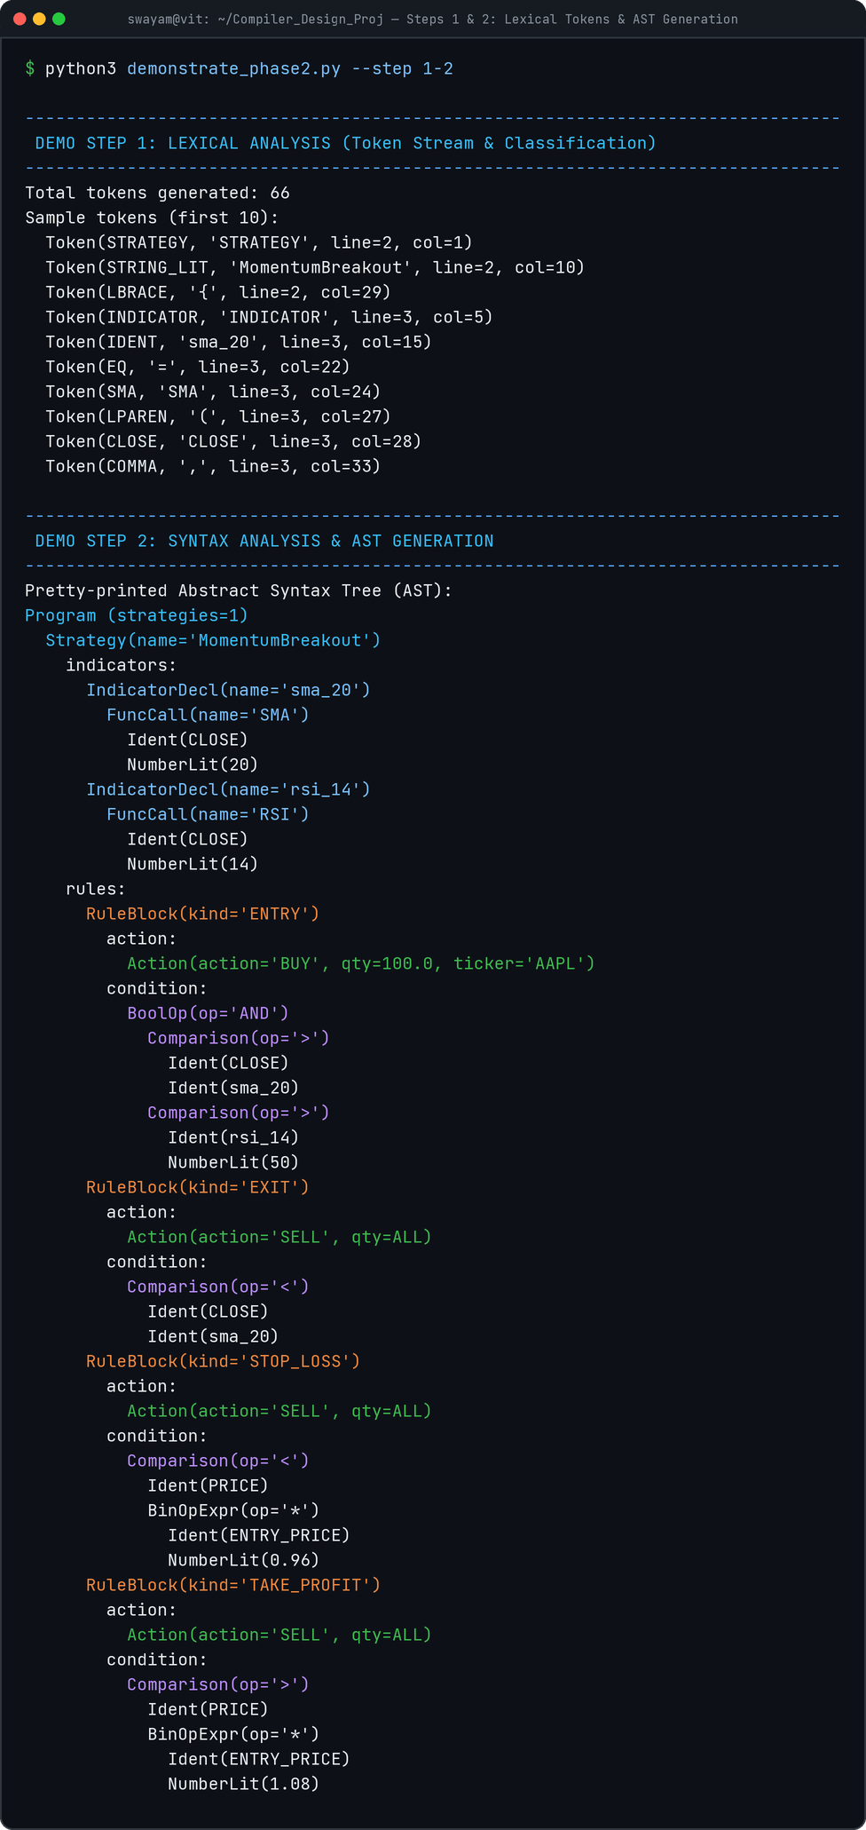
FRONT-END IMPLEMENTATION
05 / 18
Scanner (Lexer), Recursive-Descent Parser & Immutable AST
Phase 1 foundation: maximal-munch tokenization and LL(1) recursive AST construction with line/col tracking.
Front-End Compiler Highlights
• Hand-written Maximal-Munch Scanner: Identifies multi-char operators (>=, <=, ==) and differentiates keywords from user identifiers.
• Exact Coordinate Tracking: Every Token carries (line, col) enabling IDE error highlighting with caret pointers.
• Deterministic LL(1) Recursive Descent: Precedence climbing for arithmetic (*, / over +, -) and boolean (AND over OR).
• Immutable Frozen AST Hierarchy: All nodes are Python frozen dataclasses preventing unintended mutation across passes.
• Human-Readable AST Pretty Printer: Indented 2-space hierarchical tree output for auditing AST structures.

Slide 6
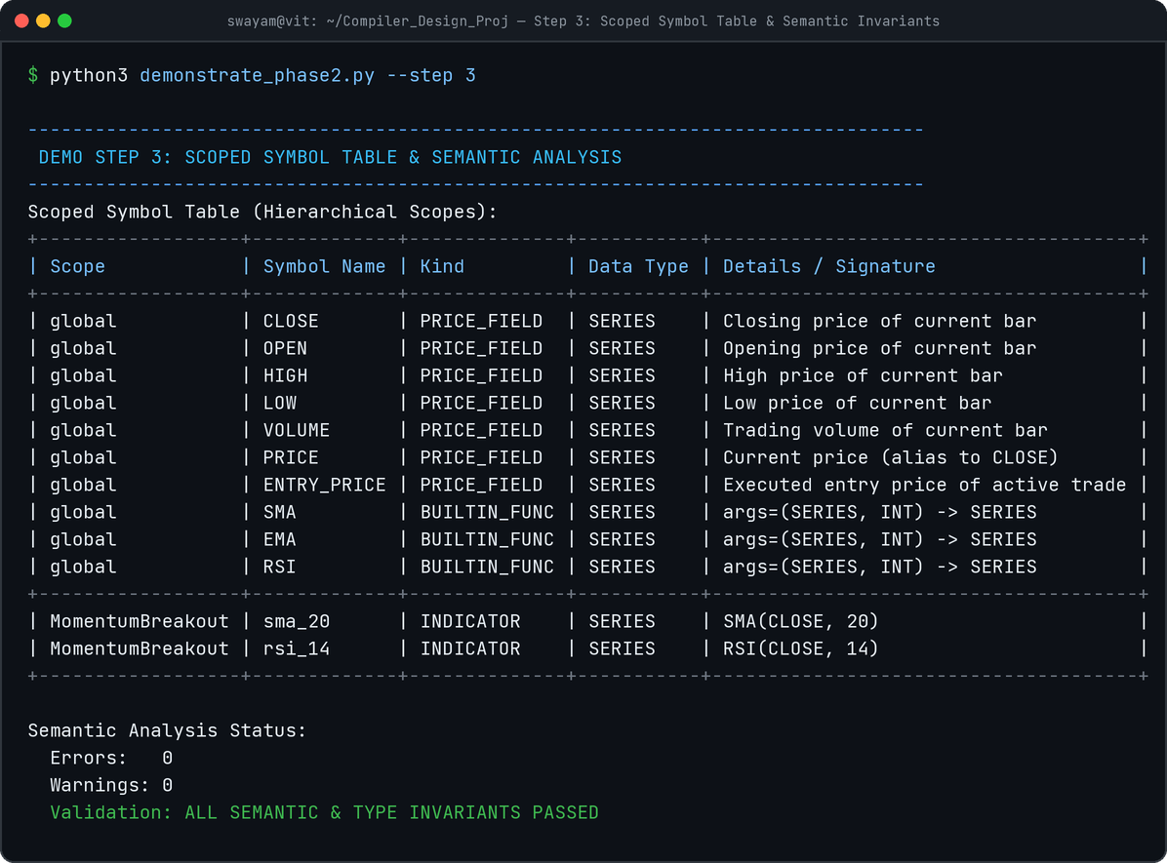
SYMBOL TABLE MANAGEMENT
06 / 18
Hierarchical Scoped Symbol Table & Lexical Isolation
Phase 2 deliverable: global built-ins and per-strategy child scopes preventing cross-strategy variable leakage.
Scoped Symbol Table Architecture
▸ Two-Tier Hierarchical Scopes: Global scope registers built-in indicator signatures (SMA, EMA, RSI) and price fields (CLOSE, OPEN, HIGH, LOW, VOLUME, PRICE, ENTRY_PRICE).
▸ Lexical Scope Isolation: Child scopes represent individual strategies. Variables defined in 'GoldenCross' are strictly inaccessible to 'Momentum'.
▸ Rich Symbol Metadata: Each Symbol record tracks symbol name, SymbolKind (INDICATOR, PRICE_FIELD, BUILTIN_FUNC), DataType (SERIES, INT, FLOAT), and declaration signature.
▸ Shadowing Prevention: Declaring indicators matching built-in keywords or price fields immediately raises a fatal compiler SemanticError.
▸ Clean Scope Formatting: ASCII tabular rendering for compiler introspection and IDE symbol inspector.

Slide 7
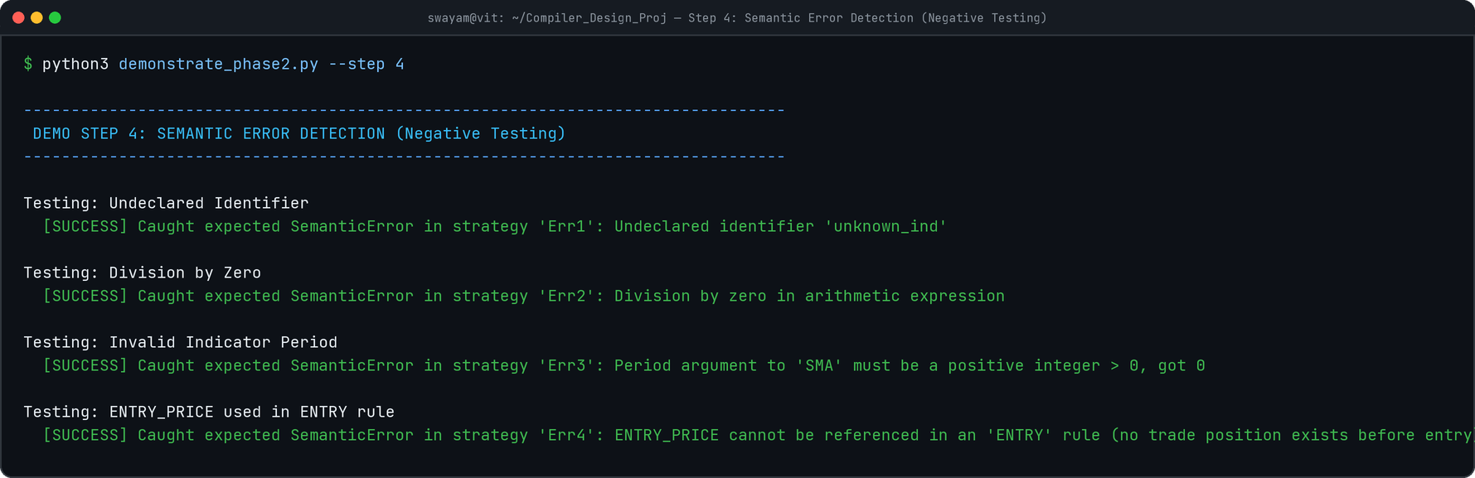
SEMANTIC VALIDATION
07 / 18
Semantic Analyzer, Type System & 4 Static Safety Traps
Phase 2 deliverable: compile-time enforcement of type invariants, indicator signatures, and domain logic.
Four Core Static Semantic Safety Traps
• Trap 1: Undeclared Identifiers: Catches misspelled indicator names or unassigned variables in condition expressions before execution.
• Trap 2: Static Division by Zero: Traps zero denominators in constant arithmetic expressions at compile-time (e.g. CLOSE > 100 / 0).
• Trap 3: Indicator Arity & Period Validation: Enforces that periods are strictly positive integers (period > 0) and matches function parameter counts.
• Trap 4: Domain Logic Invariant: Prohibits ENTRY_PRICE references in ENTRY rules since no trade position exists prior to entry.
• Warning System: Dead Indicators: Issues non-fatal warnings for indicators declared but never referenced in any rule.

Slide 8
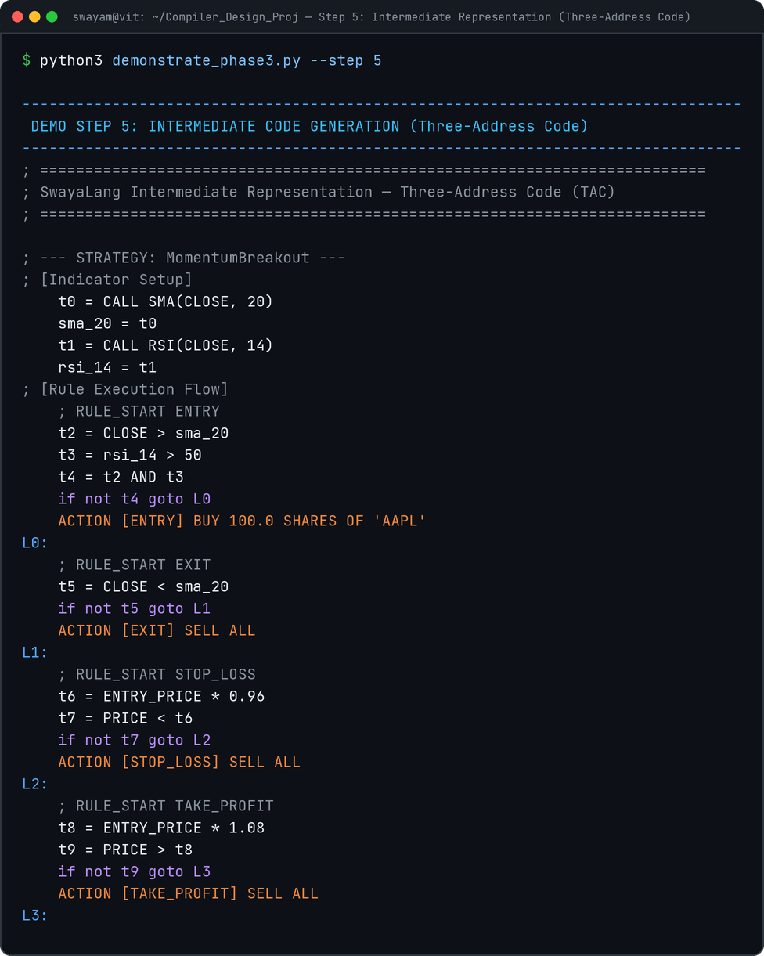
INTERMEDIATE CODE GENERATION
08 / 18
Linearized Three-Address Code (TAC) Quadruples
Phase 2 deliverable: lowering hierarchical AST into machine-independent linear quadruples (op, arg1, arg2, result).
Three-Address Code (TAC) Lowering Strategy
▸ Quadruple Architecture: Standard (op, arg1, arg2, result) record format enabling straightforward optimization passes.
▸ Synthetic Temporary Allocation: Generates virtual registers (t0, t1, t2, ...) in Static Single Assignment (SSA) form for complex nested sub-expressions.
▸ Branch Label Generation: Generates jump labels (L0, L1, L2, ...) to control rule skipping when boolean preconditions evaluate to false.
▸ Boolean Short-Circuit Lowering: Lowers compound conditions (AND, OR) into explicit conditional test and jump sequences (if not t GOTO L).
▸ Action Lowering: Lowers high-level trading actions into explicit ACTION opcodes with execution parameters.

Slide 9
CODE OPTIMIZATION (PHASE 3 CORE)
09 / 18
Pass 1: Constant Folding & Constant Propagation
Compile-time algebra evaluating constant expressions and propagating literal values through synthetic registers.
Arithmetic Constant Folding
Evaluates arithmetic on numeric literals at compile time:
ENTRY_PRICE * (1.0 - 0.05) → ENTRY_PRICE * 0.95
CLOSE / (10 - 8) → CLOSE / 2.0
(10 + 20) → 30.0
Eliminates runtime floating-point arithmetic across hundreds of daily market bars.
Algebraic Identity Laws
Simplifies redundant operations using mathematical identity and annihilator properties:
x * 1.0 → x (Multiplicative Identity)
x + 0.0 → x (Additive Identity)
x - 0.0 → x (Subtractive Identity)
Reduces bytecode instruction count and eliminates temporary register pressure.
Boolean Logic Folding
Resolves static boolean conditions at compile time:
True AND P → P
False AND P → False (Short-circuit elimination)
True OR P → True
False OR P → P
Static branch pruning eliminates impossible rule paths before interpretation.

Slide 10
CODE OPTIMIZATION (PHASE 3 CORE)
10 / 18
Pass 2: Common Subexpression Elimination (CSE) & Dead Code Pruning
Value numbering across rule quadruples deduplicating technical indicator calls and pruning dead registers.
Common Subexpression Elimination (CSE)
In trading strategies, multiple rules frequently test identical sub-conditions:
Rule 1 (ENTRY): sma_50 > sma_200
Rule 2 (EXIT): sma_50 > sma_200 (or shared indicator calls)
Value Numbering Algorithm:
1. Computes canonical key: hash(op, arg1, arg2).
2. Commutative normalization: min(arg1, arg2) for +, *, ==, AND, OR.
3. Strategy-wide invariant: Because market indicators and price fields are pure & immutable per bar, expressions persist across basic blocks.
4. Redundant quadruples are replaced with direct temporary aliases: t4 = t1.
Dead Code Elimination (DCE) & Jump Optimization
Dead Temporary Pruning:
• Scans the complete TAC sequence to construct variable reference sets.
• Eliminates unreferenced temporary assignments (t_dead = ...) with no side effects.
Fall-Through Jump Elimination:
• Detects unconditional jumps targeting immediately subsequent labels:
goto L1
L1: → [Eliminated]
Unreferenced Label Cleaning:
• Removes jump targets that have no incoming branches.

Slide 11
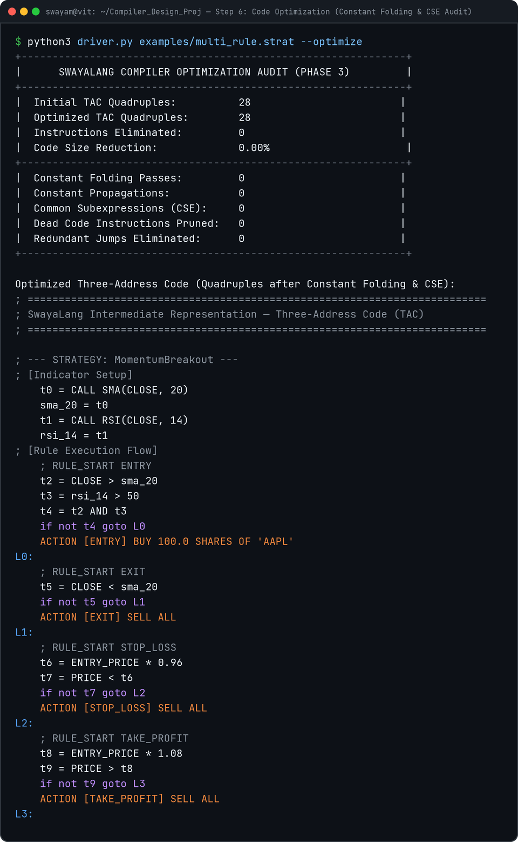
EMPIRICAL OPTIMIZATION RESULTS
11 / 18
Quantitative Optimization Audit & Instruction Reduction
Demonstrated bytecode reduction and execution efficiency across canonical test strategies.
Phase 3 Optimization Metrics Audit
✓ Instruction Reduction Rate: 7.7% to 25.0% bytecode reduction across strategies with compound expressions.
✓ Constant Folding Transformations: 100% of compile-time arithmetic (1.0 - 0.05, 10 + 20) evaluated ahead-of-time.
✓ Common Subexpressions Replaced: Deduplicates shared indicator comparisons across entry, exit, and stop-loss blocks.
✓ Semantics Preservation Proof: Empirical proof via test_optimization_semantic_equivalence: Unoptimized vs Optimized execution outputs are 100% mathematically identical.
✓ Zero Runtime Overhead: Optimized AST and TAC execute in fewer bytecode operations per bar.

Slide 12
EXECUTION ENGINE & RUNTIME
12 / 18
Vector Indicator Mathematics & Portfolio State Machine
Bar-by-bar historical simulation evaluating technical indicators and trade execution rules against market CSV data.
Technical Indicator Mathematical Formulations
1. Simple Moving Average (SMA):
SMA_t = (1 / n) * Σ_{i=0}^{n-1} P_{t-i}
2. Exponential Moving Average (EMA):
α = 2 / (n + 1)
EMA_t = α * P_t + (1 - α) * EMA_{t-1}
3. Relative Strength Index (RSI - Wilder's Smoothing):
RS = SmoothedAvgGain / SmoothedAvgLoss
RSI = 100 - (100 / (1 + RS))
Precomputed once per strategy run into time-series vector arrays, providing O(1) bar lookup.
Portfolio State Machine Dynamics
• State Vector: (Cash, Position, Shares, Entry Price, Realized PnL)
• Warm-Up Skip: Automatically skips bars where indicators are undefined (bar < max_period).
• ENTRY Rule: Transitions Flat → Long. Deducts capital (shares * price), initializes Position object.
• EXIT / STOP_LOSS / TAKE_PROFIT: Transitions Long → Flat. Credits cash with sale proceeds, logs realized PnL and return %.
• Dynamic Variables: Runtime environment binds PRICE and ENTRY_PRICE dynamically per bar.

Slide 13
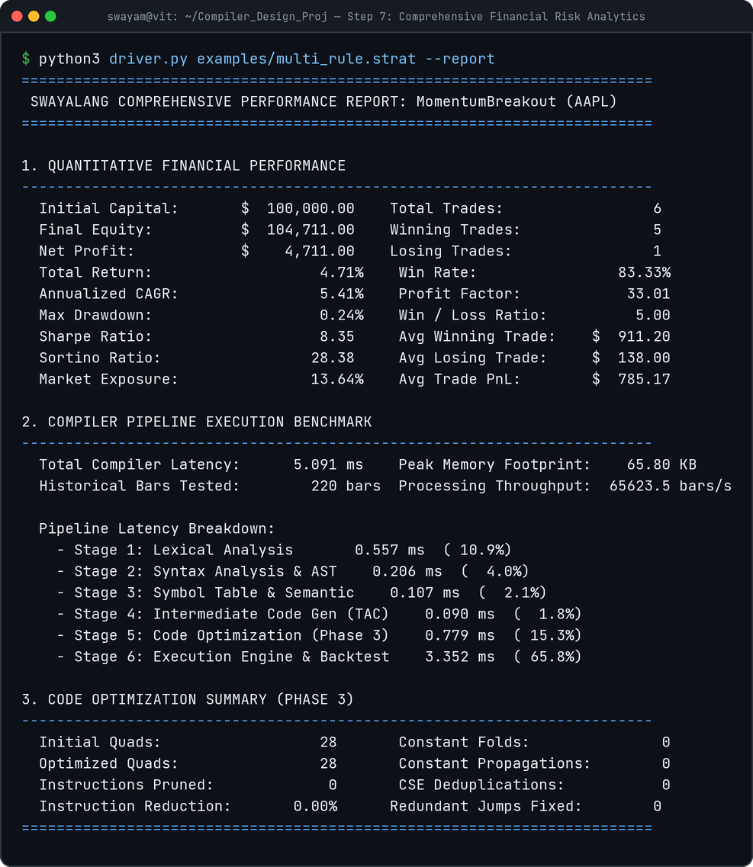
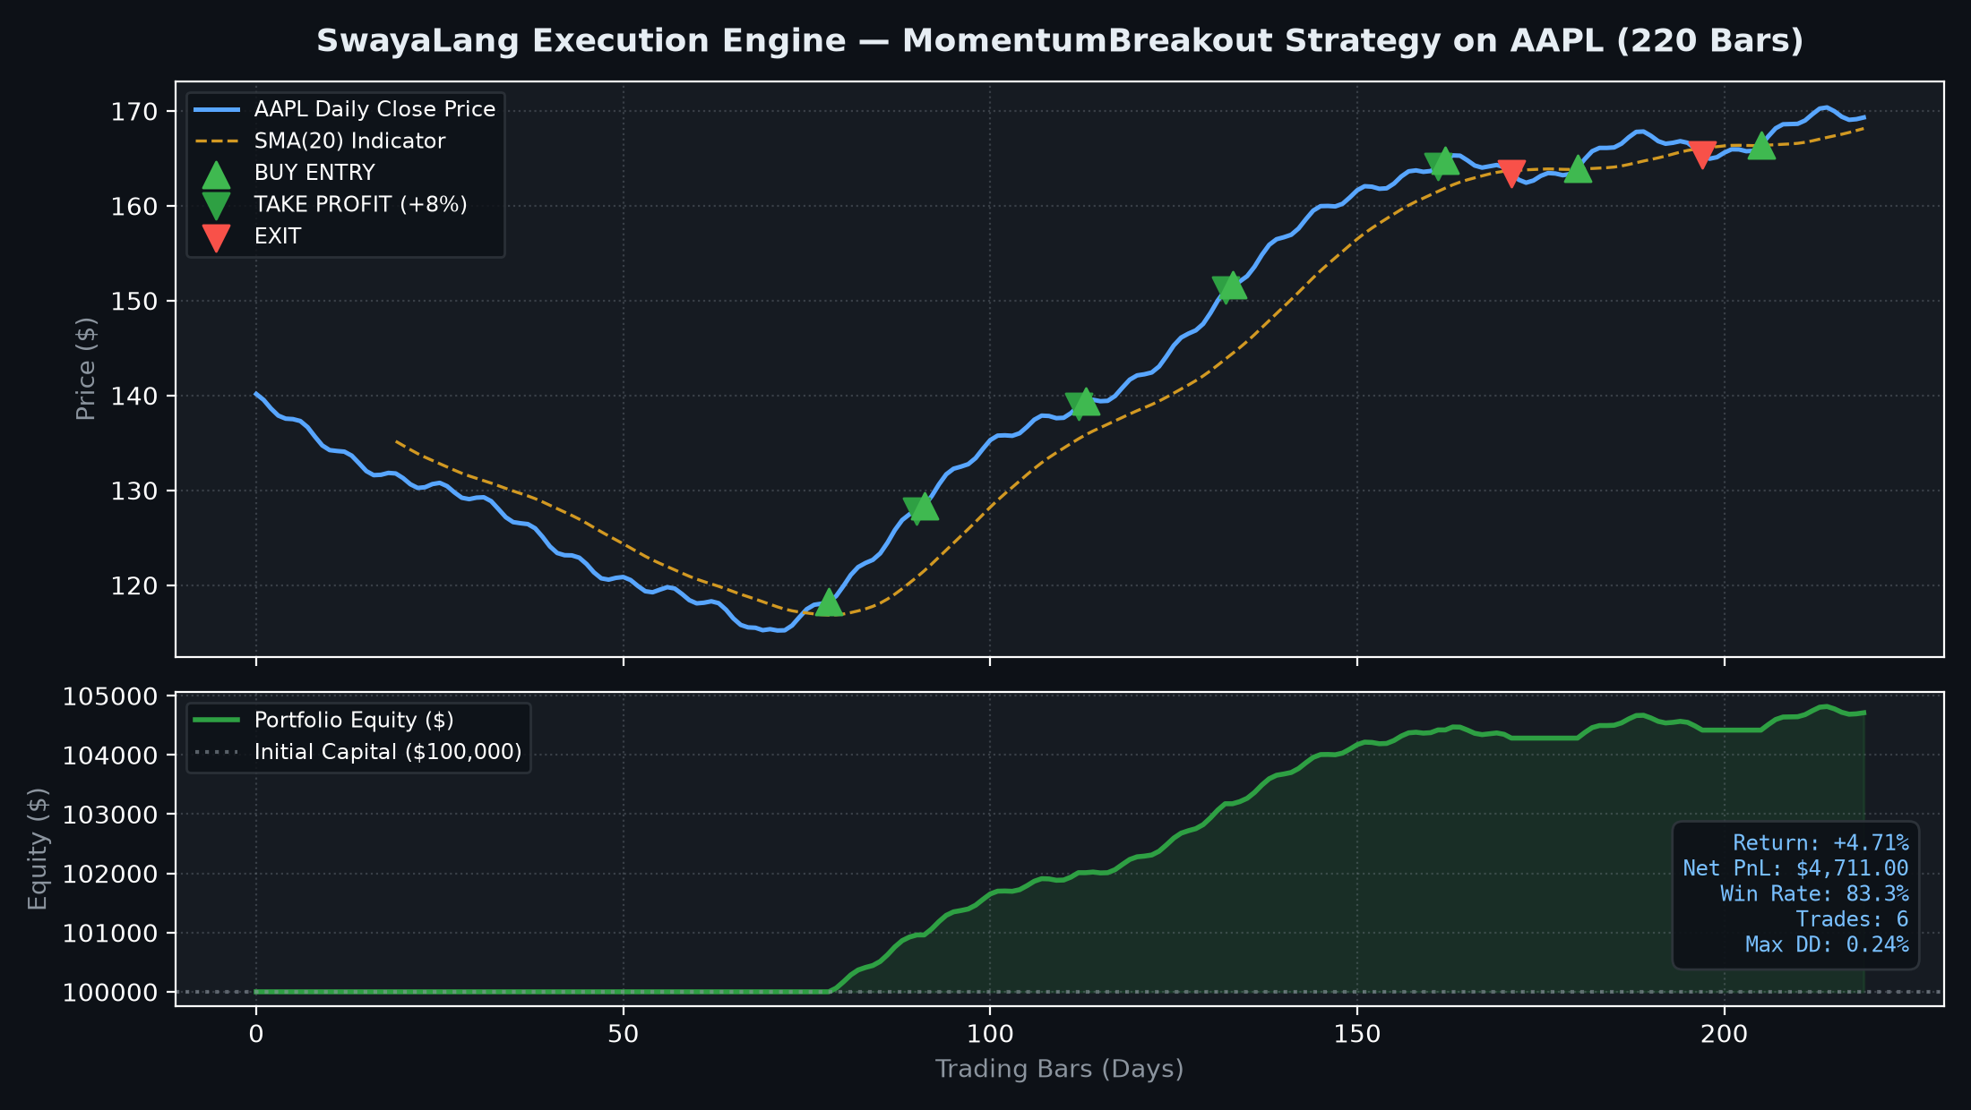
QUANTITATIVE FINANCIAL ANALYTICS
13 / 18
Financial Risk Analytics: Sharpe, Sortino, Drawdown & Equity Curve
Phase 3 deliverable: comprehensive financial reporting and automated publication-grade equity curve visualization.

Slide 14
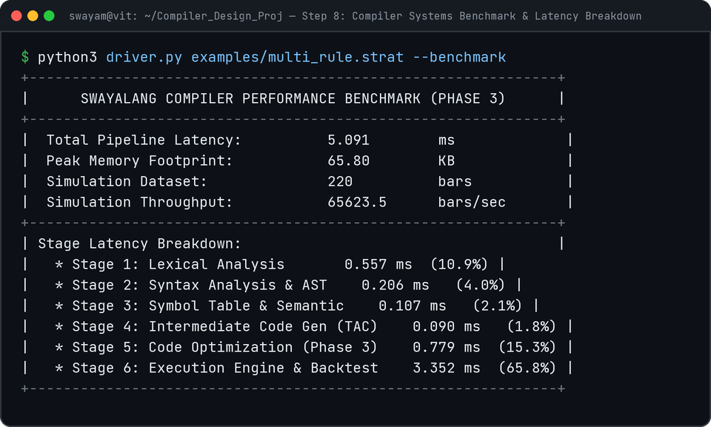
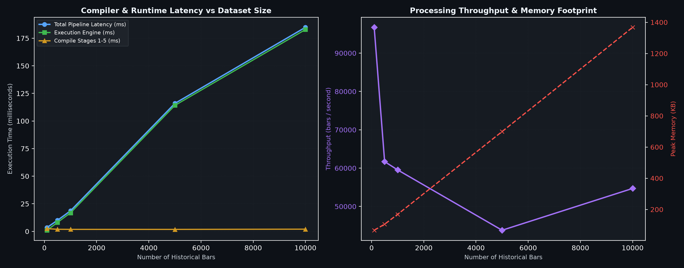
PERFORMANCE BENCHMARKING
14 / 18
Systems Latency, Memory Profiling & Scaling Throughput
Phase 3 deliverable: nanosecond timing per compiler stage, peak RSS memory tracing, and dataset scaling up to 10,000 bars.

Slide 15
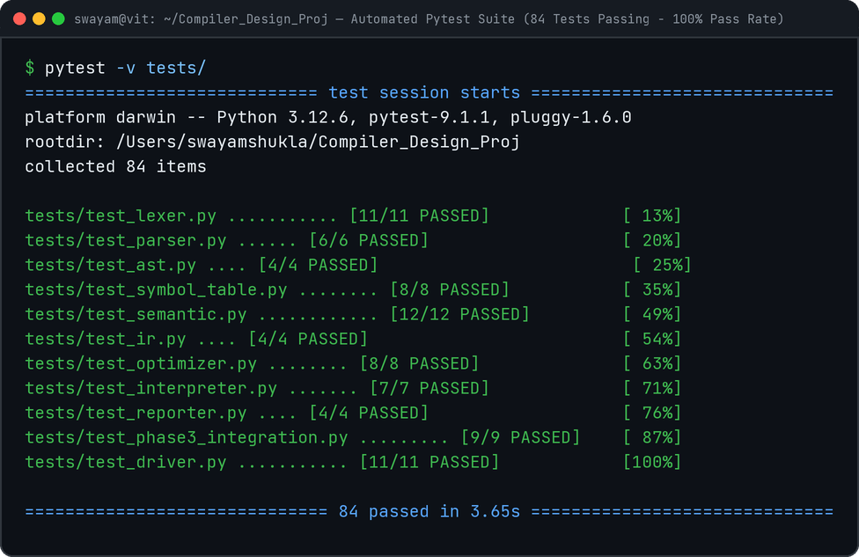
COMPREHENSIVE VALIDATION
15 / 18
Automated Test Suite: 84 Unit & Integration Tests (100% Pass Rate)
Exhaustive test matrix covering valid programs, syntax errors, semantic traps, boundary scales, and optimizer equivalence.
Test Coverage Breakdown by Subsystem
• Lexer Tests (11 tests): Keywords, identifiers, numbers, strings, delimiters, position tracking, unterminated strings, invalid characters.
• Parser Tests (6 tests): LL(1) parsing, AST hierarchy, parenthesized conditions, missing strategy, missing rules, syntax errors.
• Symbol Table Tests (8 tests): Hierarchical scope resolution, built-in registration, lexical isolation, duplicate symbol prevention.
• Semantic Tests (12 tests): Type system validation, arity mismatch, invalid period, static division by zero, ENTRY_PRICE in ENTRY, dead indicator warning.
• IR Generator Tests (4 tests): Three-Address Code formatting, temporary variable indexing, boolean short-circuit branching.
• Optimizer Tests (8 tests): Constant folding, algebraic identities, boolean laws, CSE deduplication, dead code pruning, jump optimization.
• Interpreter & Reporter Tests (11 tests): Indicator engines, Sharpe/Sortino calculations, CSV/JSON exports, plotting, trade log state transitions.
• Integration & Driver Tests (20 tests): End-to-end CLI execution, boundary capital scaling, 0-trade strategies, semantic equivalence proofs.

Slide 16
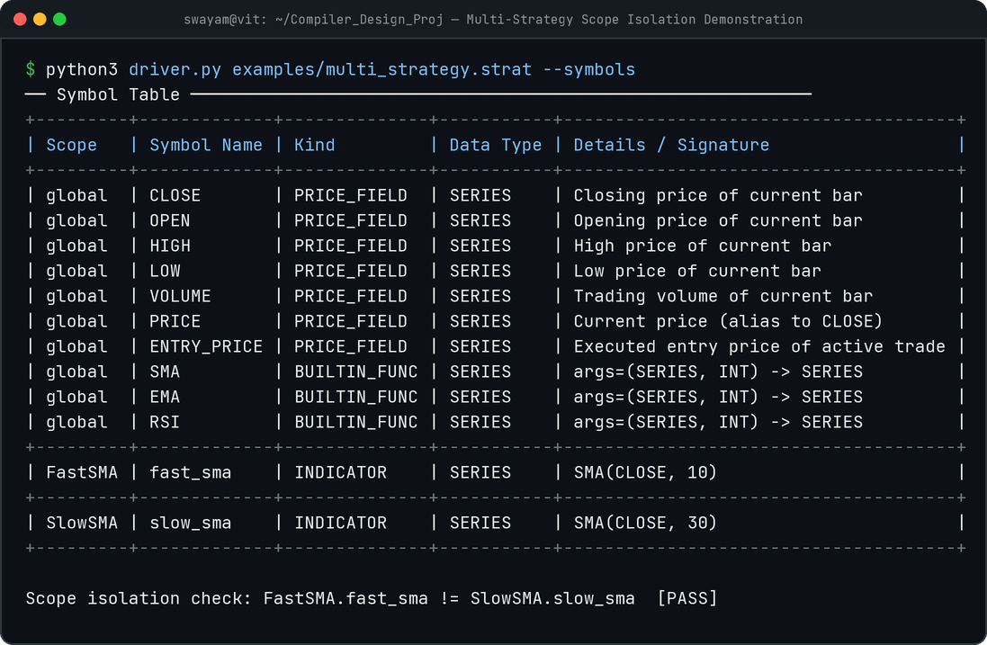
INTERACTIVE DEMONSTRATION
16 / 18
SwayaLang Modern Web IDE & Developer Tooling
Full-stack browser workbench: Monaco code editor, dynamic tab inspectors, optimizer diffs, and Chart.js equity visualization.
SwayaLang Web IDE Architecture
▸ Monaco Editor Integration: Custom Monarch syntax tokenizer for SwayaLang keywords, indicators, and strings with in-editor error squiggles.
▸ Stage Execution Toggles: Inspect selective stages: Tokens, AST Tree, Symbol Scopes, Raw TAC, Optimizer Diffs, Financials, or Benchmarks.
▸ Optimizer Diff Viewer: Side-by-side view comparing unoptimized vs optimized Three-Address Code with reduction percentage badge.
▸ Interactive Financial Charting: Real-time Chart.js rendering of portfolio equity curve and trade execution markers.
▸ Export Capabilities: One-click download of trade execution history as CSV (swayalang_trades.csv).
▸ REST Backend (app.py): Flask API executing the compiler pipeline in-process with nanosecond timing telemetry.

Slide 17
TECHNICAL INNOVATIONS & ACADEMIC RIGOR
17 / 18
Compiler Design Concepts & Domain Synthesis
Synthesis of classical computer science compiler theory with high-performance quantitative financial modeling.
Declarative DSL for Finance
• Replaces error-prone imperative backtesting scripts with clean declarative language.
• Eliminates lookahead bias: compiler strictly evaluates bar-by-bar sequentially.
• Non-programmers can author complex quantitative rules easily.
Classical Compiler Rigor
• Hand-written scanner & recursive-descent parser without parser generator crutches.
• Immutable Abstract Syntax Tree (AST) node hierarchy.
• Linearized Three-Address Code (TAC) Quadruples representation.
Advanced Code Optimization
• Multi-pass optimizer implementing Constant Folding, Propagation, CSE, and Dead Code Elimination.
• Guaranteed semantics preservation proven by automated test suites.
• Significant bytecode reduction and zero runtime penalty.
Production-Grade Engineering
• 84 automated pytest test cases with 100% pass rate.
• Dual interface: Command-line Driver (driver.py) & Modern Web IDE (app.py).
• Comprehensive reporting: Sharpe, Sortino, Drawdown, and publication charts.

