Slide 1

Lending Club Case Study Submission
Presented By
Vaibhav Shukla
Pankaj Kumar Sharma

Slide 2
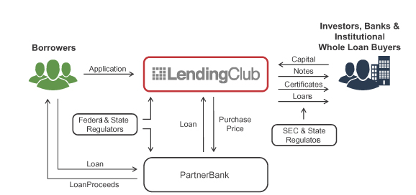
Abstract
Lending Club is a market place which lending various types of personal loans , Business loans and Financing of medical procedures. When company receives a loan application, the company have to take decision of loan approval based on the applicant’s profile.
As an employee of Lending Company our aim is to analyse the past data . The data contains all the information about Applicant like annual income home ownership and past loan whether they ‘defaulted’ or not.
The aim is to identify patterns which , indicate if a Applicant is likely to be default, which may be used for taking decision such as denying loan, reducing the amount of loan, lending (risky applicants) at a higher interest rate etc.

Slide 3
Problem Solving Approach – Flow chart
Data Understanding
Univariate Analysis
Conclusion
Read loan dataset. Check sample data, size and datatype, Then find out the Target variable
Find out and analyse the important variables. Create plots for variables. Plot variables with loan status and find out the inference.
Using analysis conclude the highly impact variables which is results in loan Status. Similarly conclusion is drawn by analyzing combination of variables impacting the loan default.
Data Preparation
Univariate Analysis
Conclusion
Data Cleaning
Bivariate Analysis
Data Cleaning
Bivariate Analysis
Cleaning missing values, removing redundant columns, correcting data type, cleaning the data depending on requirements
Plot pair plots, heat map, scatter plots. Find out the impact of combination of variables on loan status.

Slide 4
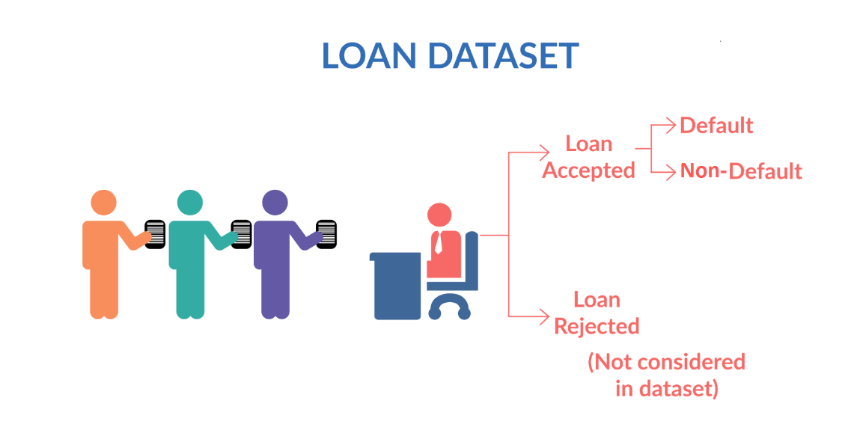
Data Understanding
Loan Data is imported from “loan.csv” file. The raw data contains shape 39717 Row and 111 Columns
Checked the Datatype of Various Columns.
There are different Types of variables present in the data like
Applicant Demographics such as ( Employment length, Employment title, Annual income etc)
Loan information & its Characteristics such as ( Loan amount, Funded amount, Loan grade, Loan status, Interest rate etc)
Customer Behavior ( when loan is approved) such as (application type, loan purpose, Delinquency 2 year, Revolving balance.
Now, Applicant behavior variables are not available at the time of loan application , Thus its can not be use for prediction of loan approval.
We also checked the columns which contains numerical data and extract it for further data insights.
We identified Target variable columns , in this case “loan_status” is target column.
Shape of dataset
Row – 39717, column - 111

Slide 5
Data Cleaning
1
Original Loan dataset
Original data set – Loan.csv
Shape: Row – 39717, Column - 111
2
Delete all the columns having 39717 null value
3
Dropping non imp columns
4
Removing rows & column with missing value
5
Imputing null value and correcting datatypes
Final data set is Clean Ready for Summarise

Slide 6
Methods followed to clean data
Checked null value in column
Deleted null values
Deleted the columns where all 39717 values are null.
Deleted columns
Deleted unnecessary columns such as zip_code, desc, url, funded amount etc
Removed outliers
Removed extreme high and low values that would not affect the result analysis
Removed duplicate data
Removed identical data
Filtere row
Filtered loan_status data, dropped loan_status as “current” ,we only need “fully paid” and “charged off “ for analysis
After performing these step, we proceed for EDA analysis over Cleaned Data.

Slide 7
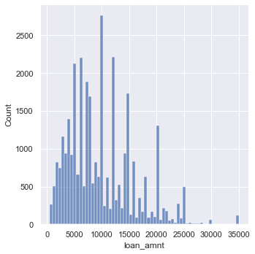
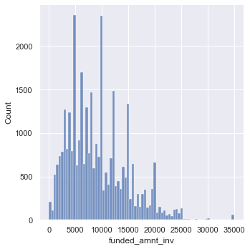
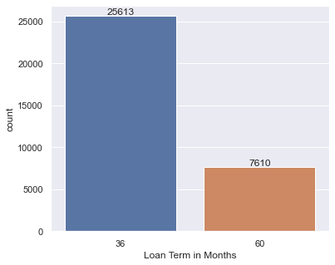
Univariate Analysis
Similar to loan amount more number of loans were sanctioned near 5000 while the amount 10000 is almost similar to 5000 which were sanctioned
Most of the loans were for 36 months term as compared to the 60 months loans

Slide 8
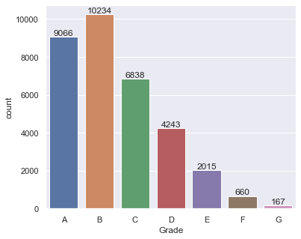
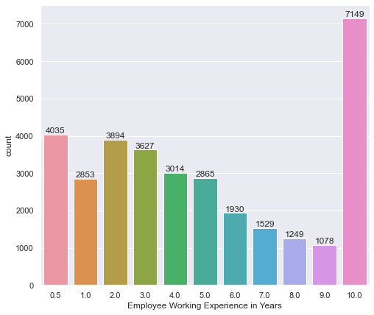
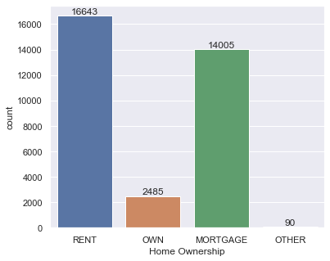
Univariate Analysis continued…..
Grade vs loan count Bar plot
Employee Experience vs loan count Bar plot
Home ownership vs loan count Bar plot
most of the loans are grade A and B type. Therefore we can say, most of the loans are high graded
Majority of employees applying for the loans are having more than 10 years of experience
Most of the borrowers are renting the house followed by morgage while other is the least.

Slide 9
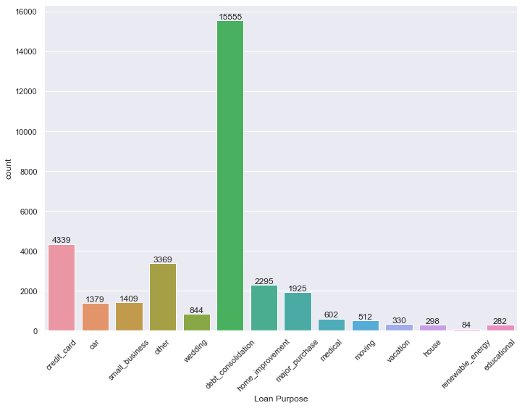
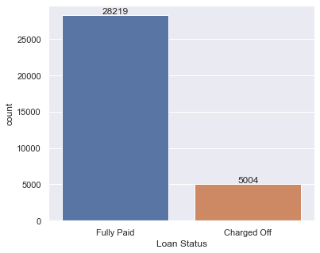
Univariate Analysis continued…..
Loan status vs count Bar plot
Loan purpose vs count Bar plot
Majority of loans are fully paid
Maximum number of loans are applied for the debt consolidation followed by credit card while renewable energy is the least.

Slide 10
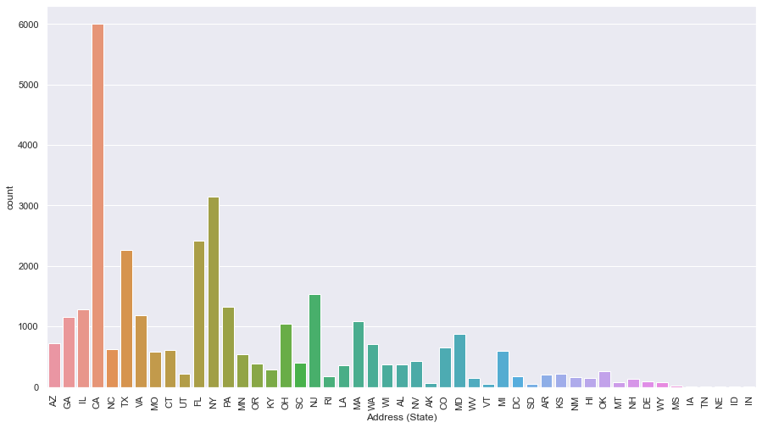
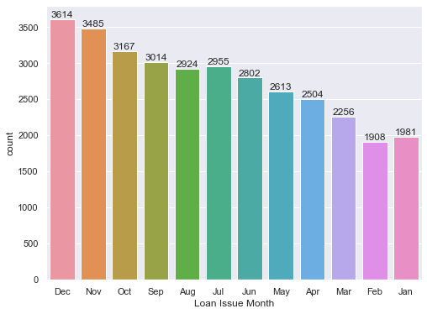
Univariate Analysis continued…..
Loan issue month vs count Bar plot
Address (state) vs count Bar plot
Maximum number of loans were applied in December. also. We can observe that the number of loan are getting increased in last quarter.
Maximum loans are applied from the state CS followed by NY.

