Slide 1

Lending Club Case Study Submission
Presented By
Vaibhav Shukla
Pankaj Kumar Sharma

Slide 2
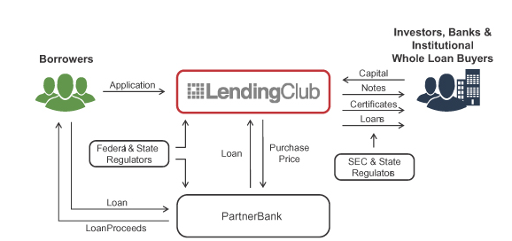
Abstract
Lending Club is a market place which lending various types of personal loans , Business loans and Financing of medical procedures. When company receives a loan application, the company have to take decision of loan approval based on the applicant’s profile.
As an employee of Lending Company our aim is to analyse the past data . The data contains all the information about Applicant like annual income home ownership and past loan whether they ‘defaulted’ or not.
The aim is to identify patterns which , indicate if a Applicant is likely to be default, which may be used for taking decision such as denying loan, reducing the amount of loan, lending (risky applicants) at a higher interest rate etc.

Slide 3
Problem Solving Approach – Flow chart
Data Understanding
Univariate Analysis
Conclusion
Read loan dataset. Check sample data, size and datatype, Then find out the Target variable
Find out and analyse the important variables. Create plots for variables. Plot variables with loan status and find out the inference.
Using analysis conclude the highly impact variables which is results in loan Status. Similarly conclusion is drawn by analyzing combination of variables impacting the loan default.
Data Preparation
Univariate Analysis
Conclusion
Data Cleaning
Bivariate Analysis
Data Cleaning
Bivariate Analysis
Cleaning missing values, removing redundant columns, correcting data type, cleaning the data depending on requirements
Plot pair plots, heat map, scatter plots. Find out the impact of combination of variables on loan status.

Slide 4
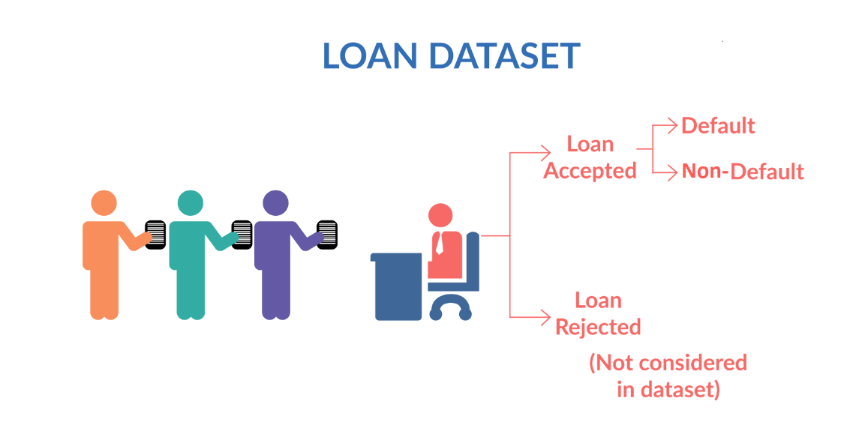
Data Understanding
Loan Data is imported from “loan.csv” file. The raw data contains shape 39717 Row and 111 Columns
Checked the Datatype of Various Columns.
There are different Types of variables present in the data like
Applicant Demographics such as ( Employment length, Employment title, Annual income etc)
Loan information & its Characteristics such as ( Loan amount, Funded amount, Loan grade, Loan status, Interest rate etc)
Customer Behavior ( when loan is approved) such as (application type, loan purpose, Delinquency 2 year, Revolving balance.
Now, Applicant behavior variables are not available at the time of loan application , Thus its can not be use for prediction of loan approval.
We also checked the columns which contains numerical data and extract it for further data insights.
We identified Target variable columns , in this case “loan_status” is target column.
Shape of dataset
Row – 39717, column - 111

Slide 5
Data Cleaning
1
Original Loan dataset
Original data set – Loan.csv
Shape: Row – 39717, Column - 111
2
Delete all the columns having 39717 null value
3
Dropping non imp columns
4
Removing rows & column with missing value
5
Imputing null value and correcting datatypes
Final data set is Clean Ready for Summaries

Slide 6
Methods followed to clean data
Checked null value in column
Deleted null values
Deleted the columns where all 39717 values are null.
Deleted columns
Deleted unnecessary columns such as zip code, desc, URL, funded amount etc.
Removed outliers
Removed extreme high and low values that would not affect the result analysis
Removed duplicate data

Slide 7
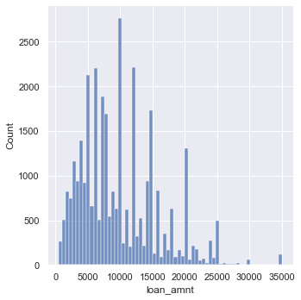
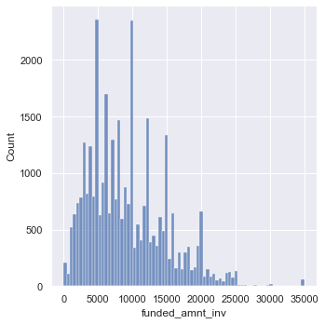
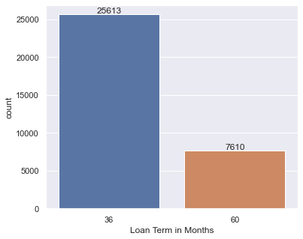
Univariate Analysis
Similar to loan amount more number of loans were sanctioned near 5000 while,
the amount 10000 is almost similar to 5000 which were sanctioned
Most of the loans were for 36 months term as compared to the 60 months loans

Slide 8
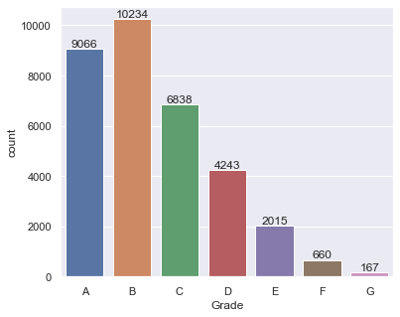
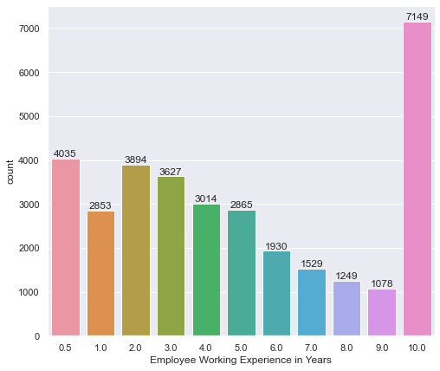
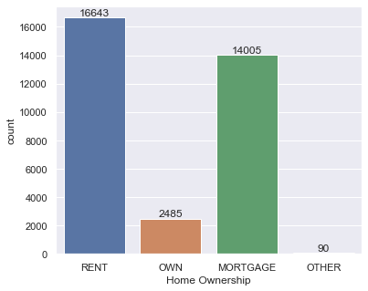
Univariate Analysis continued…..
Grade vs loan count Bar plot
Employee Experience vs loan count Bar plot
Home ownership vs loan count Bar plot
most of the loans are grade A and B type. Therefore we can say, most of the loans are high graded
Majority of employees applying for the loans are having more than 10 years of experience
Most of the borrowers are renting the house followed by morgage while other is the least.

Slide 9
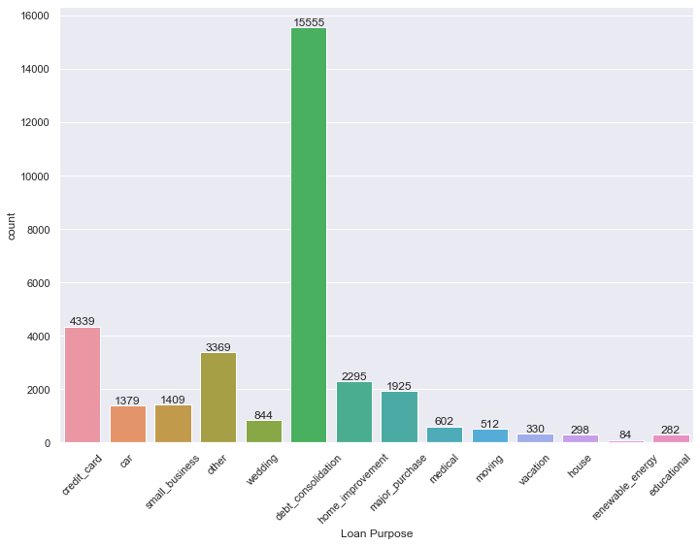
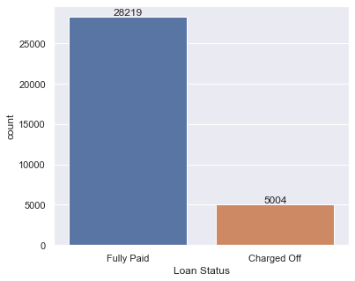
Univariate Analysis continued…..
Loan status vs count Bar plot
Loan purpose vs count Bar plot
Majority of loans are fully paid
Maximum number of loans are applied for the debt consolidation followed by credit card while renewable energy is the least.

Slide 10
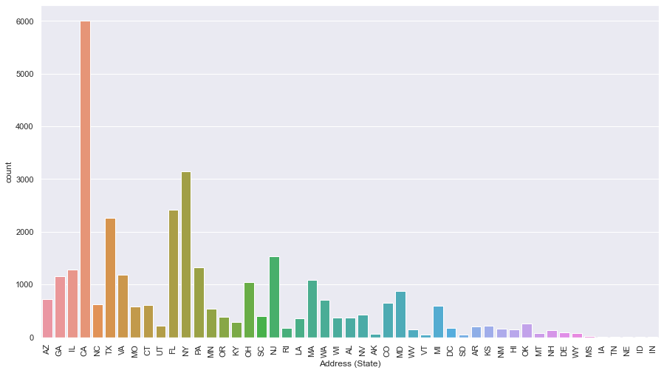
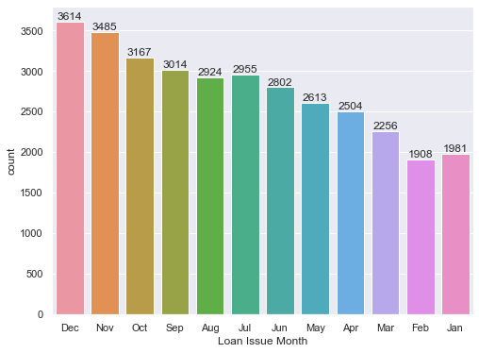
Univariate Analysis continued…..
Loan issue month vs count Bar plot
Address (state) vs count Bar plot
Maximum number of loans were applied in December. also. We can observe that the number of loan are getting increased in last quarter.
Maximum loans are applied from the state CS followed by NY.

Slide 11
Univariate Analysis Insights
As per the analysis below are important Insights:-
Sl.no | insights
1 | More number of loans are applied near 5000 while the amount 10000 was applied the most.
2 | Most of the applicants have taken loan for 36 months than 60 months.
3 | Most of the loans are from grade A, B, and C.
4 | Majority of employees applying for the loans are having more than 10 years of experience.
5 | Most of the borrowers are renting the house instead of their own house or others.
6 | Around 85% of loans are fully paid and 15% are considered as charged off (Defaulted).
7 | Maximum loans are applied for debt consolidation.
8 | Number of loans are getting increased exponentially every year. 2011 witnessed for maximum number of loans.
9 | Loans are getting increased on every month. Maximum number of loans are applied in December.
10 | Credit has been mushroomed in the recent years. Mid and late nineties are having very less credit.
11 | Most of the loans are getting applied in last quarter of the year
12 | By considering the states, maximum loans are applied from CS state

Slide 12
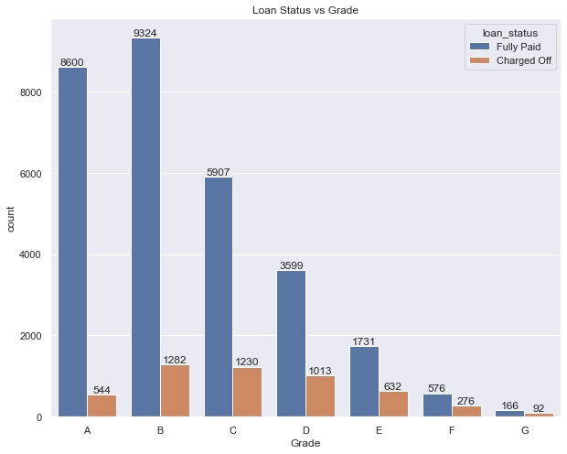
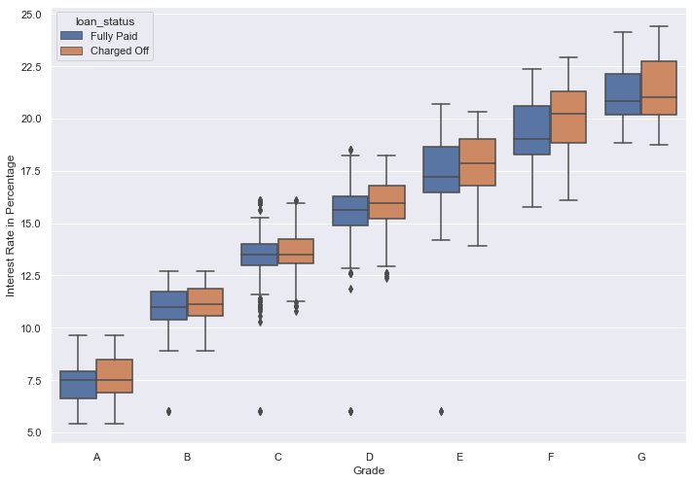
Bivariate & Multivariant Analysis:-
In Bivariate & Multivariant analysis we plotted bar graph and heat map and subgraph with combination of the important variables identified during univariate analysis and loan status.
From the univariate analysis, we have seen that the chance of default is changing heavily with the purpose. In the bivariate analysis, we can see the patterns of the default against the purpose and the remaining important derived variables one-by-one.
Bar plot for Grade and loan status vs int. rate percentage
Most of loans are High Grade loans and High Quality loans have low interest rate
higher interest rate have higher tendency to default the loan

Slide 13
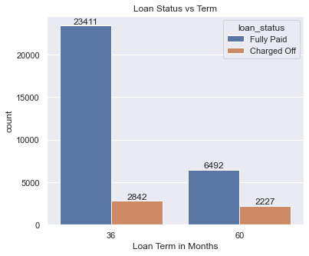
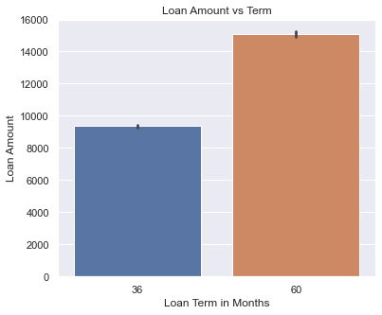
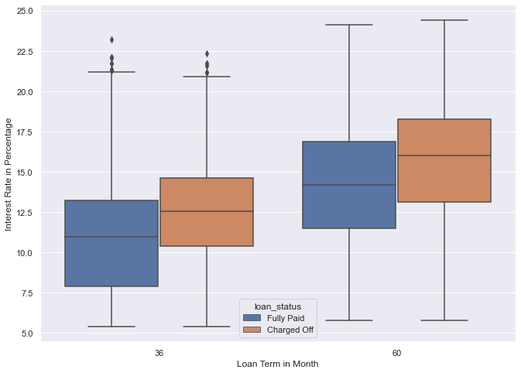
Bivariate & Multivariant Analysis Continued:-
On an average the default rate is 14%. The default rate is high (34%) when loan term is 60 months as compare to loan term of 36 months (13%).
Higher amount loans are having long term which is 60 months.
In both the terms, the chances of charged off are high if the interest rate is more

Slide 14
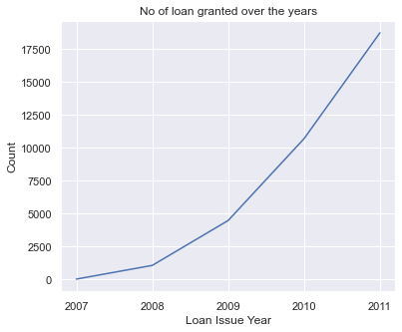
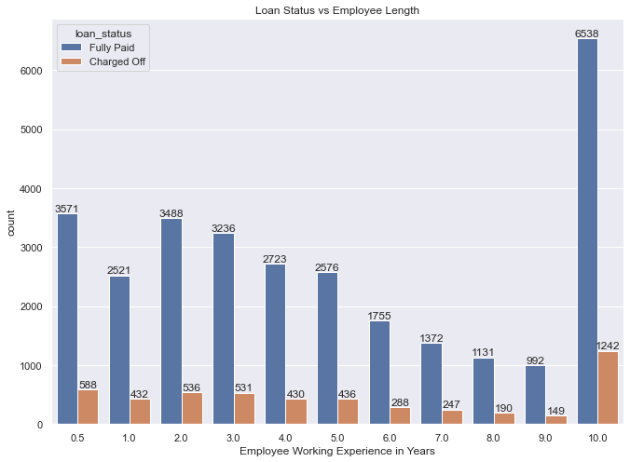
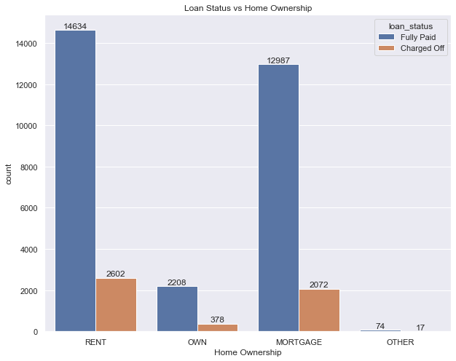
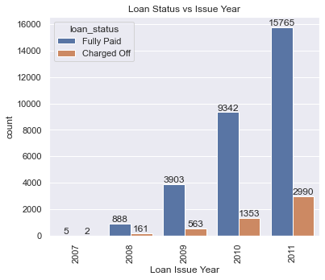
Bivariate & Multivariant Analysis Continued:-
Majority of employees applying for the loan have more than 10 years of experience,
Tendency of Applicant to default the loan with 10 years of experience is also high
Applicants having their home rented or on mortgage have almost equal tendency to default the loan
The loans granted has been increasing exponentially over the years,
2011 were having maximum defaulters as compared to other years.

Slide 15
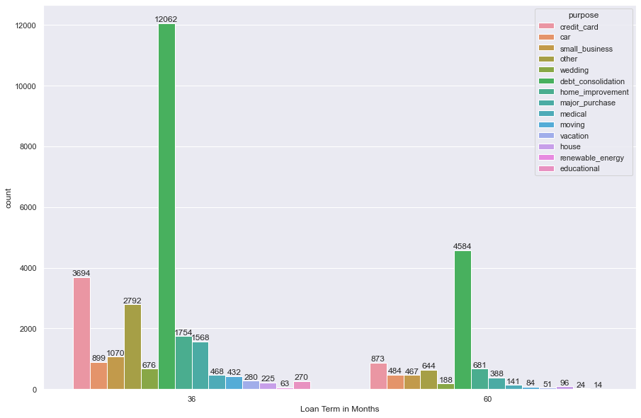
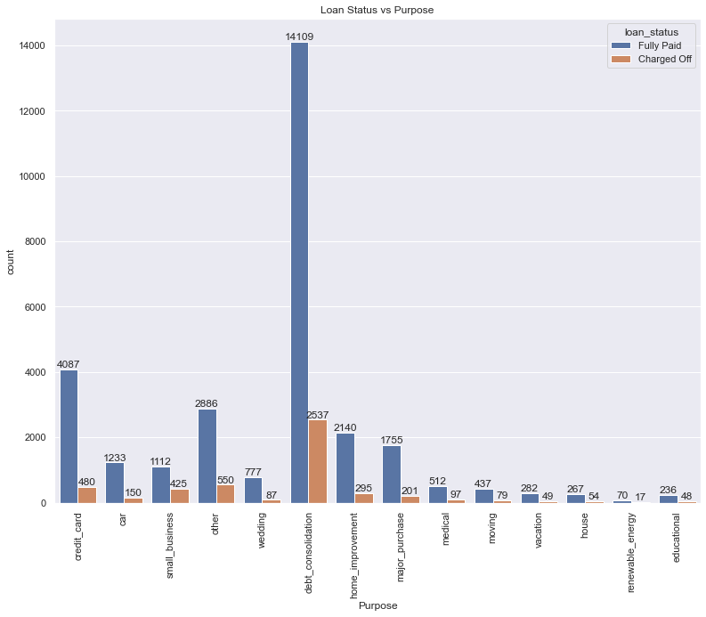
Bivariate & Multivariant Analysis Continued:-
Analysis confirm that chances of default is high when purpose is small business and the term is 36 months.
Also for 60 month term the default chance is high when purposes are debt consolidation, educational, house, other, small business and the vacation purposes
The ratio of defaulters is maximum for small scale business borrowers followed by renewable energy.

Slide 16
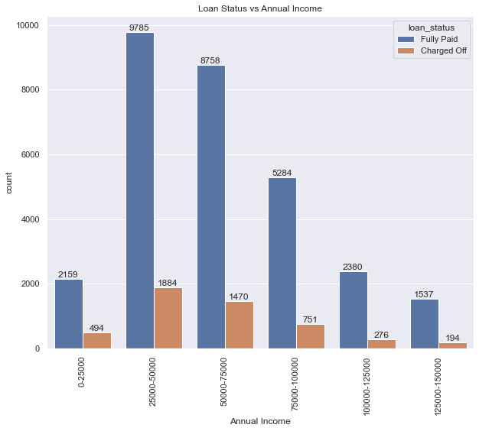
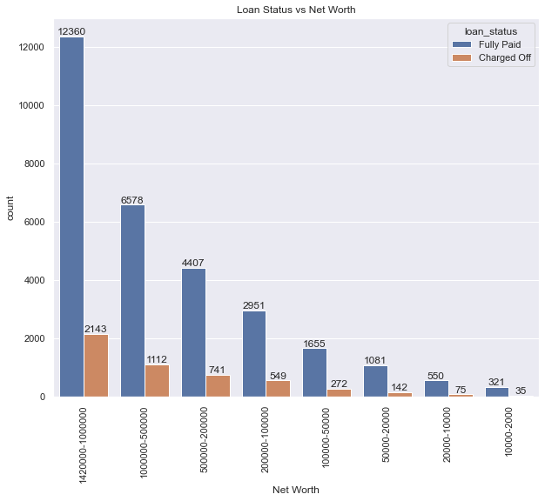
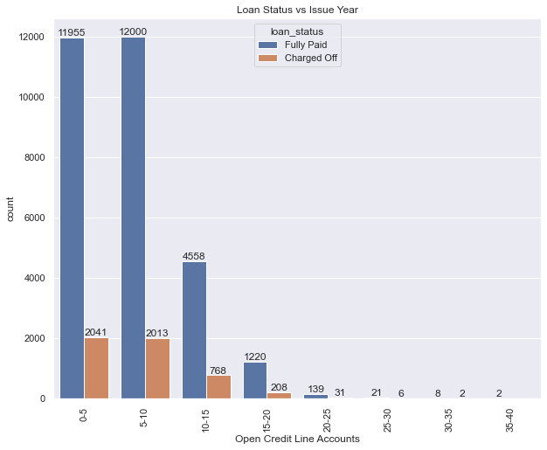
Bivariate & Multivariant Analysis Continued:-
Borrowers whose net worth is between 100000-200000 tend to more defaulters followed by highest net worth borrowers.
Default chances is inversely proportional to the annual income. High the income less chance of default
Borrowers having more credit line open accounts tends to be charged off more

Slide 17
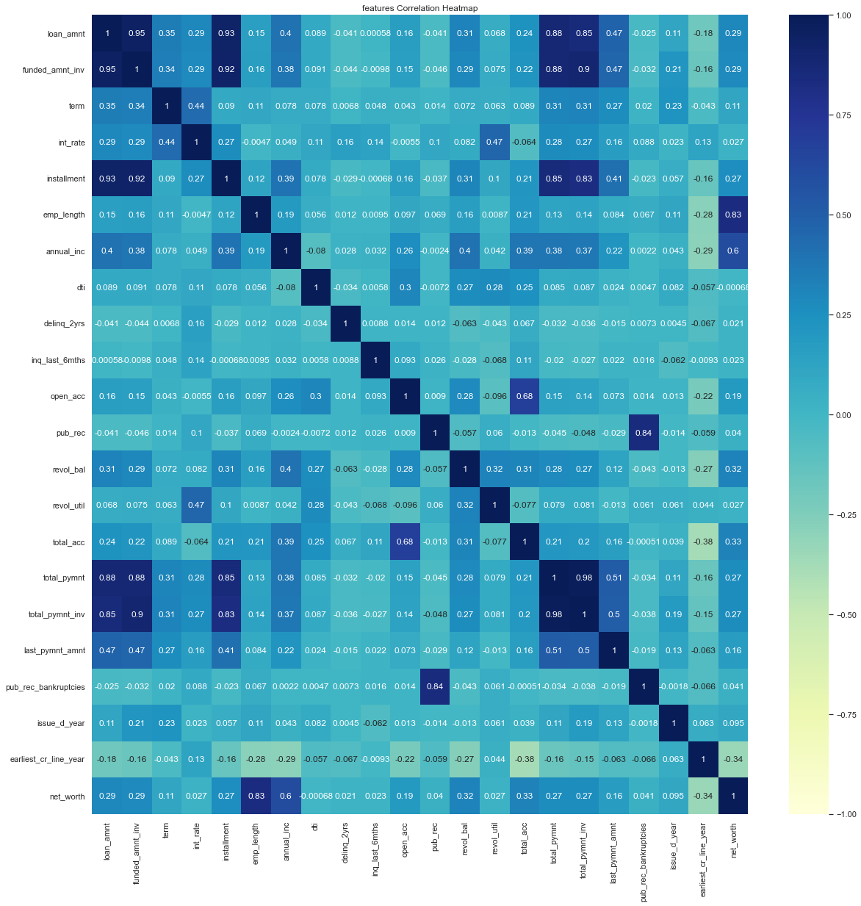
Features Correlation Heatmap:-
Employee working length is highly correlated with net worth.
Public derogatory records are highly correlated with public bankruptcies records.
Installments are highly correlated with loan amount.
Total payment to investors is highly correlated with funded amount y investors

Slide 18
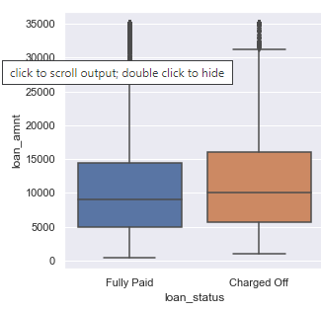
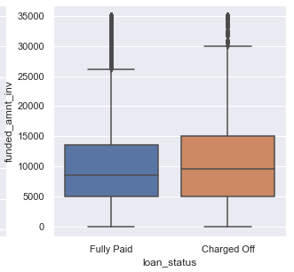
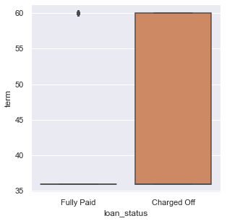
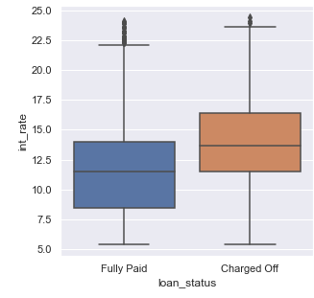
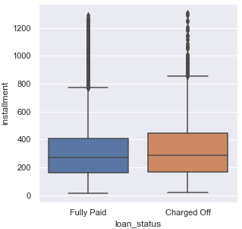
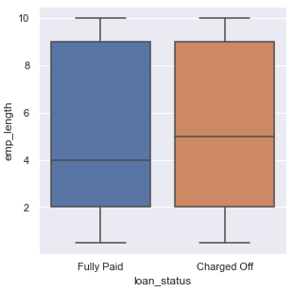
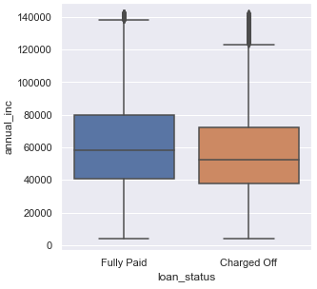
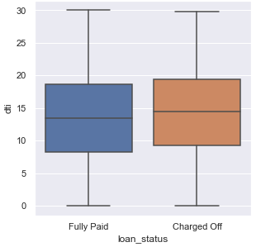
Sub plot for all numeric data

Slide 19
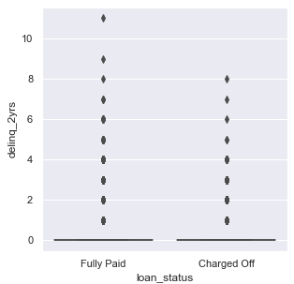
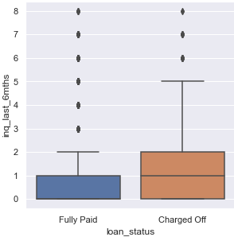
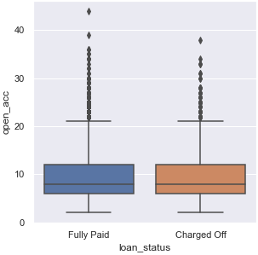
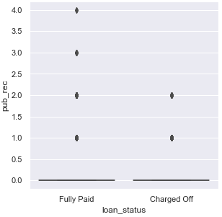
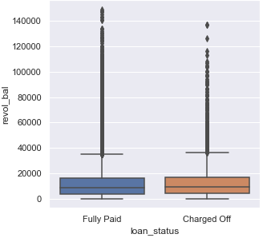
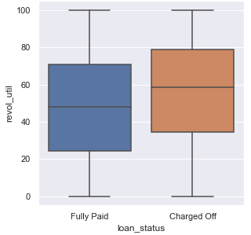

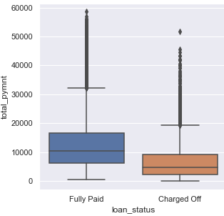
Sub plot for all numeric data

Slide 20
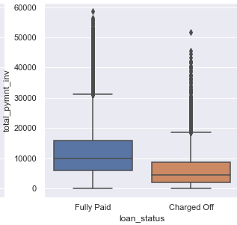
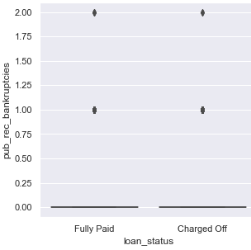
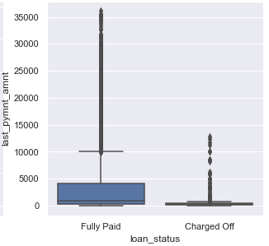
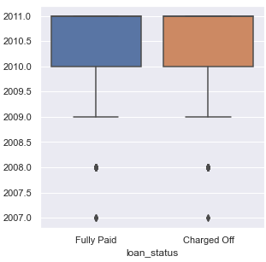
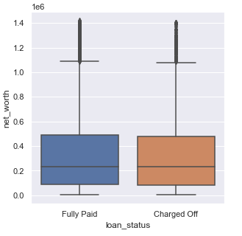
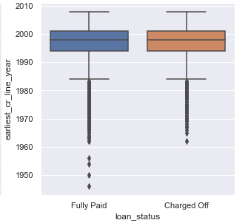
Sub plot for all numeric data

Slide 21
Conclusions
As per analysis below are the important conclusion:
Sl.no | Conclusion
1 | Though more number of loans are applied for 36 months, the ratio of charged off loan is more for 60 months.
2 | The chance of default is monotonically increasing with the interest rate i.e. the high the interest rate high the default rate chances. Interest rate is high for lower grades. So there is possibility of charged off for them, are getting charged off Lower grade loans more.
3 | The ratio of defaulters is maximum for small scale business borrowers; however, the numbers are high for debt consolidation
4 | Default chances is inversely proportional to the annual income. High the income less chance of default.
5 | Default chances is increasing with the increase in the debt-to-income ratio.
6 | Default chances is directly proportional to the loan amount. Also, chances of default is more when the home_ownership is "other“.
7 | From Analysis its confirm that chances of default is high when purpose is small_business and the term is 36 months. Also for 60 month term the default chances is high when purposes are debt_consolidation, educational, house, other, small business and the vacation purposes.
8 | Trend shows that default chances is 100% when the home_ownership status is other and the term is 60 months. Even when the term is 36 months, the default chances is the high when the home_ownership status is other. But there is only one entry (term = 60 months and home_ownership = other), and very less entries in the other home_ownership. So it is better to avoid the loans when the home_ownership is others.
9 | In general Educational loan, house, other and the small_business with very high interest rate, small business with medium and high interest rate and renewal energy and house with high interest rate are showing more chances of default .
10 | The high income group for all purpose is relatively safe to lend money. The small_business is showing high default chances in all income group except very high income group. Loan with purpose renewal_energy is showing high chance of default with very low, low and high income bracket.
11. | Loan with purpose car, credit card, home improvement, medical and wedding is showing less chances of default among various category and one of the safest purpose to lend. On the other hand loan with purpose small business, debt consolidation, renewal energy, educational, house and other is showing high chances of default.

Slide 22

..

