Slide 1
Comprehensive Time Series Analysis and Forecasting of the U.S. Unemployment Rate
Kajal Shukla
May 2023

Slide 2
Problem Statement
The U.S. unemployment rate is a critical economic indicator with far-reaching implications for policy-making, financial markets, and social welfare. This project focuses on conducting a comprehensive time series analysis of the U.S. unemployment rate, which entails studying the dataset's characteristics and developing an accurate forecasting model. The project explores historical data to uncover inherent patterns, trends, and seasonality within the unemployment rate. The primary objective is to compare the suitability of the Arima and Exponential Smoothing models for creating effective forecasting models to predict future unemployment rates.

Slide 3
Hypothesis
Null Hypothesis: The U.S. unemployment rate follows a stationary process and does not show any significant trend, seasonality, or other predictable patterns over time.
Alternative Hypothesis: The U.S. unemployment rate exhibits significant trend, seasonality, or other predictable patterns, indicating a non-stationary process that can be captured by time series forecasting models.
The objective of this analysis is to assess the evidence and determine if the data provides enough support to reject the null hypothesis. By identifying underlying patterns in the unemployment rate, we can develop reliable forecasting models that leverage these patterns for predicting future unemployment rates.

Slide 4
Data Properties
2
864
Distinct Variables
Date and Unemployment Rate
Data points of Unemployment rate
Jan 1950 to December 2021
FRED Economic Data | St. Louis FED
Data Source
Timeframe of the data

Slide 5
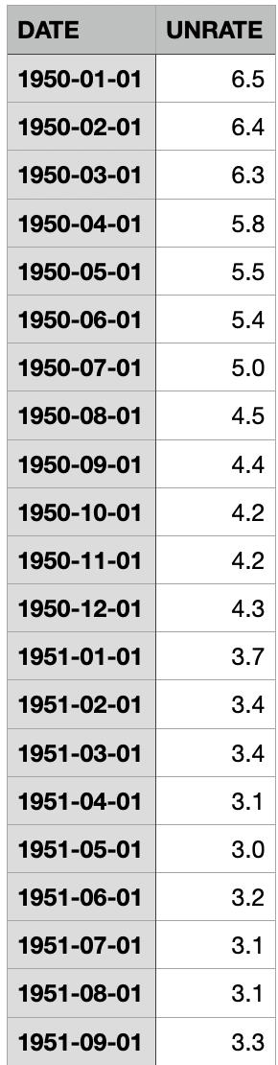
Data Processing
Loaded Unemployment Rate Dataset: Retrieved the unemployment rate dataset from FRED Economic Data | St. Louis FED, ensuring a reliable and authoritative data source.
Train Dataset: Extracted the training data from 1950 to 2021, covering a substantial historical period for analysis and modeling.
Test Dataset: Reserved a separate test dataset comprising the period from January 2022 to December 2022, allowing for unbiased evaluation of the forecasting models.
Column Renaming: Renamed the columns of the training dataset to enhance clarity and improve interpretability. The columns were renamed as "date" and "umempl_rate."
Date Formatting: Converted the "Date" column to the appropriate date format for time series analysis, ensuring consistency and compatibility with time-based operations.
Exploratory Data Analysis (EDA): Conducted basic EDA to gain initial insights into the data, such as data distribution, seasonal patterns, and potential outliers, facilitating a better understanding of the underlying characteristics.

Slide 6
Data Integrity Check: Verified the presence of null values in the dataset to ensure data integrity and completeness, enabling reliable analysis and modeling.
Time Series Conversion: Converted the original data into a time series format, enabling the application of specialized time series analysis techniques and forecasting models.
Stationarity Check: Assessed the stationarity of the time series data, examining characteristics like the trend, seasonality, and statistical properties to determine if further processing is required for accurate modeling.
Feature Engineering: Applied feature engineering techniques, including calculating a 6-month moving average and the STL decomposition method, to capture underlying patterns, reduce noise, and extract meaningful features for forecasting.
First-Order Differencing: Performed first-order differencing on the training and test datasets to make the data stationary, eliminating trends and improving model performance.
Forecasting Models: Utilized the ARIMA (AutoRegressive Integrated Moving Average) and Exponential Smoothing models to develop accurate and reliable forecasts of the unemployment rates, leveraging the processed data for improved insights and predictions.

Slide 7
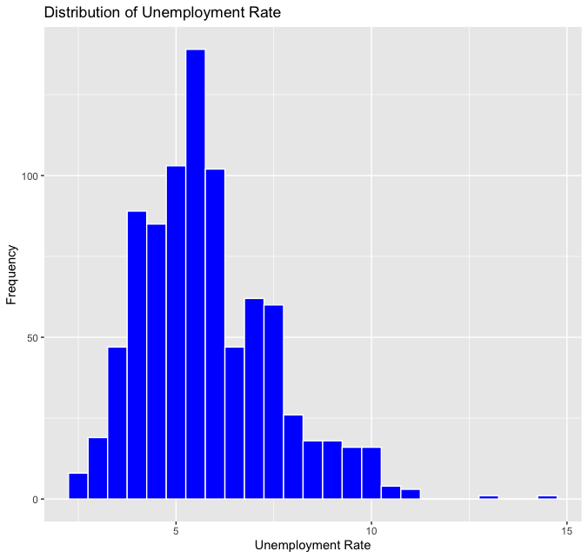
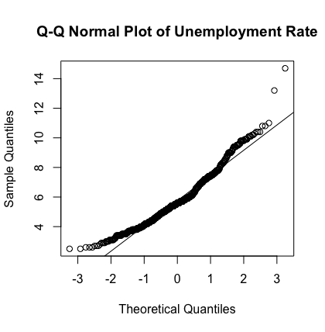
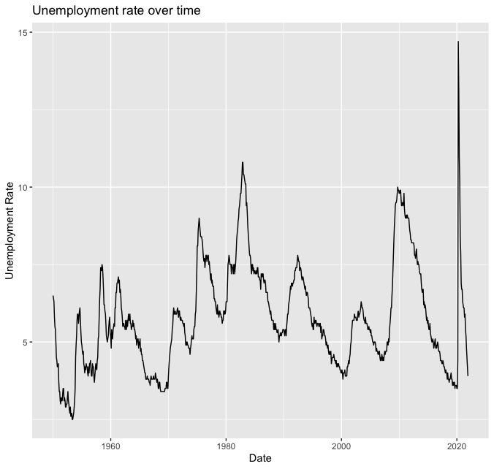
Exploratory Data Analysis
The line plot showcases the movement and trends of the unemployment rate over time, helping us identify economic downturns and recoveries.
The histogram displays the frequency of different unemployment rate ranges, providing insights into the concentration of rates and highlighting the outliers present at 12 or 13.
The deviation of the Q-Q plot from a straight line suggests that the dataset does not follow an independent and identically distributed (i.i.d.) normal distribution.

Slide 8
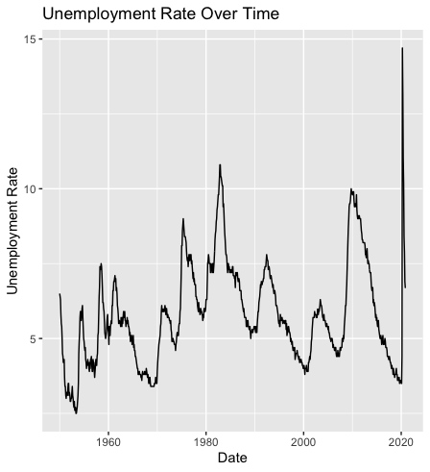
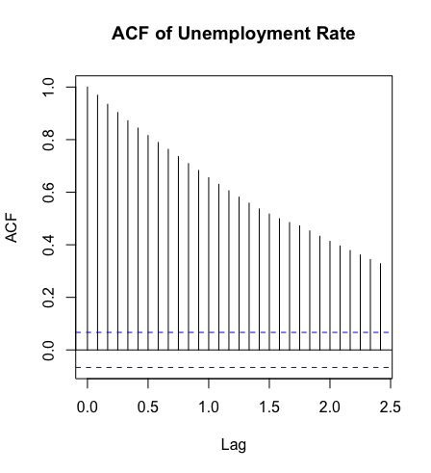
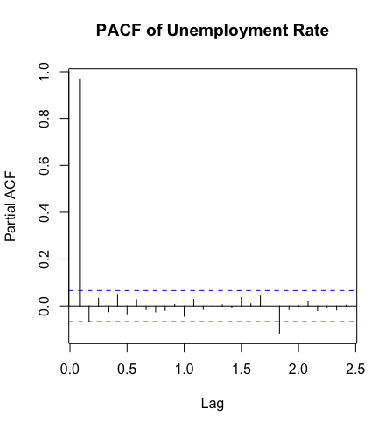
Exploratory Data Analysis - Qualitative
Time Series data of the Unemployment Rate
ACF of the Unemployment
Rate
PACF of the Unemployment
Rate

Slide 9
Exploratory Data Analysis - Analysis
The slow decay of the autocorrelation function (ACF) suggests that the data is not stationary, indicating the presence of underlying trends, seasonality, or other patterns. To gain more insights into these patterns, I employed the 6-month moving average and the Seasonal and Trend decomposition using Loess (STL) method.

Slide 10
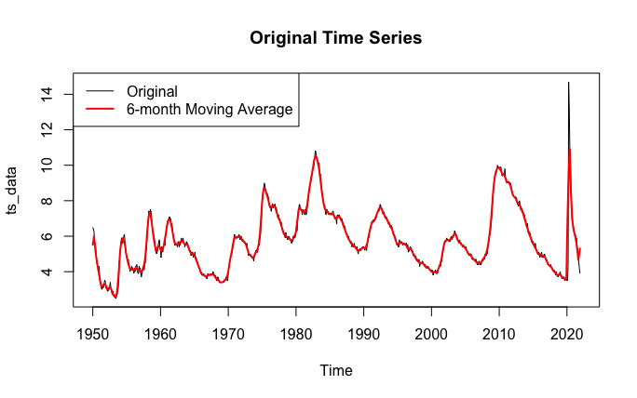
Feature Engineering: 6- Month Moving Average
Calculation of the 6-month moving average involves averaging the unemployment rate over a rolling window of 6 months using the stats::filter()
The purpose is to reduce noise and short-term fluctuations in the data.
It provides a smoothed representation of the unemployment rate, making it easier to identify long-term trends.
The moving average emphasizes the underlying patterns and movements in the unemployment rate.
It helps in identifying economic downturns or recoveries.
The smoothed series provides a clearer picture of the unemployment trend over time.

Slide 11
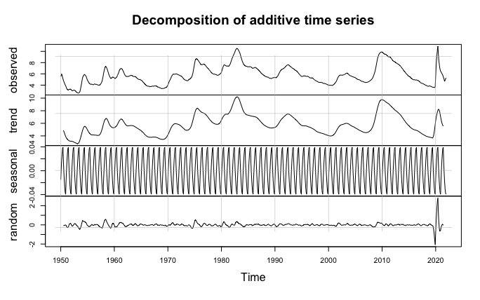
Seasonal and Trend decomposition using Loess (STL)
STL decomposition is applied to the moving average series obtained from the original data.
It separates the moving average series into three components: seasonal, trend, and random.
The seasonal component captures repetitive patterns or cycles in the unemployment rate.
The trend component represents the long-term upward or downward movement in the unemployment rate.
The random component represents the residual or irregular fluctuations in the unemployment rate.
Plotting the decomposition components helps visualize their contributions.
The STL decomposition on the moving average helps capture the different components of the unemployment rate and analyze their impact on the overall series. The random element, extracted from the decomposition, captures the underlying irregular variations in the unemployment rate.

Slide 12
Analysis of STL Decomposition
Based on the plot, the trend is at the peak during 2010. During periods of economic recession, it is common for unemployment rates to experience an increase. This was particularly evident in the case of 2010, which coincided with the aftermath of the global financial crisis that originated in 2008. The financial crisis profoundly impacted the global economy, leading to a widespread downturn characterized by layoffs, business closures, and a decline in economic activity. These factors contributed to higher unemployment rates as businesses struggled to maintain their workforce.
It is important to note that even after the worst phase of a recession, the economy's recovery can be gradual. While specific economic indicators may show signs of improvement, the labor market often takes longer to bounce back. This can result in sustained high unemployment rates even as other sectors of the economy begin to recover. The recovery of the labor market is influenced by various factors, including business confidence, investment levels, and consumer spending, which collectively contribute to creating new job opportunities and reducing unemployment rates.

Slide 13
The 6-month moving average helped smooth out the data fluctuations by computing the average of each observation and its surrounding six months. This approach allowed me to identify and visualize any long-term trends or patterns in the data.
Additionally, I utilized the STL method, which decomposes the time series into three components: trend, seasonal, and random (residual). The trend component captures the long-term behavior, the seasonal component captures repeating patterns, and the random component represents the irregular and unpredictable fluctuations. By applying the STL method, I aimed to separate these components and better understand the underlying patterns in the data.
By combining the 6-month moving average and the STL method, I could examine the trends and patterns more comprehensively, enabling me to make informed decisions regarding further data processing and modeling for accurate forecasting.

Slide 14
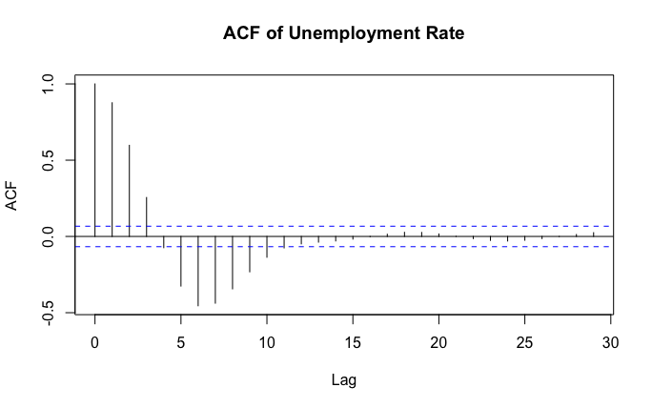
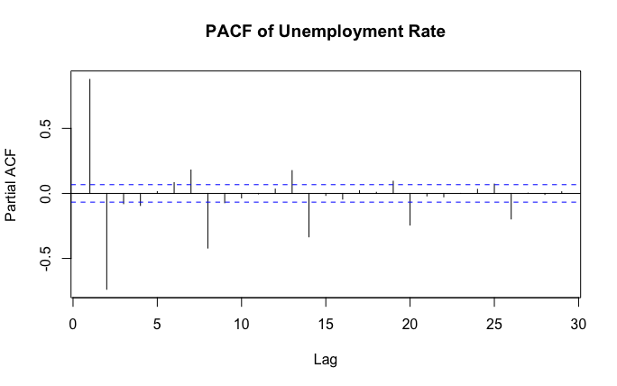
Assessment of Stationarity and Alternative Hypothesis
A correlation pattern in the ACF plot of the random component after performing the STL decomposition suggests that the series may not be stationary. This observation supports my alternative hypothesis that the U.S. unemployment rate exhibits significant trends, seasonality, or other predictable patterns, indicating a non-stationary process. However, in order to create forecasting models to anticipate future unemployment rates, the data must be made stationary.

Slide 15
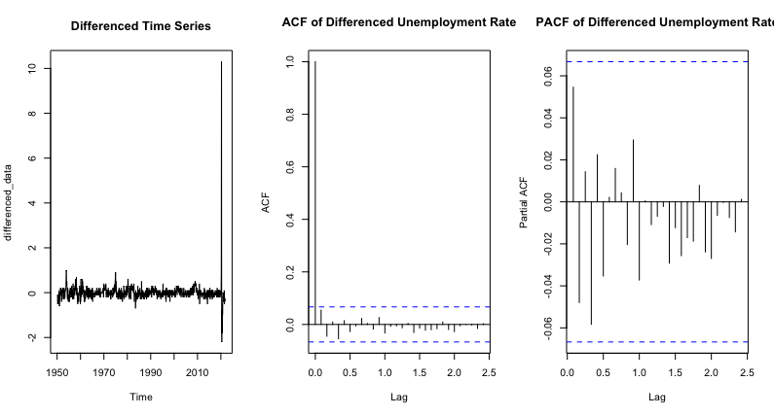
Transformation: First Order Differencing
First-order differencing was applied to the training data, eliminating autocorrelation in the ACF plot. This transformation successfully rendered the data stationary, indicating the removal of seasonality and trends. The absence of autocorrelation in the ACF plot confirms that the differenced data is suitable for further time series analysis and modeling.

Slide 16
First-order differencing on the Test Data
First-order differencing was performed not only on the training data but also on the test data. This step was crucial to maintain consistency between the train and test datasets when comparing and evaluating the forecasting models. By applying first-order differencing to the test data as well, we ensured that both datasets had the same level of differencing, allowing for a fair and accurate assessment of the model's performance on unseen future data.

Slide 17
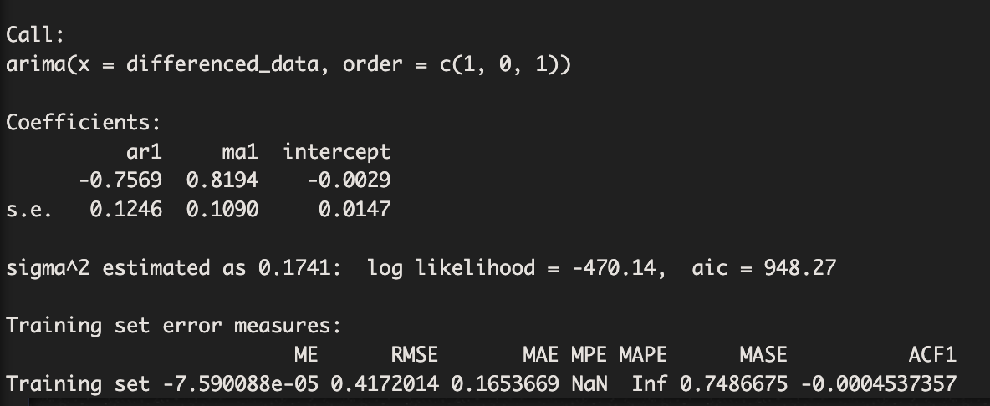
Models - arima()
The ARIMA (AutoRegressive Integrated Moving Average) model was employed for forecasting in this analysis. The optimal orders for the ARIMA model were determined using the auto.arima() function, which automatically selects the best orders based on the data. The selected ARIMA model had an order of (1, 0, 1), indicating the presence of autoregressive, differencing, and moving average components.
The arima() function was then used to fit the ARIMA model to the differenced data. The summary of the fitted ARIMA model provides essential information about the estimated coefficients, standard errors, and other statistical measures.
The forecast() function was applied to the ARIMA model to generate estimates for future periods. The resulting forecasted values were initially in the differenced scale, so the differenced values were transformed back to the original scale by adding the lagged values of the test data.

Slide 18
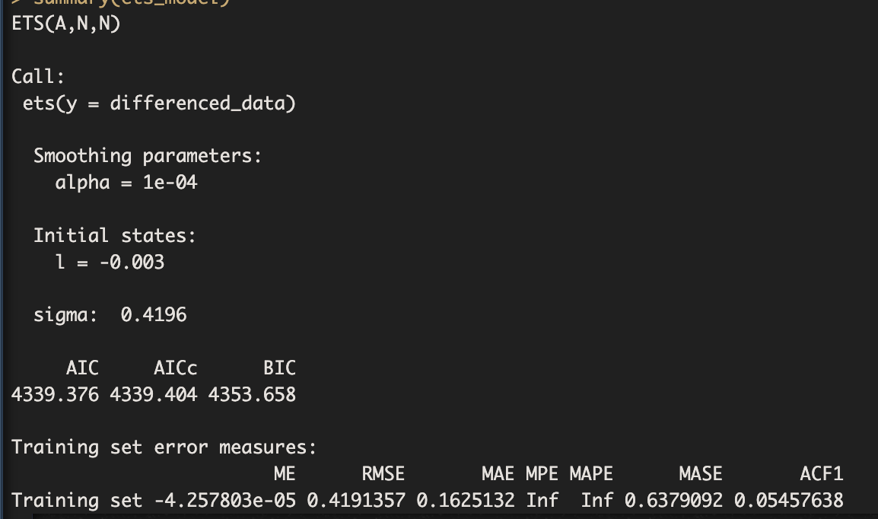
Models - ets()
The ETS (Error, Trend, Seasonality) model was utilized to forecast unemployment rates. The ETS model was fitted to the differenced training data using the ets() function. This function estimates the model parameters based on the provided data. The summary of the fitted model includes essential information such as the estimated parameters, goodness-of-fit measures, and other diagnostic statistics.
The forecast() function generates forecasted values for the length of the differenced test data. The resulting forecasted values represent the predicted changes in the unemployment rates.

Slide 19
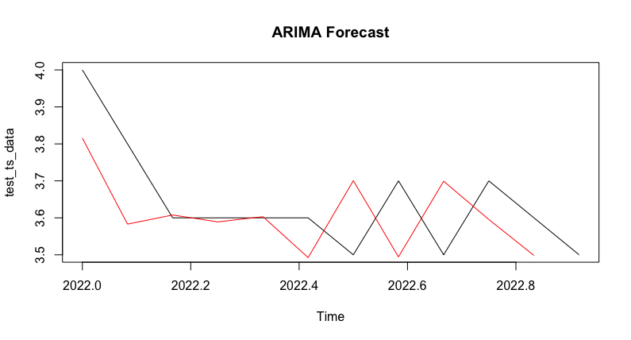
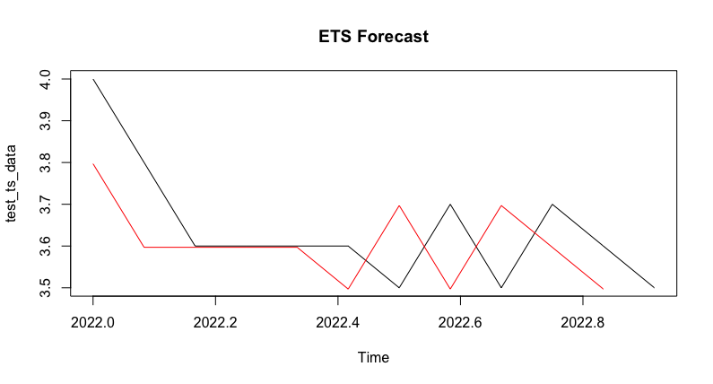
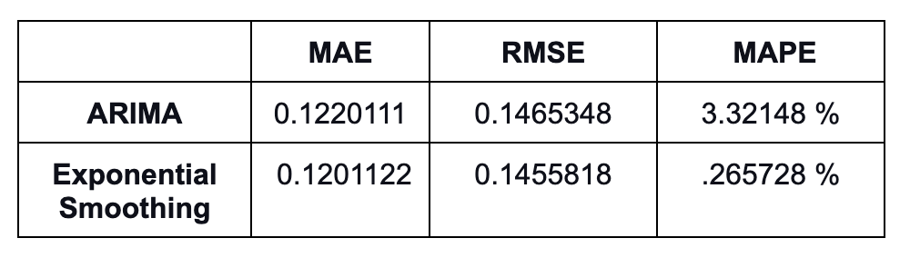
Results

Slide 20
Evaluation
The forecasting models were evaluated and compared against the actual values to assess their performance. The ARIMA and ETS models showed similar performance in forecasting the unemployment rate. The ARIMA model achieved a Mean Absolute Error (MAE) of 0.1220111, Root Mean Squared Error (RMSE) of 0.1465348, and Mean Absolute Percentage Error (MAPE) of 3.321480%. The ETS model, on the other hand, achieved a slightly lower MAE of 0.1201122, RMSE of 0.1455818, and MAPE of 3.265728%. Although the ETS model performed marginally better with slightly lower error metrics, the difference in performance between the two models is relatively small. Therefore, both models can be considered reasonable for predicting the unemployment rate.

Slide 21
Strategies for Improving Unemployment Rate Forecasting
Potential improvements can be made by exploring additional features that may influence the unemployment rate, such as demographic factors or policy changes, to enhance future forecasting of the unemployment rate. By incorporating these relevant features into the modeling process, it is possible to capture additional patterns and improve the accuracy of the forecasts. Furthermore, advanced models like neural networks (NN) or ensemble methods can be explored, accompanied by rigorous model selection and optimization processes. This approach ensures that the most suitable forecasting model is identified and utilized to improve the accuracy of future unemployment rate predictions.

Slide 22
THANK YOU!

