Slide 1
MOGADISHU CRIME ANALYTICS
Findings, Insights & Strategic Recommendations
Evidence-based review of 300 reported records
300
292
42%
37%
Raw records
Valid dated incidents
Closed cases
High severity
Prepared from the provided Excel workbook
Source: Uploaded crime dataset • Analysis prepared from the workbook provided
1

Slide 2
Data Quality & Preparation
Cleaning improved consistency, but one record remains incomplete for date/ID analysis.
RAW RECORDS
CLEANED RECORDS
VALID DATED RECORDS
RAW MISSING CELLS
300
8 duplicates
292
142
Rows supplied in the workbook
Used for time-trend analysis
Across the seven source fields
Cleaning actions
Important limitation
• Standardized category labels such as MALE / male and closed / Closed.
• Removed inconsistent capitalization before aggregation.
• Derived year and month fields for trend analysis.
• Flagged records requiring review rather than silently treating missing values as valid.
• One cleaned row has no Crime_ID and no Crime_Date, so it is excluded from date-based analysis.
• The workbook mixes 2025 and 2026 records; 2026 appears to be a partial year.
• These figures describe recorded incidents in the dataset—not necessarily total crime occurring in the city.
Source: Uploaded crime dataset • Analysis prepared from the workbook provided
3

Slide 3
Executive Summary
The dataset points to concentrated demand, property crime pressure, and a substantial case backlog.
HIGHEST DISTRICT
MOST FREQUENT CRIME
HIGH SEVERITY
CASE CLOSURE
Hodan
Theft
37%
42%
85 records • 29.0% of cleaned data
85 records • 29.0% of cleaned data
107 records classified as High
123 closed • 170 not closed
What the data says
Management implication
• Crime is geographically concentrated: Hodan and Wadajir account for nearly half of cleaned records.
• Theft is the leading offense, indicating a clear opportunity for property-crime prevention.
• High-severity incidents are a significant operational burden, especially in Hodan.
• Most cases are not yet closed, creating a strong need for investigative prioritization.
• Use hotspot-based patrol allocation rather than distributing resources evenly.
• Create a focused case-clearance workflow for Open and Under Investigation cases.
• Pair theft prevention with business/community security measures.
• Track monthly performance using a consistent dashboard and data-quality controls.
Source: Uploaded crime dataset • Analysis prepared from the workbook provided
2

Slide 4
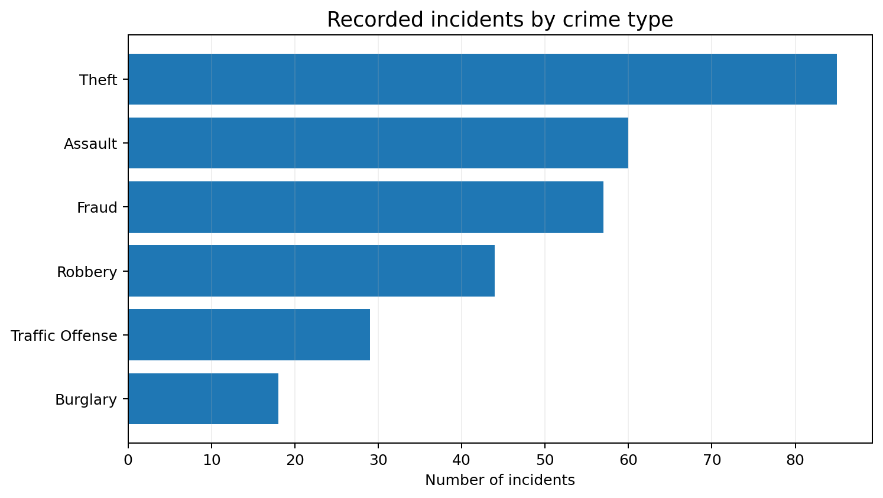
Crime Profile
Theft is the leading offense, followed by Assault and Fraud.
Key insight
• Theft leads with 85 incidents (29.0%).
• Assault (60) and Fraud (57) are the next largest categories.
• The pattern supports a dual strategy: property-crime prevention plus focused response to interpersonal violence.
Priority action
Strengthen theft prevention in high-volume areas while maintaining targeted capacity for assault and fraud investigations.
Source: Uploaded crime dataset • Analysis prepared from the workbook provided
4

Slide 5
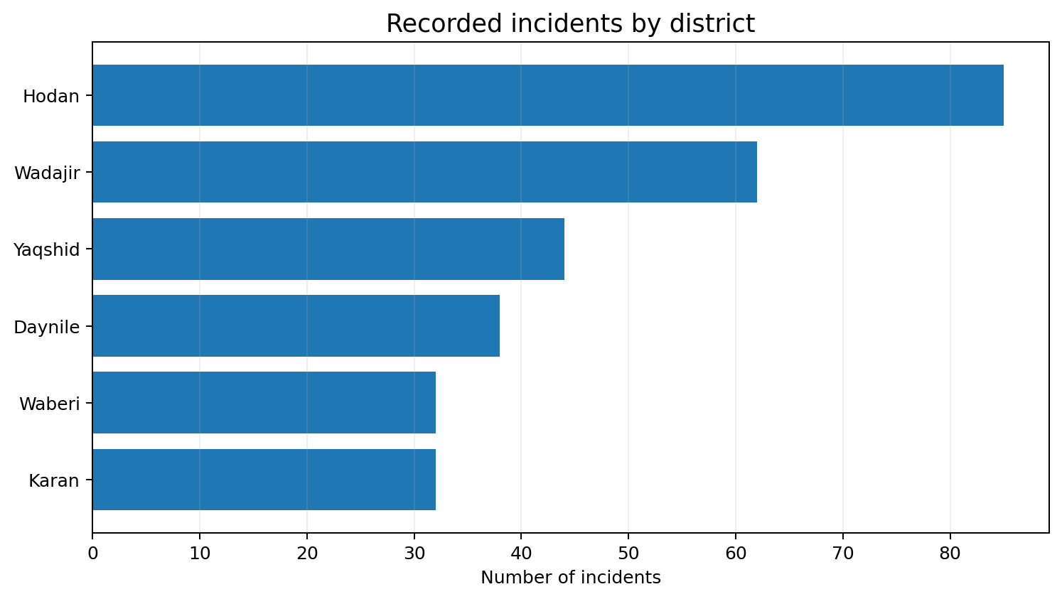
Geographic Concentration
Hodan and Wadajir carry the largest share of recorded incidents.
Hotspot interpretation
• Hodan: 85 incidents (29.0%).
• Wadajir: 62 incidents (21.2%).
• Together: 147 incidents (50.2%) of cleaned records.
• Resource deployment should be weighted toward high-volume districts, while retaining baseline coverage elsewhere.
Source: Uploaded crime dataset • Analysis prepared from the workbook provided
5

Slide 6
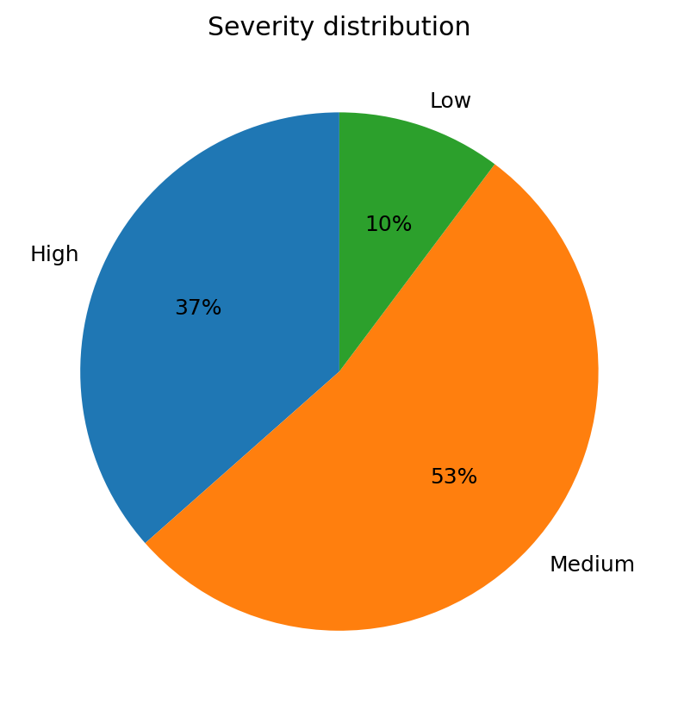
Severity & Operational Risk
High-severity cases require priority response and closer supervisory attention.
Where high severity is concentrated
Hodan
35
33%
Daynile
18
17%
Wadajir
18
17%
Karan
14
13%
Waberi
12
11%
Yaqshid
10
9%
Recommendation: triage High-severity cases first, with clear escalation rules and supervisor review.
Source: Uploaded crime dataset • Analysis prepared from the workbook provided
6

Slide 7
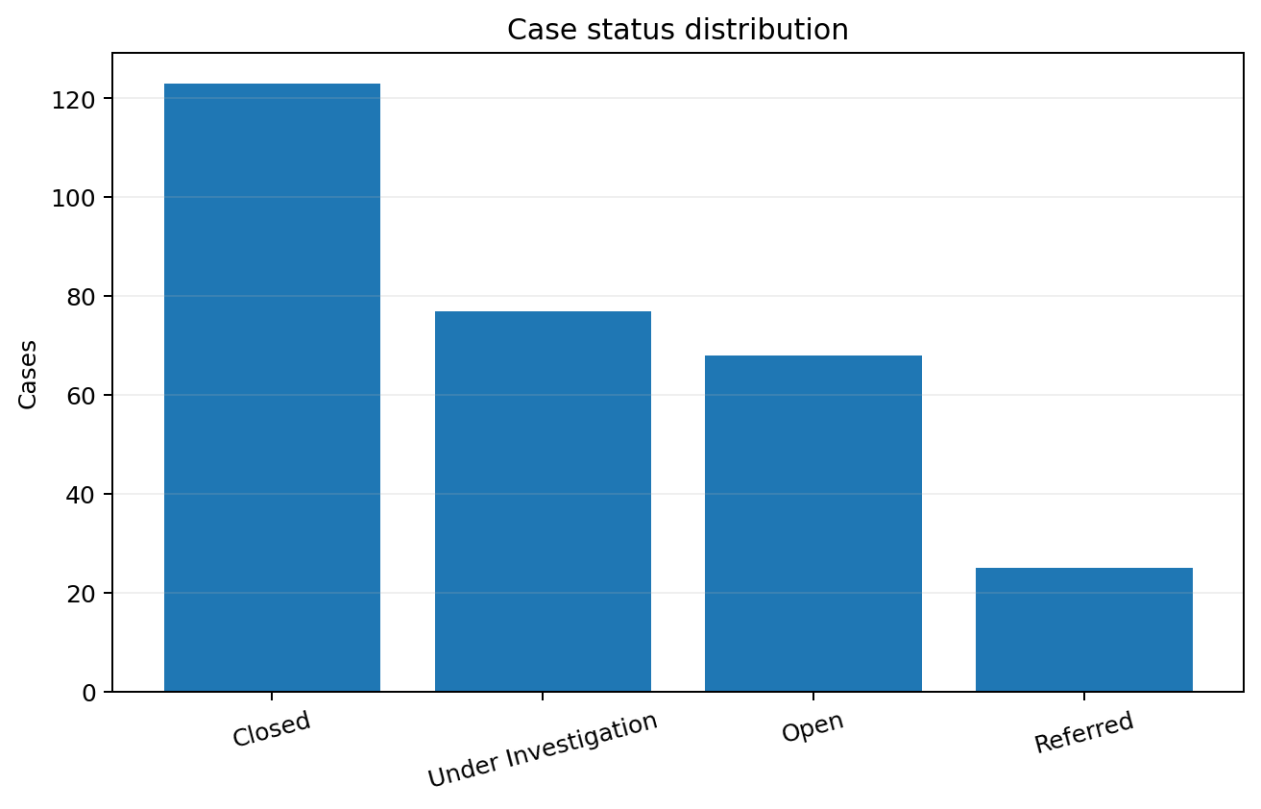
Case Status & Clearance
Closure is below half of the dataset, leaving a substantial active workload.
CLOSED
42%
123 cases closed
ACTIVE / NOT CLOSED
58%
170 cases remain Open, Under Investigation, or Referred
Management focus
• Build an aging list for Open and Under Investigation cases.
• Set weekly clearance targets by priority level.
Source: Uploaded crime dataset • Analysis prepared from the workbook provided
7

Slide 8
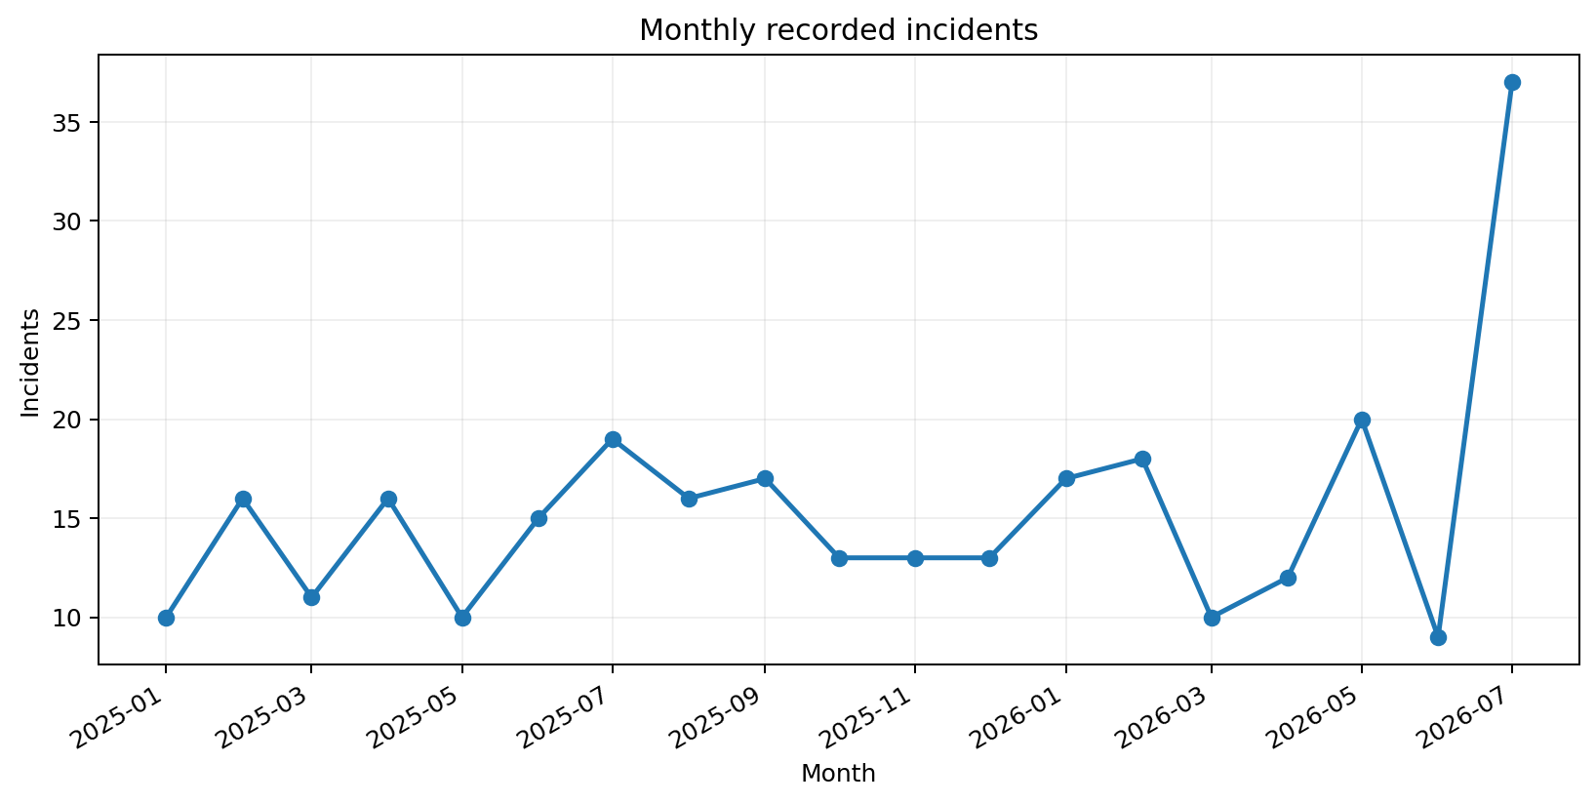
Time Pattern
Monthly reporting varies substantially; July 2026 is the highest month in the valid dated records.
Peak month
July 2026
37 recorded incidents
Caution
Monthly variation may reflect reporting volume as well as underlying crime. Use the trend for operational monitoring, not as a standalone estimate of true incidence.
Source: Uploaded crime dataset • Analysis prepared from the workbook provided
8

Slide 9
Key Findings
Five evidence-based conclusions from the cleaned and normalized dataset.
1
District concentration
2
Dominant crime category
Hodan is the largest hotspot (85 records), followed by Wadajir (62).
Theft is the most common offense (85 records; 29.0% of cleaned records).
3
High-severity burden
4
Clearance challenge
107 records (36.5%) are High severity, with Hodan carrying the largest high-severity count.
Only 123 of 293 cleaned records are closed (42.0%); 170 remain not closed.
5
Victim gender pattern
Male victims: 160 (54.6%); Female: 90 (30.7%); Unknown: 43 (14.7%).
Source: Uploaded crime dataset • Analysis prepared from the workbook provided
9

Slide 10
Strategic Recommendations
Translate the findings into targeted, measurable operational actions.
01
Target police resources
02
Accelerate case clearance
Prioritize patrols, checkpoints and visible deterrence in Hodan and Wadajir based on incident volume.
Create a dedicated workflow for Open and Under Investigation cases, with weekly aging reviews and escalation.
03
Prevent theft
04
Prioritize high severity
Expand community awareness, business security partnerships, CCTV coverage and property-marking initiatives in hotspots.
Use a triage matrix that gives High-severity incidents faster response, investigation and supervisory review.
05
Strengthen data governance
06
Monitor performance
Make Crime_ID, date, district, status and severity mandatory; standardize categories at entry.
Maintain a monthly dashboard covering volume, hotspots, severity, clearance and case aging.
Source: Uploaded crime dataset • Analysis prepared from the workbook provided
10

Slide 11
90-Day Implementation Roadmap
A practical sequence for moving from analysis to measurable action.
0–30 days
31–60 days
61–90 days
Stabilize
Target
Measure
• Standardize data-entry fields and mandatory values.
• Create a case-aging list and severity triage rules.
• Map Hodan and Wadajir incident hotspots.
• Reallocate patrol capacity using hotspot evidence.
• Launch theft-prevention engagement with businesses and communities.
• Begin weekly case-clearance reviews.
• Compare closure and response metrics against baseline.
• Review high-severity concentration and repeat hotspots.
• Publish a monthly management dashboard.
Success should be measured through fewer high-risk hotspots, faster case closure, stronger data completeness, and better prevention coverage.
Source: Uploaded crime dataset • Analysis prepared from the workbook provided
11

