Slide 1



Created By:
Python

Slide 2
SAR Group:
Contribution by team:-
->SHUBHAM KRISHNA YADAV(coder)
->ABHISHEK YADAV(tester)
->ROHIT YADAV(idea implementer )

Slide 3

->This project is based on QR Code .
->It has been made my using python language.
->It takes UPI Id as input and generate it as qr code.

Slide 4

Here's how it works:
Data Input: You enter the desired information into the generator.
Encoding: The generator converts the data into a specific pattern of black and white squares.
QR Code Generation: The generator creates a visual representation of the encoded data.
Download or Print: You can download the QR code as an image file or print it directly.

Slide 5
The following steps are the representation
of whole process :-
STEP 1.
In the first step the program asks the user to enter their upi id , as shown in the diagram-
STEP 2.
In the next step the user has entered the upi id , as shown in the diagram-

Slide 6
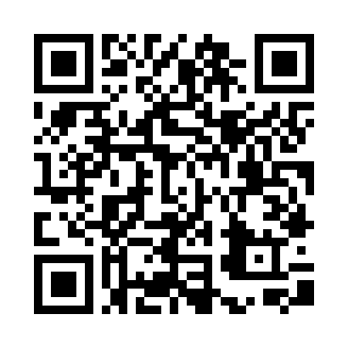
STEP 3.
As the user has entered their UPI id the QR code has been generated.

Slide 7

Future Scope:-
Enhanced Security and Privacy. Product Information and Marketing
Dynamic QR Codes with Real-Time Updates. Healthcare
Biometric Authentication with QR Codes Education
AI-Powered QR Code Generation and Analysis Product Information and Marketing Personalized Experiences

Slide 8
THANK YOU

