Slide 1

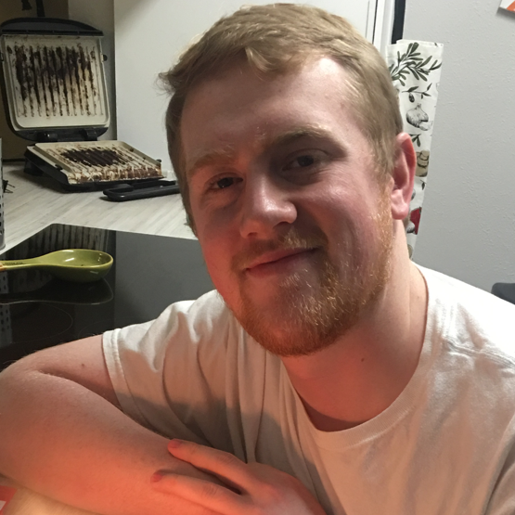






Sign In
Sam hulme
First time here? Say hi by entering a message below. I’m always curious to know who visits my site! After that, feel free to poke around and see what interesting things you can find. There is always new stuff being added!
Enter name or message here…
Say Hello
Resume
Projects
Social
Sam Hulme | (406) 750-8136 | shulme33@gmail.com
Samhulme.com

Slide 2
Sign In
Sam hulme
First time here? Say hi by entering a message below. I’m always curious to know who visits my site! After that, feel free to poke around and see what interesting things you can find. There is always new stuff being added!
Enter name or message here…
Say Hello
Resume
Projects
Social
Sam Hulme | (406) 750-8136 | shulme33@gmail.com
Samhulme.com

Slide 3
Sign In
Sam hulme
First time here? Say hi by entering a message below. I’m always curious to know visits my site! Then feel free to poke around and see what interesting things you can find. There is always new stuff being added!
Enter name or message here…
Say Hello
Resume
Projects
Social Networks
Take a look at my resume
Take a look at my resume
Take a look at my resume
Sam Hulme | (406) 750-8136 | shulme33@gmail.com
Samhulme.com

Slide 5
Color Scheme
#1F222A
#8F9294
#A5BCC3
#D9E0E2
#F4F3F3

