Slide 1

In the World of Hadoop

Slide 2
What is Hadoop ?
Hadoop is a software framework for distributed processing of large datasets
across large clusters of computers
Hadoop is open-source implementation for Google MapReduce and GFS
Hadoop is based on a simple programming model called MapReduce
Hadoop is based on a simple data model, any data will fit
Hadoop framework consists on two main layers
• Distributed file system (HDFS)
• Execution engine (MapReduce)

Slide 3
HDFS: An introduction
What is HDFS ?
Spread or distributed over multiple nodes
Redundancy of data
Why it is needed ?
Data reliability or fault tolerance
Higher throughput

Slide 4
HDFS
Data blocks of file system
Why data block are so large in HDFS
Benefits of the Block concept
File larger than the size of one disk can be saved
Simplicity of storage for file subsystem as blocks are of fixed size
Helps in data availability

Slide 5

HDFS architecture
Source : Apache Hadoop wiki

Slide 6
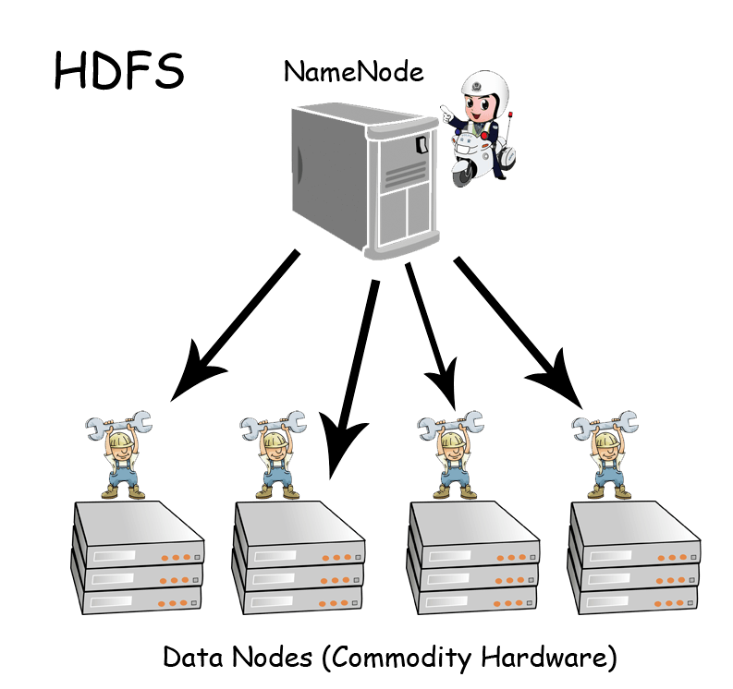
HDFS architecture
NameNode :
maintains the file system metadata
manages the file system namespace
This information is stored persistently on the local disk in the form of two files:
the namespace image and the edit log
DataNodes :
workhorses of the file system
store and retrieve blocks when
they are told to
report back to the nameNode
periodically with lists of blocks that they are storing

Slide 7
HDFS architecture
NameNode and DataNode are pieces of software
HDFS is built using the Java language
highly portable Java language ensures that HDFS can be deployed on a wide range of machines

Slide 8
NameNode Explained
The File System Namespace
Data Replication
It periodically receives a Heartbeat and a Block report from each of the DataNodes in the cluster
Cluster Rebalancing
Data Integrity by applying check sum on each block

Slide 9
Persistence of File System Metadata
It uses a EditLog to persistently record every change that occurs to file system metadata
It uses a file in its local host OS file system to store the EditLog
entire file system namespace, including the mapping of blocks to files and file system properties, is stored in a file called the FsImage
it keeps an image of the entire file system namespace and file Blockmap in memory
At the time of booting it reads the FsImage and EditLog from disk, applies all the transactions from the EditLog to the in-memory representation of the FsImage,
Then flushes out this new version into a new FsImage on disk. And discard old EditLog because its transactions have been applied to the persistent FsImage

Slide 10
HDFS Robustness
Type of failures
NameNode failures
DataNode failures
Network failure
NameNode Failure :
single point of failure
Can bring down entire system
If the NameNode machine fails, manual intervention is necessary

Slide 11
NameNode failure prevention
Hadoop provides two mechanisms for this
Backing up of FsImange and Editlog file on multiple machines or on a remote NFS
Run a secondary NameNode
Secondary NameNode, despite its name does not act as a NameNode
Its main role is to periodically merge the namespace image with the edit log to prevent the edit log from becoming too large
secondary NameNode usually runs on a separate physical machine
it requires plenty of CPU and as much memory as the NameNode to perform the merge
It keeps a copy of the merged namespace image, which can be used in the event of the NameNode failing

Slide 12
Accessing the HDFS
Way of accessing the HDFS
Command-Line Interface
HFDS can be accessed through File system shell, it includes various shell-like commands that directly interact with the (HDFS)
The Java Interface
It exposes a JAVA API to access the HDFS programmatically. It provides classes and methods for reading and writing data.

Slide 13
Command line Interface
hadoop fs -cat URI [URI …]
hadoop fs -cat hdfs://nn1.example.com/file1 hdfs://nn2.example.com/file2
hadoop fs -copyFromLocal <localsrc> URI
hadoop fs -copyToLocal URI <localdst>
hadoop fs -cp URI [URI …] <dest>
hadoop fs -get <src> <localdst>

Slide 14
Command line Interface
hadoop fs -put <localdst> <src>
hadoop fs -getmerge <src> <localdst>
hadoop fs -ls <args>
hadoop fs -ls /user/hadoop/file1
hadoop fs -mkdir <paths>
hadoop fs -mv URI [URI …] <dest>
hadoop fs -rm [-skipTrash] URI [URI …]
hadoop fs -rmr [-skipTrash] URI [URI …]
hadoop fs -tail [-f] URI
hadoop fs -text <src>
hadoop fs -touchz URI [URI …]

Slide 15
HDFS: continued…
It is meant for
It is not meant for
Very large files
Streaming data access
Commodity hardware
Low-latency data access
Lots of small files
Multiple writers, arbitrary file modifications

