Slide 1

Apache Spark™
Lightning-fast cluster computing

Slide 2
What is Spark ?
Spark is an open source big data processing framework
It is Hadoop-compatible, fast and expressive cluster-computing platform
Spark does not use MapReduce as an execution engine(EE), But It is an EE in itself
Spark is in-memory computation engin
It was originally developed in 2009 in UC Berkeley’s AMPLab, and open sourced in 2010 as an Apache project.

Slide 3
Why Spark ?
unified framework to manage big data processing (text data, graph data etc)
Much faster than MapReduce
General purpose data processing engine. It supports SQL queries, Streaming data, Machine learning (ML), and Graph algorithms
Multi-lingual support
It comes with a built-in set of over 80 high-level operators.

Slide 4
Any kind of Big data analysis
Batch Processing
Interactive Data processing
Stream data processing

Slide 5
Spark components

Slide 6
Spark Core
Spark Core contains the basic functionality of Spark like task scheduling, memory management, fault recovery, interacting with storage systems
Spark Core is also home to the API that defines resilient distributed datasets
RDDs represent a collection of items distributed across many compute nodes that can be manipulated in parallel
Spark Core provides many APIs for building and manipulating these collections.

Slide 7
Spark SQL
Spark SQL is Spark’s package for working with structured data
It allows querying data via SQL as well as the HQL
it supports many sources of data, including Hive tables, Parquet, and JSON
SQL queries with the programmatic data manipulations supported by RDDs in Python, Java, and Scala
Spark SQL was added to Spark in version 1.0

Slide 8
Spark Streaming
It enables processing of live streams of data. Examples of data streams include logfiles generated by production web servers, or queues of messages
Streaming API for manipulating data streams closely matches RDD API
It provides same degree of fault tolerance, throughput, and scalability as Spark Core

Slide 9
MLlib
Spark comes with a library containing common machine learning (ML) functionality
MLlib provides multiple types of machine learning algorithms
Like classification, regression, clustering, and collaborative filtering, as well as supporting functionality such as model evaluation
It also provides some lower-level ML primitives, including a generic gradient descent optimization algorithm

Slide 10
GraphX
GraphX is a library for manipulating graphs (e.g., a social network’s friend graph)
GraphX extends the Spark RDD API
GraphX also provides various operators for manipulating graphs
library of common graph algorithms (e.g., PageRank and triangle counting)

Slide 11
Spark Vs Hadoop
MapReduce is a great solution for one-pass computations

Slide 12
Spark Architecture
Spark Architecture includes following three main components:
Data Storage
API
Management Framework
The API provides the application developers to create Spark based applications using a standard API interface. Spark provides API for Scala, Java, and Python programming

Slide 13
Resilient Distributed Datasets
RDD is the core concept in Spark framework
RDD can be visualized as a table in a database but It can hold any type of data
Spark stores data in RDD on different partitions
RDDs are used for rearranging the computations and optimizing the data processing
These are fault tolerent because an RDD know how to recreate and recompute the datasets.
RDDs are immutable.

Slide 14
Operation on RDD
Transformation : Transformation don't return a single value, they return a new RDD. Nothing gets evaluated when you call a Transformation function, it just takes an RDD and return a new RDD.
e.g map, filter, flatMap, groupByKey,
Action: Action operation evaluates and returns a new value. When an Action function is called on a RDD object, all the data processing queries are computed at that time and the result value is returned.
e.g. collect, count, first, take

Slide 15
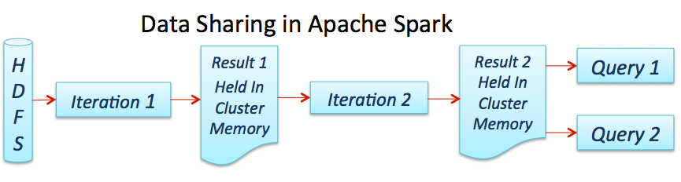
Working of Spark

Slide 16
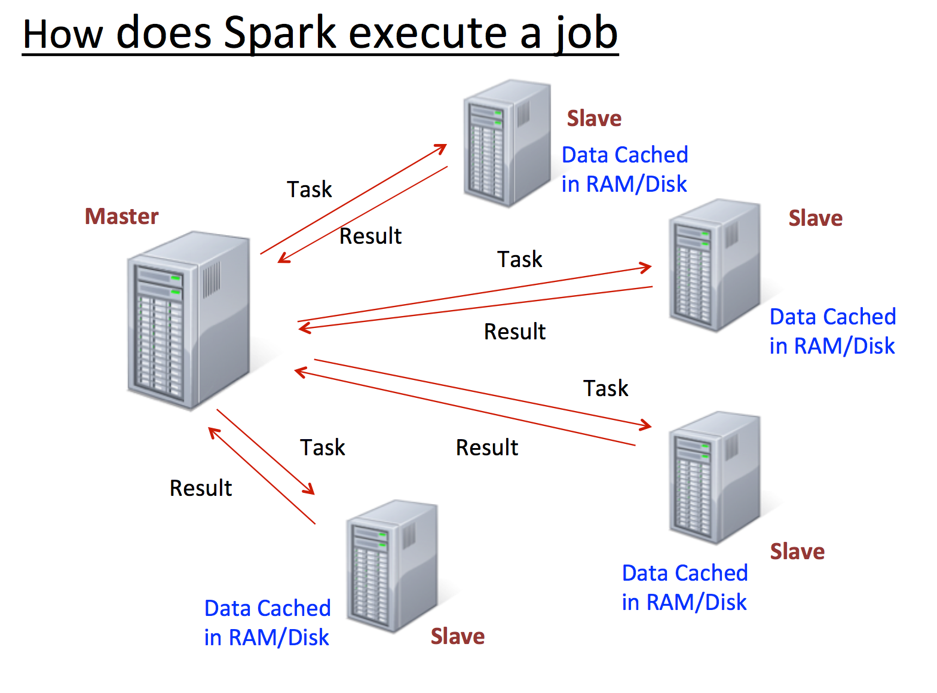
Spark Job Flow

