Slide 1
JSON

Slide 2
Introduction To JSON
JSON → Java Script Object Notation
When exchanging data between a browser and a server, the data can only be text.
JSON is text, and we can convert any JavaScript object into JSON, and send JSON to the server.
We can also convert any JSON received from the server into JavaScript objects.
This way we can work with the data as JavaScript objects, with no complicated parsing and translations.
JSON is lightweight , text based and open standard data interchange format.
Uses Of JSON:
For Serializing data to be sent over a network.
For facilitating communication between incompatible platforms
For developing JavaScript based applications
For sending public data through Web services and Application Programming Interfaces (APIs)
For fetching data without hard coding in HTML

Slide 3
Features Of JSON:
Standard Structure
Simplicity
Open source
Self describing
Light weight
Scalable/Reusable
Clean Data
Efficiency
Interoperability
Extensibility
Internationalization
Advantages of JSON:
Quick Serialization
Efficient Coding
Faster parsing than XML
Simple to work with other Languages.
Easy differentiated between data types.

Slide 4
JSON AND XMl:
Similarities Between JSON and XML
Both JSON and XML are "self describing" (human readable)
Both JSON and XML are hierarchical (values within values)
Both JSON and XML can be parsed and used by lots of programming languages
Both JSON and XML can be fetched with an XMLHttpRequest
Dissimilarities Between JSON and XML
JSON doesn't use end tag
JSON is shorter
JSON is quicker to read and write
JSON can use arrays
The biggest difference is:
XML has to be parsed with an XML parser. JSON can be parsed by a standard JavaScript function.
Why JSON is Better Than XML
XML is much more difficult to parse than JSON.
JSON is parsed into a ready-to-use JavaScript object

Slide 5
Data Types:
In JSON, values must be one of the following data types:
JSON Strings
{ "name":"John" }
JSON Numbers
{ "age":30 }
JSON Objects
"employee":{ "name":"John", "age":30, "city":"New York" }
JSON Arrays(can be of different types)
"employees":[ "John", "Anna", "Peter" ]
JSON Booleans
{ "sale":true }
JSON null
{ "middlename":null }

Slide 6
From JavaScript Literals to JSON:
JSON has stricter rules:
Object member name to be a valid JSON string in. quotation marks
A member value or an array element in JSON to be confined to a restricted set.
JSON does not support date time literals.
Syntax
var myObj = { "name":"John", "age":31, "city":"New York" };
RULES
Arrays → Always in square brackets
Objects → Always in curly braces
Always in name → value pairs separated by commas, and value delimited by colon
.

Slide 7
JSON versus XML Coding
<employees> <employee> <firstName>John</firstName> <lastName>Doe</lastName> </employee> <employee> <firstName>Anna</firstName> <lastName>Smith</lastName> </employee> <employee> <firstName>Peter</firstName> <lastName>Jones</lastName> </employee> </employees>
{"employees":[ { "firstName":"John", "lastName":"Doe" }, { "firstName":"Anna", "lastName":"Smith" }, { "firstName":"Peter", "lastName":"Jones" } ]}

Slide 8
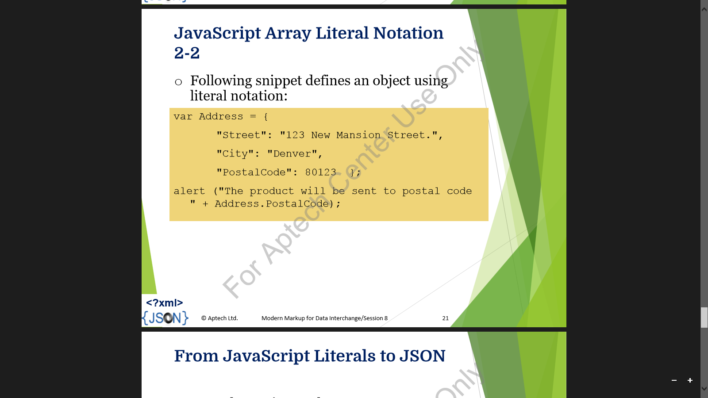
aRRAY
Literal Notations in JavaScript:
Expresses Fixed values literally.
Is a floating point number, string ,integer, Boolean , array or object.
Contains zero or more expressions in a sequence in an array literal.
Contains a list of members in an object literal.
Following code defines an array using literal notations ;
var fruits=[“Pineapple” ,”Orange”, “Melon”, “Kiwi”, “Guava”];
alert(fruits[4] +” is one of the “ + fruit.length +”fruits.”);

Slide 9
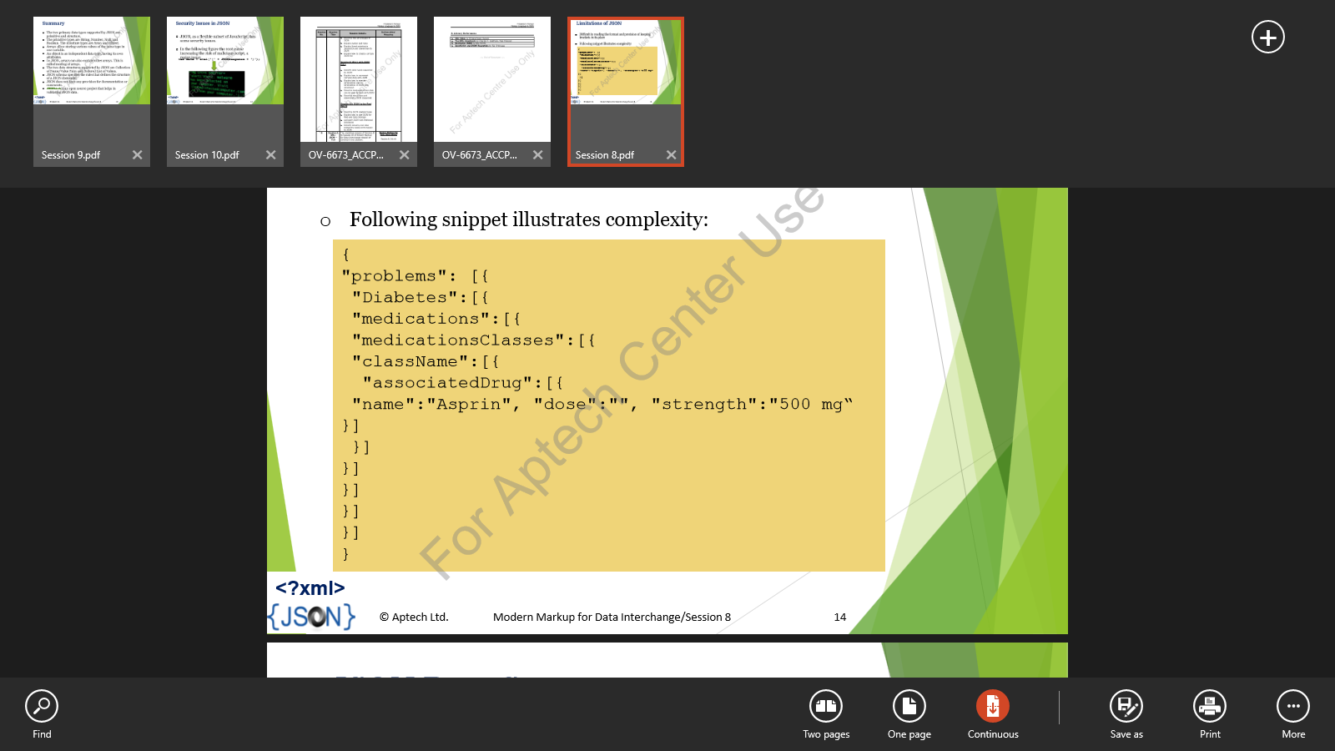
Limitations with JSON:
Difficult in reading the format and precision of keeping brackets in its place.
Following snippet illustrates complexity:
The JSON.stringify() method allows converting a JavaScript object into a JSON String.
The JSON.parse() method allows parsing object using JavaScript

