Slide 1
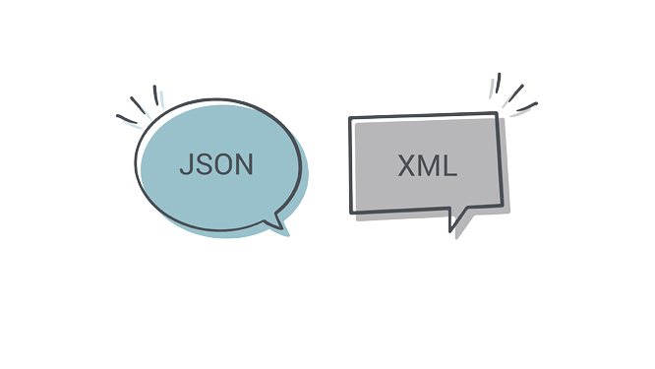
XML Extensible Markup Language

Slide 2
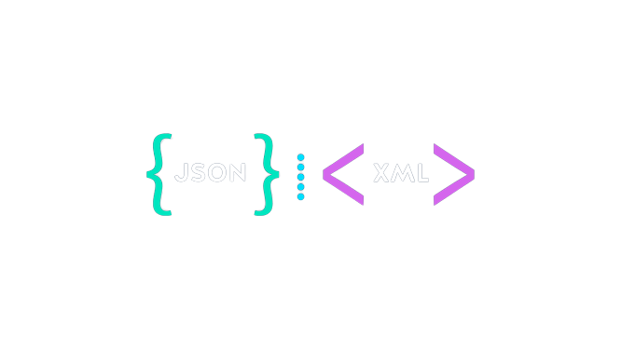
What is XML, and What Does it Do?
XML is not a programming language with specific tasks. Instead, it offers a faster framework for addressing various needs. Some languages that support the framework structure are XHTML, XSLT, and SOAP(Simple Object Access Protocol).
XML follows a set of rules that computers can easily understand and process. It aims to be simple and user-friendly on the Internet. It can handle any language since it relies on textual characters for its structure.
People created XML to make it easier to share information electronically. Over time, it became widely used for web-based information exchange, aligning with the increasing needs of users.

Slide 3
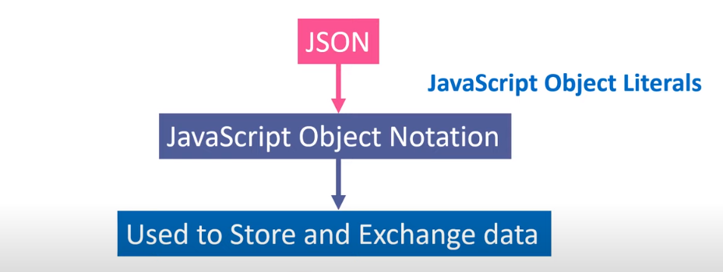
What is Json?

Slide 4
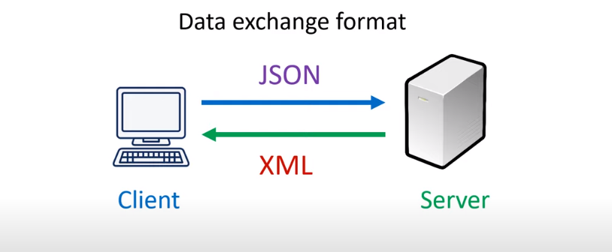
When to use Json?

Slide 5
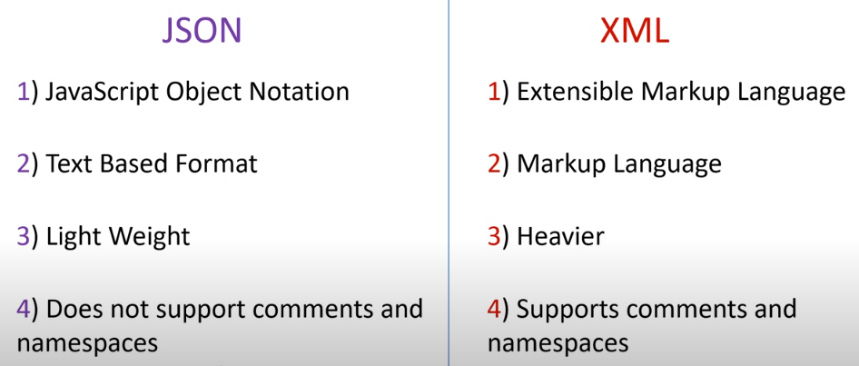
Deference between JSON & XML ?

Slide 6
Why we use XML & JSON ?
Both XML and JSON can be used for developing APIs, but JSON has become more prevalent and popular due to its lightweight nature and ease of use in web-based APIs. However, the choice between XML and JSON for API development depends on various factors:
Historical Context: XML was more commonly used in the past for APIs due to its structured nature and support for complex data types. Many older APIs still use XML.
JSON's Rise in Popularity: JSON has gained popularity in recent years, especially in web development and modern APIs, due to its simplicity, lightweight structure, and easy integration with JavaScript. Many new APIs, particularly those related to web services and RESTful APIs, often use JSON due to its ease of parsing and human readability.
In essence, while both XML and JSON can be used for API development, the choice typically leans towards JSON due to its simplicity, ease of use, and its alignment with web-based technologies and practices.

Slide 7
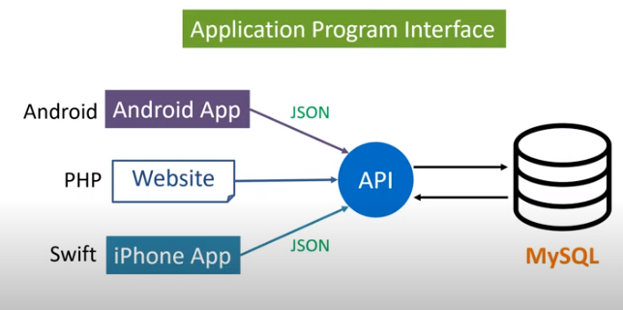
What is APIs (Application Programming Interfaces)?

Slide 8
XML eXtensible Markup Language
A markup language is a computer language that uses tags to define elements within a document.
It is called extensible because it has customized tags
Difference between HTML AND XML
HTML | XML
To structure or design a webpage | To exchange data or structure data
Uses predefined tags. | Uses user defined tags, does not have predefined tags.
Not Case Sensitive | Case Sensitive
No Concept of error generation | Well formed else error
Not Strict language | Strict language
Extension 🡪html . | Extension🡪.xml

Slide 9
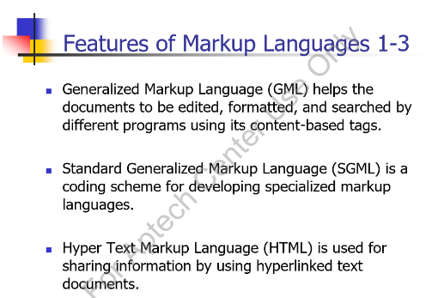
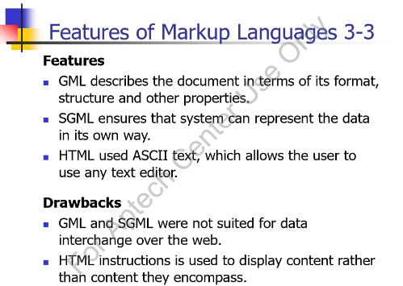

Slide 10
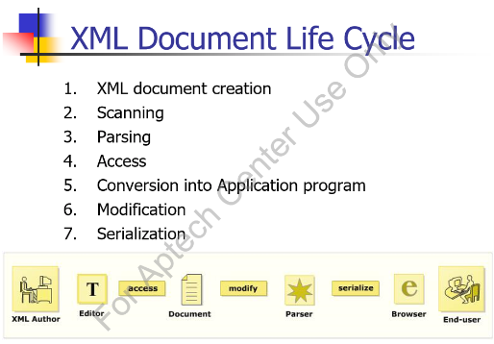
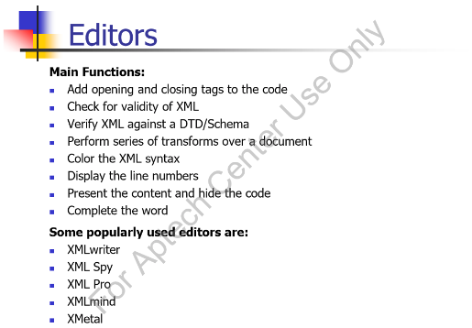

Slide 11
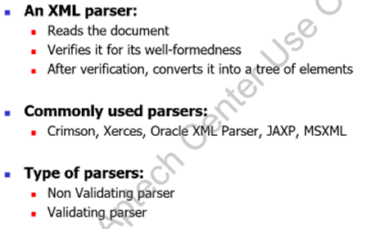
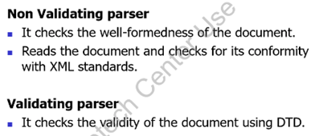
Easy data exchange
One of the great things about XML is that it can allow easy sharing of data between different applications - even if these applications are written in different languages and reside on different platforms.
Self-describing data
Provide an easy to use and standardized way to store self-describing data (self-describing data is data that describes both its content and its structure).

Slide 12
Syntax
XML Declaration
XML declaration statement is the first line of every XML document.
It simply states what version of XML you are using and the type of encoding you are using
Basic Structure
<root> <child> <subchild>.....</subchild> </child> </root>
Comments in XML
<!– this is comment section-->
<?xml version="1.0" encoding=“UTF-8"?>

Slide 13
Key Points
The XML specification was created by the World Wide Web Consortium (W3C), the body that sets standards for the web.
XML is a software- and hardware-independent tool for carrying information.
XML DTD or XML Schemas are used to define the XML document structure
XML Elements Must be Properly Nested
XML Documents Must Have a Root Element(only one)
XML Attribute Values Must be Quoted
All Elements Must have an Opening and Closing Tag
Well-formed of XML Document
Well-formed-ness refers to the standards that are to be followed by the XML documents. Well-formedness makes XML processors and browsers read XML documents. A document is well- formed, if it fulfills the following rules
XML tags should be valid
Tags can begin with letter, an underscore or a colon.
Tags can contain combination of letters, numbers, periods, colons, underscores, or hyphens.
Tags should not contain whitespace.
Tags should not start with reserved words like xml.

Slide 14
Key Terminologies
(Unicode) Character
An XML document is a string of characters. Almost every legal Unicode character may appear in an XML document.
Processor and Application
The processor analyzes the markup and passes structured information to an application. (parsing)
Markup and Content
All strings which constitute markup either begin with the character
< and end with a >. Strings of characters which are not markup are content.
Tag
A markup construct that begins with < and ends with >.
Element
A logical document component either begins with a start-tag and ends with a matching end-tag or consists only of an empty-element tag.
Attributes
Provide information that is not a part of the data.
<name Id= “123”> Shahzaib </name>

Slide 15
Attribute
Attributes provide extra information about elements.
Attributes are always placed inside the opening tag of an element.
<name id=“123" > hamza </name>
Avoid Xml Attributes
Attributes cannot contain multiple values (element can)
Attribute cannot contain tree structure.
Attributes are not easily expandable.
<Address City = “Khi” Street = “2A” />
Use Child Elements instead.
<Address>
<City></City>
<Street></Street>
</Address>

Slide 16
Entities
Sort of short code for a particular word that is to be repeated again and again. Created using & before the word and ; after the word
Some characters have a special meaning in XML, like the less than sign (<) that defines the start of an XML tag.
The following entities are predefined in XML:
&amp; for & (almost always necessary)
&lt; for < (almost always necessary)
&gt; for > (not usually necessary)
&quot; for " (necessary inside double quotes)
&apos; for ' (necessary inside single quotes)

Slide 17
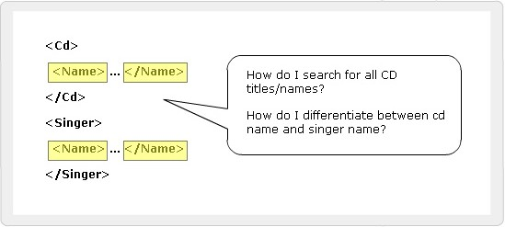
Namespaces
Duplicate Element Names
It allows developers to create their own elements
and attributes for their own projects.
Developer has to ensure the uniqueness of the element names and attributes in a document.
Name conflicts are inevitable from different developers.
It is difficult for the browser to distinguish a conflicting element.
Namespaces
Elements are distinguished by using namespaces.
A namespace is a collection of names.
Namespaces allow the browser to:
Combine documents from different sources
Identify the source of elements or attributes

Slide 18
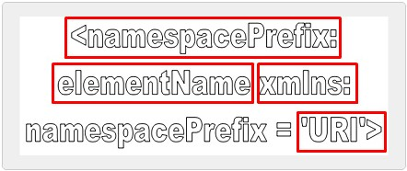
SYNTAX
EXAMPLE:
<S:Student xmlns:S=” http://www.abc.com”>
<S:First>John</S:First>
<S:Last>Dewey</S:Last>
<S:Title>Student</S:Title>
</S:Student>

Slide 19
SUMMARY
XML Namespaces
Namespaces distinguish between elements and attributes with the same name from different XML applications.
It is a collection of names that can be used as element names or attribute names in XML document.
XML namespaces provide a globally unique name for a element or attribute to avoid name collisions.
Working with Namespaces syntax
Namespaces are declared by an xmlns attribute whose
value is the URI of the namespace.
If an attribute name has no prefix, it has no namespace.
A default namespace is used by an element and its child elements if the element does not have a namespace prefix.

Slide 20
DTD🡪 Document Type Definition
A Document Type Definition (DTD) defines the legal building blocks of an XML document. It defines the document structure with a list of legal elements and attributes.
A DTD can be declared inline inside an XML document, or as an external reference.
USE OF DTD
With a DTD, each of your XML files can carry a description of its own format.
With a DTD, independent groups of people can agree to use a standard DTD for interchanging data.
Your application can use a standard DTD to verify that the data you receive from the outside world is valid.
You can also use a DTD to verify your own data.

Slide 21
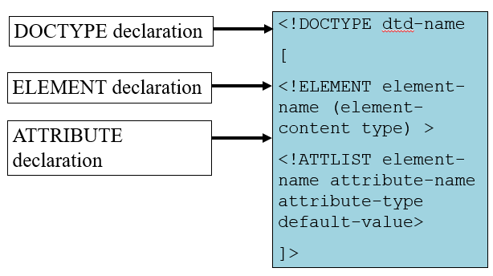
Structure of a DTD

Slide 22
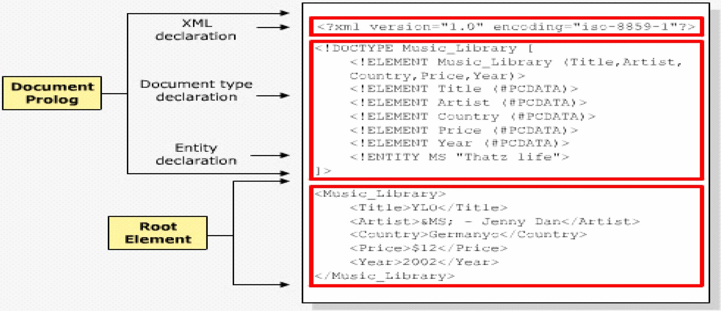
Internal DTD Declaration
If the DTD is declared inside the XML file, it should be wrapped in a DOCTYPE definition with the following syntax:
<!DOCTYPE root-element [element-declarations]>

Slide 23
ELEMENT IN DTD
<?xml version="1.0"?> <!DOCTYPE note [ <!ELEMENT note (to,from,heading,body)> <!ELEMENT to (#PCDATA)> <!ELEMENT from (#PCDATA)> <!ELEMENT heading (#PCDATA)> <!ELEMENT body (#PCDATA)> ]> <note> <to>Tove</to> <from>Jani</from> <heading>Reminder</heading> <body>Don't forget me this weekend</body> </note>
!DOCTYPE note defines that the root element of this document is note
!ELEMENT note defines that the note element contains four elements: "to,from,heading,body"
!ELEMENT to defines the to element to be of type "#PCDATA"
!ELEMENT from defines the from element to be of type "#PCDATA"
!ELEMENT heading defines the heading element to be of type "#PCDATA"
!ELEMENT body defines the body element to be of type "#PCDATA"

Slide 24
PCDATA
PCDATA means parsed character data.
PCDATA is text that WILL be parsed by a parser. The text will be examined by the parser for entities and markup.
Tags inside the text will be treated as markup and entities will be expanded.
However, parsed character data should not contain any &, <, or > characters; these need to be represented by the &amp; &lt; and &gt; entities, respectively.
CDATA
CDATA means character data.
CDATA is text that will NOT be parsed by a parser. Tags inside the text will NOT be treated as markup and entities will not be expanded.

Slide 25
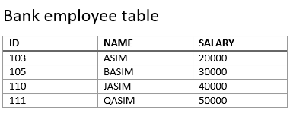
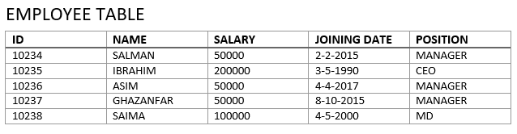
Practical:

Slide 26
ATTRIBUTE IN DTD
Syntax
<!ATTLIST tag-name attribute-name type attribute-value>
Example
------In DTD--------------
<!ATTLIST name ID CDATA #REQUIRED
------In XML--------------
<name ID=“1234> hamza </name>
Attribute (Attribute-Default-Value)
Value
Explanation
#DEFAULT
The attribute has a default value.
#REQUIRED
The attribute value must be included in the element.
#IMPLIED
The attribute does not have to be included.
#FIXED
The attribute value is fixed.

Slide 27
ENTITY IN DTD
Entity Declaration
Entities that have their contents within the XML document are called internal entities.
Syntax
<!ENTITY entity-name "entity-value">
Example
------In DTD--------------
<!ENTITY writer “IQBAL">
<!ENTITY copyright "Copyright Aptech Ltd.">
------In XML--------------
<author>&writer;&copyright;</author>

Slide 28
External DTD Declaration
If the DTD is declared in an external file, it should be wrapped in a DOCTYPE definition with the following syntax:
<!DOCTYPE root-element SYSTEM "filename">
EXAMPLE
.XML FILE
<?xml version="1.0"?> <!DOCTYPE note SYSTEM "note.dtd"> <note> <to>Tove</to> <from>Jani</from> <heading>Reminder</heading> <body>Don't forget me this weekend!</body> </note>
.DTD FILE
<!ELEMENT note (to,from,heading,body)> <!ELEMENT to (#PCDATA)> <!ELEMENT from (#PCDATA)> <!ELEMENT heading (#PCDATA)> <!ELEMENT body (#PCDATA)>

Slide 29
Nodes Quantifiers
asterisk (*) - The element may appear zero or more times
question mark (?) - The element may appear zero or one time, only
plus sign (+) - The element appears at least once if not more times
DTD - XML Building Blocks
The Building Blocks of XML Documents
Elements
Attributes
Entities
PCDATA
CDATA

Slide 30
SCHEMA
It is an XML-based alternative to DTD.
An XML schema describes the structure of an XML document.
The XML Schema language is also referred to as XML Schema Definition (XSD).
An XML Schema:
defines elements that can appear in a document
defines attributes that can appear in a document
defines which elements are child elements
defines the order of child elements
defines the number of child elements
defines whether an element is empty or can include text
defines data types for elements and attributes
defines default and fixed values for elements and attributes

Slide 31
DTD V/S SCHEMA
XML Schemas are the Successors of DTDs Main reasons:
DTDs do not have built-in datatypes.
DTDs do not support user-derived datatypes.
XML Schemas Support Data Types
One of the greatest strength of XML Schemas is the support for data types.
With support for data types:
It is easier to describe allowable document content
It is easier to validate the correctness of data
It is easier to work with data from a database
It is easier to define data facets (restrictions on data)
It is easier to define data patterns (data formats)
It is easier to convert data between different data types

Slide 32
SYNTAX
Defining a Simple type Element
The syntax for defining a simple element is:
<xs:element name="abc" type="xyz"/>
where abc is the name of the element and xyz is the data type of the element.
Data types
XML Schema has a lot of built-in data types. The most common types are:
xs:string
xs:decimal
xs:integer
xs:boolean
xs:date
xs:time
The <schema> Element
<?xml version="1.0"?> <xs:schema> ... ... </xs:schema>

Slide 33
Simple Example
XML elements:
<name>huda</name>
<age>36</age>
<birthDate>1970-03-27</ birthDate >
Corresponding element definitions:
<xs:element name="name" type="xs:string"/>
<xs:element name="age" type="xs:integer"/>
<xs:element name=" birthDate " type="xs:date"/>

Slide 34
Values for Simple Elements
Simple elements may have a default value OR a fixed value specified.
Default: A default value is automatically assigned to the element when no other value is specified. <xs:element name="color" type="xs:string“ default="red"/>
Fixed A fixed value is also automatically assigned to the element, and you cannot specify another value. In the following example the fixed value is "red": <xs:element name="color" type="xs:string" fixed="red"/>

Slide 35
Attributes
Defining a Attribute
The syntax for defining a attribute is:
<xs:attribute name="xxx" type="yyy"/>
where xxx is the name of the attribute and yyy specifies the data type of the attribute..
XML Attribute:
<lastname lang="EN">Smith</lastname>
Corresponding Attribute definitions:
<xs:attribute name="lang" type="xs:string"/>
ATTRIBUTES CAN BE DEFAULT OR FIXED AS WELL AS OPTIONAL AND REQUIRED
Optional and Required Attributes Attributes are optional by default. To specify that the attribute is required, use the "use" attribute: <xs:attribute name="lang" type="xs:string" use="required"/>

Slide 36
XSD Restrictions
XSD Restrictions/Facets
Restrictions are used to define acceptable values for XML elements or attributes. Restrictions on XML elements are called facets.
Restrictions on Values
<xs:element name="age"> <xs:simpleType> <xs:restriction base="xs:integer"> <xs:minInclusive value="0"/> <xs:maxInclusive value="120"/> </xs:restriction> </xs:simpleType> </xs:element>

Slide 37
XSD Restrictions
XSD Restrictions/Facets
Restrictions are used to define acceptable values for XML elements or attributes. Restrictions on XML elements are called facets.
Restrictions on Values
<xs:element name="age"> <xs:simpleType> <xs:restriction base="xs:integer"> <xs:minInclusive value="0"/> <xs:maxInclusive value="120"/> </xs:restriction> </xs:simpleType> </xs:element>

Slide 38
Restrictions on a Set of Values The example below defines an element called "car" with a restriction. The only acceptable values are: Audi, Golf, BMW:
<xs:element name="car"> <xs:simpleType> <xs:restriction base="xs:string"> <xs:enumeration value="Audi"/> <xs:enumeration value="Golf"/> <xs:enumeration value="BMW"/> </xs:restriction> </xs:simpleType> </xs:element>

Slide 39
Examples
EXAMPLE 1:
<xs:element name="password"> <xs:simpleType> <xs:restriction base="xs:string"> <xs:length value="8"/> </xs:restriction> </xs:simpleType> </xs:element>
EXAMPLE 2:
<xs:element name="password"> <xs:simpleType> <xs:restriction base="xs:string"> <xs:minLength value="5"/> <xs:maxLength value="8"/> </xs:restriction> </xs:simpleType> </xs:element>

Slide 40
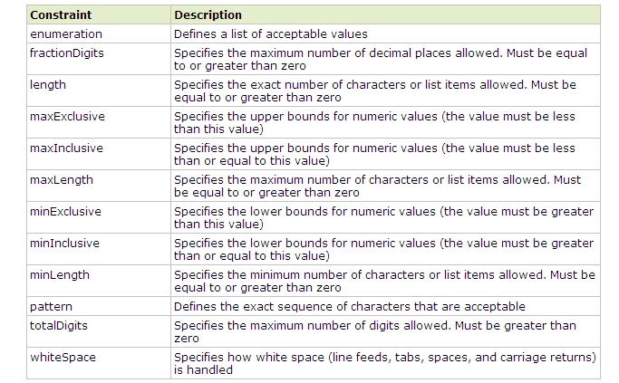
Restrictions for Datatypes

Slide 41
Complex-type
Complex-type elements have attributes, child elements, or some combination of the two.
For example, the Name and HomePage elements below are both complex-type elements
<?xml version="1.0"?> <Person> <Name> <FirstName>Mark</FirstName> <LastName>Twain</LastName> </Name> <HomePage URL="http://www.marktwain.com"/> </Person>
<xs:element name="ElementName">
<xs:complexType>
<!--Content Model Goes Here-->
</xs:complexType>
</xs:element>

Slide 42
There are four kinds of complex elements:
There are four kinds of complex elements:
empty elements
elements that contain only other elements
elements that contain only text
elements that contain both other elements and text
1.Empty Elements
XML
<product prodid="1345" />
XSD
<xs:element name="product"> <xs:complexType> <xs:attribute name="prodid" type="xs:positiveInteger"/> </xs:complexType> </xs:element>

Slide 43
2.Containing Elements Only
XML
<person> <firstname>John</firstname> <lastname>Smith</lastname> </person>
XSD
<xs:element name="person"> <xs:complexType> <xs:sequence> <xs:element name="firstname" type="xs:string"/> <xs:element name="lastname" type="xs:string"/> </xs:sequence> </xs:complexType> </xs:element>
Note: <xs:sequence> tag means that the elements defined ("firstname" and "lastname") must appear in that order inside a "person" element.

Slide 44
3.Containing Text-Only
XML
<shoesize country="france">35</shoesize>
XSD
<xs:element name="shoesize"> <xs:complexType> <xs:simpleContent> <xs:extension base="xs:integer"> <xs:attribute name="country" type="xs:string" /> </xs:extension> </xs:simpleContent> </xs:complexType> </xs:element>

Slide 45
4. Containing both other elements and text
XML
<letter> Dear Mr.<name>John Smith</name>. Your order <orderid>1032</orderid> will be shipped on <shipdate>2001-07-13</shipdate>. </letter>
XSD
<xs:element name="letter"> <xs:complexType mixed="true"> <xs:sequence> <xs:element name="name" type="xs:string"/> <xs:element name="orderid" type="xs:positiveInteger"/> <xs:element name="shipdate" type="xs:date"/> </xs:sequence> </xs:complexType> </xs:element>
Note: To enable character data to appear between the child-elements of "letter", the mixed attribute must be set to "true"

Slide 46
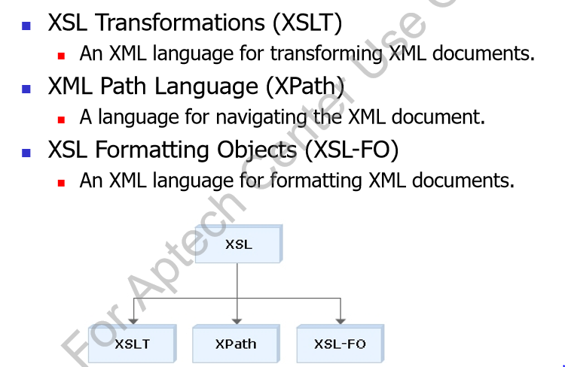
XSL
XSL 🡪 eXtensible Stylesheet Language is a styling language for XML.
(Also XSLT 🡪 eXtensible Stylesheet Language Transformations)
In the transformation process, XSLT uses XPath to define parts of the source document that should match one or more predefined templates. When a match is found, XSLT will transform the matching part of the source document into the result document.

Slide 47
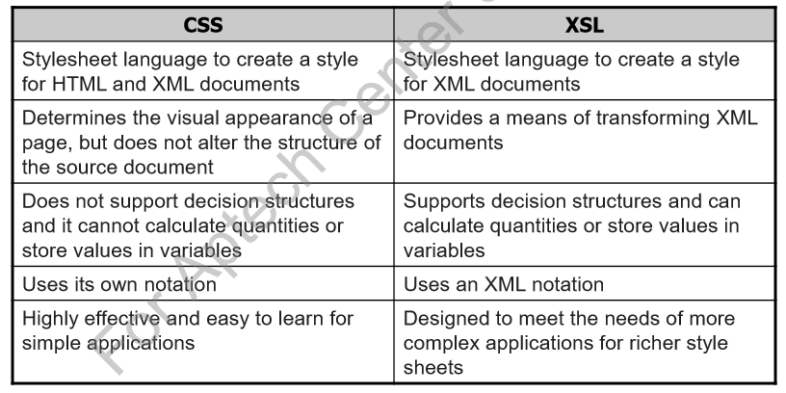
Difference Between CSS and XSL

Slide 48
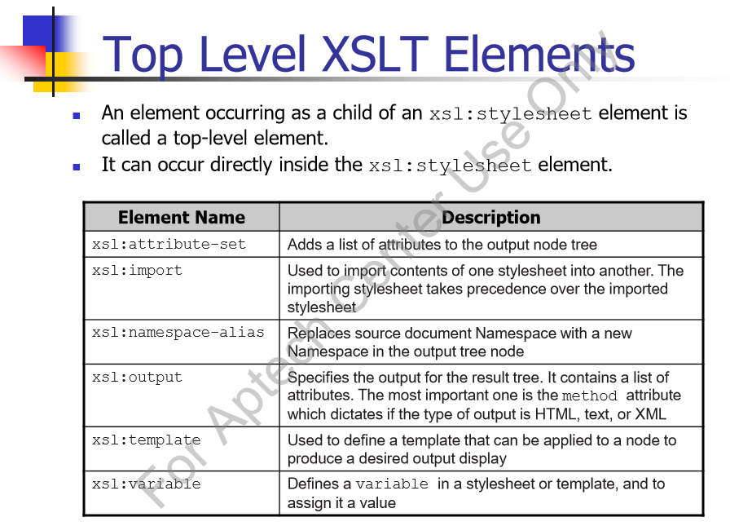
Syntax
<xsl:stylesheet version="1.0"
xmlns:xsl="http://www.w3.org/1999/XSL/Transform">
<xsl:template match="/">
<html>
……
</html>
</xsl:template>
</xsl:stylesheet>

Slide 49
XSLT elements
Style Sheet Declaration
(according to the W3C XSLT Recommendation ) is:
<xsl:stylesheet version="1.0" xmlns:xsl="http://www.w3.org/1999/XSL/Transform">
Or
<xsl:transform version="1.0" xmlns:xsl="http://www.w3.org/1999/XSL/Transform">
<xsl:template> Element
An XSL style sheet consists of one or more set of rules that are called templates.
A template contains rules to apply when a specified node is matched.
The <xsl:template> element is used to build templates.
The match attribute is used to associate a template with an XML element. The match attribute can also be used to define a template for the entire XML document. The value of the match attribute is an XPath expression (i.e. match="/" defines the whole document).

Slide 50
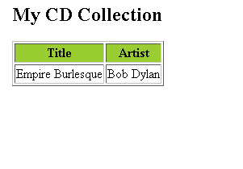
<xsl:value-of> Element
The <xsl:value-of> element can be used to extract the value of an XML element and add it to the output stream of the transformation:
<?xml version="1.0" encoding="ISO-8859-1"?>
<!-- Edited by XMLSpy® -->
<xsl:stylesheet version="1.0"
xmlns:xsl="http://www.w3.org/1999/XSL/Transform">
<xsl:template match="/">
<html>
<body>
<h2>My CD Collection</h2>
<table border="1">
<tr bgcolor="#9acd32">
<th>Title</th>
<th>Artist</th>
</tr>
<tr>
<td><xsl:value-of select="catalog/cd/title"/></td>
<td><xsl:value-of select="catalog/cd/artist"/> </td>
</tr>
</table>
</body>
</html>
</xsl:template>
</xsl:stylesheet>
The select attribute in the example above, contains an XPath expression. An XPath expression works like navigating a file system; a forward slash (/) selects subdirectories.

Slide 51
<?xml version="1.0" encoding="ISO-8859-1"?>
<xsl:stylesheet version="1.0” xmlns:xsl="http://www.w3.org/1999/XSL/Transform"> <xsl:template match="/"> <html> <body> <h2>My CD Collection</h2> <table border="1"> <tr bgcolor="#9acd32"> <th>Title</th> <th>Artist</th> </tr> <xsl:for-each select="catalog/cd"> <tr> <td><xsl:value-of select="title"/></td> <td><xsl:value-of select="artist"/></td> </tr> </xsl:for-each> </table> </body> </html> </xsl:template>
</xsl:stylesheet>

Slide 52
XSLT <xsl:sort> Element
The <xsl:sort> element is used to sort the output.
<?xml version="1.0" encoding="ISO-8859-1"?>
<xsl:stylesheet version="1.0” xmlns:xsl="http://www.w3.org/1999/XSL/Transform"> <xsl:template match="/"> <html> <body> <h2>My CD Collection</h2> <table border="1"> <tr bgcolor="#9acd32"> <th>Title</th> <th>Artist</th> </tr> <xsl:for-each select="catalog/cd"> <xsl:sort select="artist"/> <tr> <td><xsl:value-of select="title"/></td> <td><xsl:value-of select="artist"/></td> </tr> </xsl:for-each> </table> </body> </html> </xsl:template>
</xsl:stylesheet>

