Slide 2
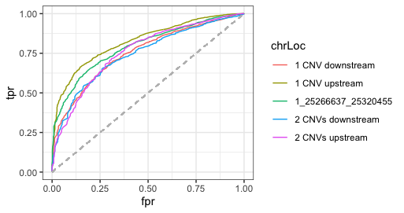
ChrLoc | AUC
2CNVs downstream | 0.7444828
1 CNV downstream | 0.7534007
CNV | 0.7927739
1 CNV upstream | 0.825569
2 CNVs upstream | 0.7603353

Slide 3
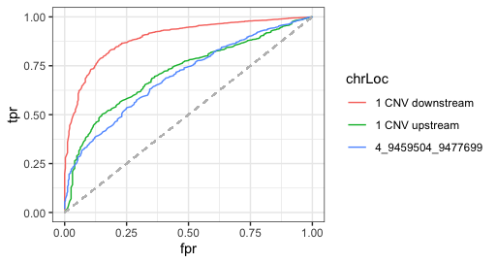
ChrLoc | AUC
2CNVs downstream | 0.7444828
1 CNV downstream | 0.8932585
CNV | 0.6975298
1 CNV upstream | 0.7288535
2 CNVs upstream | 0.7603353

