Slide 1
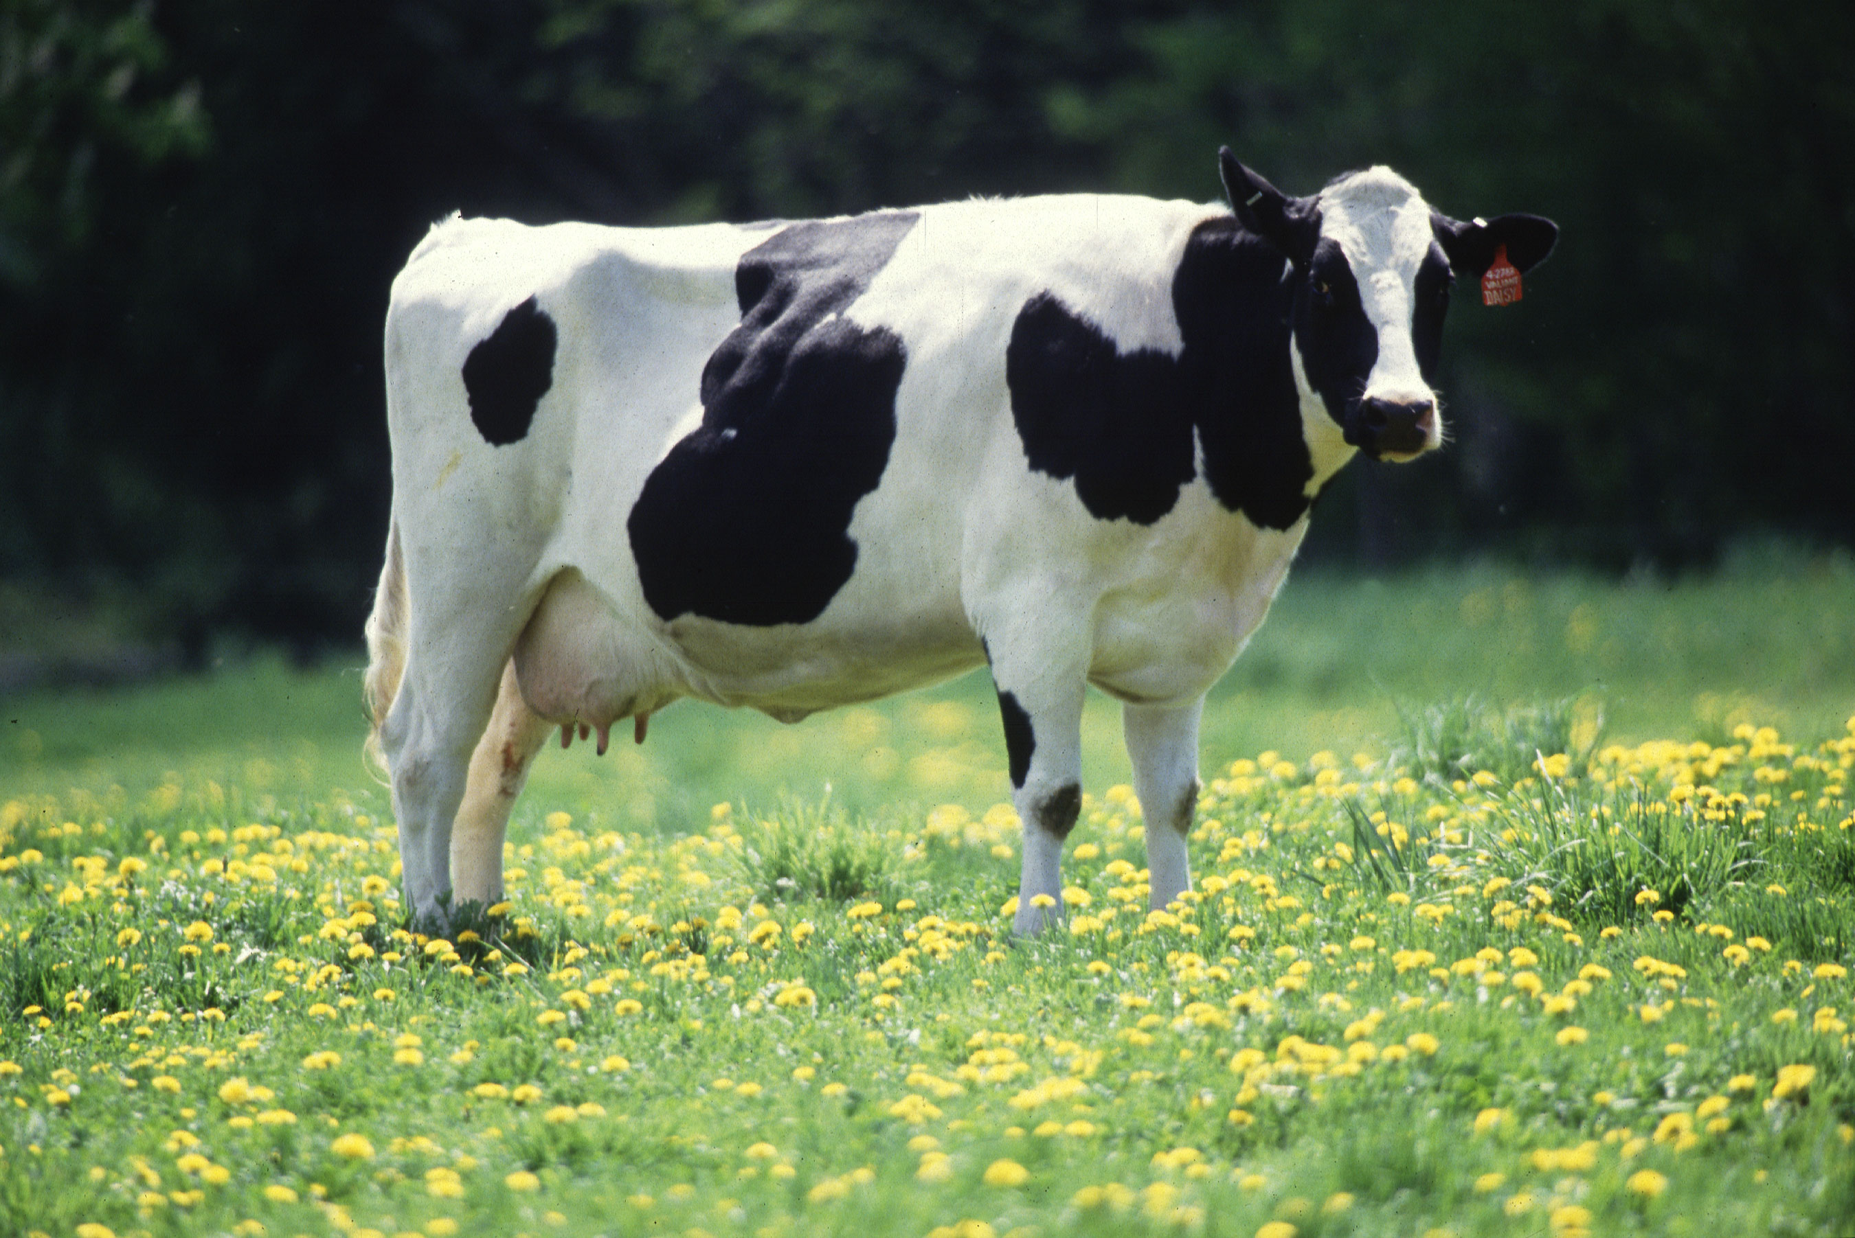
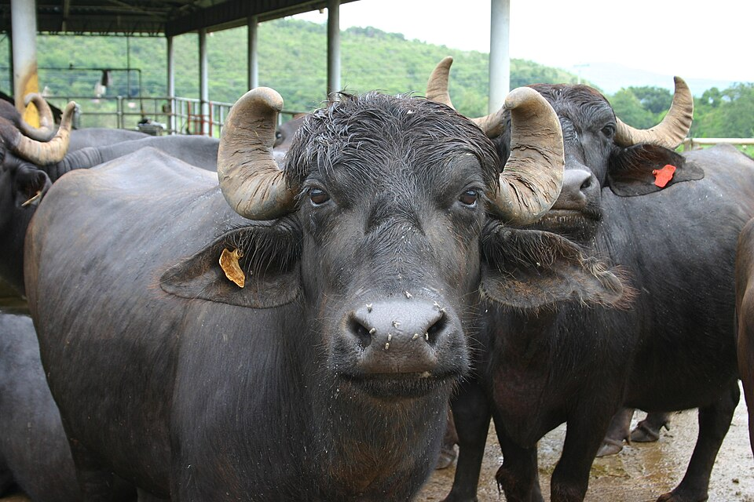
ANIMAL REPRODUCTION
Repeat Breeding
Causes · Diagnosis · Treatment · Prevention
in Cows and Buffaloes
Veterinary Gynaecology
& Obstetrics
Seminar Presentation
Holstein Friesian — high-yielding dairy cow
Murrah buffalo — leading Indian dairy breed
Notes:
Welcome the audience. Introduce the topic of repeat breeding as a major reproductive disorder in dairy cattle and buffaloes. Mention that the seminar will cover etiology, diagnosis, treatment, prevention and a special focus on buffaloes.

Slide 2
Presentation Roadmap
02
Twenty-four slides organised into four sections
I
Foundations
Section I
II
Etiology
Section II
III
Diagnosis & Treatment
Section III
IV
Buffalo Focus & Prevention
Section IV
• Introduction & Definition
• Incidence & Economic Impact
• Overview of causes
• Infectious / Genital
• Nutritional & Metabolic
• Hormonal & Endocrine
• Management & AI errors
• Pathophysiology flow
• Clinical approach
• Treatment principles
• Hormonal protocols
• Intra-uterine therapy
• Buffalo-specific repeat breeding
• Cow vs Buffalo comparison
• Prevention strategies
• Recent advances
• Conclusion
Repeat Breeding in Cattle | Veterinary Gynaecology & Obstetrics
Page 2 of 24
Notes:
Walk through the four-section structure. Tell the audience they will see section divider slides between major parts.

Slide 3
01
SECTION
Foundations
Setting the stage — what repeat breeding is and why it matters
REPEAT BREEDING
Notes:
Introduce Section I — the foundational concepts of repeat breeding.

Slide 4
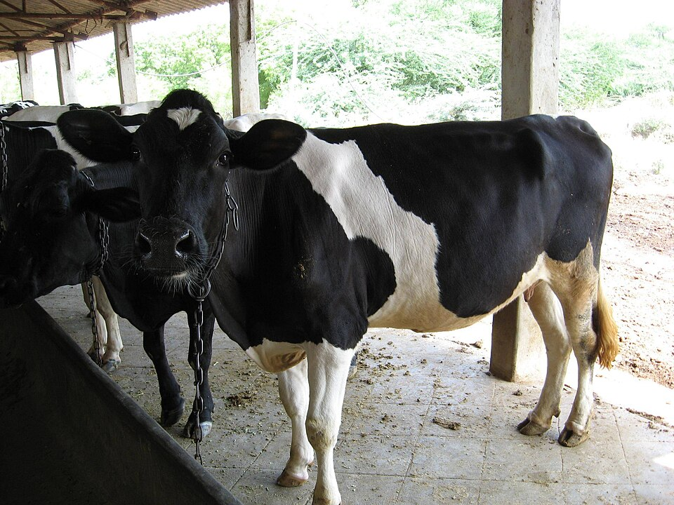
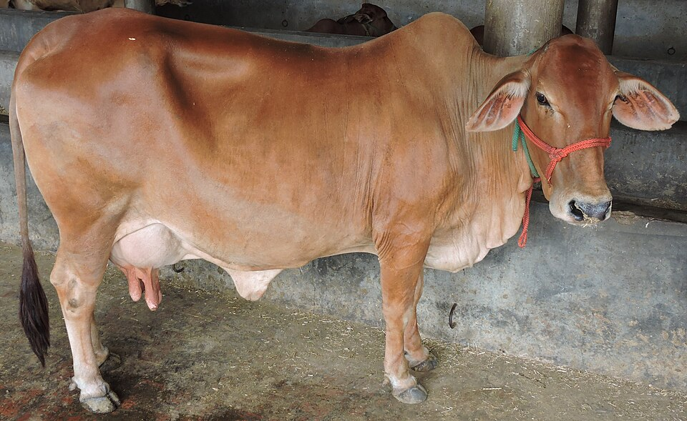
Introduction
04
Reproductive efficiency is the backbone of profitable dairying
▸ Reproduction is the most important factor governing the economic success of any dairy enterprise.
▸ A normal fertile cow should conceive within 60–90 days post-partum and deliver one calf every 12–13 months.
▸ Failure to conceive after repeated inseminations — despite normal estrous cycles and apparently healthy genitalia — is termed REPEAT BREEDING.
▸ One of the most frustrating and economically damaging reproductive disorders in cattle and buffaloes worldwide.
▸ Multifactorial — involving the cow, the bull / semen, the inseminator and the environment.
Holstein dairy cow on pasture
KEY TAKEAWAY Reproductive failure of even a few cows can erase the entire margin of a dairy unit.
Sahiwal — indigenous Indian dairy breed
Repeat Breeding in Cattle | Veterinary Gynaecology & Obstetrics
Page 4 of 24
Notes:
Reproduction drives milk production, calf supply and culling decisions. Repeat breeding directly hits all three. Stress that the cow is otherwise apparently healthy.

Slide 5
Definition
05
“ A repeat breeder is a cow / buffalo of normal breeding age and parity, cycling regularly at intervals of 18–24 days, with no clinically detectable abnormality of the genital tract, that has failed to conceive after three or more successive services with fertile semen. ”
Regular cycles
≥ 3 services
No abnormality
Fertile semen
Competent AI
▸ Also known as: Repeat Breeder Syndrome / Repeat Breeder Cow (RBC).
▸ Older synonym: 'Conception Failure'.
▸ Differentiate from anoestrus, sub-oestrus, true infertility and sterility.
KEY TAKEAWAY Five criteria together define a repeat breeder — missing any one means a different reproductive problem.
Repeat Breeding in Cattle | Veterinary Gynaecology & Obstetrics
Page 5 of 24
Notes:
Emphasise all five criteria. Many cows mis-classified as repeat breeders are actually anoestrus or sub-oestrus cases.

Slide 6
Incidence & Economic Importance
06
10 – 15 %
Global incidence in normal herds
20 – 30 %
In poorly managed herds
12 – 24 %
Indian dairy herds (cross-breds higher)
8 – 18 %
Buffaloes (often masked by silent oestrus)
Direct Losses
Indirect Losses
Estimated Cost
• Extra AI doses & semen cost
• Veterinary & hormone bills
• Extended dry / open period
• Reduced lifetime calves
• Lower lactation yield
• Increased calving interval
• Premature culling
• Loss of genetic progress
• Each extra open day ≈ ₹150–250
• Per repeater ≈ ₹8 000–15 000 / lactation
• National losses run into thousands of crores
• Major drag on smallholder economy
Repeat Breeding in Cattle | Veterinary Gynaecology & Obstetrics
Page 6 of 24
Notes:
Place the problem in numerical terms. The audience must appreciate that a single repeat breeder can wipe out a smallholder's annual profit.

Slide 7
02
SECTION
Etiology
A multifactorial syndrome — the cow, the bull, the inseminator & the environment
REPEAT BREEDING
Notes:
Section II covers all major causes of repeat breeding.

Slide 8
Etiology — An Overview
08
Causes are grouped into four broad heads
1. Fertilization Failure
2. Early Embryonic Death
3. Management Errors
4. Genetic / Other
• Improper AI timing
• Poor semen quality
• Anovulation / delayed ovulation
• Tract obstruction
• Anti-sperm antibodies
• Hormonal imbalance
• Uterine infections
• Heat stress
• Chromosomal defects
• Nutritional deficiency
• Missed / mis-detected oestrus
• Wrong AI technique
• Faulty semen handling
• Inadequate records
• Stress at AI
• Inbreeding
• Lethal genes
• Freemartinism
• White heifer disease
• Age & parity
KEY TAKEAWAY Roughly 60 % of repeat breeding is due to fertilization failure or early embryonic death.
Repeat Breeding in Cattle | Veterinary Gynaecology & Obstetrics
Page 8 of 24
Notes:
Categorising causes helps direct diagnosis. Most refractory cases involve more than one category at a time.

Slide 9
Infectious & Genital Tract Causes
09
▸ Subclinical / chronic endometritis — most common cause (40–60 %).
▸ Specific infections:
• Brucellosis (Brucella abortus)
• Trichomoniasis (Tritrichomonas foetus)
• Vibriosis / Campylobacteriosis (Campylobacter fetus)
• IBR–IPV (Bovine Herpesvirus-1)
• BVD (Bovine Viral Diarrhoea virus)
• Leptospirosis, Mycoplasma, Ureaplasma spp.
▸ Anatomical defects — cervical stenosis, persistent hymen, segmental aplasia.
▸ Cystic ovarian disease (follicular & luteal cysts).
▸ Salpingitis & hydrosalpinx — block fertilization.
KEY TAKEAWAY Always rule out subclinical endometritis before any hormonal therapy.
Repeat Breeding in Cattle | Veterinary Gynaecology & Obstetrics
Page 9 of 24
Notes:
Discuss white-side test, endometrial cytology and USG findings of intra-uterine fluid as bedside diagnostics for subclinical endometritis.

Slide 10
Nutritional & Metabolic Causes
10
▸ Negative energy balance in early lactation → delayed cyclicity & poor embryo quality.
▸ Excess dietary protein → high blood urea N (>20 mg/dL) is embryotoxic.
▸ Mineral & trace-element deficiencies:
• Phosphorus, Calcium — anoestrus, weak heat
• Copper, Cobalt, Zinc, Manganese — silent heat, low conception
• Selenium / Vitamin E — early embryonic death, retained placenta
• Iodine — irregular cycles
• Vitamin A, D, E — endometrial & embryo defects
▸ Mycotoxins (zearalenone, aflatoxin) → ovarian & embryonic disturbance.
▸ Body Condition Score < 2.5 or > 4 at AI is strongly linked to repeat breeding.
KEY TAKEAWAY Aim for BCS 3.0–3.5 at AI; correct minerals 30–45 days before breeding.
Repeat Breeding in Cattle | Veterinary Gynaecology & Obstetrics
Page 10 of 24
Notes:
Mention the 'transition cow' concept and how energy balance in the first 3 weeks post-calving affects fertility weeks later through follicle quality.

Slide 11
Hormonal & Endocrine Causes
11
▸ Inadequate pre-ovulatory LH surge → delayed or failed ovulation.
▸ Sub-luteal progesterone (< 1 ng/mL after Day-5) → embryonic loss.
▸ Persistent corpus luteum (CL) — pseudo-pregnancy effect.
▸ Hyper-prolactinaemia & thyroid dysfunction.
▸ Premature luteolysis — failure of maternal recognition (low Interferon-τ).
▸ Stress-induced cortisol rise → suppression of GnRH / LH.
▸ Heat stress in summer — reduced oestradiol, weak signs of oestrus, poor oocyte quality.
KEY TAKEAWAY Day-7 progesterone < 4 ng/mL is a strong predictor of embryonic loss in repeat breeders.
Repeat Breeding in Cattle | Veterinary Gynaecology & Obstetrics
Page 11 of 24
Notes:
Hormonal causes are mostly diagnosed indirectly through treatment response; serum P4 assay where available is the single most useful test.

Slide 12
Management & Inseminator-Related Causes
12
▸ Improper heat detection — single twice-daily check misses 25–50 % of heats.
▸ Wrong time of AI — outside the optimum window (mid- to late-oestrus).
▸ Faulty semen thawing (water temperature, time) and storage practice.
▸ Repeated use of same sub-fertile bull / semen batch.
▸ Trauma to cervix or uterus during AI; deep-horn deposition errors.
▸ Hygiene lapses → introduction of pathogens at the time of AI.
▸ Lack of accurate breeding records and follow-up.
KEY TAKEAWAY Up to 40 % of 'repeat breeders' are simply mis-timed AI — fix detection first.
Repeat Breeding in Cattle | Veterinary Gynaecology & Obstetrics
Page 12 of 24
Notes:
Discuss the AM-PM rule, role of pedometers / activity collars, and importance of culture-tested semen batches.

Slide 13
Pathophysiology — Where Things Go Wrong
13
Oestrus & Ovulation
Sperm Transport
Fertilization
Embryo Development
Maternal Recognition
Pregnancy
▸ Failure of ovulation or asynchronous ovulation → no fertilization.
▸ Sperm transport disturbance / hostile cervico-uterine environment.
▸ Fertilization failure — poor oocyte / sperm quality, anti-sperm antibodies.
▸ Early embryonic death (Day 8–16) — most common in repeat breeders.
▸ Failure of maternal recognition of pregnancy → CL regresses → return to oestrus.
KEY TAKEAWAY Day 8–16 is the danger zone — most repeat-breeder embryos die before maternal recognition of pregnancy.
Repeat Breeding in Cattle | Veterinary Gynaecology & Obstetrics
Page 13 of 24
Notes:
Explain that repeat breeders typically return to heat at a normal interval because their embryo died before the Interferon-tau signal was strong enough to maintain the CL.

Slide 14
03
SECTION
Diagnosis & Treatment
Systematic clinical approach and evidence-based therapeutics
REPEAT BREEDING
Notes:
Section III — practical diagnosis and treatment.

Slide 15
Diagnosis — Systematic Clinical Approach
15
▸ History:
• Age, parity, calving date, services given, AI dates, semen used
• Bull fertility, nutrition, deworming, vaccination, prior treatments
▸ General Examination — BCS, anaemia, lameness, mastitis, systemic disease.
▸ Gynaeco-clinical Examination:
• Vaginoscopy — discharge, cervicitis, adhesions
• Per-rectal palpation — uterus, ovaries, cervix, follicles, CL
• Trans-rectal ultrasonography — follicles, CL, uterine fluid, embryo
▸ Laboratory Tests:
• Cervico-vaginal mucus culture & sensitivity, cytology
• Serum progesterone, blood urea, minerals, liver / thyroid profile
• Serology / PCR — Brucella, IBR, BVD, Leptospira, Trichomonas
KEY TAKEAWAY Always proceed in order: history → general exam → gynaeco exam → laboratory tests.
Repeat Breeding in Cattle | Veterinary Gynaecology & Obstetrics
Page 15 of 24
Notes:
Stress the diagnostic discipline. Most field failures come from skipping history-taking and going straight to hormones.

Slide 16
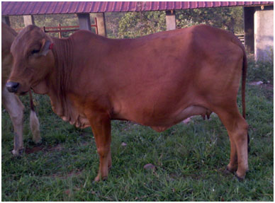
Treatment — General Principles
16
Treat the cause, not just the symptom
▸ Correct underlying nutrition & body condition (BCS 3.0–3.5 at AI).
▸ Treat genital tract infection (intra-uterine antibiotics, antiseptics).
▸ Correct hormonal imbalance with appropriate protocols.
▸ Improve heat detection and AI timing (AM-PM rule / activity meters).
▸ Use proven, high-quality semen; ensure proper thawing & deposition.
▸ Reduce stress — provide shade, water, comfortable housing, fly control.
▸ Maintain proper records; cull chronic non-responders after 5–6 services.
Well-managed dairy cow on farm
“Prevention is better, but timely treatment saves the cow.”
— Field motto in dairy practice
KEY TAKEAWAY Hormones are the last step, not the first. Fix nutrition, infection and AI errors before reaching for the syringe.
Repeat Breeding in Cattle | Veterinary Gynaecology & Obstetrics
Page 16 of 24
Notes:
Empower the audience to think causally. Hormonal therapy should be the last step after correcting husbandry.

Slide 17
Specific Therapeutic Protocols
17
GnRH at AI
Progesterone Support
Ovsynch / Double-AI
• Buserelin 10 µg or Gonadorelin 100 µg IM at AI
• Improves LH surge & ovulation
• Increases conception by 10–20 %
• Best for delayed ovulators
• CIDR / PRID for 7 days post-AI
• Long-acting P4 injection on Day 5
• Prevents premature luteolysis & embryo loss
• Best for cows with short luteal phase
• GnRH (D0) → PGF2α (D7) → GnRH (D9) → AI 16 h later
• Synchronises ovulation precisely
• Useful in herds with poor heat detection
• Modified / Co-Synch / Double-Ovsynch for repeaters
KEY TAKEAWAY Combining GnRH at AI + Day-5 progesterone is a simple, field-friendly upgrade for repeat breeders.
Repeat Breeding in Cattle | Veterinary Gynaecology & Obstetrics
Page 17 of 24
Notes:
Discuss dose, timing, contra-indications. Ovsynch needs good cow handling and timely injections — limited in smallholder settings.

Slide 18
Intra-Uterine & Adjunct Therapy
18
▸ Intra-uterine antibiotics (after culture / sensitivity):
• Cephapirin, Ceftiofur, Oxytetracycline, Enrofloxacin
• Avoid penicillin — inactivated by uterine exudate
▸ Lugol's iodine (1–2 %) flushing — mild irritant, stimulates leucocytosis.
▸ Oyster glycogen / E. coli LPS — non-specific immuno-stimulation.
▸ Intra-uterine PGF2α & oxytocin — promote uterine clearance.
▸ Mineral & vitamin supplementation:
• AD3E, Vitamin E + Selenium, Chelated Zn-Cu-Mn-Co
• Bypass protein & energy correction during AI period
▸ Herbal / Ayurvedic preparations (Aloes compound, Janova, Prajana) as adjuncts.
KEY TAKEAWAY Intra-uterine therapy must follow culture & sensitivity — blind antibiotic infusion damages the endometrium.
Repeat Breeding in Cattle | Veterinary Gynaecology & Obstetrics
Page 18 of 24
Notes:
Caution: repeated antibiotic infusions can themselves induce chronic endometritis. Mineral therapy is often under-used and gives the best return on investment.

Slide 19
04
SECTION
Buffalo Focus & Prevention
Special considerations and the road ahead
REPEAT BREEDING
Notes:
Section IV — buffalo-specific issues, prevention and the future.

Slide 20
Buffalo-Specific Repeat Breeding
20
Why buffaloes pose unique reproductive challenges
▸ Silent / sub-oestrus — up to 50–60 % of heats are missed without close observation.
▸ Late maturity (36–42 months) and longer post-partum anoestrus (90–150 days) than cows.
▸ Strongly seasonal — short photoperiod (Oct–Feb) is the peak breeding season.
▸ Summer infertility — heat stress depresses LH surge, oocyte quality and embryo survival.
▸ Smaller, deeper-seated ovaries with fewer antral follicles than cows.
▸ Higher incidence of true anoestrus, ovarian inactivity and anovulatory cysts.
Murrah buffalo (Bubalus bubalis)
Heat Detection
Hormonal / Synchrony
Environment & Nutrition
• Observe 4–5 ×/day; early morning & late evening
• Teaser bull / pedometer / activity meter
• Watch vulvar oedema, mucus, bellowing
• Ovsynch / Heatsynch / CIDR work well
• Pre-synch / Double-Ovsynch in summer
• GnRH at AI for late-cycling buffaloes
• Wallowing / showers when > 32 °C
• Shade, fans, fly control
• Bypass fat & mineral supplementation
Repeat Breeding in Cattle | Veterinary Gynaecology & Obstetrics
Page 20 of 24
Notes:
Buffaloes are not just 'larger cows' — emphasise silent oestrus, seasonality and heat-stress management as the three biggest practical issues.

Slide 21
Cow vs Buffalo — At a Glance
21
Comparative reproductive features relevant to repeat breeding
Parameter | Cow (Bos taurus / indicus) | Buffalo (Bubalus bubalis)
Age at puberty | 12–18 months | 24–36 months
Age at first calving | 24–30 months | 36–48 months
Oestrous cycle length | 21 days (18–24) | 21 days (18–22)
Duration of oestrus | 12–18 hours | 18–30 hours
Signs of oestrus | Overt — clear mucus, mounting | Often silent / sub-oestrus
Seasonality | Year-round breeder | Strongly seasonal (Oct–Feb)
Post-partum anoestrus | 45–90 days | 90–150 days
Antral follicle count | Higher | Lower
Heat-stress sensitivity | Moderate | High — needs wallow / shower
Common cause of repeat breeding | Subclinical endometritis | Silent oestrus + summer infertility
KEY TAKEAWAY Silent oestrus and summer infertility are the dominant drivers of repeat breeding in buffaloes.
Repeat Breeding in Cattle | Veterinary Gynaecology & Obstetrics
Page 21 of 24
Notes:
Use this table to highlight why generic 'cow protocols' often under-perform in buffaloes — different physiology demands different management.

Slide 22
Prevention — Better Than Cure
22
Herd-Level Practices
Cow / Buffalo-Level Practices
• Routine post-partum exam on Day 30–45
• Maintain calving interval 12–13 months
• Vaccinate against Brucella, IBR, BVD, Leptospira
• Bio-security; quarantine new animals
• Balanced ration — energy, protein & minerals
• Body Condition Scoring at dry-off, calving, AI
• Heat detection 3× daily / pedometers / activity collars
• AI by trained technicians using fertile, properly thawed semen
Environment
Records & Decisions
• Shade, fans, sprinklers / wallows in summer
• Comfortable, non-slippery flooring
• Adequate water and clean housing
• Reduce overcrowding & social stress
• Maintain individual breeding records / software
• Identify chronic repeaters early
• Selective culling after 5–6 unsuccessful services
• Periodic herd fertility audit
Repeat Breeding in Cattle | Veterinary Gynaecology & Obstetrics
Page 22 of 24
Notes:
Prevention is a herd-level discipline. Single-cow interventions rarely work without supportive management.

Slide 23
Recent Advances
23
▸ Doppler ultrasonography of CL — early detection of luteal insufficiency.
▸ Embryo transfer (ET) in chronic repeat breeders — bypasses fertilization and early embryo problems.
▸ In-vitro fertilization (IVF / OPU-IVP) for valuable persistent repeaters.
▸ Sexed semen with optimised AI timing for high-genetic-merit cows.
▸ Genomic selection — identifying cows predisposed to early embryonic death.
▸ Activity-monitoring collars & AI-based heat detection systems.
▸ Anti-oxidant therapy (Vitamin E, Selenium, Astaxanthin) to improve oocyte and embryo quality.
▸ Targeted reproductive ultrasonography & uterine biopsy for refractory cases.
KEY TAKEAWAY ET and OPU-IVP can rescue genetically valuable repeat breeders that fail all conventional therapy.
Repeat Breeding in Cattle | Veterinary Gynaecology & Obstetrics
Page 23 of 24
Notes:
Recent advances are largely accessibility-limited in smallholder settings, but Doppler USG and activity meters are increasingly affordable.

Slide 24
Conclusion & References
24
Conclusion
▸ Repeat breeding is a multifactorial syndrome — a symptom rather than a disease.
▸ Successful management requires accurate diagnosis, correction of nutrition, infection and hormonal imbalance, plus excellent AI practices.
▸ Buffaloes need extra attention to silent oestrus, seasonality and summer heat-stress mitigation.
▸ Prevention through good husbandry and herd health is far more economical than treatment.
References (selected)
• Roberts S.J. — Veterinary Obstetrics & Genital Diseases (Theriogenology), 3rd Ed.
• Arthur, Noakes, Pearson & Parkinson — Veterinary Reproduction & Obstetrics, 11th Ed.
• Hafez E.S.E. & Hafez B. — Reproduction in Farm Animals, 7th Ed.
• Peters A.R. & Ball P.J.H. — Reproduction in Cattle, 3rd Ed.
• Bartlett P.C. et al. — Repeat breeder syndrome in dairy cattle, JDS.
• Gustafsson H. & Emanuelson U. — Repeat breeding syndrome in Swedish dairy cattle, Acta Vet. Scand.
• Perera B.M.A.O. — Reproductive cycles of buffalo, Anim. Reprod. Sci.
Image credits: cow & buffalo photographs from Wikimedia Commons (CC BY-SA / public domain).
THANK YOU
Notes:
Wrap up. Restate that repeat breeding is preventable. Invite questions and discussion.

