Slide 1
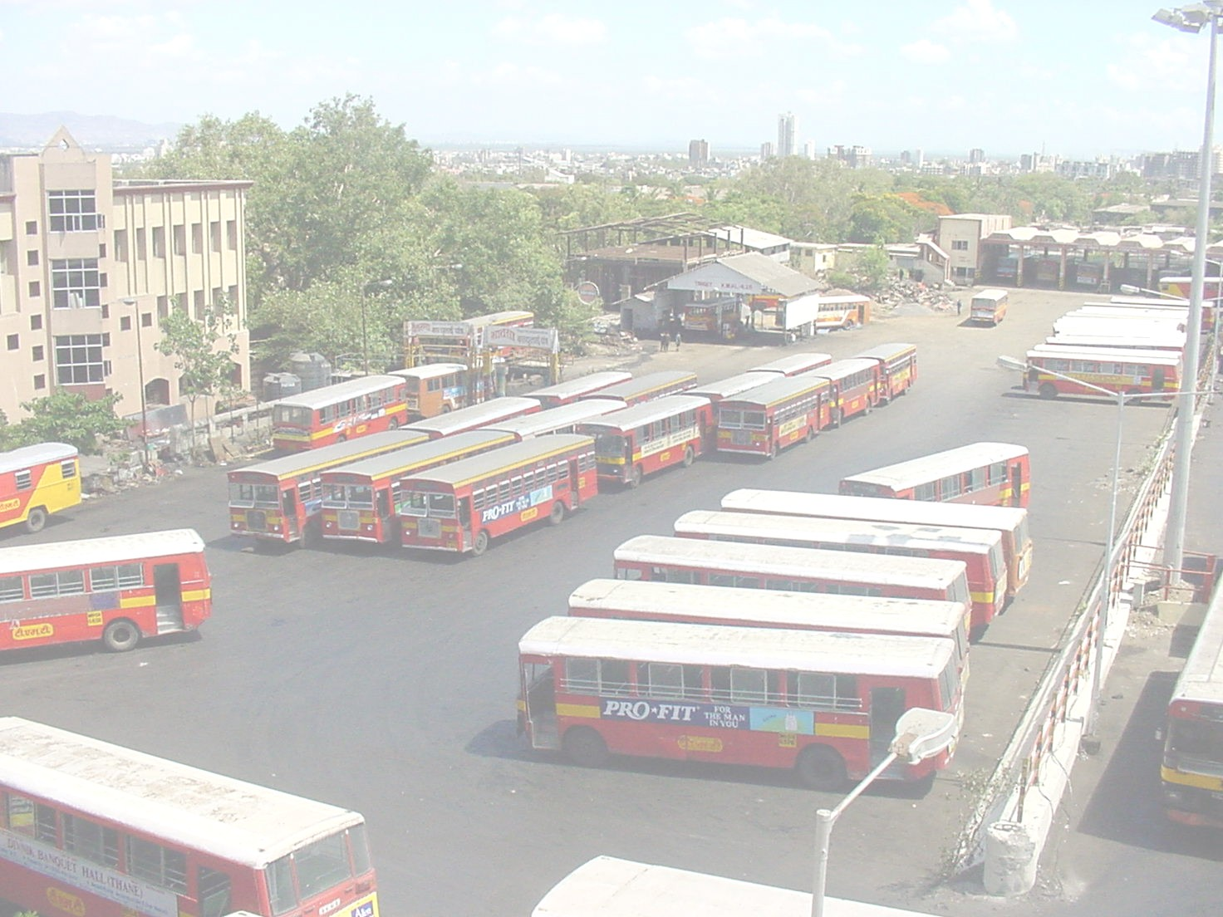
A Maintenance Program for a bus fleet
Lessons from a Potential CDM Project in India
Kaushik Deb, TERI

Slide 2
Structure of the presentation
The policy context
CDM and transport: Synergies
Key barriers
The Project
Need for an effective maintenance
Inspection Systems: CDM project
Emission savings
Cost estimates
Lessons

Slide 3
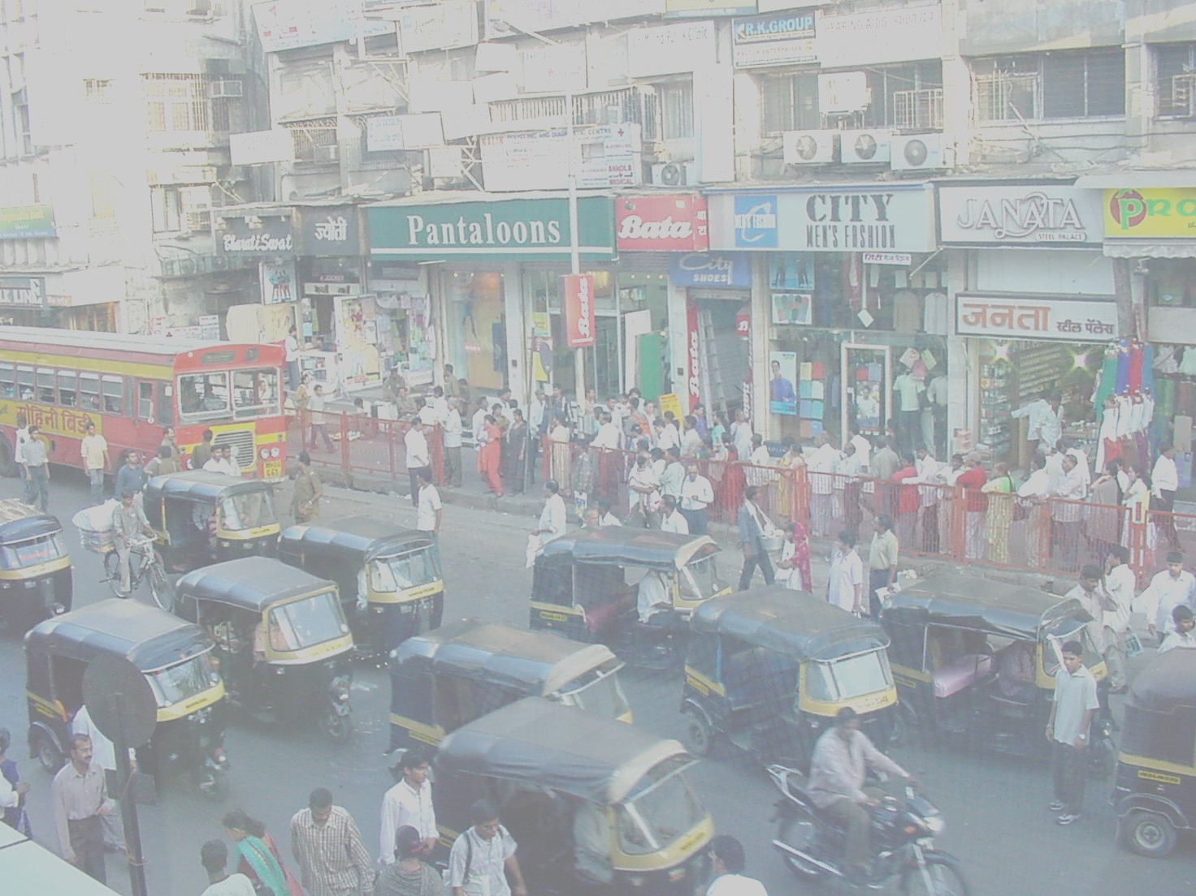
Urban transport in India
Large urban population
Over 1/3 in 2001
High vehicle density in urban areas
33% concentrated in cities with 10% population
82% are personal vehicles
Inadequate public transport
Effective public transport in only 10 cities
Rail in only 3 cities
No urban transport policy
Diffused institutional arrangements
Implications for economic sustainability
Cities are vertices of continued growth

Slide 4
Trends in vehicle population

Slide 5
Vehicle Ownership
Cities
Vehicles Per
1000 Persons
Per capita
income (US $)
London (1990)
356
$22,000
Paris (1990)
383
$34,000
Tokyo (1990)
266
$37,000
Delhi (1998)
200
$850
Shanghai (2000)
69
$4,000
Notes:
As you can see, the members of the Business Environmental Leadership Council are large companies which represent most major sectors of the economy
The diversity of the companies means we have a diversity of activities to reduce greenhouse gas emissions

Slide 6
Urban travel demand projections
Sundar & Deb (2000)
7% GDP growth
DISHA 2047
Year 2019
5% GDP growth
MoST (1999)

Slide 7
Vehicular Growth
Notes:
India has witnessed a rapid increase in its vehicle population over the last four decades. From a mere 3 million vehicles in the 1960s, the number has gone up to over 35 million by 2000. This growth is expected to continue in the coming years also. Large cities, particularly the metropolitan cities, face a higher concentration of motor vehicles than the smaller towns.
T E R I. 2003
Transportation economics and environmental issues that influence product strategy
New Delhi: The Energy and Resources Institute. 208 pp.

Slide 8
Policy response in India
Largely technology based response
Vehicle emissions
Fuel quality
Mandating alternative fuels
Inadequate attention to demand management
NMT discriminated against in resource
Land use development haphazard, not in sync with transport planning
Public transport not encouraged, personal vehicles have become more accessible

Slide 9
Emission norms
New vehicles
1991: First mass emission norms (CO & HC)
1995: Catalytic converters for cars in 4 metros
1996: Further tightening of norms (CO, HC & NOx)
2000: Bharat Stage I (~EUROI)
2001: Bharat Stage II in Delhi (~EURO II)
Sustained progress!!!
In use vehicles
1989: Idle emission regulation
2004: Some tightening
Piece meal efforts
No Statutory Maintenance & Fuel Efficiency Requirements !!!

Slide 10
Government’s Auto Fuel Policy
Category
Bharat Stage II April 2005
Bharat Stage III
April 2010
Bharat Stage IV
2 & 3 wheelers
Entire country
Entire country
(preferably from April 2008)
All other new vehicles
Entire country
Entire country
April 2003
7 cities other than metros
April 2005
11major cities
April 2010
11 major cities
Notes:
Dates of implementation need fine-tuning. Need to study each state’s level of implementation to decide how it can be accelerated.
Export market and the level of stringency in emission norms in these regions.

Slide 11
Need for an effective system for in use vehicles
Norms very lax
No consistent improvement
Limited coverage
Only idle tests for CO (petrol)
Free acceleration tests for smoke (diesel)
Limited regulatory ability
Equipment not calibrated
No auditing/ training
Weak maintenance system

Slide 12
Synergizing Objectives
Global
Significant potential for GHG mitigation in transport in India
National
Positive impacts on local air quality, health & safety
High priority for urban centres
Revenue from carbon credits

Slide 13
GHG emissions from transport
1999
OECD & IEA 2001

Slide 14
Fuel consumption & GHG emissions in Urban India
Notes:
Trip length increases by 37.5% by 2025
At least 60% of the urban travel demand should be catered to by public transport compared to the current 54%. This also implies an increase in the modal share of such intermediate modes of public transport as taxis and passenger three-wheelers from the current 20% to about 23%.
The strategies outlined above should achieve a 25% reduction in emissions per vehicle by 2025 and 50% by 2050 through improved vehicle technology and fuel quality. Also, the following technology mix is being considered to cut down emissions.
The share of ordinary diesel-powered cars in the total fleet of personal vehicles to be maintained at the present level of 15% — the present trend, if it continues unchecked will increase this figure to 35% by 2050.
The share of ordinary diesel-powered IPT (intermediate public transport) in the total fleet of personal vehicles to be maintained at the present level of 25% — the present trend, if it continues unchecked will increase this figure to 50% by 2050.
The share of vehicles powered by CNG (compressed natural gas), ULSD (Ultra Low Sulphur Diesel), and cleaner gasoline, to rise to about 25% of the total personal and IPT vehicle fleet by 2050. This will be a substantial jump increase; the present trend will lead to only a 10% share by 2050.
The share of zero-emission vehicles, such as those powered by fuel cells or solar power, should rise to about 25% of the total personal and IPT vehicle fleet by 2050—again, the present trend will take it to only about 5% by 2050.
Finally, the entire urban bus fleet will run on CNG or ULSD.

Slide 15
Air quality is a concern

Slide 16
Transport contributes 3-22% of PM emissions

Slide 17
Financial performance of public transport operators in India
Rupees
1800
1600
1400
Costs per
1200
km
1000
800
Revenue
600
per km
400
1990
1992
1994
1996
1998

Slide 18
Barriers
Baselines
data availability
uncertain sectoral forecasts
Leakages
Fuel efficiency Vs VOCs
Monitoring and verification costs
dispersed and large number of mobile sources
Additionality
Mandated use of alternative fuels
Comprehensive I&C regime proposed

Slide 19
Project description
Existing maintenance regime inadequate and primitive
Even minor improvements would have large benefits
GHG savings from
Better maintenance
Result: Improved energy efficiency. Hence
GHG savings, Local emissions benefits
Impact: Range estimate of GHG reduction
5% improvement in fuel efficiency in US (Das et al 2001)
5.5% improvement in Jakarta (Cornie)
12.6% improvement in fuel efficiency (USEPA IM240 Program)
10-20% improvement in fuel efficiency in India (Das et al)

Slide 20
Project structure
Project proponent: Thane Municipal Transport Undertaking
Statutory public bus company
Owned by Thane Municipal Corporation
Mandate: Provide transport services to Thane
Activities
Bus operation
Depots and terminals
Bus maintenance

Slide 21
Bus fleet covered in the program

Slide 22
Maintenance checklist
Visual safety tests
Steering
Chassis
Fuel tank & piping
Engine mountings
Battery terminals etc
Seatbelts
Lighting
Oil leakages
Leaf springs…
Automated safety tests
Headlamp beam
Brakes
Sideslip
Emissions
Volumetric concentration for gasoline
Opacity for diesel

Slide 23
Design issues
Project boundary
Government owned bus company. Reduces
institutional complexity
data requirements, thus project development costs
Operational lifetime
Life of equipment = 15 years
Crediting period: 10 years
Reduced uncertainty
Monitoring & verification
Fuel consumption already monitored daily
Hence, no expense on monitoring

Slide 24
Emission savings: Methodology
GHG emissions
Vehicle kms
Baseline projections based on
Existing travel trends
Expected changes in emission factors, fuel efficiencies
Increasingly stringent norms
Improved technology
Sustained improvements in efficiency:5%
Reference years: 2005 & 2015

Slide 25
GHG savings
Baseline
Reduction scenario

Slide 26
Project costs
Net present value of project
— US$ 0.13 million
Project cost
US$ 0.54 million
Cost of CO₂
~ US$ 8.5
Substantial local benefits

Slide 27
Transport CDM projects: Lessons
Baselines
Carry out pilot tests to estimate fuel efficiency gains
Leakages
Captive fleet with fixed mobility
Independent of VOCs, exogenously determined demand
Monitoring and verification costs
Data already monitored independently
Preexisting statutory auditing: CAG
Additionality
Comprehensive I&C regime proposed in India
But no maintenance guidelines, requirements

Slide 28
Structure of a CDM project
The Executive Board
Baselines
Additionality
Leakages
Monitoring & verification
CER market
Price of CERs
Total CERs
Cost of project
Cost issues
Equity/Debt Vs revenue streams
CER revenues only as revenue streams!!!

Slide 29
Structure the project well!!!

