Slide 1

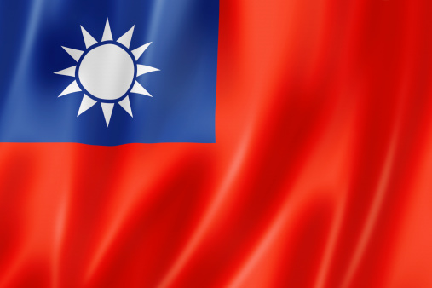
Taiwanese student style
G12
By: Ruben Hannink, Ou-xiang Chen, Wouter van Gent, Shun Nishijima

Slide 2
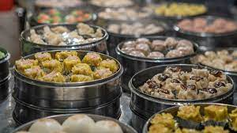
General cultural background of the Taiwanese
Work-life balance
- work overtime regularly
- Nowadays, many young people(62%) denied promotion and higher salary for work-life balance
Making friends
- Taiwan is both friendly and international. Language Exchange is popular
- They are little shy for new people.
Life outside of the school
- Taiwan is very good for hiking and go beaches and shores.
- Street food is so popular, very cheap and tasty.

Slide 3

Behavior
- generally polite and shy
- title/surname
- bow, shake hands
- refuse gift
- parallel chopsticks

Slide 4
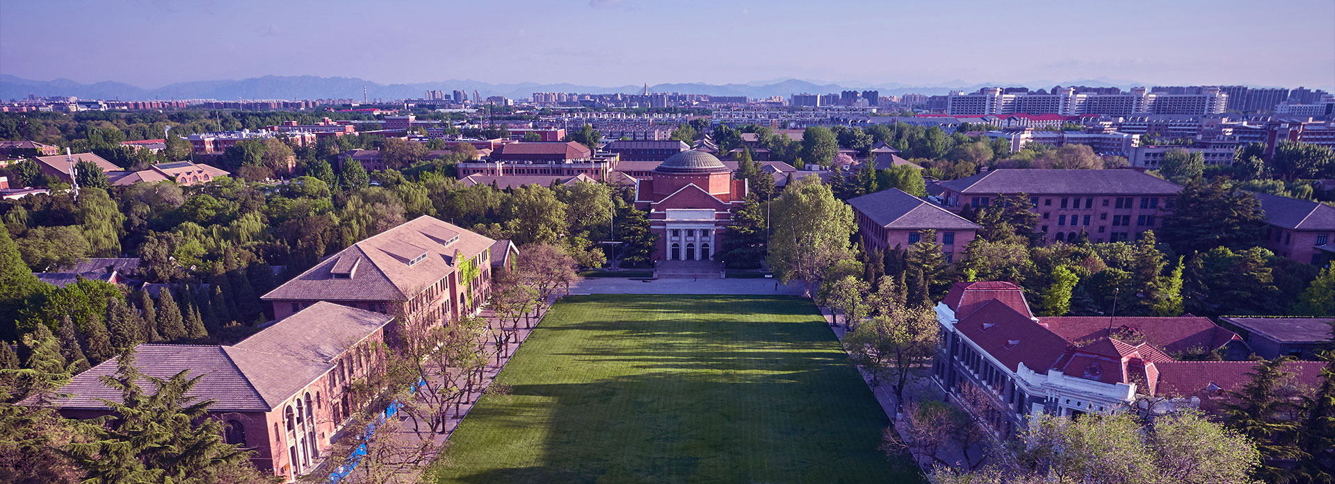
Differences in university
70% of students too shy to ask questions
Help-seeking is often seen as a sign of weakness and shame
Passive learning
Forus on memorizing and practicing
Effort and persistence more important than grades
Similar facilities as the UT
A-F Grading

Slide 5
Differences in university
Period | Time | Period | Time | Period | Time
1 | 8:00~8:50 | 5 | 13:20~14:10 | a | 18:30~19:20
2 | 9:00~9:50 | 6 | 14:20~15:10 | b | 19:30~20:20
3 | 10:10~11:00 | 7 | 15:30~16:20 | c | 20:30~21:20
4 | 11:10~12:00 | 8 | 16:30~17:20
n | 12:10~13:00 | 9 | 17:30~18:20

Slide 6


Q & A

Slide 7
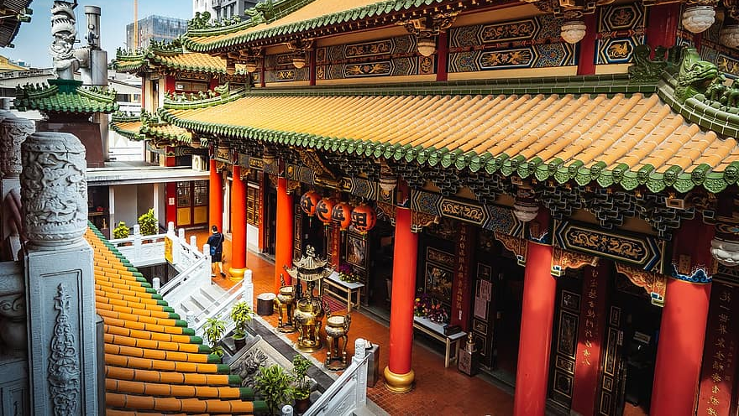
End

Slide 8
Link, appendix
( https://blakestephenanderson.medium.com/working-in-taiwan-a731877a8594 - Blake Anderson)
( https://www.commisceo-global.com/resources/country-guides/taiwan-guide )
( https://www.taipeitimes.com/News/lang/archives/2013/05/01/2003561114 )
( https://en.prnasia.com/releases/apac/62-of-taiwan-s-employees-willing-to-forgo-higher-salaries-or-job-promotions-for-work-life-balance-michael-page-366000.shtml - Cision)
( https://www.us2taiwan.org/finding-friends - Learn & Study)
( https://www.scholaro.com/db/countries/Taiwan/Grading-System )
( https://student.site.nthu.edu.tw/index.php?Lang=en - Tsing Hua University)
( https://www.tandfonline.com/doi/pdf/10.1080/09515070110104015?needAccess=true - Chi Nan University)
( https://asiaexchange.org/blogs/how-is-the-student-life-in-taiwan/ )

