Slide 1
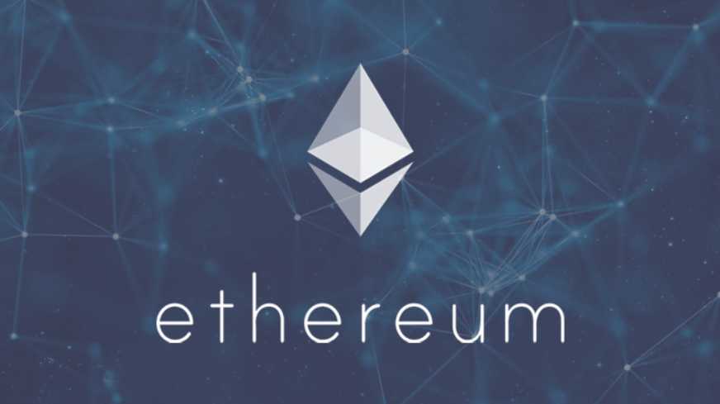

Blaze Sneaker NFTs
Ethereum Smart Contract DApp
Group 2:
Tiara King,
AJ Nettles,
Leigh Allison
CS646: Blockchain and Cryptocurrency
Fall 2022
COLLEGE OF ARTS AND SCIENCES
DEPARTMENT OF COMPUTER SCIENCE

Slide 2
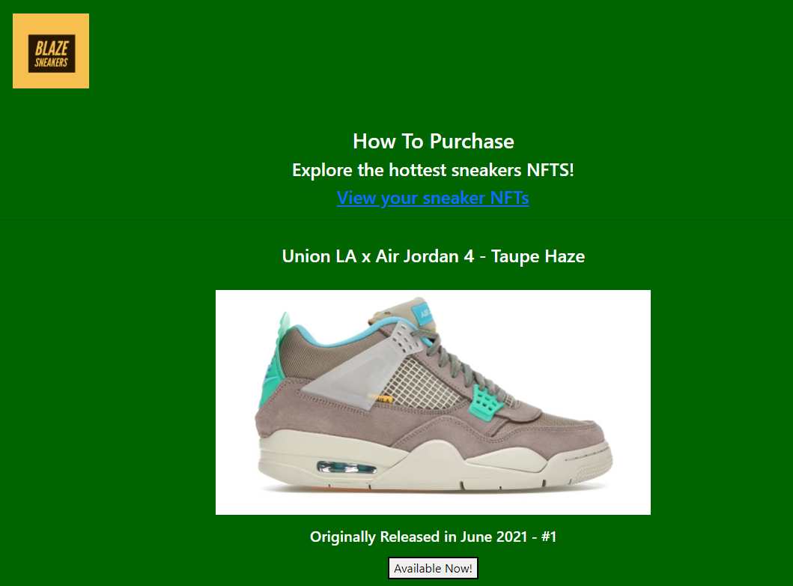
Overview
Purchase sneaker NFTs
View NFTs that you own
Add new NFTs for sale (contract owner)

Slide 3
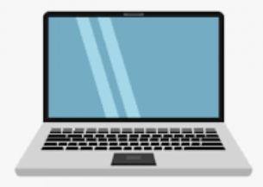

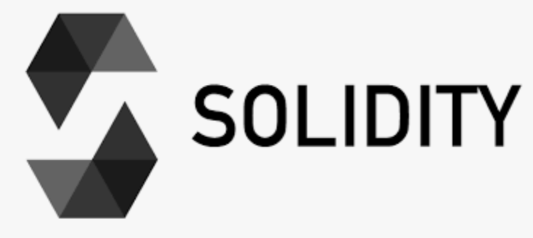
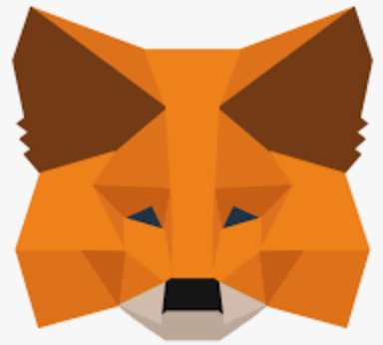
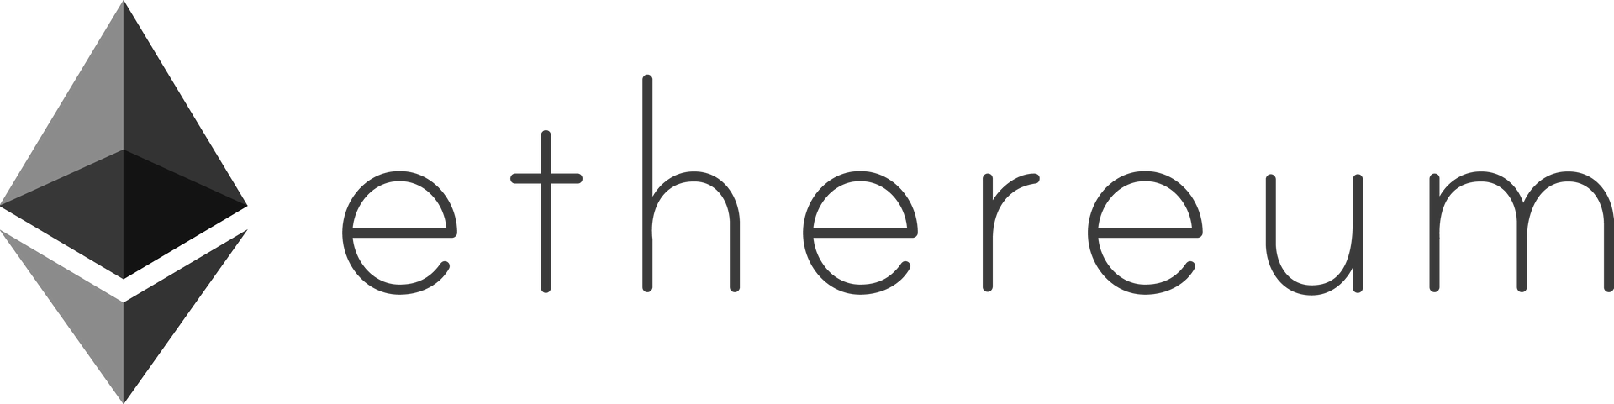

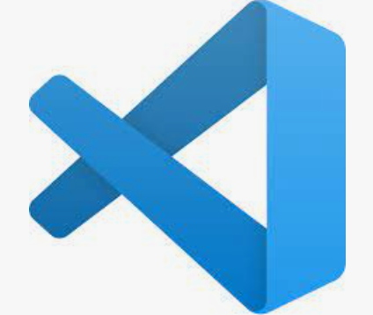


Architecture
Client-side
Server-side
Remix IDE
HTML / JavaScript
EVM & Blockchain
Rinkeby Testnet
web3.js
MetaMask
VS Code
Live Server

Slide 4
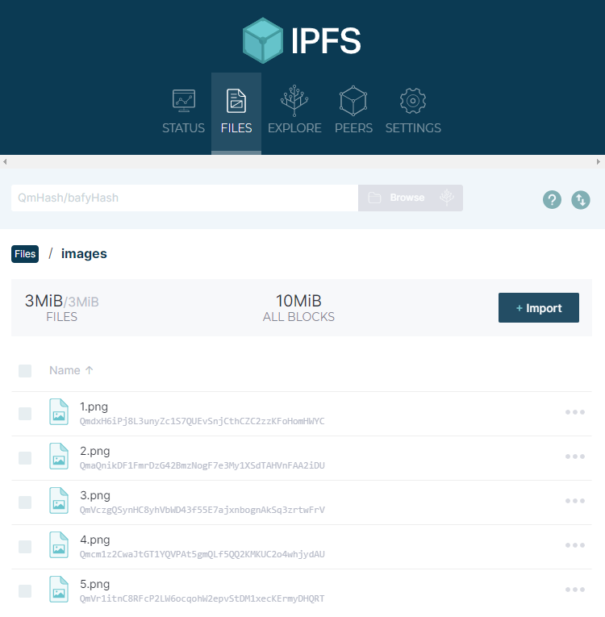
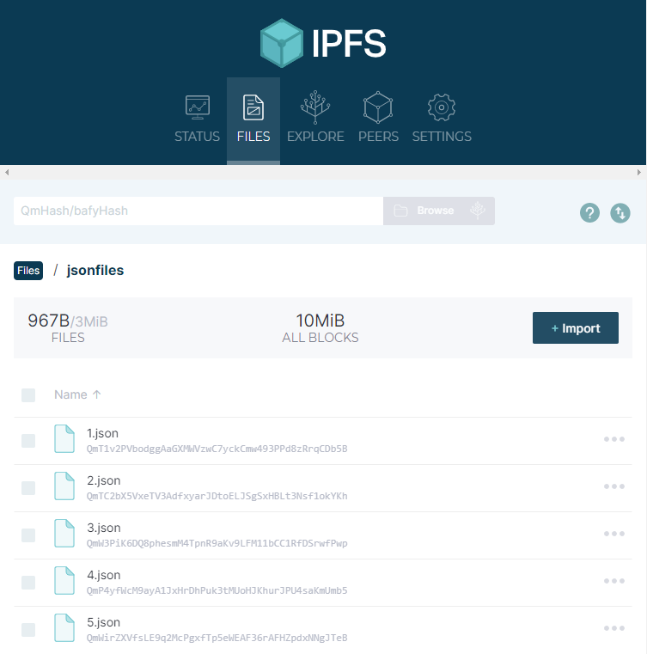
IPFS File Storage
Install IPFS
Upload NFT images to IPFS
Include path to images and upload json file for each
Reference folder as “https://ipfs.io/ipfs/folderhash”

Slide 5
IPFS File Storage
Install IPFS
Upload NFT images to IPFS
Include path to images and upload json file for each
Reference folder as “https://ipfs.io/ipfs/folderhash”

Slide 6
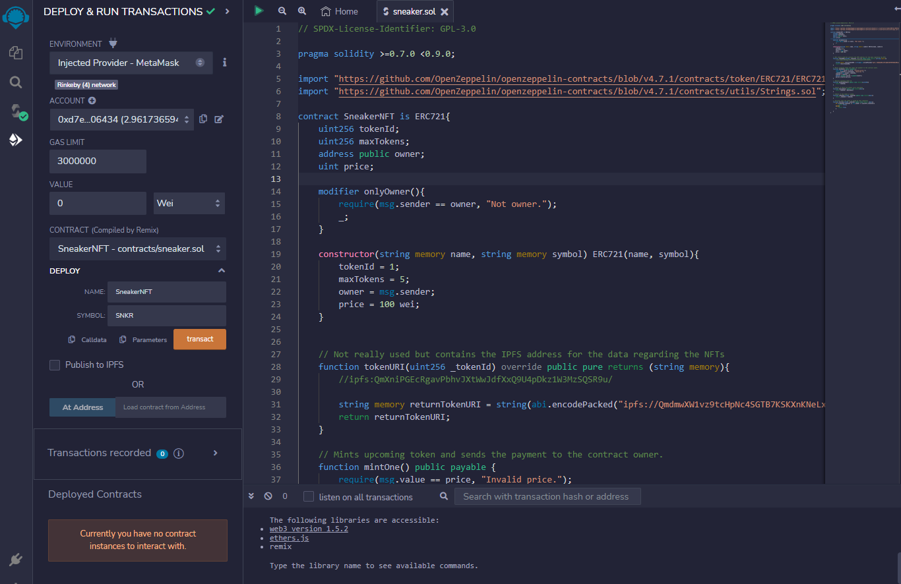
Backend (Remix – Solidity)
Write and deploy Ethereum smart contract in Remix online IDE
Use ERC721 from OpenZeppelin for NFT
Include functions for minting and for the contract owner to add more available NFTs

Slide 7
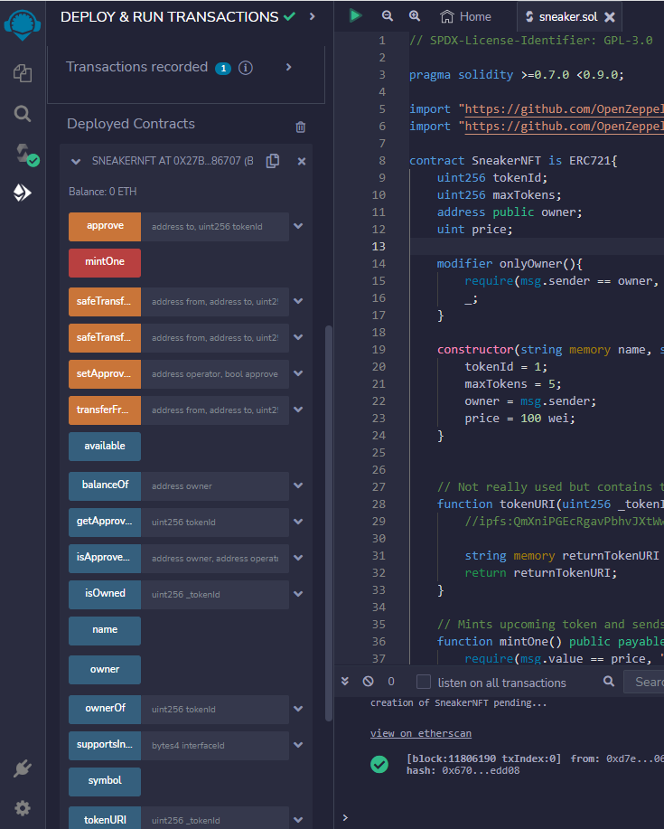
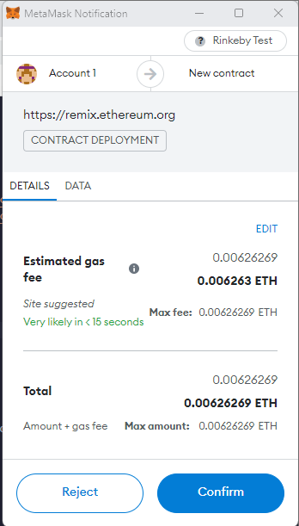
Contract Deployment
Use MetaMask to deploy with your account (injected provider)
Test interacting with contract in Remix

Slide 8
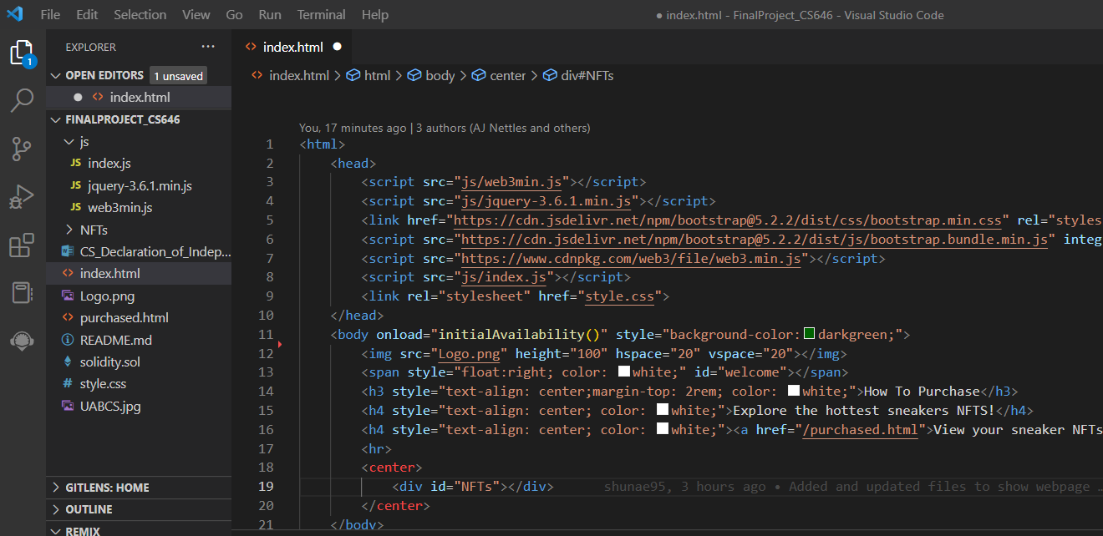
Frontend – VS Code (html, js, css)
Create web pages for purchasing and viewing SNKR NFTs
Call smart contract using javascript
Use LiveServer to run the web site

Slide 9
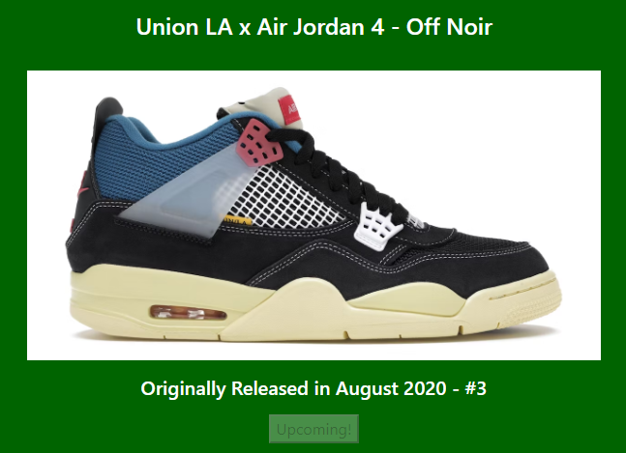
Demo

Slide 10
Lessons Learned

Slide 11


QUESTIONS?
Images ©
https://store.unionlosangeles.com/

