Slide 1
QPhotoView
A Photographers' Image Viewer
and Image Sorting Tool
Idea and Design by
Stefan Hundhammer <Stefan.Hundhammer@gmx.de>

Slide 2
Requirements: Priority 1 (Highest)
It's a photographer's tool
The photo is the most important thing
Quick (!) for showing photos full screen
Quick (!) for comparing two or more photos
(go to next/previous)
No unnecessary stuff on the screen
Simplicity and ease of use

Slide 3
Requirements: Priority 2
Show Image in 1:1 zoom
(one photo pixel corresponds to one screen pixel)
Zoom in and out
Pan zoomed image (mouse drag)
Open in image editor (Gimp, PhotoShop, ...)
Delete current photo (to trash can / for real)
Show (relevant!) photo meta data
(exposure time, aperture, ISO speed, focal length, lens, camera model)

Slide 4
Requirements: Priority 3 (Add-on)
Rotate +/- 90°, 180°
View current directory / collection as thumbnails
Add to collection / photo tray
View only photos from selected photo tray

Slide 5
Not Desired
Degenerate into generic do-it-all viewer for everything including PDF, PostScript, Text
Slow image display
Direct photo editing (red eye removal etc.)
A cluttered screen of which the photo gets only a small part for display
Display bullshit technical EXIF data
(like JPEG compression algorithm etc.)
Widget/window borders, status bars, menu bars, tool bars etc. all over the place

Slide 6
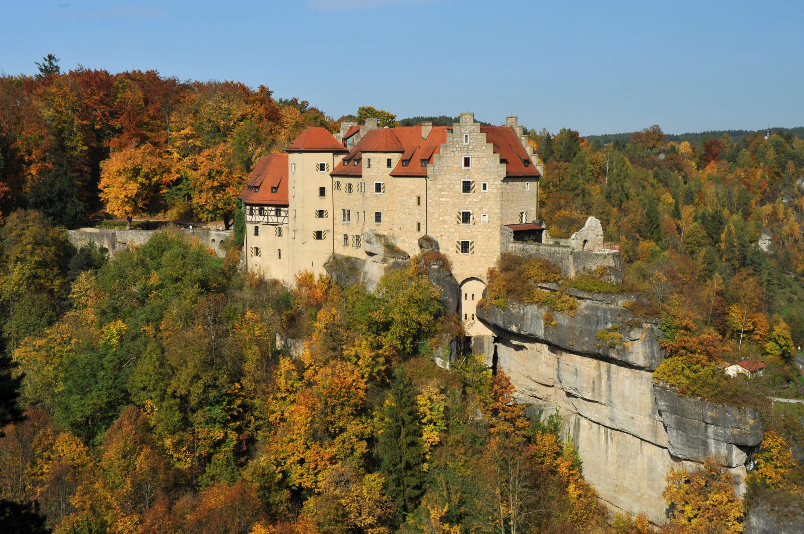
Screen Layout
(16:10 Screen, 3:2 Photo in Landscape Format)

Slide 7
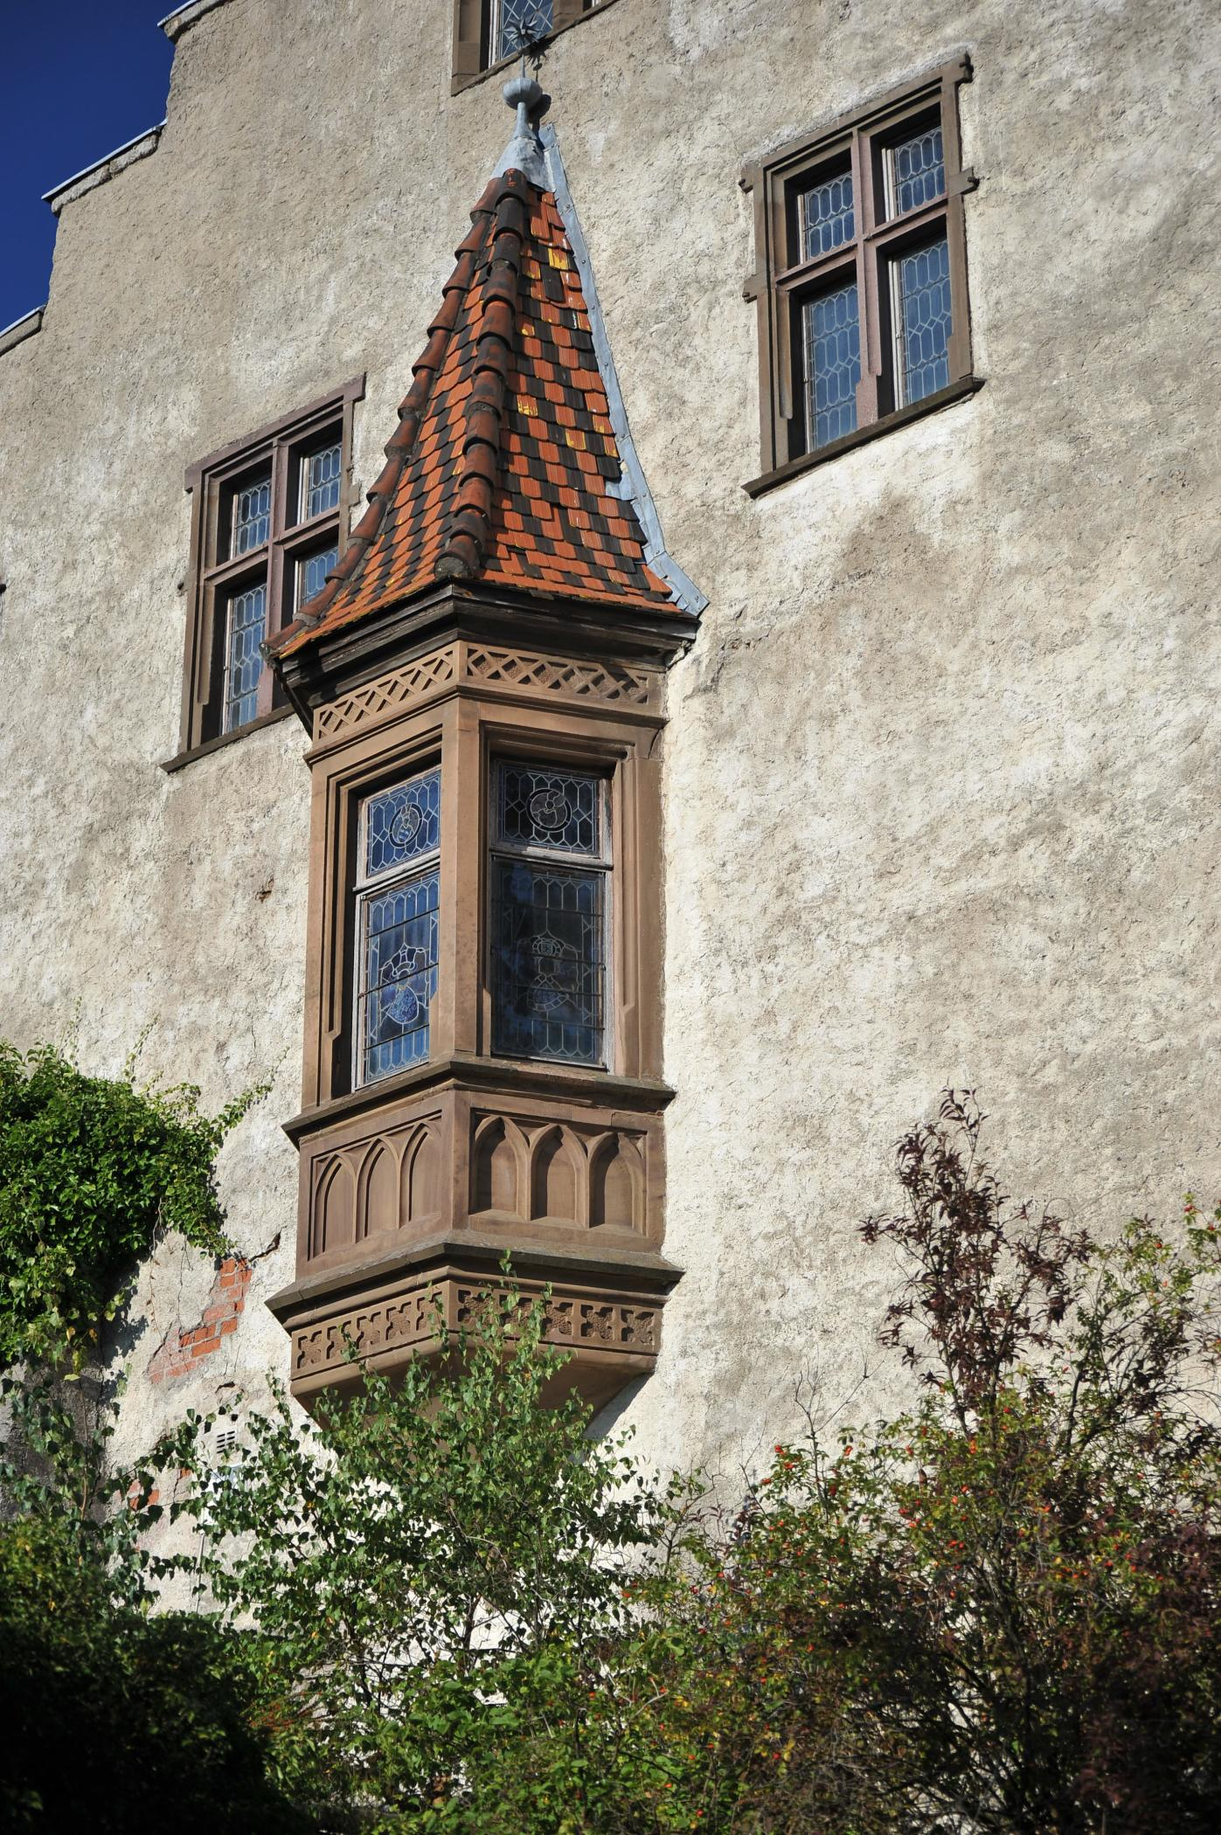
Screen Layout
(16:10 Screen, 3:2 Photo in Portrait Format)

Slide 8
Layout with EXIF Data
(16:10 Screen, 3:2 Photo in Landscape Format, EXIF at Right Border)
1/200 s
f/11
ISO 200
52 mm equiv.
Taken
2008-10-13
14:25:02
Nikon D700
28-300
f/3.5-5.6

Slide 9
Layout with EXIF Data
(16:10 Screen, 3:2 Photo in Landscape Format, EXIF at Bottom)
1/200 s f/11 ISO 200 52 mm equiv. Taken 2008-10-13 14:25:02 Nikon D700 28-300 f/3.5-5.6

Slide 10
Layout with EXIF Data
(16:10 Screen, 3:2 Photo in Portrait Format)
1/800 s
f/4.5
ISO 200
70 mm equiv.
Taken
2008-08-30
17:41:24
Nikon D700
28-300
f/3.5-5.6

Slide 11
Screen Areas
File Edit Navigate View Settings
T
o
o
l
B
u
t
t
o
n
s
1/200 s
f/11
ISO 200
52 mm equiv.
Taken
2008-10-13
14:25:02
Nikon D700
28-300
f/3.5-5.6
17/87

