Slide 1


Model repository and future maintenance
Treasure Valley Groundwater Flow Model Training
Stephen Hundt, USGS (shundt@usgs.gov)
March 14th, 2023

Slide 2
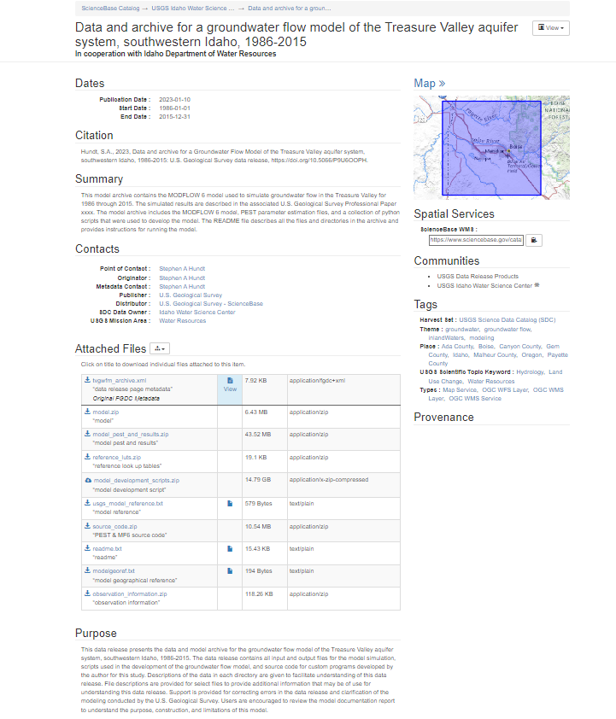
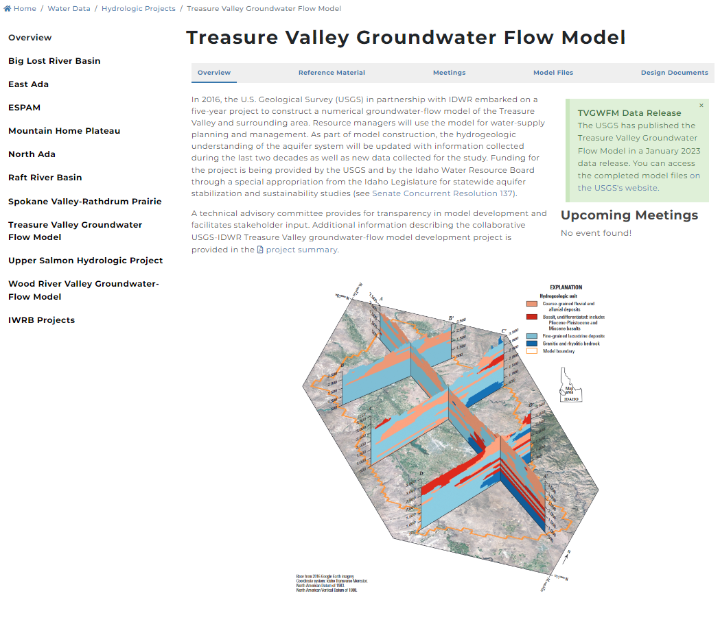
Where to get it
USGS model archive
Sciencebase link
IDWR Treasure Valley project site
IDWR link

Slide 3
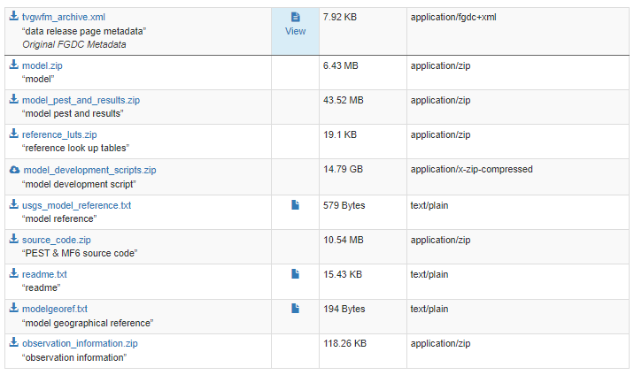
Data release contents
Please, read the **** readme file!
All directories are explained
model.zip
Just MODFLOW files
model_pest_and_results.zip
MODFLOW & PEST files
Utilities and utility files
“results”
model_development_scripts.zip
python files to preprocess and create MODFLOW & PEST files
not designed to be fully reproducible, but may be helpful
All inputs and all decisions are in here
Source code for utilities
observation_information
Observation target data and LUTs

Slide 4
Maintenance
Short term: me
shundt@usgs.gov
If (when) you notice mistakes please tell me - if early enough we can update repository
Longer term: IDWR
Details TBD
I’m not going anywhere – I’m happy to help

