Slide 1


MODFLOW, PEST, and Utility Files
Treasure Valley Groundwater Flow Model Training
Stephen Hundt, USGS (shundt@usgs.gov)
March 14th, 2023

Slide 2
Contents
Review of some MODFLOW details
MODFLOW files
Executing MODFLOW
Review of some PEST details
PEST files
Executing PEST

Slide 3
MODFLOW

Slide 4
MODFLOW 6
Latest version
Grid options
Structured
Layered unstructured
Fully unstructured
Can ‘pinch’ layers, connect layers through inactive intermediate layer cells
Multiple stress package files in same model
Minor change in package availability
Different input structure
Including tabular time-series files
Simulation versus groundwater flow model
Can have multiple models tightly coupled

Slide 5
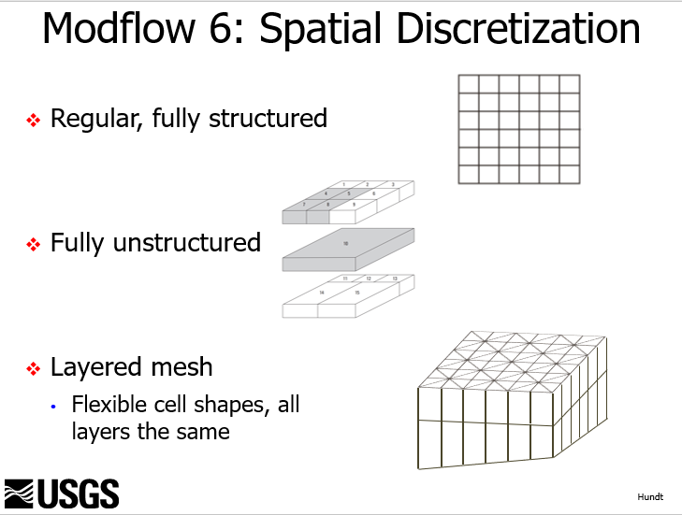
MODFLOW 6
Latest version
Grid options
Structured
Layered unstructured
Fully unstructured
Can ‘pinch’ layers, connect layers through inactive intermediate layer cells
Multiple stress package files in same model
Minor change in package availability
Different input structure
Including tabular time-series files
Simulation versus groundwater flow model
Can have multiple models tightly coupled

Slide 6
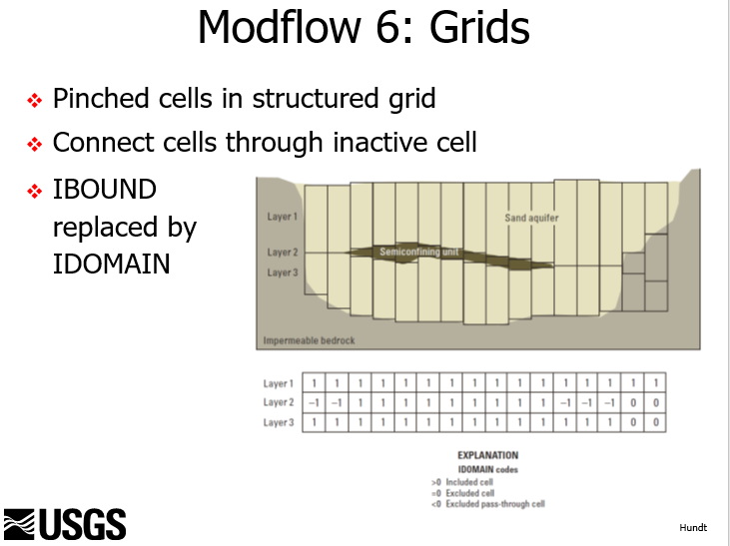
MODFLOW 6
Latest version
Grid options
Structured
Layered unstructured
Fully unstructured
Can ‘pinch’ layers, connect layers through inactive intermediate layer cells
Multiple stress package files in same model
Minor change in package availability
Different input structure
Including tabular time-series files
Simulation versus groundwater flow model
Can have multiple models tightly coupled

Slide 7
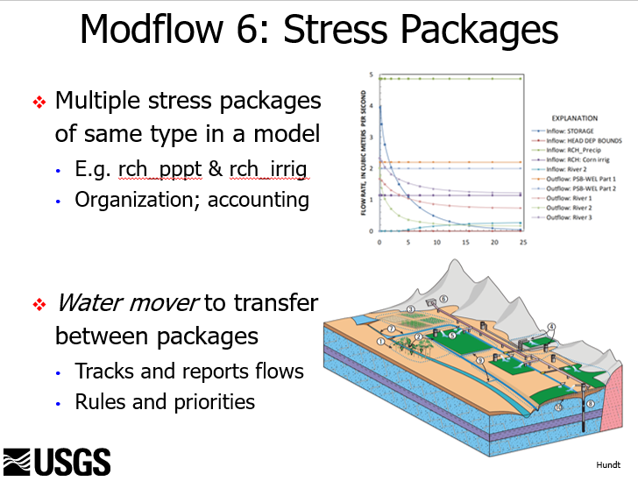
MODFLOW 6
Latest version
Grid options
Structured
Layered unstructured
Fully unstructured
Can ‘pinch’ layers, connect layers through inactive intermediate layer cells
Multiple stress package files in same model
Minor change in package availability
Different input structure
Including tabular time-series files
Simulation versus groundwater flow model
Can have multiple models tightly coupled

Slide 8
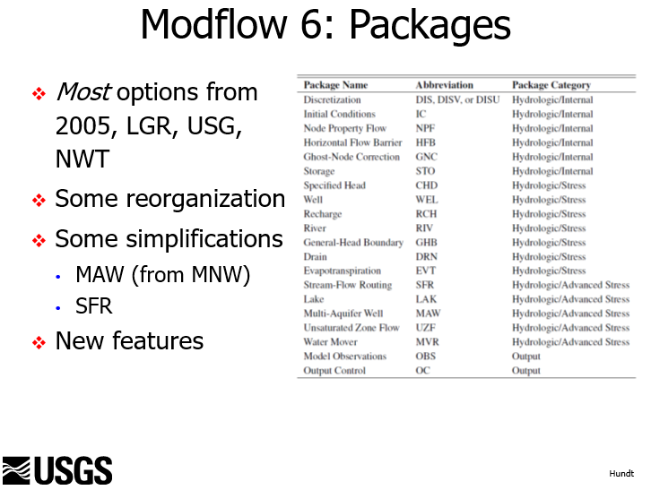
MODFLOW 6
Latest version
Grid options
Structured
Layered unstructured
Fully unstructured
Can ‘pinch’ layers, connect layers through inactive intermediate layer cells
Multiple stress package files in same model
Minor change in package availability
Different input structure
Including tabular time-series files
Simulation versus groundwater flow model
Can have multiple models tightly coupled

Slide 9
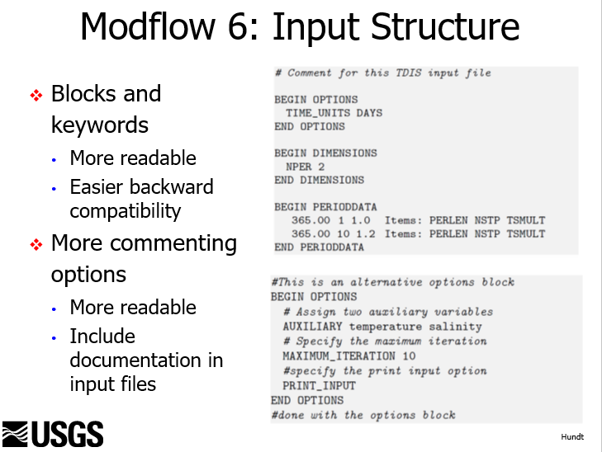
MODFLOW 6
Latest version
Grid options
Structured
Layered unstructured
Fully unstructured
Can ‘pinch’ layers, connect layers through inactive intermediate layer cells
Multiple stress package files in same model
Minor change in package availability
Different input structure
Including tabular time-series files
Simulation versus groundwater flow model
Can have multiple models tightly coupled

Slide 10
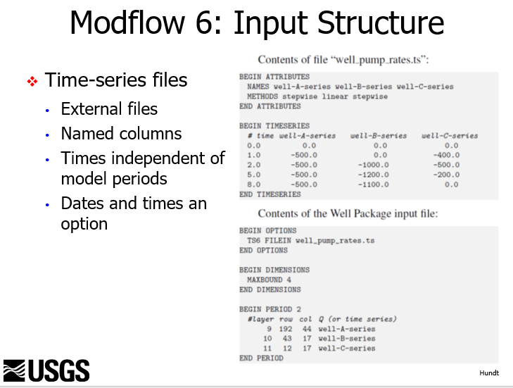
MODFLOW 6
Latest version
Grid options
Structured
Layered unstructured
Fully unstructured
Can ‘pinch’ layers, connect layers through inactive intermediate layer cells
Multiple stress package files in same model
Minor change in package availability
Different input structure
Including tabular time-series files
Simulation versus groundwater flow model
Can have multiple models tightly coupled

Slide 11
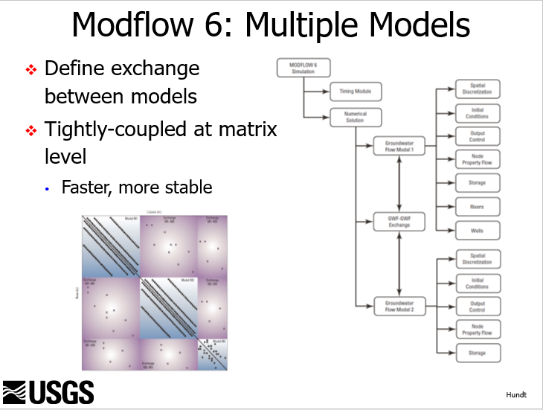
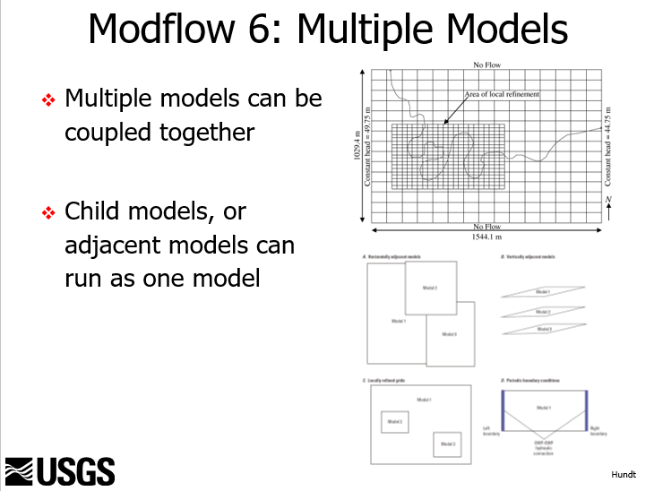
MODFLOW 6
Latest version
Grid options
Structured
Layered unstructured
Fully unstructured
Can ‘pinch’ layers, connect layers through inactive intermediate layer cells
Multiple stress package files in same model
Minor change in package availability
Different input structure
Including tabular time-series files
Simulation versus groundwater flow model
Can have multiple models tightly coupled

Slide 12
MODFLOW Files
Simulation files
Groundwater flow input files
Output files

Slide 13
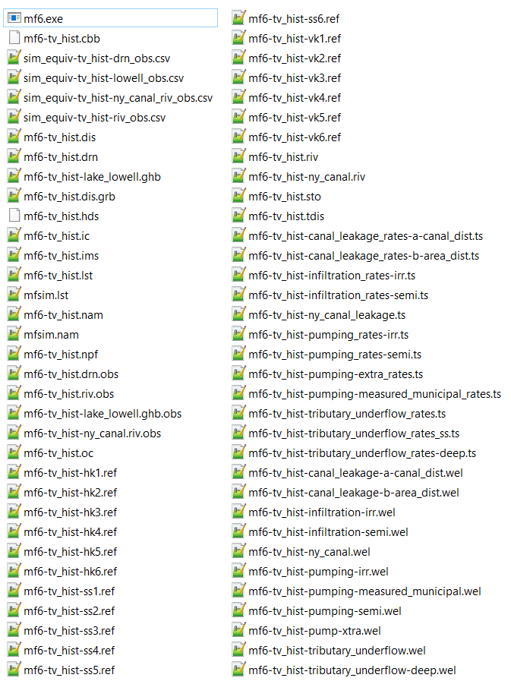
Simulation Files
mfsim.nam
TDIS
IMS

Slide 14
Groundwater Flow Input Files
NAM
DIS
IC
NPF
STO
REF
DRN
GHB
RIV
WEL
TS
OC
OBS

Slide 15
Output Files
Simulation
mfsim.lst
Groundwater Flow
LST
GRB
CSV (obs output)
HDS
Binary
CBB
Binary
(not by default)

Slide 16
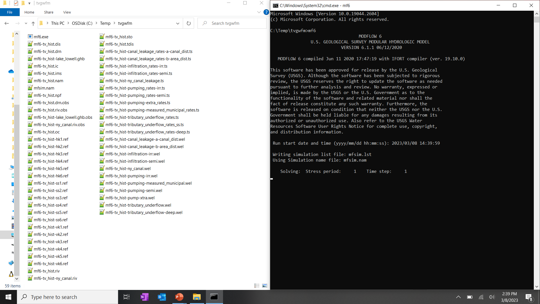
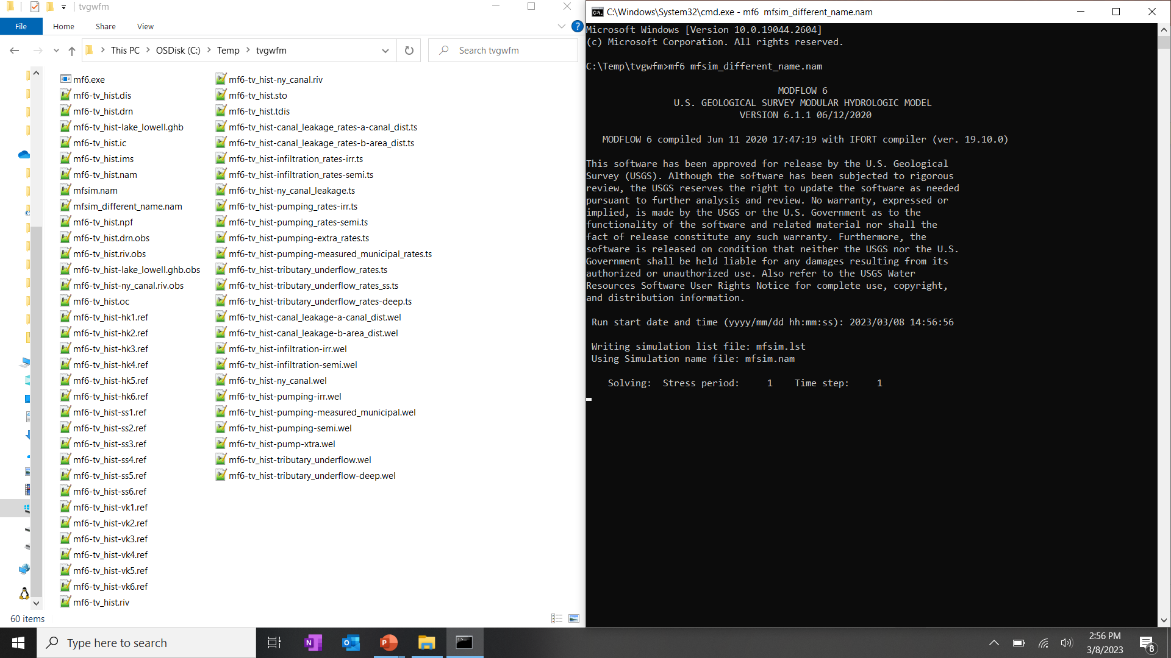
Executing MODFLOW
Just call mf6 from the directory of your model files
Default is to use mfsim.nam
Don’t need to specify a file if using mfsim.nam in the working directory
Can specify a different simulation name file

Slide 17
Custom Utility Files

Slide 18
Custom Utilities
In the model_pest_and_results directory you will find three executables starting with util_
util_irr_lands
Calculates stresses associated with irrigated lands
Canal leakage; incidental recharge; pumping
Calculates multipliers for distributing canal leakage
Proportion of
Creates time-series files used by well package files
Changes with PEST iterations (irrigated lands parameters). May want to change with scenarios.
util_make_node_to_bore
Needed for making simulated equivalents for observation wells that span multiple model layers
Tells mf6mod2obs how calculate a weighted average of heads from multiple model cells
Weights are proportional to open interval * conductivity
Changes with PEST iterations, but not scenarios
util_cell_pumping_alloc
Needed for distributing pumping to multi-layer wells
Pumping is distributed in proportion to open interval * conductivity
Changes with PEST iterations, but not scenarios

Slide 19
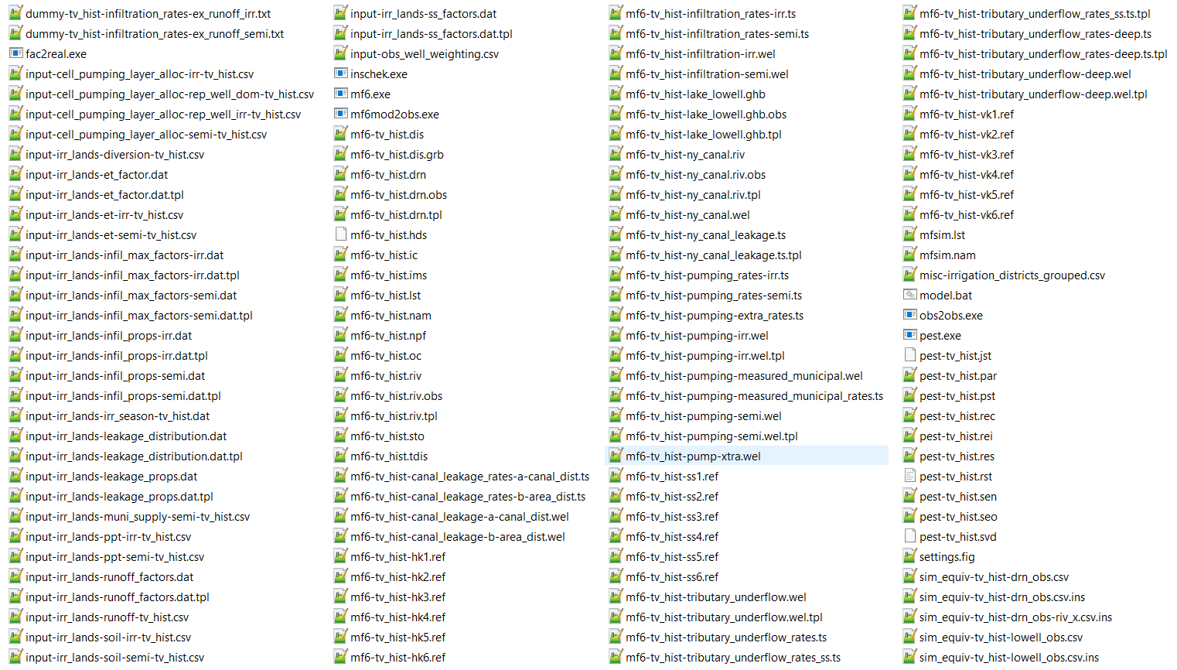
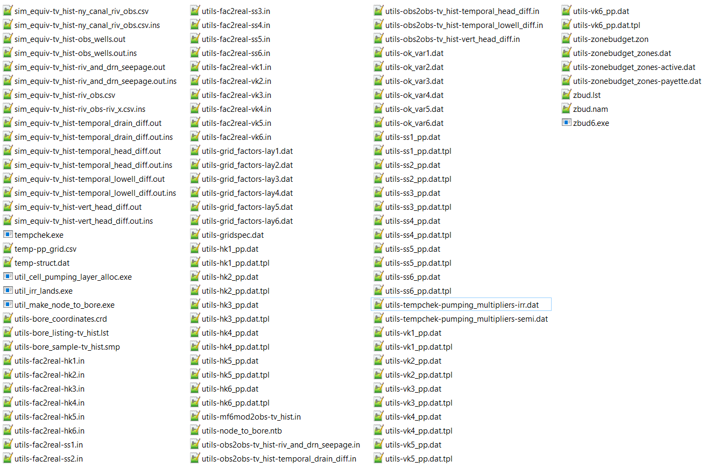
Custom Utilities: util_make_node_to_bore

Slide 20
Custom Utilities: util_cell_pumping_alloc

Slide 21
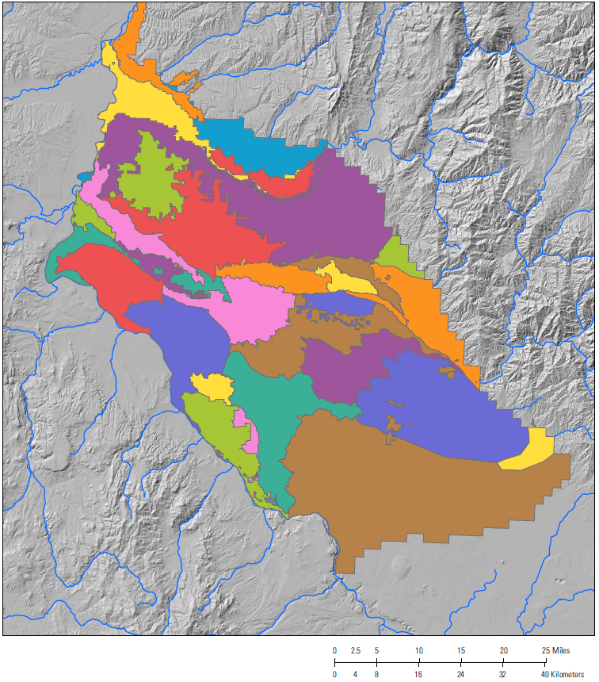
Irrigated Lands: Entities
Start with irrigation entities
Entity that is listed in diversion records
Almost match those of previous models
Boise project board of control subdivided
Black canyon
The irrigation_entity.shp shapefile has #’s and irrigation_entity_names.csv LUT has names
Some are combined
The misc-irrigation_districts_grouped.csv LUT has new numbers of those combined
The original TS data is preserved (but unused) in input files for reference

Slide 22
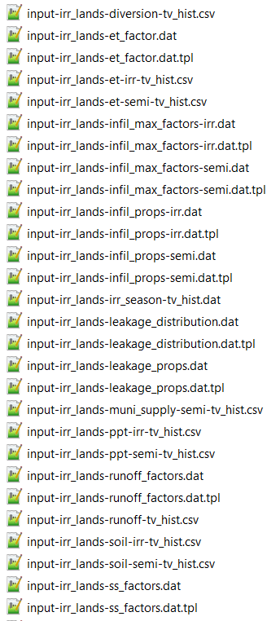
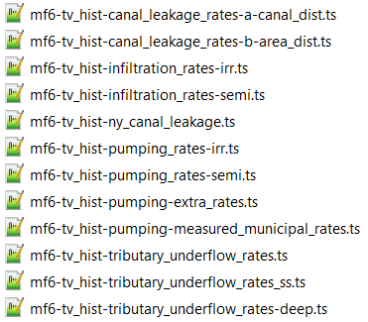
Irrigated Lands Utility Files
Input files
Parameter files
Volumetric Inputs:
Diversions
ET
Soil moisture
Measured municipal supply
Parameters
Flux factors
ET, maximum excess infiltration, irrigation infiltration, canal leakage, steady-state factors, SW return
Canal leakage spatial distribution
Time-series output files:
Irrigation pumping, irrigation infiltration, canal leakage
util_irr_lands
.wel files
Time-series files
other mf files …
MODFLOW

Slide 23
Custom Utilities: util_irr_lands

Slide 24
Parameter Estimation Files
PEST & utilities

Slide 25
Parameter Estimation Files
PEST Control file
Files for PEST I/O
Post-processing utilities
PEST output files

Slide 26
Parameter Estimation Files

