Slide 1


Running Scenarios
Treasure Valley Groundwater Flow Model Training
Stephen Hundt, USGS
March 14th, 2023

Slide 2
Contents
Running scenarios: conceptually
Running scenarios: in practice
Exercise: creating a baseline scenario
Exercise: creating scenarios
Pumping scenario
Recharge scenario
Drought scenario
Warming scenario
Canal lining scenario

Slide 3
Approaches to Running Scenarios
…

Slide 4
Running Scenarios – In Practice
Hands-on exercise: creating a baseline scenario
Start from final stress period of historic – copy the final 10 years of the historic period for the background stresses of the baseline
Steps:
Changing the time period
Creating an initial condition
Creating boundary stresses time-series from last 120 stress periods
Edit boundary packages with time-varying stress locations or multipliers
Rename (tv_hist -> tv_scenario)
Notes:
Files to create or collect:
New initial condition
X oc file that only prints final heads
X hds file from this
X Initial condition file that reads the above hds file
Location info:
X grid file with layers
X node information file
- grid file joined with node information
Observation files:
- head observation file (one location)
- flux boundary observation (any that we don’t already create???)
Time info:
X historic scenario tdis file
X stress period excel table w/ date, sp, and total time
X drought severity index
New boundary – simple
- wel file with constant pumping, no ts file
- wel file with cyclical pumping, ts file, historic period
Existing boundaries – new time period
- one simple example (reuse historic, last 5 year for 5 year simulation, 5 year repeated a few times for a 20 year simulation, dry year for a )
Scenario files

Slide 5
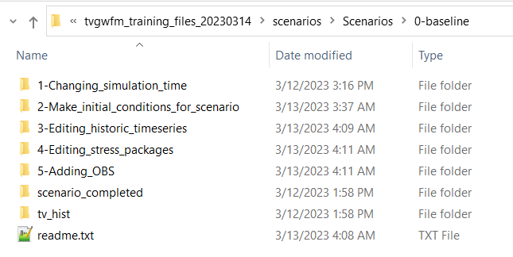
Time period
All transient
Last 10 years
120 stress periods
Ignore leap years (Egyptian calendar!)
Just cause it was easier for this demonstration
Change STO and TDIS
Make a TOTIME array for changing time-series files

Slide 6
Initial Condition
Historic period begins with steady-state period & constant IC
Scenarios will probably be all transient
Extract the heads from the final historic stress period and define as initial condition for scenarios

Slide 7
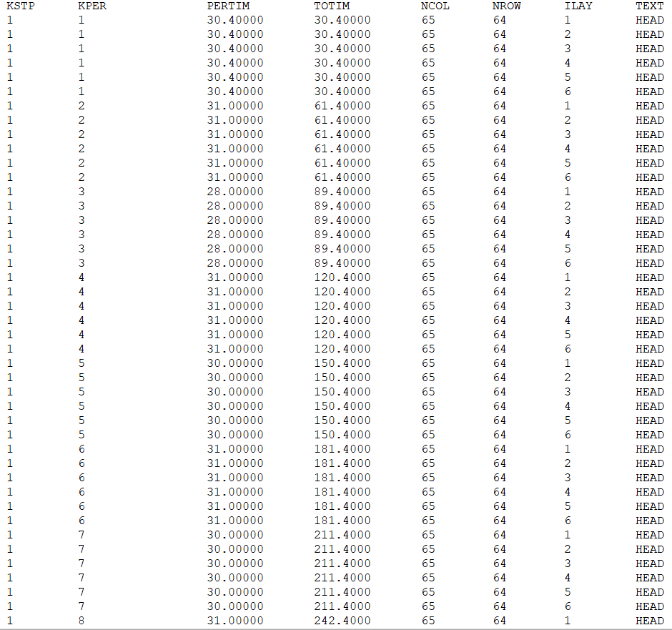
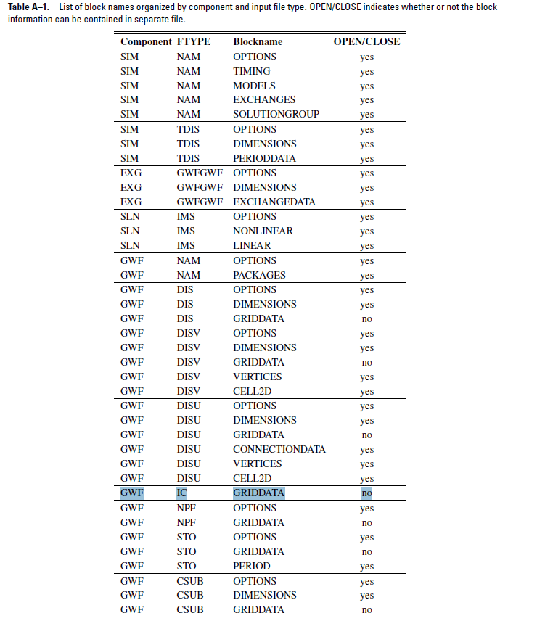

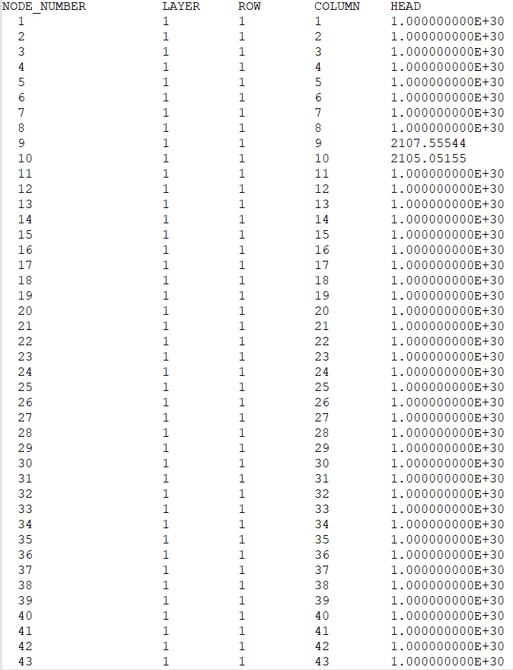
Initial Condition
Cannot read from separate file
List input
Extract from chosen time of the historic heads file
PEST gwutils:
mf6arrdet – to get info about hds file
mf6bin2tab_h to get tabulated output from hds file

Slide 8
Using historic time-series files
Tedious, there are a lot
Keep the last 120 rows (remove 241 rows)
Change the time column

Slide 9
Using historic stress package files
Some stress packages have time varying boundary cells or multipliers
Need to decide what is most appropriate
Keep the most recent (spatial distribution of recharge) because land use is most realistic?
Do the same as time-series and keep the last 120 stress periods worth of data?

Slide 10
Observation (OBS) Package
Boundary packages can have observation files. They are specified in the boundary file.
Head and drawdown observations must be listed in the name file.

Slide 11
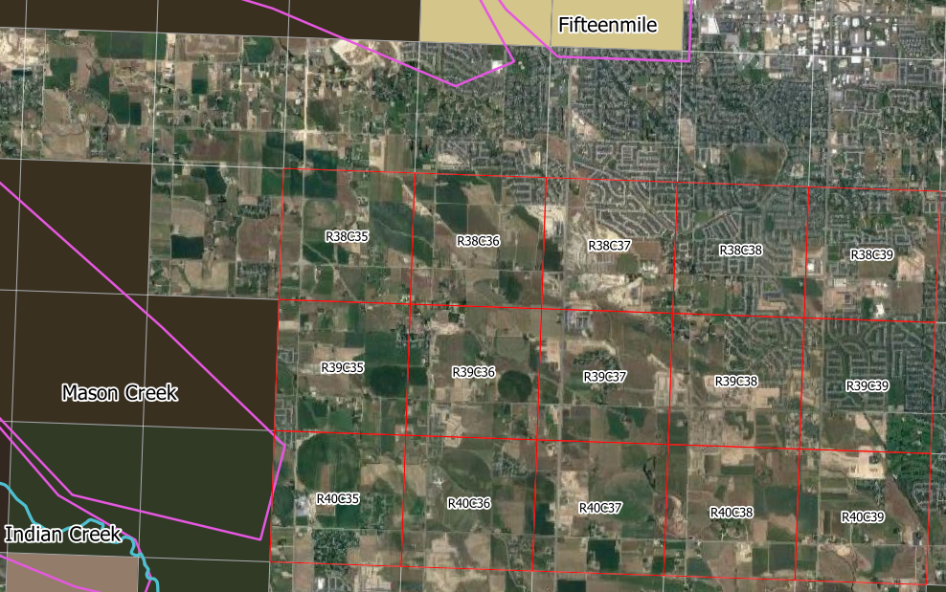
Observation (OBS) Package
10 observations
Layer 1 and layer 3
layer | row | column
1 | 38 | 35
1 | 38 | 39
1 | 39 | 37
1 | 40 | 35
1 | 40 | 39
3 | 38 | 35
3 | 38 | 39
3 | 39 | 37
3 | 40 | 35
3 | 40 | 39

Slide 12
Example Scenarios
Hands-on Exercises

Slide 13
Caveats
Reminder: Regional model, 1 mile grid size, no local heterogeneity – not designed for impacts in individual wells or from single pumping wells
These are just for demonstration; they aren’t very realistic or meaningful

Slide 14
Pumping Scenario
New ‘well field’ (many wells in a large area) with pumping throughout entire 10 year scenario
Observe heads around the well field and fluxes from drains
New steps:
Adding a stress package file
Compare observation output files

Slide 15
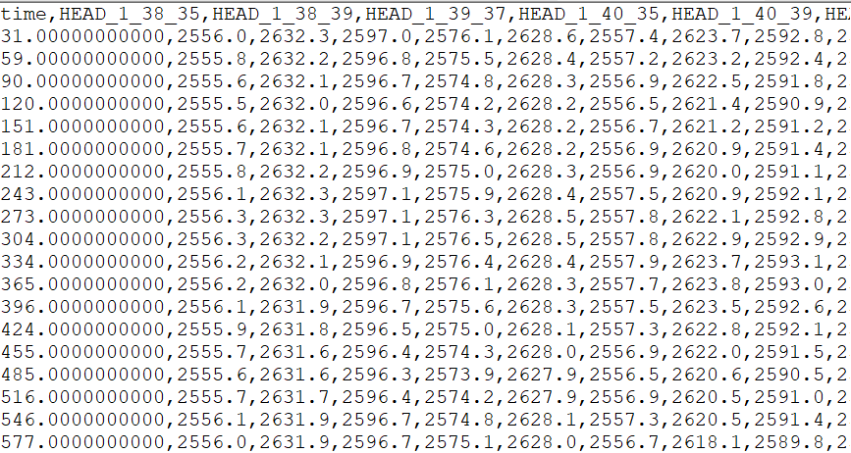
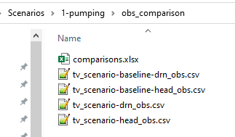
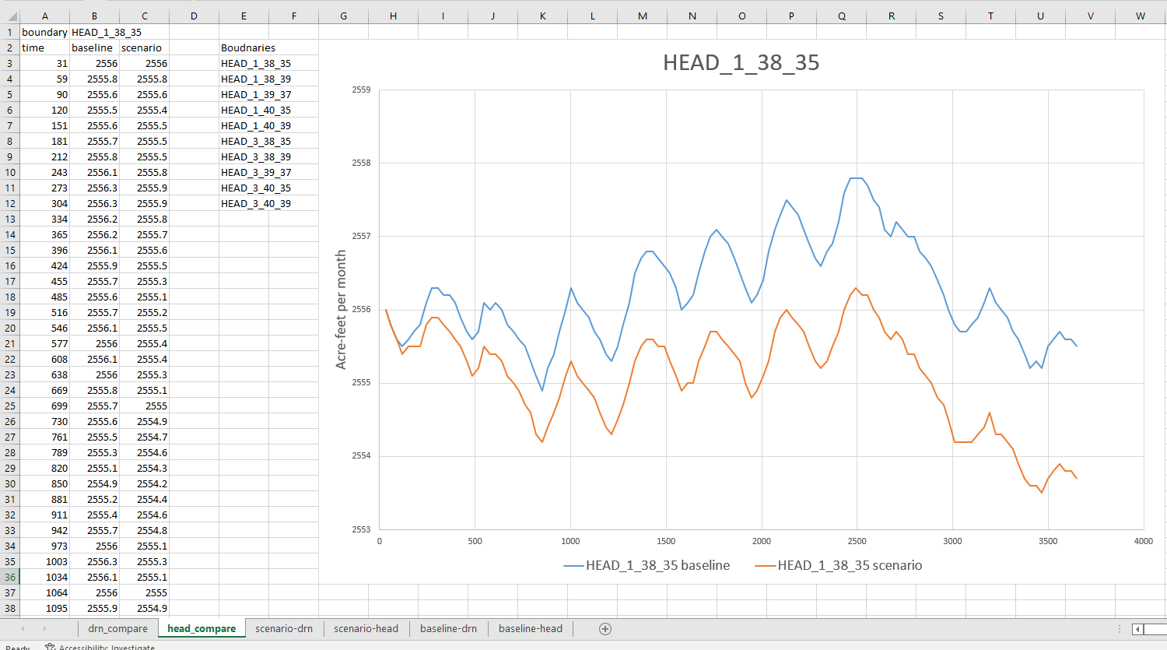
Comparing OBS files
Obs output is csv and can be easily loaded into common software
I’m using excel

Slide 16
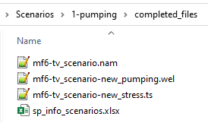
Adding Stress Package to MF6
Pretty easy:
Create a new WEL file (.wel)
Add to NAME file (.nam)
Optional: create a new time-series file (.ts)

Slide 17
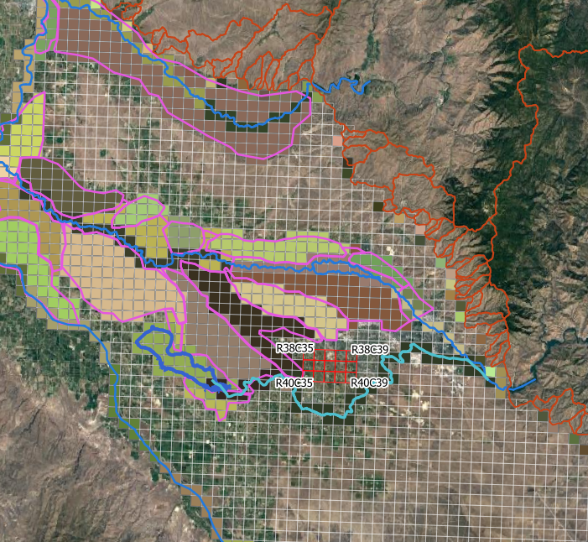
Pumping Scenario
A few cells in a row to represent a region of increase pumping from multiple wells
Pumping:
Layer 3
Row 39
Columns 36, 37, 38
Continuous pumping:
20,000 AF / year
Observation wells around (already made)

Slide 18
Recharge Scenario
Recharge in the same cells as the previous scenario
Recharge for only first year of scenario
New steps:
Changing the multiplier on the well package
Removing lines from time-series files; replacing with value of 0 to last for the final 9 years of the scenario

Slide 19
Recharge Scenario
sdf
Reuse files from pumping scenario
A few cells in a row to represent a region of recharge facilities
Recharge:
Layer 1
Row 39
Columns 36, 37, 38
One year of recharge:
100,000 AF / year
Observation wells around (already made)

Slide 20
Warming Scenario
Across the board increase in ET
Across the board decrease in diversions
Leave everything else the same (including NY Canal leakage) to see impacts of these changes only
New step:
Editing the util_irr_lands input files
Running the util_irr_lands utility

Slide 21
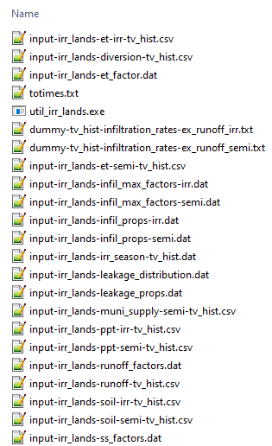
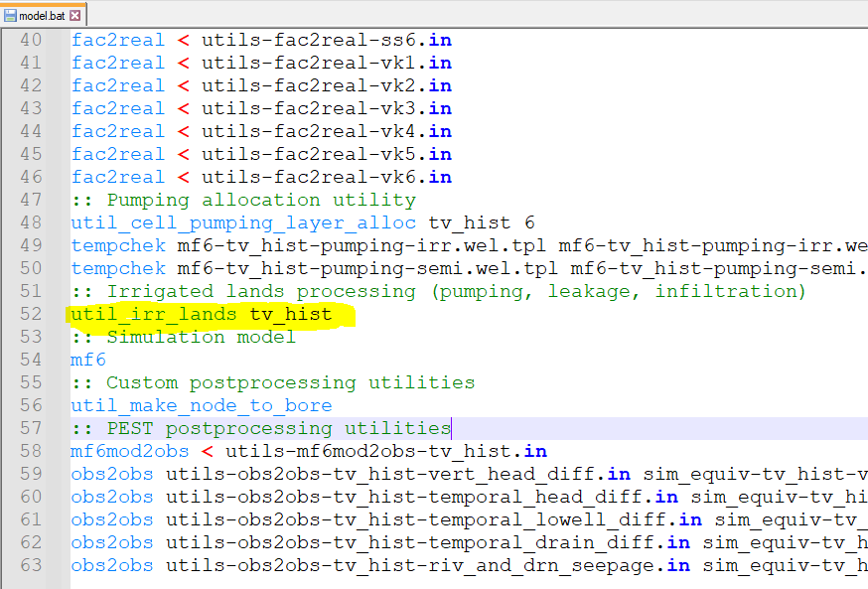
Using supply and demand utility files
Requires a number of input files:
Those starting with “input-irr_lands…”
The “dummy-… files”
One could edit the input files of volumetric quantities or parameter files
PEST’s model.bat will show you how to call the utility

Slide 22
Warming Scenario
Get the last 10 years of all inputs to the
Increase ET by 10%
Decrease diversions by 10%
Run the utility
Copy the time-series files

Slide 23
Canal Lining Scenario
Line the New York Canal
Across the board decrease in leakage
New step:
Change the factor parameter in a time-series file

Slide 24
Canal Lining Scenario
Drop New York Canal recharge by 25% across the board
Easy to do: SFAC parameter in the TS file

