Slide 1
Synthetic Data Generation for Navigation in GPS-Denied Environment
- An outline for APL ASPIRE Students in 2022 Summer
Shunguang Wu
06/25/2022

Slide 2
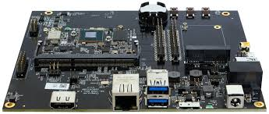
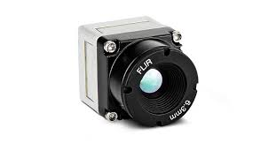
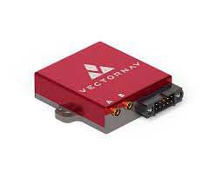
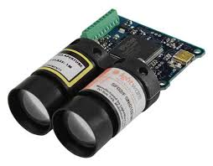
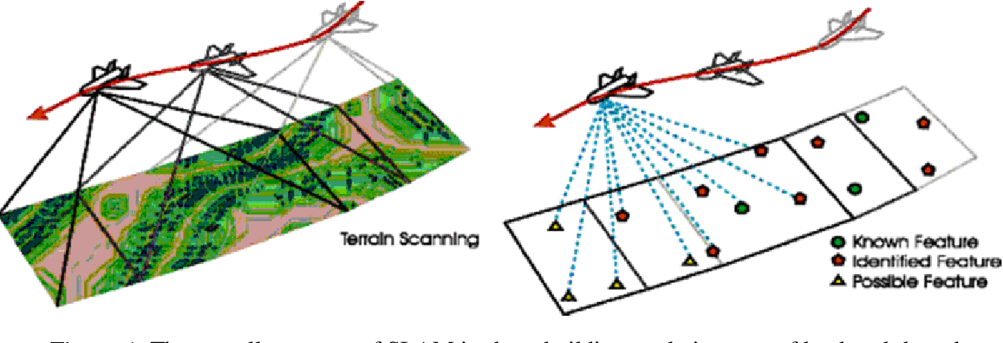
Background: Computational Platform and Sensors
System on Chip (SoC) Computer
VectorNav (at 50-100Hz)
GPS (lat, lon, height)
Inertial Measurement Unit (IMU)
-acc: acceleration in body-fixed coordinates
-gyro: delta angle rotation around three axis
Magnetic field of the earth
Baro: flight height based on air pressure
Other
Camera (at 30 or 60Hz)
Measure platform velocity based on pixel change between two image frames
Range Sensor (at 50Hz)
Measure range from camera to scene
(image from web)

Slide 3
What we shall do in this summer
Literature review: navigation in GPS denied environment
(week 1, work together)
Learn Basic Matlab
Learn Basic git and open gitHub account
Create a rigid body platform, and put the three sensors on it
Design some flight paths
(week 2,3, work together)
Flight the rigid body platform along the paths
Generate synthetic measurement data for VectorNav
Student A
Verify and visualizing the generated data
(week 2-6)
Generate synthetic measurement data from Camera & range sensor.
Student B
Verify and visualizing the generated data
Continue development and prepare a IEEE-STEM conference paper
(Deadline: at the end of December )
(Fall semester, optional)

Slide 4
Literature review: Navigation in GPS denied environment
Why do we need it?
What kind of platforms and sensors the community use?
What kind of measurements these sensors providing?
Why people using synthetic data in R&D?
(No math, just high level common sense kind of concept/understanding)

Slide 5
Matlab
Should be already installed in your machine
Basic data type, vector, and 2d-matrix operations
figure, plot(), and plot3()

Slide 6
Create a rigid body platform
Qs: what kind of shape we should choose, what is the simplest one with minimum parameters and good/close enough to the reality?
Hints
There should have a body-fixed coordinate system on this platform, each sensor should have a (x, y, z) coordinate on it.
Hint: Math to describe the rigid-body?
Hint: Matlab visualization

Slide 7
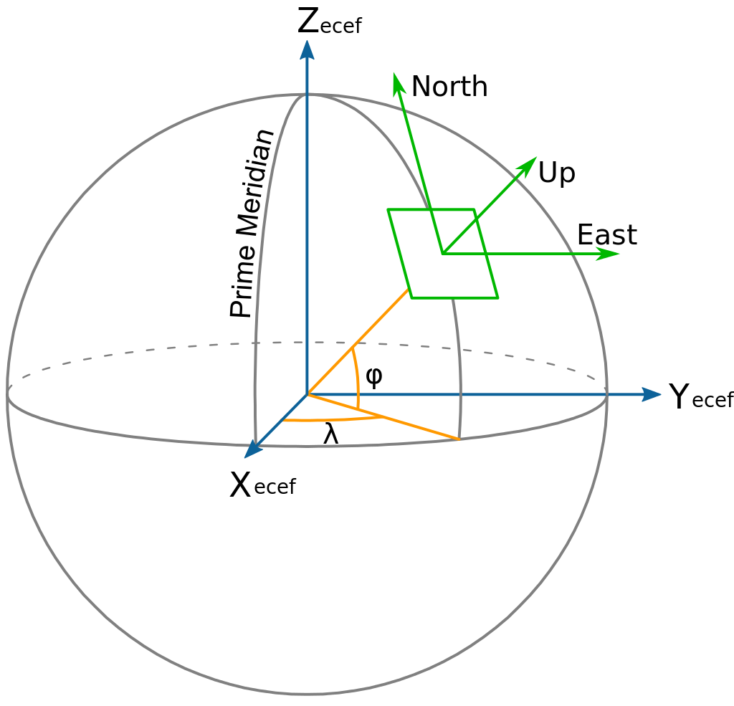
Design flight paths
Global coordinate reference (earth fixed)
(lat, lon, height)
ECEF
ENU or NED
Matlab function to transfer from one to another
Some paths may considering
A 2D line (with fixed height)
A 2D circle (with fixed height)
Oval / ellipse (with fixed height)
etc.
Coding practice: generate a path and plot it
(image from web)

Slide 8
VectorNav synthetic measurements
Problem1: Given a rigid body in flight (global measurement), how to generate its local measurement (IMU and Gyro)?
Problem2: Given the local measurement (IMU and Gyro), how to recover its global flight path?
1 and 2 can be used to verify the correctness of each other
Repeat the above steps by adding Gaussian noise?

Slide 9
VectorNav synthetic measurements
struct Nav{
uint64_t fn{ 0 }; //sample index
uint64_t time_us{ 0 }; //sample time in macro second, 1 sec = 1e6 us
uint8_t gpsNumSats{ 0 }; //num of satellite
vec3f gpsMeasPosLla{}; //[deg,deg,m]
vec3f gpsMeasVelNed{}; //[deg,deg,m]
vec3f gpsMeasPosU{ 0 }; //NED unsertainty (m)
vec3f gpsMeasVelU{ 0 }; //NED Vel uncertainty (m/s)
vec3f mag[3] //Gauss:compensated magnetic measurement
float pressure{ 0 }; //kPa: compensated pressure measurement
uint32_t deltaTime_us{ 0 }; //delta time in macro sec
vec3f deltaTheta{}; //gyro deg
vec3f deltaVel{}; //imu m/sec
};

Slide 10

Camera – synthetic measurements (approach 1)
Problem: Given (lat, lon, height), camera parameters (focal length, imgW, imgH), and view angle (look down) can we retrieve a google earth image?
Basic Image format (bmp, jpg, png) and its data structure in Matlab.
Load an image from file, manipulate, display, and save it with different format
Study if there any open source to solve this problem?
Or
What is the math behind this problem?
(image from web)

Slide 11
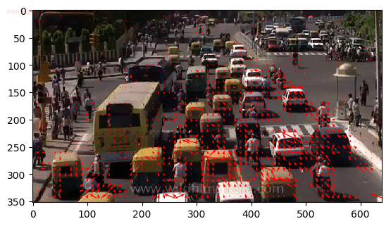
Camera – synthetic measurements (approach 2)
Problem: given platform flight velocity in NED, camera parameters (focal length, imgW, imgH, view angle) can we retrieve optical flow?
Part 1: learn
what is optical flow (without math)?
pixel flow: Image based (dx, dy)
from pixel flow to angular flow
from angular flow to global velocity
(I will give more slides to detail these steps)
(image from web)
Part 2: solve the original problem by inversing part 1
(If we solved the problem in approach 1, we do not need to go approach 2)

Slide 12
Camera – flow data structure
struct FlwSample{
uint64_t img_fn{0}; //image frame number
uint64_t time_us{0}; //image frame time in macro second
int32_t flow_quality{ 0 };//-1 marked not publishing the flow to EKF
uint32_t dt_us{ 0 }; //time interval between two frames in macro second
float flow_x_pix{0}; //pixels in image coordinate: top left(0,0), x-right, y-down
float flow_y_pix{0}; //pixels in image coordinate
float flow_x_rad{0}; //radius flow
float flow_y_rad{0}; //radius flow
float integrated_x_gyro_rad{0};
float integrated_y_gyro_rad{0};
float integrated_z_gyro_rad{0};
float vel_x_mps{0}; //m/s, Flow in x-sensor direction, angular-speed compensated
float vel_y_mps{0}; //m/s, Flow in y-sensor direction, angular-speed compensated
float range_meas{0};
};

Slide 13
Administration
Team meeting Friday: 4 - 5pm
Present what you did in the past week and what you will do in coming week
OK no show, but need to notify me earlier
Use APL official Email for communications, ask me if you have any questions
Work on APL provided computer.
Source code and document at gitHub
Create you account at GitHub, and email me your account url
Will invite you to the project
Box for sharing data files

Slide 15
Navigation in GPS Denied Environment
(students figure it out in literature review)

