Slide 1
xEyes Block Diagrams
swu@xEyes.com
9/26/2019

Slide 2
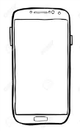
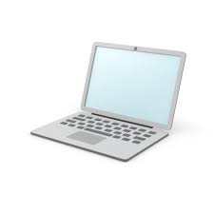

Overview
Remote image/video view & alarm message
wired or
wireless
Network
Route/
Switch
Network
Route/
Switch
1
2
wired or
wireless
Computer
(processing)
n
wired or
wireless
Local
view
Local
storage
Remote
storage
History
search
& view

Slide 3
Capture Agent
Overview
Capture Agent
File name service thread
Capture Thread 1
…
Capture Thread n
Capture Object
Audio
RTSP
DeMixer &Decoder
Audio Frm Q
(shared)
YUV
Scale
YUV
Convert
RGB
Local
Storage Mgr
RGB Frm Q
(shared)
disk

Slide 4
AI Agent
Overview
AI Agent
File name service thread
xDetection
Thread 1
…
xDetection
Thread n
xDetection Object
Key Frm
Y
ML people detection
Object Q
(shared)
RGB Frm Q
(shared)
N
change detection
Detection
DB

Slide 5
Local View Agent
Local
View
Thread
RGB Frm Q: Camera 1
Object Q: Camera 1
…
RGB Image
Display
Window
RGB Frm Q: Camera n
Object Q: Camera n

Slide 6
Relay Agent
Relay Thread
Remote display
on phone computer
RGB Frm Q: Camera 1
Object Q: Camera 1
video
streams
Remote /cloud
storage
…
Alarm
message
images
RGB Frm Q: Camera n
FB,
wechat
email
etc.
Object Q: Camera n

Slide 7
GUI
c1
c2
c3
c4
Logo
Image
id
name
fps ImgSz rec disp

