Slide 1
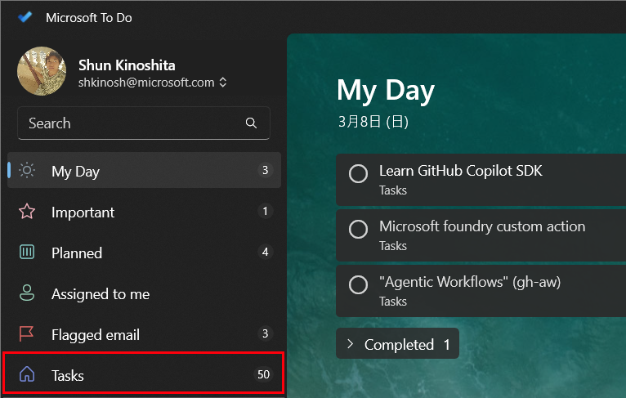
Task-breaker - From overwhelm to done
https://github.com/shunkino/task-breaker
Problem:
In a Enterprise, many people use To Do apps to manage their work, but when tasks are created without much thought, you can end up unsure whether a task is truly “done,” or unclear about what the next step should be. When that happens, you don’t finish what you planned for the day, it feels discouraging, and over time the backlog keeps growing—eventually leading to a sense of helplessness. On the other hand, if you try to do everything “properly”—breaking tasks into the right size and writing down all the necessary context as notes—it takes a lot of time. Then you have less time to actually make progress on the work itself.
Solution:
I believe this happens because the context and level of detail that the user has in their head are not sufficiently captured in the task. Later—when trying to make progress or deciding whether to mark a task as complete—the user can’t accurately recall the original context, and the task becomes hard to manage. By leveraging an AI solution to collect missing context and monitor task granularity, we can keep tasks at an appropriate size and with the right level of detail. This makes it easier for users to manage task status—and to record progress even in small steps. The biggest benefit is reducing the feeling of being overwhelmed by tasks, which should help prevent burnout.
(So many tasks piled up that I wanted to knock out, but couldn’t.…🥲)

Slide 2
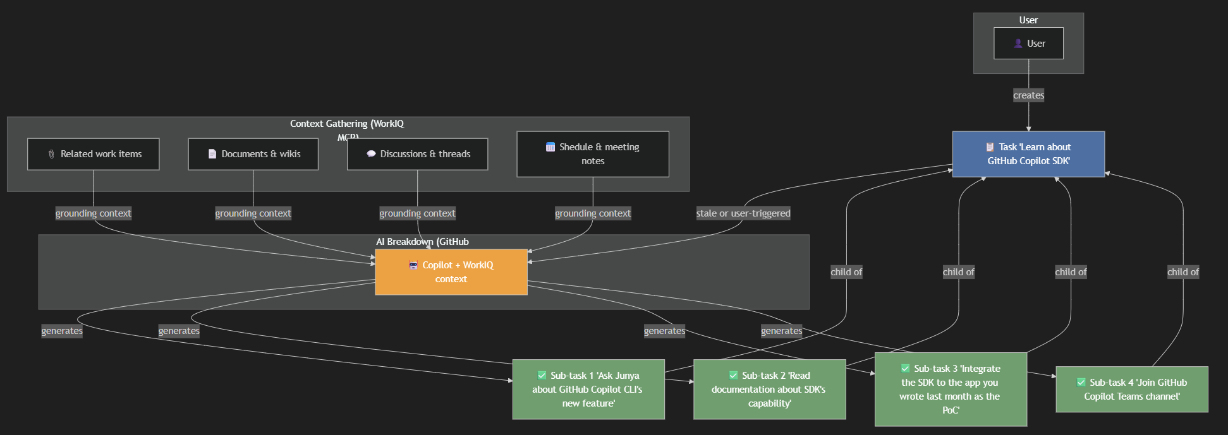
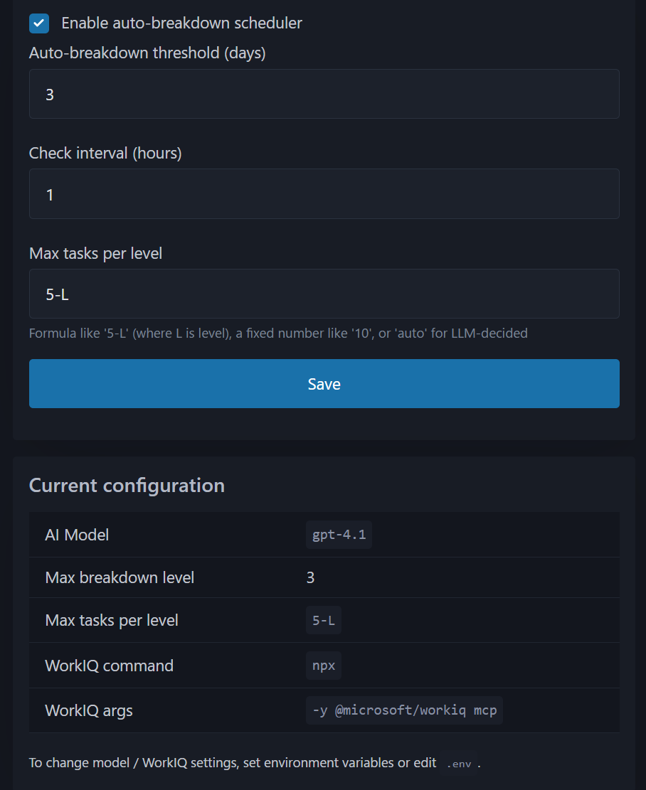
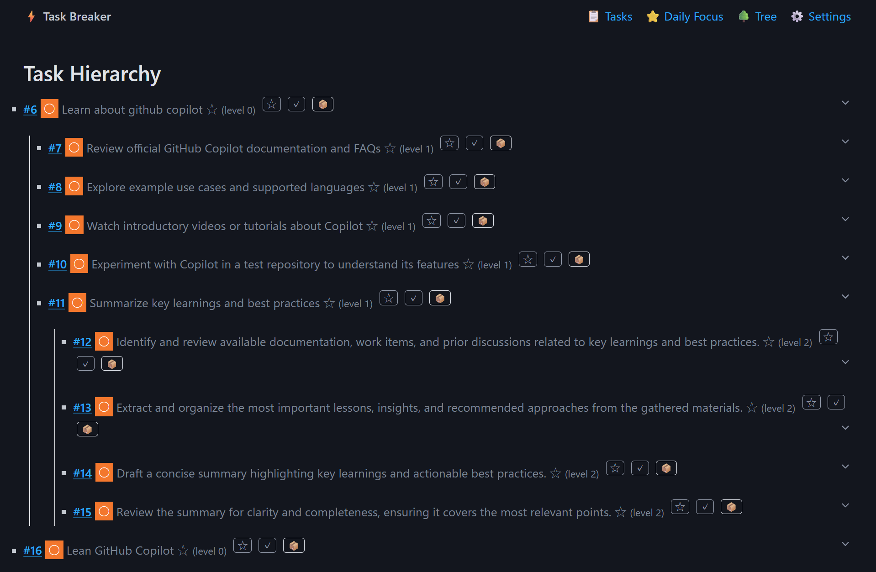
Architecture and Features
Main user scenario:
The user creates a task.
WorkIQ gathers relevant context and stores it alongside the task.
If the task becomes stale for a configured period (or the user clicks Break down), the break-down flow starts.
The break-down flow uses the task notes and additional context from WorkIQ to split the task into smaller, actionable tasks.
Additional Features:
Core to‑do list with task hierarchy (parent/child tasks)
Breakdown scheduler with configurable intervals and per‑level subtask generation limits
Business Value:
Maximize the value of organizational knowledge to support day‑to‑day execution
Reduce overwhelm from stale tasks and help prevent burnout

