Slide 1
KNN Classification
Classic, easy, supervised learning

Slide 2
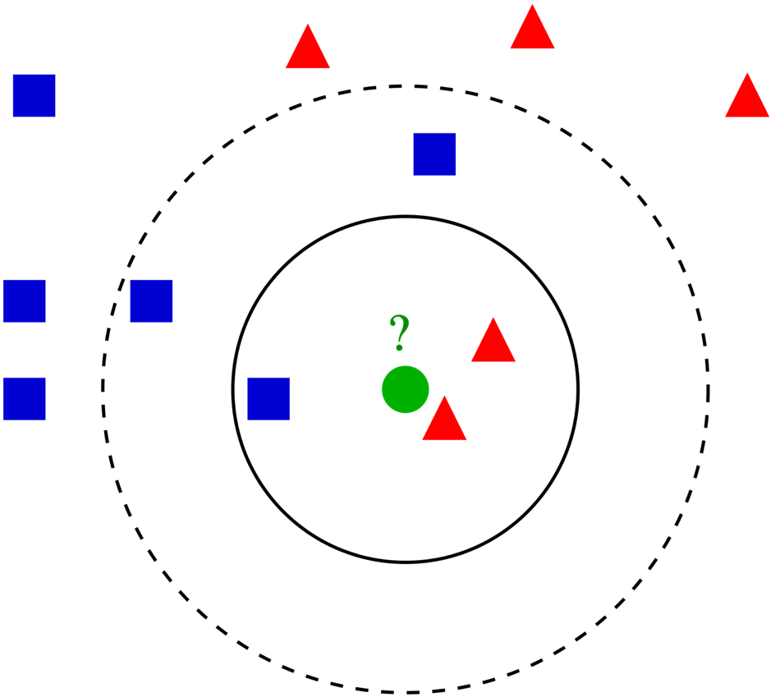
KNN Classification
If k=1, We should classify the green circle as the closest class, which is red triangle.
If k=3, We should calculate the probability belong to every class. The nearest three observations are two red triangle and a blue rectangle. So we should classify the green ball as red triangle.
How about k=5?

Slide 3
KNN Classification
If k=2, it works.
If k=4, it seems does not work.

Slide 4
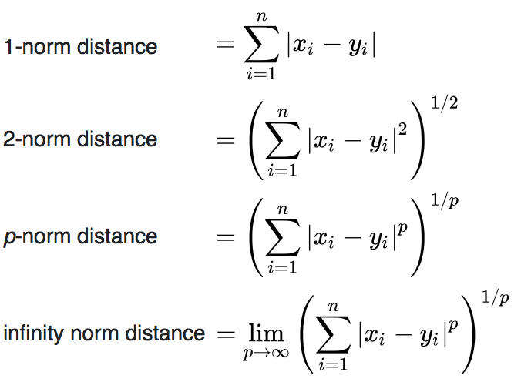
KNN Classification

Slide 5
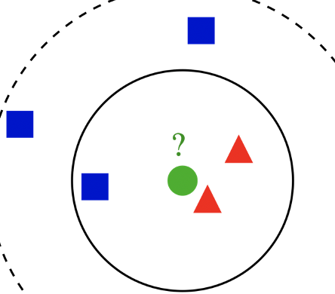
KNN Classification
In order to classify the observations without any label:
Calculate the distance between all the labeled point to the point.
Sort the order.
Choose the smallest k points.
Among these k points, we calculate the probability of each class occurring.
Return the class with highest probability

Slide 6
KNN Classification
KNN is lazy-learning algorithm.
We do not need training data, so the time complexity is 0.
However, the time complexity of classification is O(n), if the observations are n.

Slide 7
KNN Classification
KNN is lazy-learning algorithm.
We do not need training data, so the time complexity is 0.
However, the time complexity of classification is O(n), if the observations are n.

Slide 8
KNN Classification
the unbalanced problem
Solve method: give the classes with different weight to balance the data.

Slide 9
KNN Classification
How to find the optimal k?
Using different K to calculate the misclassification error rate of testing data with KNN. and choose the smallest one.
Is it the best one?

Slide 10
KNN Classification
How to find the optimal k?
Cross-validation error rate is more reliable.

