Slide 1
AI-Assisted Design & Optimization (AutoML + Metaheuristics)
By Shunmugapriya Swamy

Slide 2
What is the Thesis About?
Investigates the effect of hyperparameter optimization on machine-learning performance.
Evaluates models across multiple benchmark datasets with different characteristics.
Establishes a baseline model for each dataset.
Applies different optimization strategies to search for improved model configurations.
Compares:
  Predictive performance
  Optimization time
  Training time
  Convergence behaviour
Investigates whether optimization consistently improves model performance.

Slide 3
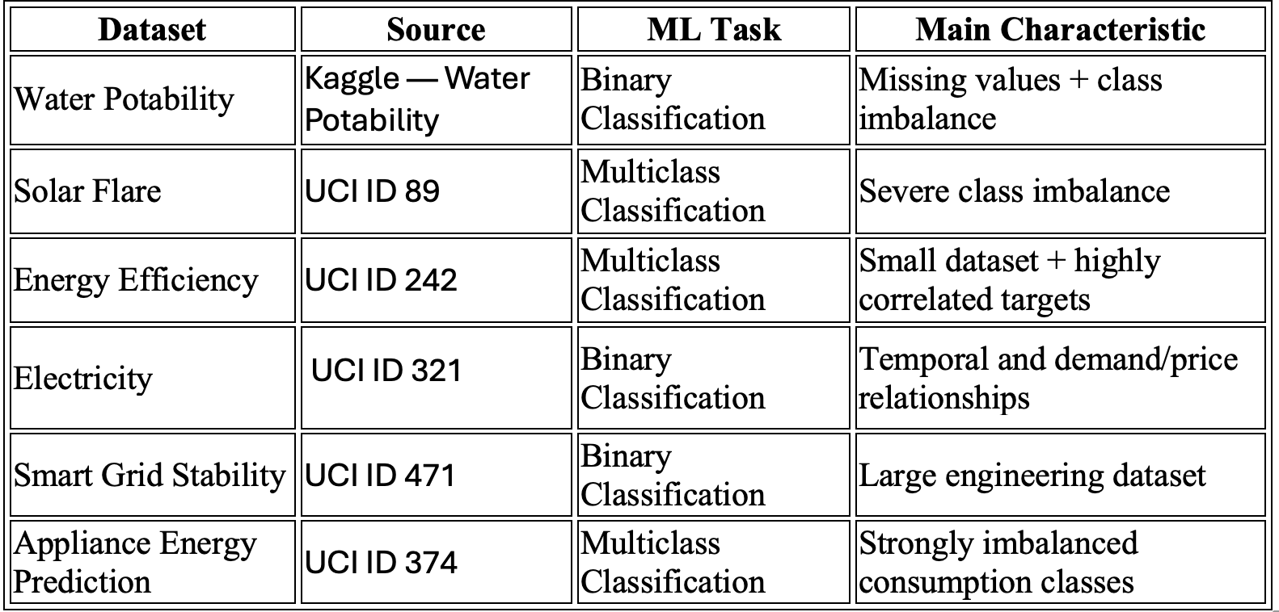
Datasets
Why these datasets?
Provide different data characteristics.
Cover binary and multiclass classification.
Include different dataset sizes and feature types.
Include datasets with class imbalance, missing values and temporal structure.
Allow optimization methods to be evaluated under different modelling conditions.

Slide 4
What Was Done in Phase 1?
For each dataset:
Dataset structure and feature analysis
Missing-value and duplicate analysis
Target/class distribution analysis
Feature distribution analysis
Feature–target relationship analysis
Correlation analysis
Dataset-specific target preparation
Baseline model development
Dataset-specific analysis
Water: Missing values, class imbalance and feature relationships
Solar Flare: Multiclass distribution and categorical/numerical features
Energy Efficiency: Heating/Cooling relationship and energy-class construction
Electricity: Price, demand, period and target-transition analysis
Smart Grid: Stability distribution and feature relationships
Appliance Energy: Consumption distribution and K-Means clustering

Slide 5
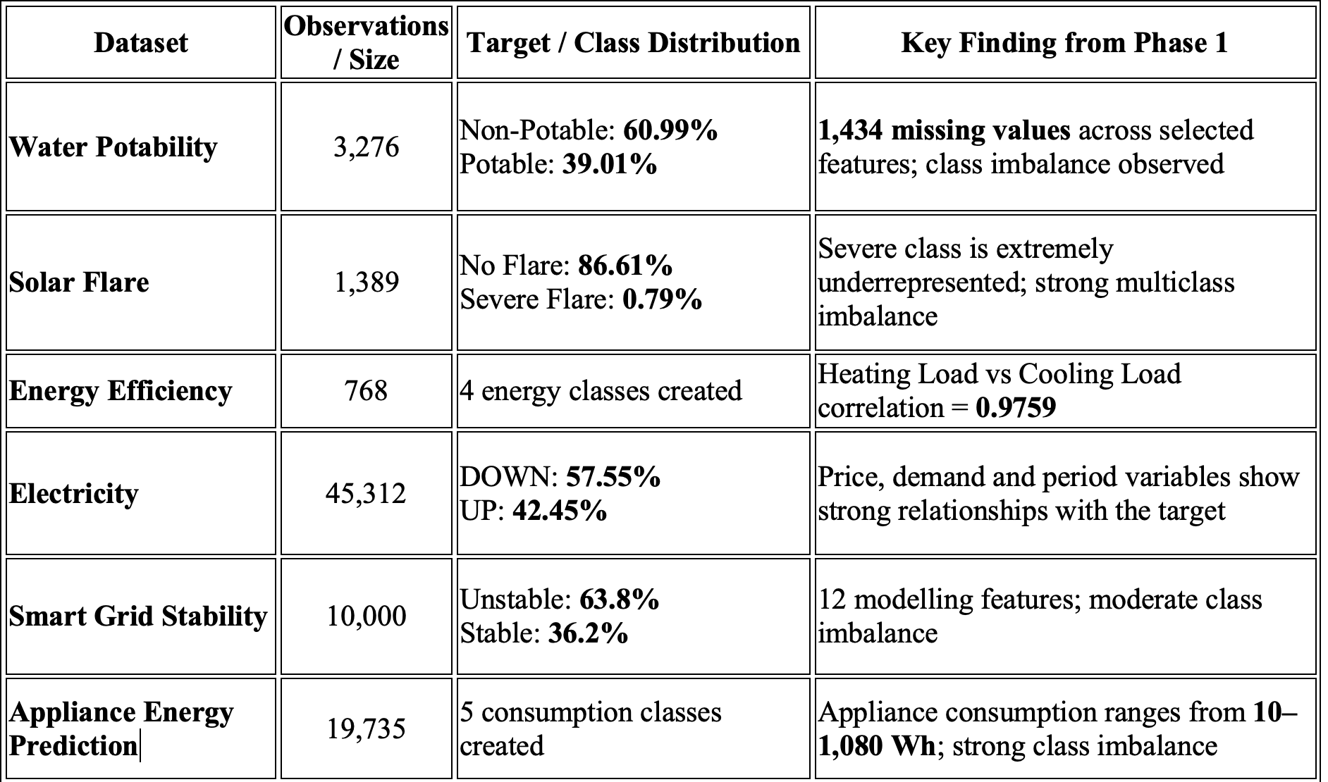
Phase 1 Results

Slide 6
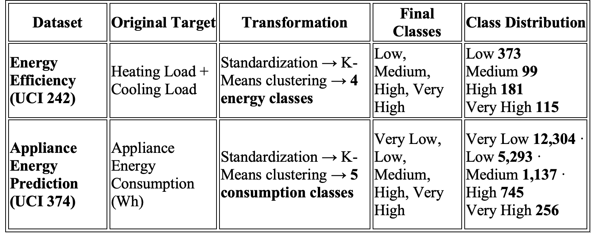
From Continuous Energy Consumption to Classification Classes

Slide 7
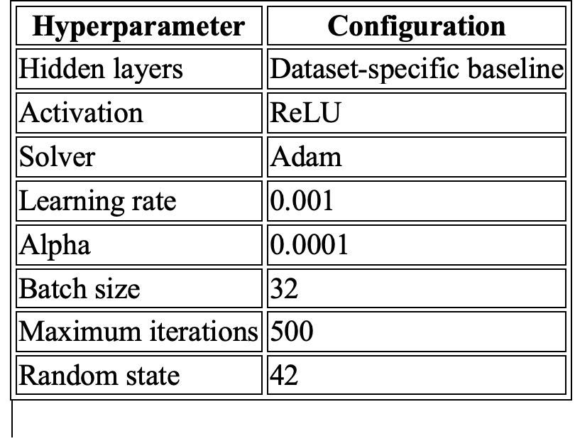
Baseline Model
What was done?
A baseline model was trained before applying optimization.
The baseline uses a fixed set of hyperparameters.
The same baseline provides the reference point for later optimization.
Test data is kept separate from the optimization process.
Training time and predictive metrics are recorded.
Why baseline first?
It shows how well the model performs without optimization.
It identifies whether the dataset already has a strong predictive structure.
It provides a reference for measuring improvement or degradation.
It helps determine whether further optimization is computationally justified.

Slide 8
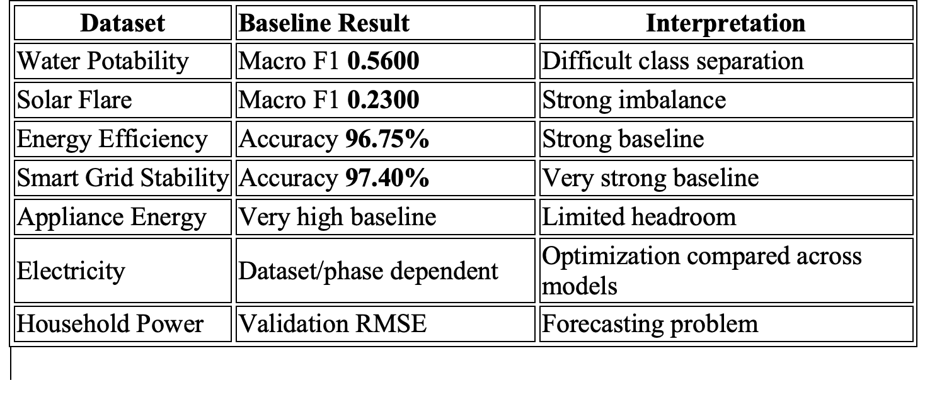
Baseline Performance Across Datasets
Key observations
Baseline performance differs substantially between datasets.
Some datasets are already very easy for the selected model.
Others show clear limitations caused by class imbalance or complex relationships.
Therefore, the expected benefit of hyperparameter optimization is not the same for every dataset.

Slide 9
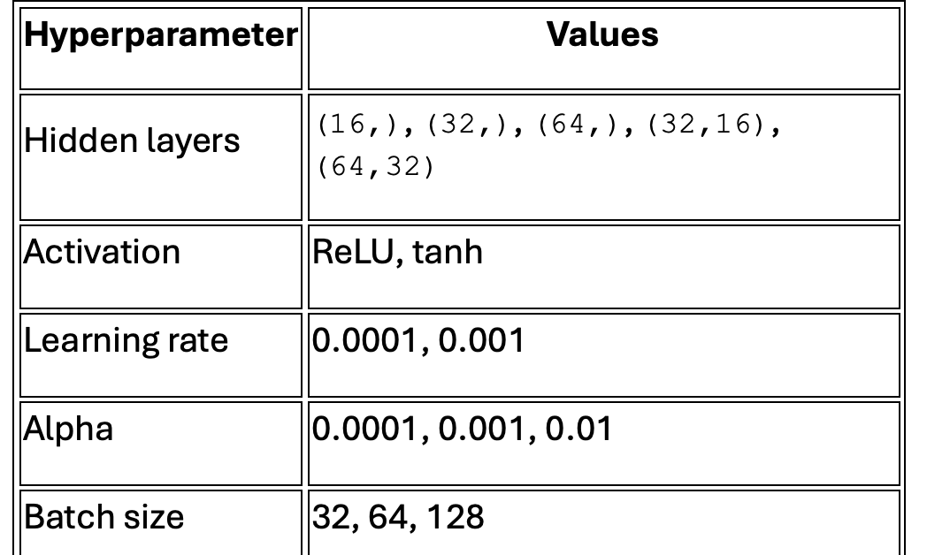
Hyperparameter Search Space
The search space contains 180 possible combinations.
Every optimization algorithm operates within the defined search space.
This keeps the comparison focused on the search strategy, rather than changing the underlying model space.
The MLP training limit remains 500 iterations; optimizer iterations/trials are a separate concept.

Slide 10
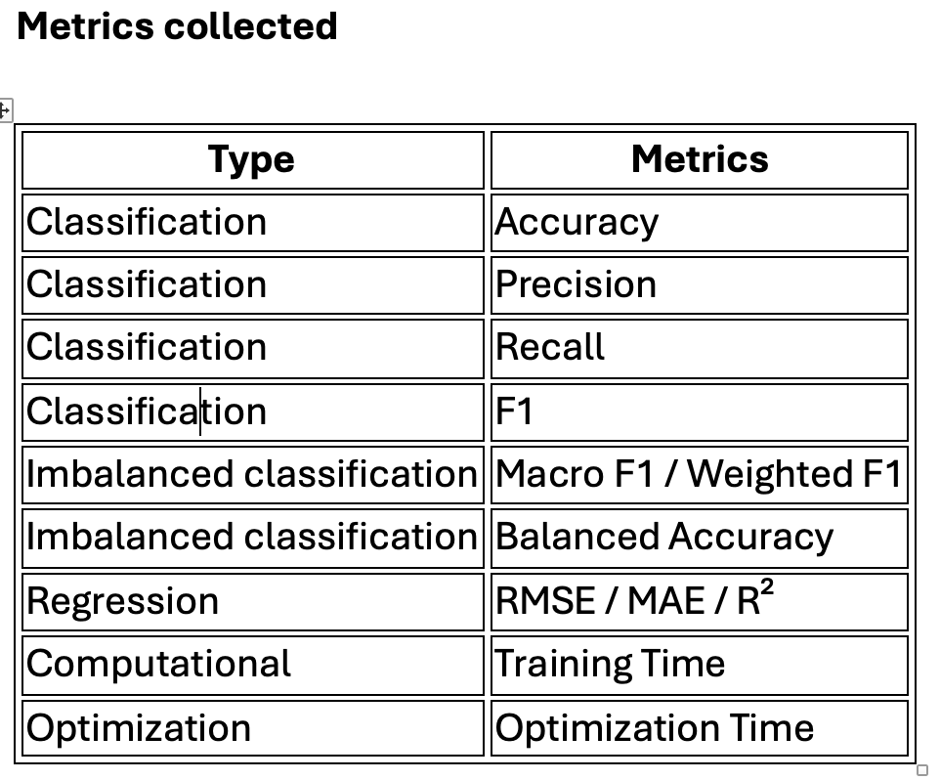
Candidate Evaluation
How was each configuration evaluated?
Generate/select a hyperparameter configuration.
Build the model.
Train the model.
Evaluate the configuration using validation/CV data.
Store the performance score.
Record optimization time.
Continue searching for another configuration.
Select the best configuration according to the defined optimization metric.
Retrain the selected model.
Evaluate once on the independent test set.

Slide 11
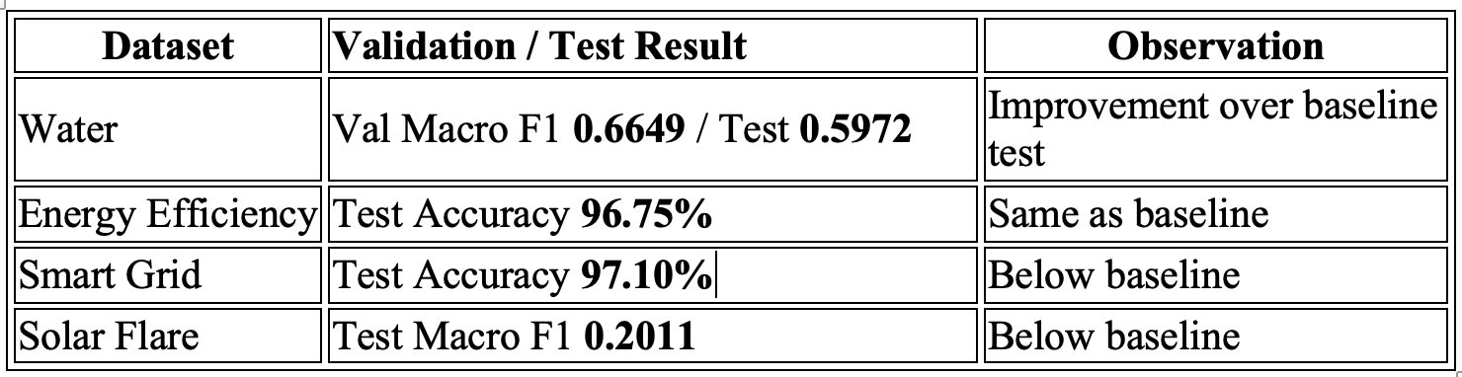
Optimization Algorithm 1: Random Search
What does Random Search do?
Random Search selects hyperparameter configurations randomly from the predefined search space.
Each selected configuration is trained and evaluated.
The configuration with the best validation/CV score is retained.
It does not use information from previous trials to guide the next selection.
What did we learn?
Random Search can quickly explore different regions of the search space.
It can find useful configurations without requiring a complex optimization model.
However, it may spend evaluations on weak configurations.
More random trials increase computational cost.
Improvement is highly dataset-dependent.
What was experimented with?
Different hidden-layer structures
ReLU and tanh
Different learning rates
Different regularization values
Different batch sizes
Multiple random configurations

Slide 12
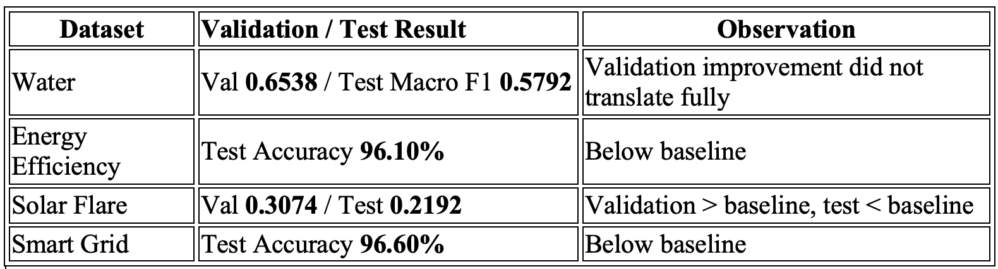
Optimization Algorithm 2: Bayesian Optimization
What does Bayesian Optimization do?
Bayesian Optimization learns from previously evaluated configurations.
It uses the observed results to identify promising regions of the search space.
New configurations are selected based on the accumulated search information.
Therefore, the search is guided rather than purely random.
What did we learn?
Bayesian search can use previous trials more efficiently than random exploration.
It can achieve strong validation scores.
However, a strong validation score does not guarantee better independent test performance.
The optimization itself introduces additional computational overhead.
What was experimented with?
Evaluate configuration
Update search model
Identify promising region
Select next configuration

Slide 13
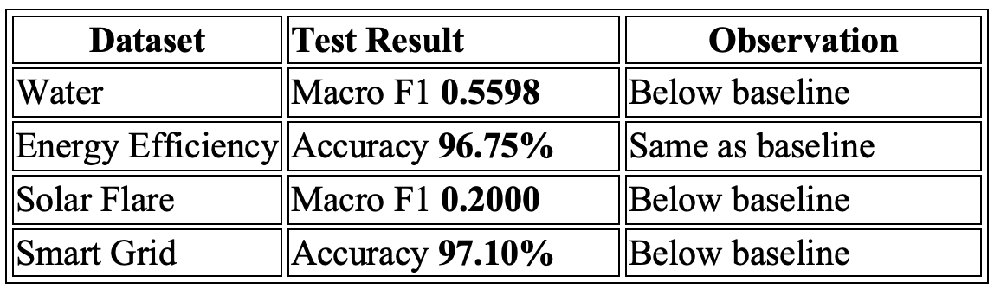
Optimization Algorithm 3: Hyperband
What does Hyperband do?
Hyperband focuses on resource allocation.
Instead of fully training every candidate, it initially gives candidates limited resources.
Poor-performing candidates are removed.
Promising candidates receive more training resources..
What did we learn?
Hyperband is useful when the search space is large.
It avoids spending full training resources on every candidate.
It can reduce unnecessary computation.
However, early elimination creates a risk:
  a configuration that performs poorly early may have improved with more training.
Search Process
Many candidates
Limited training
Evaluate
Eliminate weaker candidates
More resources for survivors

Slide 14
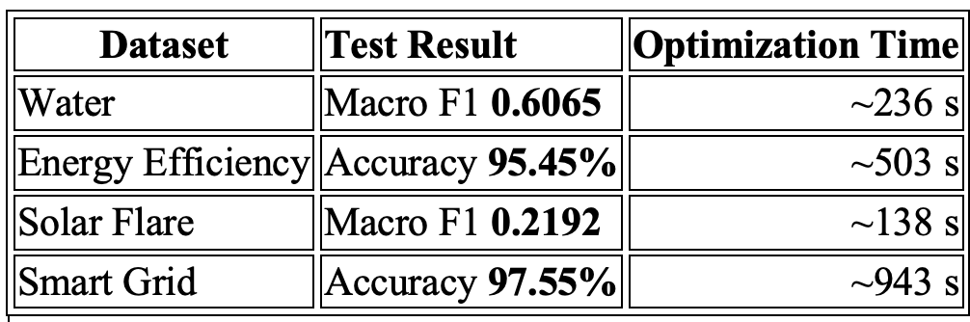
Optimization Algorithm 4: LEA
What does LEA do?
LEA treats hyperparameter configurations as a population.
Multiple configurations are evaluated.
Better configurations are retained.
New configurations are generated from the stronger candidates.
The population evolves over iterations.
What did we learn?
LEA was able to find configurations that improved validation performance in some experiments.
Water showed an improvement over the baseline test Macro F1.
Smart Grid reached 97.55% compared with the 97.40% baseline.
However, computational cost was substantially higher in some datasets.
Higher optimization cost did not always lead to better test performance.
Process
Initial population
Evaluate
Select stronger candidates
New population

Slide 15
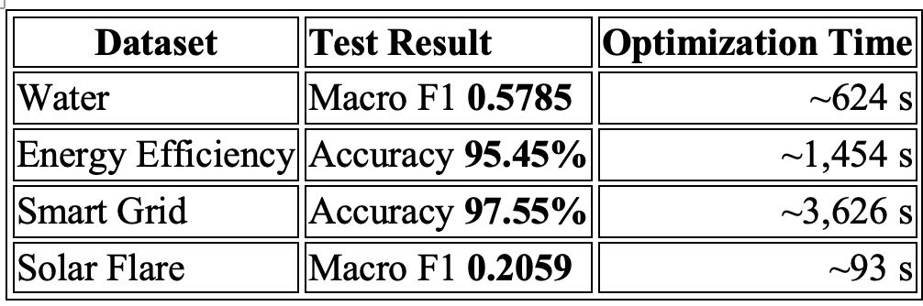
Optimization Algorithm 5: TLBO
What does TLBO do?
TLBO has two conceptual stages:
Teacher phase
  The strongest solution acts as the teacher.
  Other candidate solutions are moved toward the teacher.
Learner phase
  Candidate solutions interact with each other.
  A candidate can improve by learning from another candidate.
What did we learn?
TLBO can find strong validation configurations.
It produced only a marginal improvement on Smart Grid.
On Energy Efficiency, the optimized model performed below the baseline.
On Water, validation performance was high, but independent test performance was lower.
Optimization time can become very large.

Slide 16
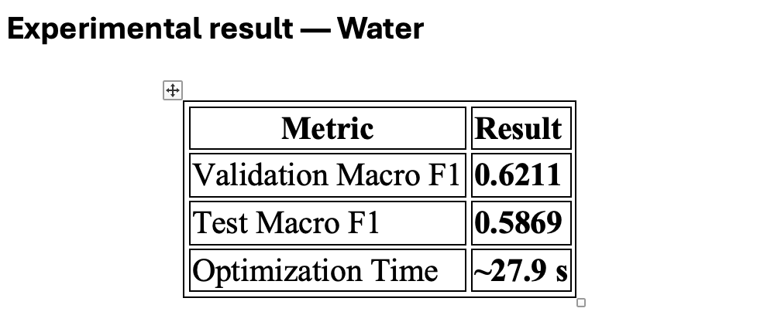
Optimization Algorithm 6: Simulated Annealing
What does Simulated Annealing do?
Starts with a candidate configuration.
Generates a neighbouring configuration.
If the new configuration is better, it is accepted.
A worse configuration can sometimes also be accepted.
The probability of accepting worse solutions decreases as the temperature decreases.
This allows the search to escape local solutions.
What did we learn?
SA provides a different search mechanism from population-based approaches.
It can explore neighbouring configurations.
The cooling schedule controls the exploration/exploitation balance.
Performance depends on temperature and cooling parameters.
Experimental result — Solar Flare
Equal computational budget was applied.
Convergence behaviour was recorded.
Temperature reduction was visualized.
The test set remained untouched during optimization.

Slide 17
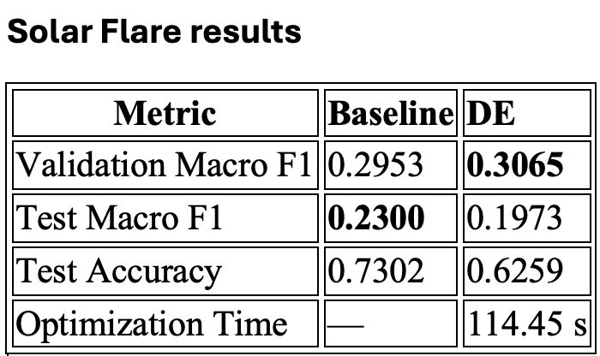
Optimization Algorithm 7: Differential Evolution
What does Differential Evolution do?
Maintains a population of candidate configurations.
Uses differences between population members to create new candidates.
Applies mutation and crossover.
Compares the new candidate with the existing candidate.
Retains the better solution.
What did we learn?
DE improved the validation Macro F1.
However, the improvement did not transfer to the independent test set.
This is another example of the validation–test gap.
The algorithm requires multiple candidate evaluations.

Slide 18
Controlled Computational Budget
Why did we introduce a controlled budget?
Different algorithms naturally require different numbers of evaluations.
Directly comparing final scores without considering computational resources can be misleading.
Therefore, later experiments allocate a defined resource budget to each optimizer.
Water Potability
3,000 training-iteration resource units per optimizer
Solar Flare
15,000 resource units per optimizer
Solar Flare example
  5-fold CV
  Maximum MLP iterations = 500
  Six full evaluations:
  6 × 5 × 500 = 15,000 resource units
Main purpose
Compare algorithms under comparable computational constraints.
Analyse not only the final score but also how efficiently the score was obtained.

Slide 19
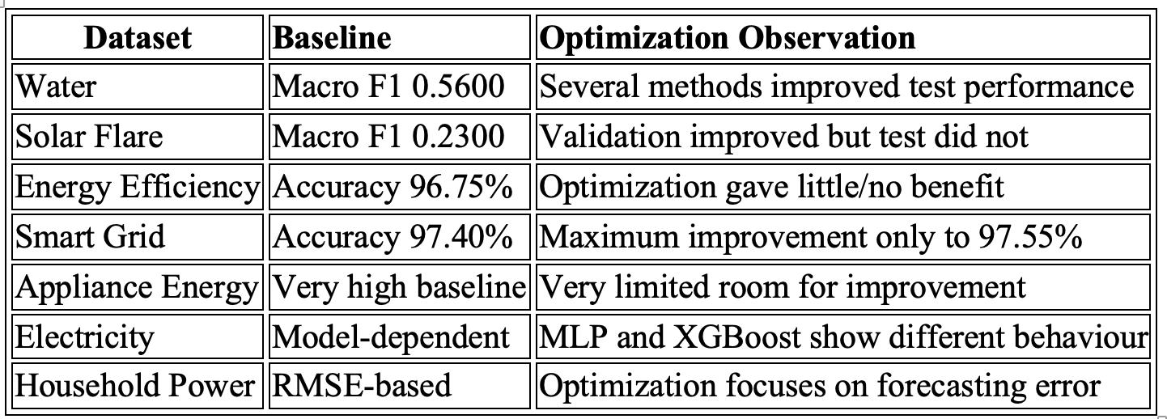
Optimization Results Across Datasets
Cross-dataset observations
Optimization does not provide a universal improvement.
The effect depends strongly on the dataset.
Strong baselines have limited optimization headroom.
Class imbalance makes Macro F1 more informative than accuracy alone.
Validation improvements sometimes disappear on the independent test set.
Computational cost varies considerably between optimization algorithms.

Slide 20
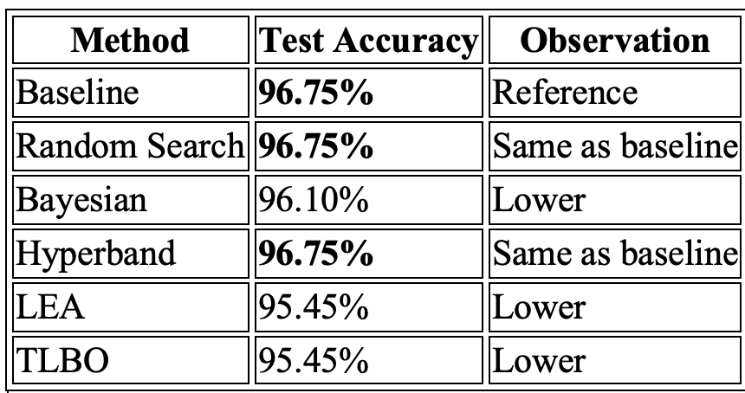
Performance vs Computational Cost
Computational observation(Why accuracy alone is not enough?)
LEA required approximately 503 seconds.
TLBO required approximately 1,454 seconds.
The final model training itself required only a small fraction of this time.
Therefore, optimization introduced substantial computational overhead.

Slide 21
Challenges and Limitations
Dataset-related challenges
Class imbalance affects classification metrics.
Solar Flare contains extremely rare classes.
Water Potability has missing values and unequal class representation.
Electricity and Household Power contain temporal relationships.
Some datasets already have very high baseline performance.
Optimization-related challenges
Large hyperparameter spaces require many evaluations.
Population-based methods can be computationally expensive.
Bayesian methods have optimization overhead.
Hyperband may eliminate candidates early.
Simulated Annealing depends on temperature and cooling settings.
Limited budgets may prevent full exploration of the search space.
Evaluation-related challenges
High validation performance may not generalize.
Test data cannot be used during optimization.
Accuracy alone is insufficient for imbalanced datasets.
Training time and optimization time need to be considered separately.

Slide 22
Controlled Computational Budget
Energy Efficiency
Baseline accuracy: 96.75%
Random Search: 96.75%
Hyperband: 96.75%
Other optimization methods produced lower results.
Further optimization offered limited expected benefit.
Smart Grid Stability
Baseline accuracy: 97.40%
Best optimized accuracy: 97.55%
Improvement: only 0.15 percentage points
LEA and TLBO required substantial optimization time.
Appliance Energy Prediction
Baseline performance was already extremely high.
Therefore, the potential improvement from hyperparameter optimization is limited.
The corrected Phase 2 run should be used for the final numerical slide.

Slide 23
What Did the Experiments Show?
Finding 1 — No universal optimizer
No single optimization algorithm consistently produced the best independent-test result across all datasets.
Algorithm performance depends on dataset characteristics.
Finding 2 — Strong baseline limits improvement
Energy Efficiency and Smart Grid already had very strong baseline performance.
Additional optimization produced little improvement.
Finding 3 — Validation ≠ Test
Several optimizers achieved higher validation scores.
Some of those improvements disappeared on the independent test set.
Finding 4 — Computational cost matters
LEA and TLBO can require substantially more computation.
The optimization process can take much longer than training the final model.
Finding 5 — Metric selection matters
Macro F1 is important for imbalanced classification.
Accuracy alone can hide poor minority-class performance.
Finding 6 — Controlled budgets improve comparison
Equal-resource experiments make optimizer comparisons more meaningful.

Slide 24
Final Conclusion
From the experiments:
A baseline is essential for measuring the real contribution of optimization.
Hyperparameter optimization can improve performance, but improvement is dataset-dependent.
More sophisticated optimization does not automatically mean better prediction.
Validation performance must be confirmed using an independent test set.
Optimization time can be much greater than final model-training time.
Controlled computational budgets provide a fairer comparison.
Dataset characteristics influence which optimization strategy is useful.
Training-loss and convergence plots provide additional evidence about model behaviour.
The effectiveness of hyperparameter optimization should be evaluated as a combination of predictive improvement, generalization, search behaviour and computational cost — rather than accuracy alone.

