Slide 1
Classification
Notes:
1

Slide 2
Machine Learning
Studies how to automatically learn to make accurate predictions based on past observations.
In the terminology of machine learning, classification is considered an instance of supervised learning, i.e., learning where a training set of correctly identified observations is available.
Machine Learning Cycle includes the following steps :
->Planning ->Data Preparation ->Modelling ->Model Presentation
Notes:
2

Slide 3
Classification
Classification is the problem of identifying to which set of categories (sub-populations) a new observation belongs.
On the basis of a training set of data containing observations (or instances) whose category membership is known.
A classification model attempts to draw some conclusion from observed values. Given one or more inputs a classification model will try to predict the value of one or more outcomes.
When we are trying to predict a categorical or nominal variable,the problem is classification,where the output variable is a category such as ‘red’ or ‘blue’,whereas when we are trying to predict a numerical variable such as ‘price’,’weight’ etc..,the problem falls under regression.
Notes:
3

Slide 4
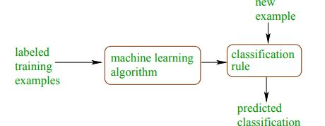
Classification
Notes:
4

Slide 5
Classification
For example, when filtering emails “spam” or “not spam”, when looking at transaction data, “fraudulent”, or “authorized”.
In short Classification either predicts categorical class labels or classifies data (construct a model) based on the training set and the values (class labels) in classifying attributes and uses it in classifying new data.
Notes:
5

Slide 6
Examples of Classification Problems:
Text categorization (e.g., spam filtering)
Fraud detection
Optical character recognition
Machine vision (e.g., face detection)
Natural-language processing (e.g., spoken language understanding)
Market segmentation (e.g.: predict if customer will respond to promotion)
Bioinformatics (e.g., classify proteins according to their function)
Notes:
6

Slide 7
Common Classification Algorithms:
Logistic Regression (Linear Classifier-output is weighted sum of inputs)
Naïve Bayes Classifier
Support Vector Machine
Decision Tree
Random Forest
K-Nearest Neighbour (KNN)
Notes:
7

