Slide 1
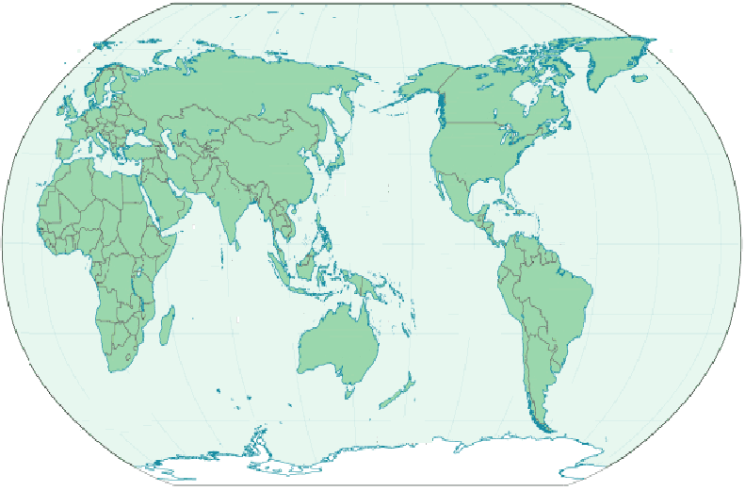




Notes:
The title of our work is “On-Line Construction of Compact Directed Acyclic Word Graphs.”
You might feel that 7 authors are little bit too many, but truth is that two papers
whose contents were almost the same were simultaneously and independently
submitted for the conference.
One is from Japan and the other is from Italy.
Then, according to the direction of the committee, the two paper
got to be combined into one paper.

Slide 2

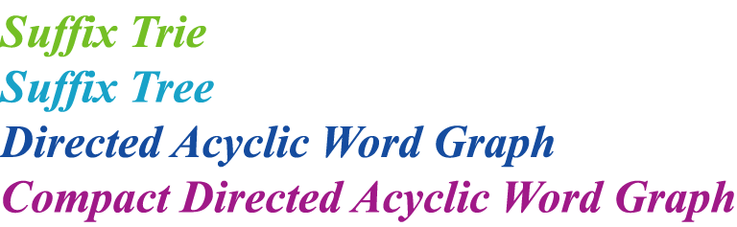
The following index structures are used to
efficiently solve a pattern matching problem.
Given a pattern p and a text t,
we can solve the pattern matching problem
in time proportional to the length of p,
by using an index structure for t.
Notes:
The following index structures, suffix tries, suffix trees, DAWGs, and CDAWGs
are used to efficiently solve the pattern matching problem.
Given a pattern p and a text t,
we can solve the pattern matching problem
in time proportional to the length of p,
by using an index structure for t, among the four.

Slide 3
Suffix Trie
compaction
minimization
Suffix Tree
DAWG
minimization
compaction
CDAWG
Notes:
Here’s a relation among the four index structures.
On one hand, suffix trees are the compacted version of suffix tries.
On the other hand, DAWGs are the minimized version of suffix tries.
And CDAWGs can be seen as both the minimization of suffix trees,
and the compaction of DAWGs.
Let me give a concrete example.

Slide 4


for string “cucumber”
b
e
r
m
r
c
u
m
b
e
r
u
c
u
c
u
m
b
e
r
m
m
b
e
r
b
b
e
r
e
e
r
34
33
r
Notes:
Given a string “cucumber”, the suffix trie goes like this.
The number of nodes is 34, and that of edges is 33.
If remaining only the root, the leaves, and the branching nodes,
it goes to …

Slide 5

for string “cucumber”
mber
r
cumber
u
cu
cumber
mber
mber
ber
er
11
10
Notes:
The suffix tree of “cucumber”.
Moreover, if eliminating the isomorphic subtrees in this suffix tree,
then it changes to …

Slide 6

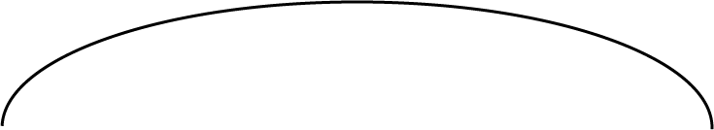



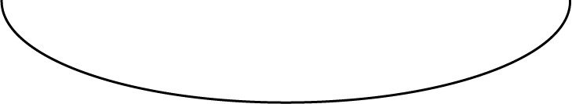
for string “cucumber”
r
mber
u
cu
cumber
mber
ber
er
3
8
Notes:
the CDAWG for “cucumber”.

Slide 7
for string “cucumber”
b
e
r
m
r
c
u
m
b
e
r
u
c
u
c
u
m
b
e
r
m
m
b
e
r
b
b
e
r
e
e
r
34
33
r
Notes:
Meanwhile, if merging the isomorphic subtrees of the suffix trie of “cucumber”,
it changes into …

Slide 8




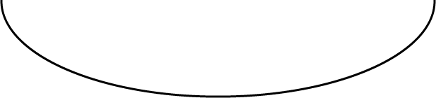
for string “cucumber”
r
u
m
c
u
c
u
m
b
e
r
m
b
r
9
14
Notes:
The DAWG for “cucumber”.
Moreover, if remaining only the source node, the sink node, and the branching node,
it goes to …

Slide 9
for string “cucumber”
r
mber
u
cu
cumber
mber
ber
er
3
8
Notes:
The CDAWG of “cucumber”.
As you see, the numbers of nodes and edges in this CDAWG are considerably smaller
than those of the other three structures.

Slide 10

For Suffix Trees Weiner (1973)
McCreight (1976)
Ukkonen (1995)
For DAWGs Blumer et al. (1985)
For CDWAGs Crochemore and Verin (1997)
’
Notes:
Algorithms to construct index structures are listed here.
Although there’re more algorithms for constructing suffix trees,
these three seem the most famous.
Blumer et al. introduced the DAWG and simultaneously developed
a linear time algorithm for it.
For CDAWGs, Crochemore and Verin gave a linear time algorithm in 1997.
Among them, these two are called “on-line”.

Slide 11

For any string w and character a,
an on-line algorithm can construct STree(wa)
only by extending STree(w) with a.
If off-line, we must build STree(wa) from scratch.
Notes:
What does “on-line” mean in this case.
For example, using an on-line algorithm,
STree(wa) can be built only by extending STree(w) with character a,
for any string w belonging to sigma asterisk, where sigma is an alphabet.
If off-line, we must built STree(wa) from scratch,
that is, we cannot utilize STree(w) to construct STree(wa),
though just one character is added.

Slide 12


On-Line Algorithm to
Construct CDAWGs
For Suffix Trees Weiner (1973)
McCreight (1976)
Ukkonen (1995)
For DAWGs Blumer et al. (1985)
For CDWAGs Crochemore and Verin (1997)
’
Inenaga et al. (2001)
Notes:
What is our work?
It is just to put our name here, that it to say,
on-line algorithm to construct CDAWGs.

Slide 13

Crochemore and Verin’s
Algorithm for CDAWGs
’
McCreight’s
Algorithm for Suffix Trees
Our
Algorithm for CDAWGs
Ukkonen’s
Algorithm for Suffix Trees
Notes:
The main idea of out algorithm.
Like Crochemore and Verin’s is based on McCreight’s,
our algorithm is based on Ukkonen’s on-line algorithm for suffix trees.

Slide 14

Basically, Ukkonen’s algorithm builds
STree(w) by appending the prefixes of w
to the tree, in increasing order.
To run in linear time
It utilizes a failure function, “Suffix Link”.
Notes:
So, from now on, we mention Ukkonen’s algorithm, before explaining our algorithm.
Basically, Ukkonen’s algorithm builds STree(w) by appending the prefixes of w
to the tree, in increasing order.
To run in linear time,
it utilizes a failure function which is called suffix link.

Slide 15

ε
STree(cacao)
o
c
a
a
o
a
ca
o
c
ao
c
o
a
a
o
o
cao
acao
cacao
Notes:
Here’s the suffix tree for string “cacao”.
Since this node corresponds to “cacao”, its suffix link points to
this node, which represents “acao”, the one-letter shorter suffix of “cacao”.
And the suffix links of the other nodes are like this.

Slide 16

Bottom node
ε
c
ca
Σ
Σ
Σ
c
c
a
a
Root node
Active point
Notes:
I’m gonna explain the construction of STree(cacao).
Here’s already the suffix tree for the empty string.
This node is the root node, and this heart mark is the active point,
which represents the location where the algorithm should update the tree at each step.
During the construction, this active point moves until it finds the location it can stop on.
This node is called the bottom node, which guarantees the active point can stop in any step.
This symbol sigma means all the characters in the alphabet sigma.
The first character is c. Since the active point can’t move with spelling out c,
the algorithm creates a new open edge labeled with c.
Then the active point goes up via the suffix link, and arrives at the bottom node.
Because it can move ahead with c in this case, it stops on the root node.
If a follows c, first of all, a is put there, because the input string is extended by a.
Then, the active point can’t move with spelling a, it again creates an edge labeled with a,
and goes up to the bottom node.
Moving with a, it stops over here.

Slide 17

cac
caca
Σ
Σ
c
a
c
a
a
c
c
a
c
a
c
a
Notes:
Since the input string now becomes cac, c is put at the tail of the label of each open edge.
Then the active point moves ahead while spelling c, like this.
That’s all, in this step.
Because a follows cac, the open edges are updated with a, as well.
After that, the active point just advances by a.

Slide 18
cacao
Σ
o
c
a
a
o
c
c
a
a
o
o
o
Notes:
Finally, the active point becomes cacao.
After putting o as usual, the active points has to creates a new open edge
labeled with o from the location where it is, but there’s no node.
Therefore, a new node is created, followed by the new edge.
Then the active point wants to move via the suffix link of the node
on which it is, but the node hasn’t the suffix link.
So, it go backwards along this edge, and then moves via the suffix link.
Then, it moves while spelling out ca, because it went up with spelling out the ca before.
Since the location also doesn’t have an edge whose label begins with o,
a node is created. Then, this is the one that the suffix link of this node points to,
because this represents ca, and it does a.
After that, a new edge labeled with o is created there.
Again, it goes up to the root node, then arrives at the bottom node.
Arriving at the root node with spelling a, which corresponds to this a,
an edge labeled with o is made.
Since the node, where the active point is now, has the suffix link, it moves via the suffix link,
arrives at the bottom node, and stops on the root node, because the sigma can be seen as character o.
This is the completion of the suffix tree of cacao.

Slide 19


cacao
12345
Σ
(5, ∞)
By means of this “∞” trick,
the algorithm builds STree(w)
in time proportional to |w|.
o
c
a
(1, 2)
(2, 2)
a
(5, ∞)
o
c
o
c
(3, ∞)
(3, ∞)
(5, ∞)
a
a
o
o
Notes:
As in many algorithm, Ukkonen’s also represents the label of an edge
as a pair of intergers, one of which corresponds to the beginning position of the label
in the input string, and the other the end position.
The matter is how to implement the second value of an open edge,
because a leaf is updated each time the input string is updated.
The solution is to implement it as “infinite”, like this.
This follows from this principle, “Once a leaf, always a leaf.”
In other words, we do not need to update open edges, once we create them.
By means of this “infinite” trick, the algorithm builds STree(w)
in time proportional to the length of w.

Slide 20



ε
c
ca
Σ
Σ
Σ
c
c
a
a
Sink node
Notes:
Finally, we’re ready to explain the on-line construction of the CDAWG for cacao.
This part is the same as the suffix tree’s, and this node is the sink node.
In the terminology of finite automata, it is the final state.
According the first letter c, an edge labeled c is created, and directed to the sink node.
Then, active point moves and stops as usual.
a follows c, so a is put here.
Creating a new edge with a, the active point behaves like this, as usual.

Slide 21
cac
caca
Σ
Σ
c
c
a
a
a
a
c
c
c
c
a
a
Notes:
With cac, after c is put at the tail of each terminal edge,
the active points moves ahead while spelling out c. That’s it.
Caca, the labels are extended by a, and then the active point advances by a.
That’s all.

Slide 22
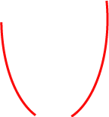



cacao
Σ
c
a
a
c
c
a
NO!
c
a
c
Is a new node made here ?
o
o
a
o
a
o
o
o
o
Notes:
The previous procedure was the same as that of the suffix tree of caca,
but the difference appears in this step.
The algorithm creates a new node because it has to create a new edge labeled with o.
Then the active point goes backwards to the root node, then arrives at the bottom, via the suffix link.
As in case of the suffix tree, it stops on this edge, spelling out ca.
Then, is a new node made here?
The answer is NO.
The reason is, these two edges are identical,
and the edge which will be created here is also the same as the edge, labeled o.
Therefore, all we have to do is …

Slide 23



cacao
Σ
c
a
a
a
c
c
a
a
o
o
o
Notes:
to redirect the edge to the node.
In this way, a is followed by cao and o in the CDAWG.

Slide 24

cacao
Σ
c
a
a
a
c
o
c
a
a
o
o
o
Notes:
Then, the active point goes up, along this edge labeled a, and moves up to the bottom node.
After reaching the root node with spelling out a, the algorithm creates a terminal edge with letter o.
Then, moving up to the bottom node, the active point finally arrives at the root node,
while spelling out o.
This is the end of the construction of the CDAWG of cacao.

Slide 25


Notes:
Suppose that, in some CDAWG, the active point stays on a edge.
and then a new node is created.

Slide 26

Notes:
And then, if it moves and stops on this edge,
then the edge is redirected to this node.
This is because this edge leads to the same node as the edge
on which the new node has been created.

Slide 27
Notes:
Suppose that the active point then stops on the edge.
In this case, the edge isn’t redirected to the node, because it doesn’t lead to
the same node as the edge on which the new node was created.

Slide 28

cacao
m
In each step, all terminal edges
are updated in constant time.
12345
6
Σ
i
i
c
1
a
a
2
2
o
5
c
a
o
5
3
a counter corresponding to the position of the last character of the string
o
i
Notes:
About the implementation of labels of edges.
We implement labels of edges this way.
We make a node have an integer which corresponds to the end position
of its incoming edges, and each edge has just the beginning position,
instead of the label itself.
Universally, the end positions of labels of edges, which direct the same node,
can be represented by the same values.
And, we implement the labels of terminal nodes like this.
This i is a counter corresponding to the position of the last character
in the string.
So, if m follows cacao, the value i changes to 6.
Just this operation updates the all labels of the terminal edges.
That is, in each step, all terminal edges are updated in constant time.

Slide 29

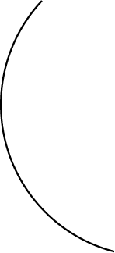
c
cacaomass
a
a
c
o
m
c
m
a
a
s
a
o
a
o
o
s
s
cacao
o
m
a
s
m
s
s
c
m
a
m
s
s
a
a
a
a
s
s
s
s
s
s
o
s
s
c
o
a
o
Notes:
If the input string is extended to cacaomass, the CDAWG becomes like this.
Notice that there’re two nodes, although they were one node in case of cacao.
What happened?

Slide 30

Σ
cacaom
a
s
The time complexity of
node separation is constant.
c
c
a
a
a
a
o
o
m
c
m
c
a
c
a
o
m
a
a
o
a
o
m
a
s
s
o
s
m
o
m
a
s
m
a
a
s
m
a
s
s
a
Notes:
Here’s CDAWG(cacaom).
When a follows, the active point moves to this node,
via an edge which doesn’t correspond to the longest path,
the longest one is ca.
That’s why we separate the node into two.
And then, the suffix link of this node is set to point to this node.
This separation is necessary, since if letter s follows, an edge labeled with s is created.
Then, note that s is preceded by a, but isn’t by ca in string cacaomas.
The number of oncoming edges is at most the length of the pass the active point
moved along. And the number of outgoing edges is at most the size of an alphabet.
So the amortized time complexity of node separation is constant.

Slide 31

procedure Redirect( s, (k, p), r );
let edge(s, (k’, p’)) = s’ be the text[k]-edge from s;
replace this edge by edge(s, (k’, k’ + p – k) ) = r;
function Separate_Node( s, (k, p) ): pair of integers;
(s’, k’) := Canonize( s, (k, p) );
if k’ <= p then return (s’, k’);
/* (s’, k’, p) is an explicit node */
if Length(s) + (p-k+1) = Length(s’) then return (s’, k’); /* solid edge */
/* non-solid case */
create a new node r’ as a duplication of s’;
Suf(r’) := Suf(s’);
Suf(s’):= r’ ;
Length(r’) := Length(s) + (p-k+1);
repeat
replace the text[k]-edge from s to s’ by edge(s, (k, p)) = r’;
(s, k) := Canonize( Suf(s), (k, p-1) );
until (s’, k’) ≠ Canonize( s, (k, p) );
return (r’, p+1);
Notes:
Here’s a pseudo-code for edge redirection and node separation.
This part redirects the edge.

Slide 32

For any string w∈Σ∗, the algorithm
constructs CDAWG(w) on-line,
in linear time with respect to |w|.
Notes:
Conclusion.
For any string w belonging to sigma, the algorithm constructs CDAWG(w)
on-line, in linear time with respect to the length of w.

Slide 33

“Construction of the CDAWG for a Trie”
Shunsuke Inenaga, Hiromasa Hoshino, Ayumi Shinohara, Masayuki Takeda, and Setsuo Arikawa
(PSC’01 September, Prague)
“On-Line Construction of Symmetric
Compact Directed Acyclic Word Graphs”
Shunsuke Inenaga, Hiromasa Hoshino, Ayumi Shinohara, Masayuki Takeda, and Setsuo Arikawa
(SPIRE2001 November, Chile)
Notes:
A few related work, both are by us, are going to be presented in conferences.
One is entitled “Construction of the CDAWG for a Trie”.
The contents is, given a strings in the form of a trie,
the algorithm of this paper creates the CDAWG of the strings,
in linear time with respect to the number of nodes in the trie.
In general, the number of nodes in the trie is less than the
total length of the strings, because the trie shares the prefixes of the strings.
The other is “On-Line Construction of Symmetric CDAWGs”.
This “symmetric” means, reading a string from both direction,
left to right, and right to left.
So, a symmetric CDAWG supports indices of a string and its reversal.
The paper tells how to create SCDAWGs in on-line manner.

