Slide 1



Shunsuke Inenaga,
Hideo Bannai, Ayumi Shinohara,
Masayuki Takeda, and Setsuo Arikawa

Slide 2

Finding a Good “Rule” to Separate Two Sets
Positive examples
Negative examples
AKEBONO MUSASHIMARU
CONTRIBUTIONS OF AI
BEYOND MESSY LEARNING
BASED ON LOCAL SEARCH ALGORITHMS
BOOLEAN CLASSIFICATION
SYMBOLIC TRANSFORMATION
BACON SANDWICH
PUBLICATION OF DISSERTATION
WAKANOHANA TAKANOHANA
CONTRIBUTIONS OF UN
TRADITIONAL APPROACHES
GENETIC ALGORITHMS
PROBABILISTIC RULE
NUMERIC TRANSFORMATION
PLAIN OMELETTE
TOY EXAMPLES

Slide 3

Finding a Good “Rule” to Separate Two Sets
Positive examples
Negative examples
AKEBONO MUSASHIMARU
CONTRIBUTIONS OF AI
BEYOND MESSY LEARNING
BASED ON LOCAL SEARCH ALGORITHMS
BOOLEAN CLASSIFICATION
SYMBOLIC TRANSFORMATION
BACON SANDWICH
PUBLICATION OF DISSERTATION
WAKANOHANA TAKANOHANA
CONTRIBUTIONS OF UN
TRADITIONAL APPROACHES
GENETIC ALGORITHMS
PROBABILISTIC RULE
NUMERIC TRANSFORMATION
PLAIN OMELETTE
TOY EXAMPLES
BONSAI

Slide 4


Machine Discovery System BONSAI (Shimozono et al. 1994)
Positive
Examples
Negative
Examples
Substring
pattern
ACDEFGHIKLMNPQRSTVWY
00110010100011100000
BONSAI
pos
neg
POS
NEG
x 11 y
Indexing
Combinatorial
Optimization
Algorithm
P
x 101 y
I(pos)
I(neg)
I(POS)
I(NEG)
x 111 y
N
Decision Tree
Generator
Accuracy
Evaluation
P
N
85%
Indexing
Decision Tree
Accuracy

Slide 5


Substring Pattern
String v is a substring of string w
if w = xvy for some strings x, y ∈ ∑*.
x = ε
w = discovery
v = disco
y = very

Slide 6

Subsequence Pattern
String v is a subsequence of string w
if v is obtained by removing zero or more
characters from w.
w = discovery
w = discovery
v = diver

Slide 7
Enhancing BONSAI to Search Subsequence Patterns
A Practical Algorithm
to Find the Best Subsequence Patterns
Masahiro Hirao, Hiromasa Hoshino,
Ayumi Shinohara, Masayuki Takeda, Setsuo Arikawa
DS 2000

Slide 8
Variable-Length-Don’t-Care Pattern
We define the ∗ symbol to match any string.
Then ∗ is called a variable-length-don’t-care
(VLDC) symbol.
A pattern containing ∗’s is called a VLDC pattern.
An example of a VLDC-pattern is ab∗ba∗,
where a, b ∈ Σ.

Slide 9
Variable-Length-Don’t-Care Pattern (Cont.)
VLDC pattern p is said to match string w, if w is
obtained by replacing ∗’s in p with some strings.
For instance, the VLDC-pattern ab∗ba∗ matches
string abababb.
a
bb

Slide 10
Variable-Length-Don’t-Care Pattern (Cont.)
VLDC patterns are a generalization of
substring patterns and subsequence patterns.
Searching substring pattern abc
VLDC pattern ∗abc∗
Searching subsequence pattern abc
VLDC pattern ∗a∗b∗c∗

Slide 11
The 1st Goal of this Work
Developing a practical algorithm to find
the best VLDC pattern that separates
two given sets of strings.
Power-up of the BONSAI system
gain the accuracy
simplify the decision tree

Slide 12


Process of Finding the Best VLDC pattern
S
INPUT
T
computing the “goodness”
of all possible patterns
OUTPUT
as fast as
possible!!
the best VLDC pattern

Slide 13


Score Function
The “goodness” of pattern p
good(p, S, T) = f(x_{p}, y_{p}, |S|, |T|)
conic
S, T : given sets of strings
x_{p} : num. of strings in S that p matches
y_{p} : num. of strings in T that p matches

Slide 14
Conic Function
Function f(x, y) is conic if
non-increasing
for any 0 ≤ y ≤ y_{max}, there exists some x₁ such that
  f(x, y) ≥ f(x’, y) for any 0 ≤ x < x’ ≤ x₁
  f(x, y) ≤ f(x’, y) for any x₁ ≤ x < x’ ≤ x_{max}
f(x, y) ≥ f(x’, y)
for any 0 ≤ x ≤ x_{max}, there exists some y₁ such that
  f(x, y) ≥ f(x, y’) for any 0 ≤ y < y’ ≤ y₁
  f(x, y) ≤ f(x, y’) for any y₁ ≤ y < y’ ≤ y_{max}

Slide 15
Conic Function (Cont.)
Function f(x, y) is conic if
for any 0 ≤ y ≤ y_{max}, there exists some x₁ such that
  f(x, y) ≥ f(x’, y) for any 0 ≤ x < x’ ≤ x₁
  f(x, y) ≤ f(x’, y) for any x₁ ≤ x < x’ ≤ x_{max}
non-decreasing
f(x, y) ≤ f(x’, y)
for any 0 ≤ x ≤ x_{max}, there exists some y₁ such that
  f(x, y) ≥ f(x, y’) for any 0 ≤ y < y’ ≤ y₁
  f(x, y) ≤ f(x, y’) for any y₁ ≤ y < y’ ≤ y_{max}

Slide 16
Conic Function (Cont.)
y
f
x
x
y
f
x
x

Slide 17
Conic Function (Cont.)
y
y
x
f
y
y
x
f

Slide 18
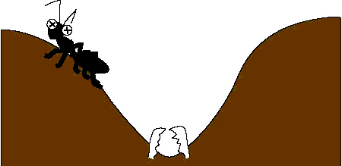
Conic Function (Cont.)

Slide 19

Basic Algorithm
FindBestVLDC(S, T)
bestScore = − ∞; bestVLDC = ε;
For all possible pattern p do
x_{p} = numOfMatchedStr(p, S);
y_{p} = numOfMatchedStr(p, T);
score = f(x_{p}, y_{p}, |S|, |T|);
if score > bestScore then
bestScore = score; bestSubseq = p;
return bestVLDC;
reduce patterns for candidates
speed-up of these parts
computing the “goodness” of pattern p

Slide 20

Prune the Search Tree – the first key -
Σ = {a, b}
a
∗
b
Cut!!
…………………..
…………………..
The search space
is exponential…

Slide 21
Property of Conic Function
(x, y)
(0, y)
(x’, y’)
f(x’, y’) ≤ upperBound(x, y)
(0, 0)
(x, 0)
upperBound(x, y) : the maximum value on the square
= max{f(0, 0), f(x, 0), f(0, y), f(x, y)}

Slide 22

Pruning Heuristics
d∗sco
numOfMatchedStr(p, T)
d∗scover
numOfMatchedStr(p, S)
≤
<
The goodness of
d∗scover
The upperBound of d∗sco
The current best score

Slide 23
Fast VLDC Pattern Matching – the second key -
1
Using DFA for VLDC patterns
Pattern Matching Machine
Using Wildcard Directed Acyclic
Word Graphs for text strings
2
Index Structure

Slide 24
Computing the Minimum Window Size (Cont.)
1
Using DFA for VLDC patterns
p = ∗a∗bab∗
Σ-{b}
Σ-{a,b}
a
b
a
b
Σ-{a}
Σ-{b}
b
Σ
w = aabbab

Slide 25
Fast VLDC Pattern Matching – the second key - (Cont.)
2
Using Wildcard Directed Acyclic Word Graphs
for text strings
The Wildcard Directed Acyclic Word Graph
of a string w, WDAWG(w), is the smallest
automaton that recognizes all VLDC patterns
which matches w.
Inenaga et al. CPM 2002, MFCS 2002

Slide 26
Fast VLDC Pattern Matching – the second key - (Cont.)
a
b
2
Using WDAWGs
∗
∗
b
∗
a
b
b
a
b
∗
w = abbab
∗
b
b
∗
a
∗
b
WDAWG(abbab)
a
∗
∗
∗
∗
a
a
a
b
b
∗
p = ∗a∗bab
∗
b
∗
∗

Slide 27
Pattern within Window
any pattern similar
to “discovery”?
p = ∗d∗scov∗ry∗
w = fhdglhetlaklfrglhertlhglehglioogfrg
xawpolmkhhjquqytsswerirvnbotuhxxxxr
ylnvntriwmvntrhbtriscovbgneinmvgerig
eoighjeoitrnrnvenoireoinvroigreintnnvoi
woireohirnnvbnrehovlneroivnirneoitro
eitruijnnbrymxbairive

Slide 28
Pattern within Window
any pattern similar
to “discovery”?
p = ∗d∗scov∗ry∗
k
w = fhdglhetlaklfrglhertlhglehglioogfrg
xawpolmkhhjquqytsswerirvnbotuhxxxxr
ylnvntriwmvntrhbtriscovbgneinmvgerig
eoighjeoitrnrnvenoireoinvroigreintnnvoi
woireohirnnvbnrehovlneroivnirneoitro
eitruijnnbrymxbairive

Slide 29
Episode Pattern
Pair <v, k> is an episode pattern of string w
if there is substring u of w such that |u| ≤ k
and v is a subsequence of u.
w = discovery
<v, k> = <diver, 8>
u = discover
u = discover
8

Slide 30
Episode Pattern (Cont.)
Pair <v, k> is an episode pattern of string w
if there is substring u of w such that |u| ≤ k
and v is a subsequence of u.
w = discovery
<v, k> = <diver, 7>
u = discover
8

Slide 31
Enhancing BONSAI to Search Episode Patterns
A Practical Algorithm
to Find the Best Episode Patterns
Masahiro Hirao, Shunsuke Inenaga,
Ayumi Shinohara, Masayuki Takeda, Setsuo Arikawa
DS 2001

Slide 32
The 2nd Goal of this Work
Developing a practical algorithm to find
the best pair of a VLDC pattern and a
window size to separate two given sets
of strings.
generalization of
an episode pattern
More power-up of the BONSAI system
gain the accuracy
simplify the decision tree

Slide 33
Computing the Best Window Size
<∗a∗ab∗, k> s₁ s₂ s₃ s₄ s₅ x_{k}
<∗a∗ab∗, 0> - - - - - 0
<∗a∗ab∗, 1> - - - - - 0
<∗a∗ab∗, 2> - - - - - 0
<∗a∗ab∗, 3> - - - - - 0
<∗a∗ab∗, 4> ○ - - - - 1
<∗a∗ab∗, 5> ○ - - - - 1
<∗a∗ab∗, 6> ○ ○ ○ ○ - 4
<∗a∗ab∗, 7> ○ ○ ○ ○ - 4
<∗a∗ab∗, 8> ○ ○ ○ ○ - 4
<∗a∗ab∗, 9> ○ ○ ○ ○ ○ 5
<∗a∗ab∗, l> ○ ○ ○ ○ ○ 5
θ 3 5 6 6 9
S = {s₁, s₂, s₃, s₄, s₅}
p = ∗a∗ab∗
x_{k}: the num. of strings in S which
<∗a∗ab∗, k> matches.
l : the length of the longest string in S.
θ : the threshold value for each s_{i} in S,
from which the VLDC pattern gets to
match s_{i}.

Slide 34
Computing the Minimum Window Size
1
Using DFA for VLDC patterns
2
Using WDAWGs for text strings
3
Using Dynamic Programming

Slide 35
Computing the Minimum Window Size (Cont.)
1
Using DFA for VLDC patterns
Σ-{b}
p = ∗a∗bab∗
Σ-{a,b}
a
b
a
b
5
Σ-{a}
Σ-{b}
b
Σ
w = aabbabab
Σ-{b}
Σ-{a,b}
6
a
b
a
b
Σ
Σ-{a}
b
Σ-{b}

Slide 36
Computing the Minimum Window Size (Cont.)
1
Using DFA for VLDC patterns
Σ-{b}
p = ∗a∗bab∗
Σ-{a,b}
a
b
a
b
Σ-{a}
Σ-{b}
b
Σ
w = aabbabab
Σ-{b}
Σ-{a,b}
4
a
b
a
b
Σ
Σ-{a}
b
Σ-{b}

Slide 37
Computing the Minimum Window Size (Cont.)
a
b
2
Using WDAWGs
0
1
2
b
∗
∗
∗
a
b
b
a
b
∗
∗
0
1
2
b
3
4
5
b
∗
a
w = abbab
∗
2
b
a
∗
∗
∗
1
∗
a
a
a
b
b
∗
2
3
∗
b
We use WDWAG(w) and WDAWG(w^{R}).
3
∗
∗
4

Slide 38
Computing the Minimum Window Size (Cont.)
3
Using Dynamic Programming
w : text string
p : VLDC pattern
d_{i,j} : the length of the shortest
suffix of w[1:j] that p[1:i] matches.
d_{0,0} = 0,
d_{i-1,0} if p[1] = ∗
∞ otherwise
0 if p[1] = ∗
∞ otherwise
d_{i,0} =
for i > 0,
d_{0,j} =
for j > 0,
min{d_{i-1,j-1}+1, d_{i,j-1}+1, d_{i-1,j}} if p[i] = ∗
d_{i-1,j-1}+1 if p[i] = w[j] for i > 0 and j > 0.
∞ otherwise
d_{i,ｊ} =

Slide 39
Experimental Results on Artificial Data
Environment : Desktop PC with
CPU: dual Xeon 2.2GHz, Memory: 1GB, OS: Debian Linux
Datasets : Σ = {a, b, c, d}
1) a completely random set
2) a set in which VLDC pattern ∗ccd∗a∗ddad∗ is embedded
3) a set in which pair <∗ccd∗a∗ddad∗, 19> is embedded

Slide 40
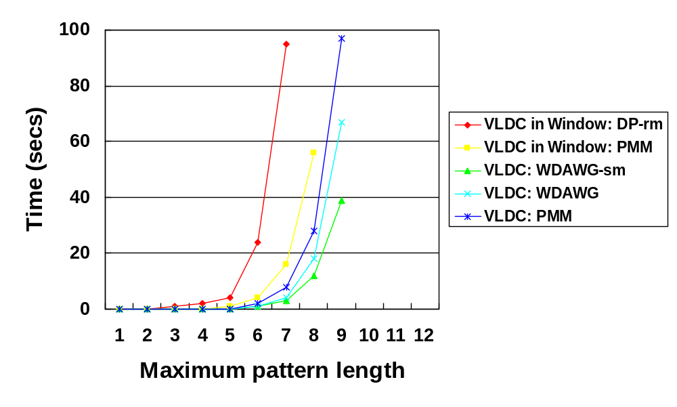
Experimental Results on Artificial Data (Cont.)
1) random data

Slide 41
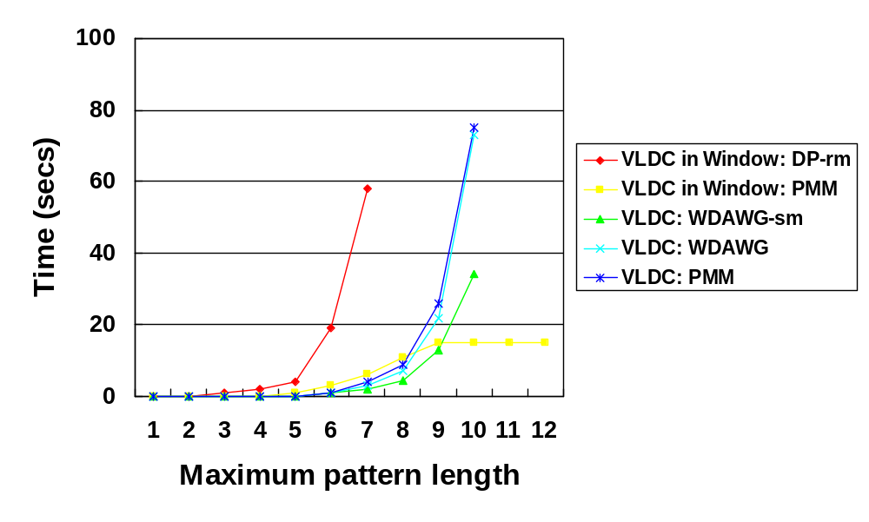
Experimental Results on Artificial Data (Cont.)
2) VLDC embedded data

Slide 42
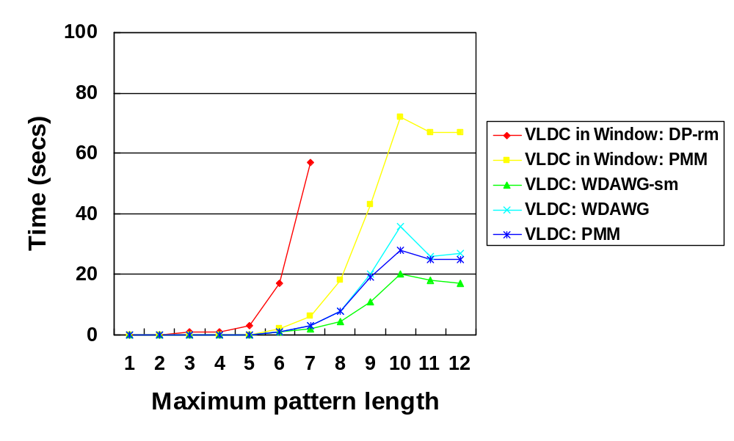
Experimental Results on Artificial Data (Cont.)
3) VLDC in window embedded data

Slide 43
Experimental Results on Real Data
Data : actual protein sequences available at
http://www.cbs.dtu.dk/services/TargetP/, consisting of,
269 sequences with signal peptide (SP),
368 sequences with mitocondrial targeting peptide (mTP),
141 sequences with chloroplast transit peptide (cTP), and
162 “Other” sequences.
The average length is around 419, and
the alphabet is the set of 20 amino acids.

Slide 44
Experimental Results on Real Data (Cont.)
The 20 amino acids are converted to 0,1, or 2,
according to the hydropathy index.
A, M, C, F, L, V, I 0 (hydropathy > 0.0)
P, Y, W, S, T, G 1 (-3.0 < hydropathy < 0.0)
R, K, D, E, N, Q, H 2 (hydropathy < -3.0)

Slide 45
Experimental Results on Real Data (Cont.)
We used SP as positive examples, and all others
as negative examples.
We then obtained the pair <0∗00∗00000∗, 26>,
that occurs in 79.1% of the sequences of SP,
and in 3.9% of the others.
The best substring pattern is ∗00000001∗,
which only gives a classifier that occurs in 56.5%
of SP and in 6.1% of the other.
The well-known hydrophobic
h-region of SP.

Slide 46
Further Work
A String Regression Algorithm and Its
Application to Pattern Discovery in Long Introns
Hideo Bannai, Shunsuke Inenaga,
Ayumi Shinohara, Masayuki Takeda, Setsuo Arikawa
GIW 2002, December 16-18, 2002, Tokyo, Japan

Slide 47
Further Work (Cont.)
DS 2002
YES!
NO!

Slide 48
Further Work (Cont.)
GIW 2002
YES!
NO!

