Slide 1
Pattern Matching on Compressed Texts II
Shunsuke Inenaga
Kyushu University, Japan

Slide 2
Agenda
Fully Compressed Pattern Matching
Straight Line Program
Compressed String Comparison
Period of Compressed String
Pattern Discovery from Compressed String (Palindrome and Square)
FCPM for 2D SLP
Open Problems

Slide 3
Fully Compressed Pattern Matching [1/3]
compressed pattern:
pattern:
Dagstuhl
&(aG
compressed text:
geoiy083qa0gj(#*gpfomo)#(JGWRE$(U)%ARY)(JPED(A%RJG)ER%U)JGODAAQWT$JGWRE)$RJ)REWJFDOPIJKSeoiy083qa0gj(#*gpfomo)#(JGWRE$(U)%ARY)(JPED(A%RJG)ER%U)JGODAAQWT$JGWRE)$geoiy083qa0gj(#*gpfomo)#(JGWRE$(U)%ARY)(JPED(A%RJG)ER%U)JGODAAQWT$JGWRE)$geoiy083qa0gj(#*gpfomo)#(JGWRE$(U)%ARY)(

Slide 4
Fully Compressed Pattern Matching [2/3]
classical pattern
matching algorithm
uncompressed
text
uncompressed
pattern
compressed
text
compressed pattern
matching algorithm
uncompressed
pattern
compressed
text
fully compressed pattern
matching algorithm
compressed
pattern

Slide 5


Possible Application of FCPM
compressed text
I’m here.
compressed
pattern
where.jpg
wally.jpg

Slide 6
Fully Compressed Pattern Matching [3/3]
FCPM Problem
Input : T = compress(T) and P = compress(P).
Output : Set Occ(T, P) of substring occurrences of pattern P in text T.

Slide 7
Straight Line Program [1/2]
SLP T : sequence of assignments
X₁ = expr₁ ; X₂ = expr₂; … ; X_{n} = expr_{n};
X_{k} : variable,
a ( )
X_{i} X_{j} ( i, j < k ).
expr_{k} :
SLP T for string T is a CFG in Chomsky normal form s.t. L(T) = {T}.

Slide 8
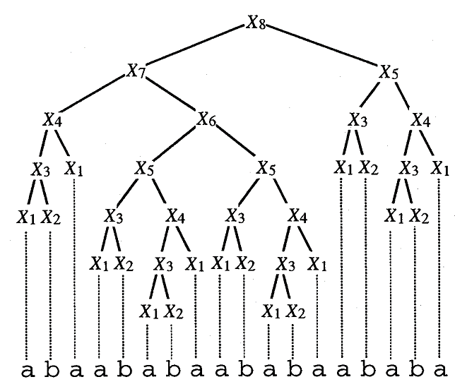
Straight Line Program [2/2]
SLP T
X₁ = a
X₂ = b
X₃ = X₁X₂
X₄ = X₃X₁
X₅ = X₃X₄
X₆ = X₅X₅
X₇ = X₄X₆
X₈ = X₇X₅
n
T =
N
N = O(2^{n})

Slide 9
Straight Line Program [2/2]
SLP T
X₁ = a
X₂ = b
X₃ = X₁X₂
X₄ = X₃X₁
X₅ = X₃X₄
X₆ = X₅X₅
X₇ = X₄X₆
X₈ = X₇X₅
X₈
n
X₇
X₅
T =
N
N = O(2^{n})

Slide 10
From LZ77 to SLP
For any string T given in LZ77-compressed
form of size k, an SLP generating T of size
O(k²) can be constructed in O(k²) time.
[Rytter ’00, ’03, ’04]

Slide 11
FCPM for SLP
FCPM Problem for SLP
Input : SLP T for text T and SLP P for pattern P.
Output : Compact representation of set Occ(T, P)
of substring occurrences of P in T.
We want to solve the problem efficiently (i.e., polynomial time & space in n and m).
n = the size of SLP T, m = the size of SLP P
|T| = O(2^{n}) T (also P) cannot be decompressed
|Occ(T,P)| = O(2^{n}) compact representation

Slide 12
Key Definition
Occ (X, Y) = { i Occ(X, Y) | |X_{l}| - |Y| i |X_{l}|}
X
X_{l}
X_{r}
set of occurrences of Y
that cover or touch the
boundary of X_{l} and X_{r}.
X: variable of T
Y: variable of P
Y

Slide 13
Key Lemma
[Miyazaki et al. ’97]
X
Occ (X, Y) forms a single
arithmetic progression.
X_{l}
X_{r}
O(1) space
Y

Slide 14
Key Observation
X
[Miyazaki et al. ’97]
X_{l}
X_{r}
Computing Occ(X, Y) is
reduced to computing
Occ (X, Y).
Y
Y
Y

Slide 15
Occ (T, P)
DP for Occ (X_{i}, Y_{j})
X_{n}
Occ (X_{n},Y₁)
Occ (X_{n},Y_{j})
Occ (X_{n},Y_{m})
O(1) space
X_{i}
Occ (X_{i},Y₁)
Occ (X_{i},Y_{j})
Occ (X_{i},Y_{m})
X₁
Occ (X₁,Y₁)
Occ (X₁,Y_{j})
Occ (X₁,Y_{m})
Y₁
Y_{j}
Y_{m}
Compact representation of Occ(T, P)
which answers a membership query to Occ(T, P) in O(n) time.

Slide 16
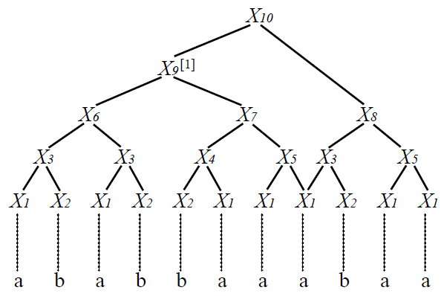
Known Results
 | Time | Space | Compression
Miyazaki et al. ’97 | O(m²n²) | O(mn) | SLP
Lifshits ’07 | O(mn²) | O(mn) | SLP
Hirao et al. ’00 | O(mn) | O(mn) | Balanced SLP
Balanced SLP

Slide 17
Fully Compressed Subsequence Pattern Matching [1/2]
FC Subsequence PM Problem
Input : SLP T for text T and SLP P for pattern P.
Output : Find whether P is a subsequence of T.
P is said to be a subsequence of T, if P can be obtained by removing zero or more characters from T.

Slide 18
Fully Compressed Subsequence Pattern Matching [2/2]
The Fully Compressed Subsequence Pattern Matching Problem on SLP compressed strings is NP-hard.
[Lifshits & Lohrey ’06]

Slide 19
Compressed String Comparison [1/2]
CSC Problem
Input : SLPs T and S for strings T and S, resp.
Output : Dis(similarity) of T and S.

Slide 20
Compressed String Comparison [2/2]
Measure | Time | Space | Reference
Equality | O(mn²) | O(mn) | Lifshits ’07
Hamming Distance | #P-complete | PSPACE | Lifshits ’07
Longest Common Substring | O((m+n)⁴log(m+n)) | O((m+n)³) | Matsubara et al. ’08
Longest Common Subsequence | NP-hard | PSPACE | Lifshits & Lohrey ’06

Slide 21
Property of common substrings [1/3]
For each common substring Z of string S and T, there always exists a variable X_{i} = X_{l}X_{r} and Y_{j} = Y_{L}Y_{R} such that:
Z is a common substring of X_{i} and Y_{j}
Z contains an overlap between X_{l} and Y_{R}
X_{i}
Overlap
X_{l}
X_{r}
Z
common substring
w
Z
Y_{L}
Y_{R}
Y_{j}

Slide 22
Property of common substrings [2/3]
For each common substring Z of string S and T, there always exists a string w such that:
w is a substring of Z
w is an overlap of variables of S and T
X_{i}
Overlap
X_{l}
X_{r}
w
Y_{L}
Y_{R}
Y_{j}

Slide 23
Property of common substrings [1/3]
For each common substring Z of string S and T, there always exists a string w such that:
Z can be calculated by expanding w
X_{i}
Overlap
X_{l}
X_{r}
Z
common substring
w
Z
Y_{L}
Y_{R}
Expand Process
Y_{j}

Slide 24
Computing Overlaps
Lemma [Karpinski et al. ’97]
For any variables X_{i} and X_{j} of SLP T, OL(X_{i}, X_{j}) can be represented by O(n) arithmetic progressions.
X_{i}
Y_{j}
Theorem [Karpinski et ai. ’97]
For any SLP T, OL(X_{i}, X_{j}) can be computed in total of O(n⁴logn) time and O(n³) space for each i, j.
Notes:
Karpinski et al showed that the set of overlaps can be represented by O(n) arithmetic progressions,
although there can be exponential number of elements.
They also showed that it can be computed in order n to the fourth log n time and n cube space.

Slide 25
Periods of Compressed String [1/2]
Compressed Period Problem
Input : SLP T for string T.
Output : Compact representation of set Period(T)
of periods of T.

Slide 26
Periods of Compressed String [2/2]
An O(n)-size representation of Period(T) can be computed in O(n⁴) time with O(n³) space.
[Lifshits ’06, ’07]

Slide 27
Compressed Palindrome Discovery [1/2]
Compressed Palindrome Discovery Problem
Input : SLP T for string T.
Output : Compact representation of set Pal(T)
of maximal palindromes of T.
Pal(T) = { }
ex. T = baabbaa
(p,q) : T[p:q] is the maximal palindrome centered at

Slide 28
Compressed Palindrome Discovery [2/2]
An O(n²)-size representation of Pal(T) can be computed in O(n⁴) time with O(n²) space.
[Matsubara et al. ’08]

Slide 29
Composition System
CS T : sequence of assignments
X₁ = expr₁ ; X₂ = expr₂; … ; X_{n} = expr_{n};
X_{k} : variable,
a ( ),
X_{i} X_{j} ( i, j < k ),
^{[p]}X_{i}X_{j}^{[q]} ( i, j < k ).
expr_{k} :
^{[p]}X = X[1:p]
X^{[q]} = X[|X|-q+1:|X|]

Slide 30
From LZ77 to CS
For any string T given in LZ77-compressed
form of size k, a CS generating T of size
O(klogk) can be constructed in polynomial
time.
[Gasieniec et al. ’96]

Slide 31
Compressed Square Discovery [1/2]
Compressed Square Problem
Input : CS T for string T.
Output : Check the square freeness of T
(whether T contains a square or not).
A square is any non-empty string of the form xx.

Slide 32
Compressed Square Discovery [2/2]
We can test square freeness of T in polynomial time in the size of given composition system T.
[Gasieniec et al. ’96, Rytter’00]

Slide 33
2D SLP
2D SLP T : sequence of assignments
X₁ = expr₁ ; X₂ = expr₂; … ; X_{n} = expr_{n};
X_{k} : variable,
a ( ),
X_{i} X_{j} ( i, j < k, height(X_{i}) = height(X_{j}) ),
X_{i} X_{j} ( i, j < k, width(X_{i}) = width(X_{j}) ),
expr_{k} :
X_{k}
X_{i}
X_{k}
=
X_{i}
X_{j}
=
X_{j}
horizontal concatenation
vertical concatenation

Slide 34
FCPM for 2D SLP
The Fully Compressed Pattern Matching Problem for 2D SLP is
-complete.
[Berman et al. ’97, Rytter’00]

Slide 35
Open Problems [1/2]
Edit distance of two SLP-compressed strings.
Compact representation of all maximal runs of an SLP-compressed string.
A run is any string x whose minimal period p satisfies p |x|/2.
ex.

Slide 36
Max Number of Runs in a String
c
cN [Kolpakov & Kucherov ’99]
c
5N
5N
[Rytter ’06]
1.05N
1.048N [Crochemore et al. ’08]
4N
3.48N
[Puglisi et al. ’08]
1.00N
3N
3.44N
[Rytter ’07]
0.95N
0.944565N [Kusano et al. ’08]
2N
1.6N
[Crochemore & Ilie ’08]
0.927N
[Franek et al. ’03]
0.90N
N
0
N: (uncompressed) text length

Slide 37
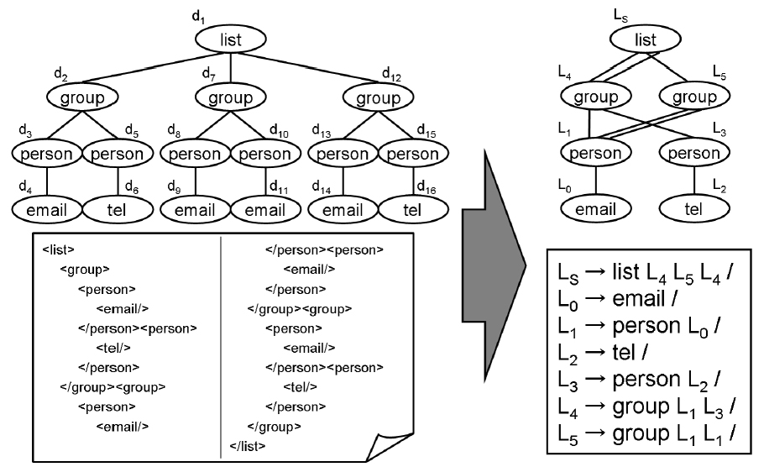
Open Problems [2/2]
Fully Compressed Tree Pattern Matching for grammar based XML compression.
TGCA (Tree Grammar Compression Algorithm) [Onuma et al. ’06]

Slide 38
References [1/5]
[Matsubara et al. ’08] W. Matsubara, S. Inenaga, A. Ishino, A. Shinohara, T. Nakamura, and K. Hashimoto, Computing longest common substring and all palindromes from compressed strings, Proc. SOFSEM'08, LNCS4910, pp. 364-375, 2008
[Lifshits ’07] Y. Lifshits, Processing compressed texts: A tractability border , Proc. CPM'07, LNCS 4580, pp 228-240, 2007
[Lifshits ’06] Y. Lifshits, Solving Classical String Problems an Compressed Texts, Dagstuhl Seminar Proceedings 06201, Schloss Dagstuhl, 2006
[Hirao et ail. ’00] M. Hirao, A. Shinohara, M. Takeda, and S. Arikawa, Faster fully compressed pattern matching algorithm for balanced straight-line programs, Proc. of SPIRE2000, pp. 132-138, IEEE Computer Society, 2000

Slide 39
References [2/5]
[Miyazaki et al. ’97] M. Miyazaki, A. Shinohara, and M. Takeda, An improved pattern matching algorithm for strings in terms of straight-line programs, Proc. CPM'97, LNCS1264, pp.1-11, 1997
[Gasieniec ’96] L. Gasieniec, M. Karpinski, W. Plandowski, W. Rytter, Efficient Algorithms for Lempel-Zip Encoding (Extended Abstract), Proc. SWAT’96, LNCS1097, pp. 392-403, 1996
[Lifsthis & Lohrey ’06] Y. Lifshits and M. Lohrey, Querying and Embedding Compressed Texts, Proc. MFCS’06, LNCS4162, pp. 681-692, 2006
[Rytter ’04] W. Rytter, Grammar Compression, LZ-Encodings, and String Algorithms with Implicit Input, Proc. ICALP 2004, LNCS 3142, pp. 15-27, 2004

Slide 40
References [3/5]
[Rytter ’03] W. Rytter, Application of Lempel-Ziv factorization to the approximation of grammar-based compression, TCS, Volume 302, Number 1-3, pp. 211-222, 2003
[Rytter ’00] W. Rytter, Compressed and fully compressed pattern matching in One and Two Dimensions, Proceedings of IEEE, Volume 88, Number 11, pp. 1769-1778, 2000
[Berman et al. ’97] P. Berman, M. Karpinski, L. L. Larmore, W. Plandowski, W. Rytter, On the Complexity of Pattern Matching for Highly Compressed Two-Dimensional Texts, Proc. CPM’97, LNCS1264, pp. 40-51 1997
[Onuma et al. ’06] J. Onuma, K. Doi, and A. Yamamoto, Data compression and anti-unification for semi-structured documents with tree grammars (in Japanese), IEICE Technical Report AI2006-9, pages 45–50, 2006.

Slide 41
References [4/5]
[Kusano et al. ’08] K. Kusano, W. Matsubara, A. Ishino, H. Bannai, A. Shinohara, New Lower Bounds for the Maximum Number of Runs in a String, http://arxiv.org/abs/0804.1214
[Franek et al. ’03] F. Franek, R. Simpson, W. Smyth, The maximum number of runs in a string, Proc. AWOCA’03, pp. 26–35, 2003.
[Kolpakov & Kucherov ’99] R. Kolpakov and G. Kucherov, Finding maximal repetitions in a word in linear time, Proc. FOCS’99, pp. 596–604, 1999.
[Rytter ’06] W. Rytter, The number of runs in a string: Improved analysis of the linear upper bound, Proc. STACS’06, LNCS3884, pp. 184–195, 2006.

Slide 42
References [5/5]
[Rytter ’07] W. Rytter, The number of runs in a string, Inf. Comput., Volume 205, Number 9, pp. 1459–1469, 2007.
[Crochemore & Ilie ’08] M. Crochemore and L. Ilie, Maximal repetitions in strings, J. Comput. Syst. Sci., Volume 74, Number 5, pp. 796-807, 2008.
[Crochremore et al. ’08] M. Crochemore, L. Ilie, and L. Tinta, Towards a Solution to the "Runs" Conjecture, Proc. CPM’08, LNCS5029, pp. 290-302, 2008.
[Puglisi et al. ’08] S. Puglisi, J. Simpson, W. F. Smyth, How many runs can a string contain?, TCS, Volume 401, Issues 1-3, pp.165-171, 2008.
[Kaprinski et al. ’97] M. Karpinski, W. Rytter, A. Shinohara, An efficient pattern-matching algorithm for strings with short descriptions, Nordic Journal of Computing, Number 4, pp.172–186, 1997.

