Slide 1

Construction of the CDAWG for a Trie
Shunsuke Inenaga, Hiromasa Hoshino,
Ayumi Shinohara, Masayuki Takeda,
and Setsuo Arikawa

Slide 2

Index Structures
To solve a pattern matching problem
efficiently, the following index structures
were invented and have been used.
Given a pattern string p and a text string t,
an index structure for t enables us
to solve the pattern matching problem
in time proportional to the length of p.

Slide 3
Relation among the Index Structures
Suffix Trie
compaction
minimization
Suffix Tree
DAWG
minimization
compaction
CDAWG

Slide 4

The Suffix Trie for Text
cucumber
b
e
r
m
r
c
u
m
b
e
r
u
c
u
c
u
m
b
e
r
m
m
b
e
r
b
b
e
r
e
e
r
34
33
r
Notes:
Given a string “cucumber”, the suffix trie goes like this.
The number of nodes is 34, and that of edges is 33.
If remaining only the root, the leaves, and the branching nodes,
it goes to …

Slide 5
The Suffix Tree for Text
cucumber
mber
r
cumber
u
cu
cumber
mber
mber
ber
er
11
10
Notes:
The suffix tree of “cucumber”.
Moreover, if eliminating the isomorphic subtrees in this suffix tree,
then it changes to …

Slide 6
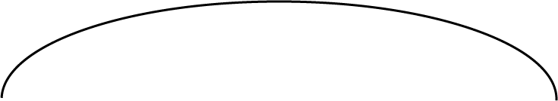



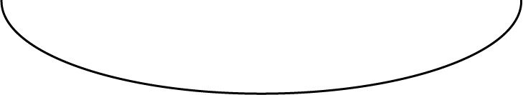
The CDAWG for Text
cucumber
r
mber
u
cu
cumber
mber
ber
er
3
8
Notes:
the CDAWG for “cucumber”.

Slide 7
The Suffix Trie for Text
cucumber
b
e
r
m
r
c
u
m
b
e
r
u
c
u
c
u
m
b
e
r
m
m
b
e
r
b
b
e
r
e
e
r
34
33
r
Notes:
Meanwhile, if merging the isomorphic subtrees of the suffix trie of “cucumber”,
it changes into …

Slide 8




The DAWG for Text
cucumber
r
u
m
c
u
c
u
m
b
e
r
m
b
r
9
14
Notes:
The DAWG for “cucumber”.
Moreover, if remaining only the source node, the sink node, and the branching node,
it goes to …

Slide 9
The CDAWG for Text
cucumber
r
mber
u
cu
cumber
mber
ber
er
3
8
Notes:
the CDAWG for “cucumber”.

Slide 10
Index Structure for Multiple Texts
Sometimes a set of text strings can be
given as an input.
An example of a CDAWG for a set of
strings is as follows.

Slide 11
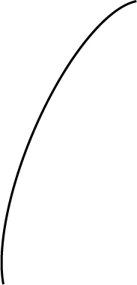
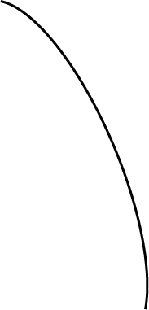

CDAWG for
T = {ababc, abcab}
T = {ababc$1, abcab$2}
a
b
b
c
c
$2
$1
a
b
c
$2
$1
a
$1
b
$2

Slide 12
Trie - Representing a Set of Strings
We consider the case that a set of text
strings are given in the form of a trie.
S = {aaab$1, aac$2, aa$3, abc$4, bab$5, ba$6}
b
$1
a
c
$2
a
$3
a
b
c
$4
b
a
$5
b
$6

Slide 13
The Goal of This Work
To build the CDAWG for a given trie
in time linear to the number of nodes
in the trie.
Note!
In general, the number of nodes in
the trie is smaller than the total length
of the text strings, because the trie shares the prefixes of the text strings.

Slide 14
The Number of Nodes in the Trie
S = {aaab$1, aac$2, aa$3, abc$4, bab$5, ba$6}
||S|| = 23
b
$1
a
c
$2
a
$3
a
b
c
$4
b
a
$5
b
$6
17

Slide 15
Main Idea of Our algorithm
We developed an on-line linear time
algorithm to construct CDAWGs for a set
of text strings. (CPM2001, Israel, July)
Our new algorithm builds the CDAWG for a given trie, based on the above, synchronizing the depth-first search for the trie.

Slide 16

For S = {abab$1, abacb$2}
a
b
a
b
$1
0
1
2
3
4
5
c
b
$2
6
7
8
0
1
2
Σ
Σ
Σ
a
a
b
b

Slide 17

a
b
a
b
$1
0
1
2
3
4
5
c
b
$2
6
7
8
3
4
5
Σ
Σ
Σ
a
a
a
b
b
b
b
b
b
a
a
b
a
a
$1
a
b
a
b
b
$1
$1
b
$1

Slide 18
a
b
a
b
$1
0
1
2
3
4
5
c
b
$2
6
7
8
0
This is unique to this
algorithm.
Σ
The Advanced Point
represents the location in the CDAWG
which corresponds to the node
currently focused on in the trie.

Slide 19
a
b
a
b
$1
0
1
2
3
4
5
c
b
$2
6
7
8
0
Σ
The Active Point
represents the location that corresponds to the longest suffix of currently scanned string, which is not represented in the sink node.

Slide 20
a
b
a
b
$1
0
1
2
3
4
5
c
b
$2
6
7
8
3
4
5
Σ
Σ
Σ
a
a
a
b
b
b
b
b
b
a
a
b
a
a
$1
a
b
a
b
b
$1
$1
b
Redirect the edge!
$1

Slide 21

a
b
a
b
$1
0
1
2
3
4
5
c
b
$2
6
7
8
3
6
Σ
a
b
c
b
$1
c
a
$1
c
b
$1

Slide 22
a
b
a
b
$1
0
1
2
3
4
5
c
b
$2
6
7
8
Separate the node!
7
Σ
a
b
b
c
b
$1
b
c
a
a
b
$1
$1
c
b
b
$1

Slide 23

a
b
a
b
$1
0
1
2
3
4
5
c
b
$2
6
7
8
8
Σ
a
b
b
c
b
$2
b
$1
$2
c
a
a
b
$2
$1
$2
$1
c
b
b
$2
$1

Slide 24
Pseudo-code
main routine
current_node := 0;
active_point := (root, ε);
advanced_point := (root, ε);
traverse-and-update(current_node, active_point, advanced_point);
procedure traverse-and-update(current_node, active_point, advanced_point)
Let label_set be the set of labels of the outgoing edges of current_node;
if |label_set| = 0 then return;
else if |label_set| ≧ 2 then create-node(advanced_point);
for each c ∈ label_set do
new_active_point := update-CDAWG(c, active_point);
Let new_advanced_point be the location active_point advances with c;
Let v be the node to which the edge labeled with c points;
traverse-and-update(v, new_active_point, new_advanced_point);

Slide 25
Conclusions
We developed an algorithm to construct
the CDAWG for a given trie, in time linear
to the number of nodes in the trie.
In addition, our algorithm can be applied
to construct the suffix trie, the suffix tree,
and the DAWG for a given trie,
by changing function update-CDAWG.

