Slide 1
A Fully Compressed Pattern
Matching Algorithm for
Simple Collage Systems
Shunsuke Inenaga (Helsinki, Finland)
Ayumi Shinohara (Kyushu, Japan)
Masayuki Takeda (Kyushu, Japan)

Slide 2
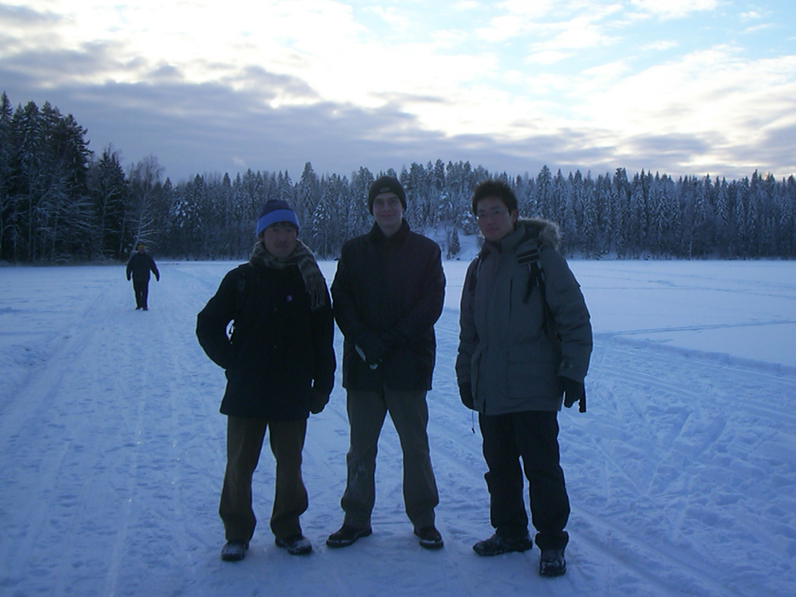


Slide 3
Fully Compressed Pattern Matching
Fully Compressed Pattern Matching
  What is Fully Compressed Pattern Matching
  Why FCPM?
  Previous Studies on FCPM
Simple Collage Systems
Simple Straight Line Programs
FCPM Algorithm for SSLP
Further Work

Slide 4
Classic Pattern Matching
pattern:
compress
text:
We introduce a general framework which is suitable to capture an essence of compressed pattern matching according to various dictionary based compressions. The goal is to find all occurrences of a pattern in a text without decompression, which is one of the most active topics in string matching. Our framework includes such compression methods as Lempel-Ziv family, (LZ77, LZSS, LZ78, LZW), byte-pair encoding, and the static dictionary based method. Technically, our pattern matching algorithm extremely extends that for LZW compressed text presented by Amir, Benson and Farach [Amir94].
We introduce a general framework which is suitable to capture an essence of compressed pattern matching according to various dictionary based compressions. The goal is to find all occurrences of a pattern in a text without decompression, which is one of the most active topics in string matching. Our framework includes such compression methods as Lempel-Ziv family, (LZ77, LZSS, LZ78, LZW), byte-pair encoding, and the static dictionary based method. Technically, our pattern matching algorithm extremely extends that for LZW compressed text presented by Amir, Benson and Farach [Amir94].

Slide 5
Compressed Pattern Matching
Compressed
Document Files
Document Files
We introduce a general framework which is suitable to capture an essence of compressed pattern matching according to various dictionary based compressions. The goal is to find all occurrences of a pattern in a text without decompression, which is one of the most active topics in
’

Slide 6
Compressed Pattern Matching
pattern:
compress
compressed text:
geoiy083qa0gj(#*gpfomo)#(JGWRE$(U)%ARY)(JPED(A%RJG)ER%U)JGODAAQWT$JGWRE)$RJ)REWJFDOPIJKSeoiy083qa0gj(#*gpfomo)#(JGWRE$(U)%ARY)(JPED(A%RJG)ER%U)JGODAAQWT$JGWRE)$ geoiy083qa0gj(#*gpfomo)#(JGWRE$(U)%ARY)(JPED(A%RJG)ER%U)JGODAAQWT$JGWRE)$ geoiy083qa0gj(#*gpfomo)#(JGWRE$(U)%ARY)(

Slide 7
Fully Compressed Pattern Matching
normal pattern
matching algorithm
uncompressed
text
uncompressed
pattern
compressed
text
compressed pattern
matching algorithm
uncompressed
pattern
compressed
text
fully compressed pattern
matching algorithm
compressed
pattern

Slide 8
Fully Compressed Pattern Matching
Instance : T = compress(T) and P = compress(P).
Query : Find all occurrences of pattern P in text T
without decompressing either T or P.
compressed text
Pattern matching is a task to find all occurrences of pattern P in text T. It is one of the most fundamental problems in string processing. In the last decade, pattern matching on compressed objects has attracted more and more interests.
geoiy083qa0gj(#*gpfomo)#(JGWRE$(U)%ARY)(JPED(A%RJG)ER%U)JGODAAQWT$JGWRE)$RJ)REWJFDOPIJRE)RE(SDKSL
decompress
compressed pattern
decompress
$%#
matching

Slide 9

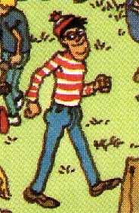

But Why FCPM?
text:
I’m here.
pattern:
where.jpg
wally.jpg

Slide 10
FCPM Algorithms
year
researchers
compression
1995
Karpinski, Rytter, Shinohara
SLP
1996
Gasieniec, Karpinski, Plandowski, Rytter
LZ77
1997
Karpinski, Rytter, Shinohara
SLP
1997
Miyazaki, Shinohara, Takeda
SLP
1999
Gasieniec, Rytter
LZW
1999
Karhumäki, Plandowski, Rytter
deterministic automata
2000
Hirao, Shinohara, Takeda, Arikawa
balanced SLP
2002
Rytter
LZ77
simple collage systems
2004
Inenaga, Shinohara, Takeda
simple collage systems

Slide 11
Simple Collage Systems
Fully Compressed Pattern Matching
Simple Collage Systems
  Collage Systems – Unifying Framework
  LZW & LZ78 in Collage Systems
  Hierarchy of Collage Systems
  Our Result on Simple Collage Systems
Simple Straight Line Programs
FCPM Algorithm for Simple Collage Systems
Further Work

Slide 12
Collage Systems
A unifying framework for compressed pattern matching.
T. Kida et al. (1999), SPIRE1999
Collage System
LZ77 compressed text
compressed pattern matching
algorithm
for collage systems
LZ78 compressed text
LZW compressed text
Previous
LZ77 compressed text
specific algorithm for LZ77
LZ78 compressed text
specific algorithm for LZ78
LZW compressed text
specific algorithm for LZW

Slide 13
Definition of Collage Systems
Collage System <D,S>
D : sequence of assignments X₁ = expr₁ ; X₂ = expr₂; … ; X_{h} = expr_{h};
X_{k} : variable,
a where a (Σ {ε}),
X_{i} X_{j} where i, j < k,
expr_{k} : ( X_{i} ) ^{j} where i < k, j N⁺,
^{[ j ]}X_{i} where i < k, j N⁺,
X_{i} ^{[ j ]} where i < k, j N⁺.
S : sequence X_{i1} X_{i2} ... X_{is} of variables in D.
primitive assignment
concatenation
repetition
prefix truncation
suffix truncation
||D|| = h, |S| = s, |<D, S>| = ||D||+|S| = h+s

Slide 14
Example of Collage System
X₁ = a ;
X₂ = b ;
X₃ = X₁ X₂ ;
a b
D :
X₄ = X₁ X₃ ;
a a b
X₅ = X₃ X₁ ;
a b a
X₆ = X₂ X₂ ;
b b
||D|| = 6
S :
X₃ X₄ X₅ X₆ X₅
|S| = 5
a b a a b a b a b b a b a

Slide 15
LZW & LZ78 in Collage Systems
LZW
LZ78
S : X_{i1} ... X_{is}
D : X₁ = a₁ ;
X_{q} = a_{q} ;
X_{q+1} = X_{i1}X_{σ(i2)} ;
X_{q+s-1} = X_{is-1}X_{σ(is)} ;
S : X₁ ... X_{s}
D : X₀ = ε ;
X₁ = X_{i1}b₁ ;
X_{s} = X_{is}b_{s} ;
Σ = {a₁, a₂, … a_{q}},
1 i₁ q,
σ(j) denotes the integer k (1 k q)
s.t. a_{k} is the first symbol of X_{j}.
b_{j} is a symbol in Σ.

Slide 16
Hierarchy of Collage Systems
Simple Collage System
concatenation
X = X_{l}X_{r}
LZW
(|X_{l}|=1 or |X_{r}|=1)
LZ78
SLP
Regular Collage System
Sequitur
concatenation
Re-Pair
MPM
BPE
X = X_{l}X_{r}
Collage System
Run-length
LZSS
concatenation
repetition
truncation
LZ77
X = X_{l}X_{r}
X = (X_{i})^{j}
X = ^{[j]}X_{i}, X = X_{i}^{[j]}

Slide 17
Our Result
Given two simple collage systems <D,S> and <D’,S’>
that are descriptions of text T and pattern P, respectively.
Occ(T,P) can be computed in O(||D||² + mn log|S|) time
using O(||D||²+mn) space.
Previous best result:
O(m²n²) time
O(mn) space
Occ(T,P) : set of all occurrences of P in T
n = ||D|| + |S| (the size of <D,S>)
m = ||D’|| + |S’| (the size of <D’,S’>)
Miyazaki et al., 1997

Slide 18
Gasieniec & Rytter’s Work
FCPM Algorithm for LZW
Claims O((m+n)log(m+n)) time
Actually decompresses a prefix of P
when it is short (has length at most 2n)
Doesn’t really suit our problem setting
Our challenge:
FCPM for SCS (including LZW)
without any explicit decompression

Slide 19
Simple Straight Line Programs
Fully Compressed Pattern Matching
Simple Collage Systems
Simple Straight Line Programs
  Straight Line Programs (SLPs)
  Translation of SCS’s to SSLPs
  Variables of SSLPs
FCPM Algorithm for Simple Collage Systems
Further Work

Slide 20
Straight Line Program
SLP T
T : sequence of assignments
X₁ = expr₁ ; X₂ = expr₂; … ; X_{n} = expr_{n};
X_{k} : variable,
a where a (Σ {ε}),
X_{i} X_{j} where i, j < k.
expr_{k} :
SLP T is a CFG in Chomsky normal form.
SLP T for string w is a CFG s.t. L(T) = {w}.

Slide 21
Translation of SCS into SLP
Simple
Straight Line
Program
Simple Collage System
X₁ = a ;
X₁ = a;
X₂ = b;
X₃ = X₂ X₂;
X₄ = X₁ X₃;
X₅ = X₃ X₁;
X₆ = X₂ X₂;
X₇ = X₃ X₄;
X₈ = X₇ X₅;
X₉ = X₈ X₆;
X₁₀ = X₉ X₅;
X₂ = b ;
D :
X₃ = X₁ X₂ ;
a b
X₄ = X₁ X₃ ;
a a b
X₅ = X₃ X₁ ;
a b a
X₆ = X₂ X₂ ;
b b
S :
X₃ X₄ X₅ X₆ X₅

Slide 22
Derivation Tree of SSLP
Simple
Straight Line
Program
X (= X_{l} X_{r}) is left simple
if |X_{l}| = 1.
X₁₀
X₁ = a;
X₂ = b;
X₃ = X₂ X₂;
X₄ = X₁ X₃;
X₅ = X₃ X₁;
X₆ = X₂ X₂;
X₇ = X₃ X₄;
X₈ = X₇ X₅;
X₉ = X₈ X₆;
X₁₀ = X₉ X₅;
X₉
X₅
X₈
X₆
X₃
X₁
X₇
X₅
X₂
X₂
X₁
X₂
X₃
X₄
X₃
X₁
X₁
X₂
X₁
X₃
X₁
X₂
X₁
X₂
a
b
a
a
b
a
b
a
b
b
a
b
a

Slide 23
Derivation Tree of SSLP
Simple
Straight Line
Program
X (= X_{l} X_{r}) is right simple
if |X_{r}| = 1.
X₁₀
X₁ = a;
X₂ = b;
X₃ = X₂ X₂;
X₄ = X₁ X₃;
X₅ = X₃ X₁;
X₆ = X₂ X₂;
X₇ = X₃ X₄;
X₈ = X₇ X₅;
X₉ = X₈ X₆;
X₁₀ = X₉ X₅;
X₉
X₅
X₈
X₆
X₃
X₁
X₇
X₅
X₂
X₂
X₁
X₂
X₃
X₄
X₃
X₁
X₁
X₂
X₁
X₃
X₁
X₂
X₁
X₂
a
b
a
a
b
a
b
a
b
b
a
b
a

Slide 24
Derivation Tree of SSLP
Simple
Straight Line
Program
X (= X_{l} X_{r}) is complex
otherwise.
X₁₀
X₁ = a;
X₂ = b;
X₃ = X₂ X₂;
X₄ = X₁ X₃;
X₅ = X₃ X₁;
X₆ = X₂ X₂;
X₇ = X₃ X₄;
X₈ = X₇ X₅;
X₉ = X₈ X₆;
X₁₀ = X₉ X₅;
X₉
X₅
X₈
X₆
X₃
X₁
X₇
X₅
X₂
X₂
X₁
X₂
X₃
X₄
X₃
X₁
X₁
X₂
X₁
X₃
X₁
X₂
X₁
X₂
a
b
a
a
b
a
b
a
b
b
a
b
a

Slide 25
FCPM Algorithm for Simple Collage Systems
Fully Compressed Pattern Matching
Simple Collage Systems
Simple Straight Line Programs
FCPM Algorithm for Simple Collage Systems
  Reduction of Computing Occ(X,Y)
  Efficient Computation by Dynamic Programming
Further Work

Slide 26
Occ (X, Y)
set of occurrences of Y
that cover or touch the
boundary of X_{l} and X_{r}.
Occ (X, Y) = { i Occ(X, Y) | |X_{l}| - |Y| i |X_{l}|}
X
X_{l}
X_{r}
X: variable of T
Y: variable of P
Y

Slide 27
Property of Occ (X, Y)
Occ (X, Y) forms a single arithmetic progression.
X
O(1) space
X_{l}
X_{r}
Y

Slide 28
Text Decomposition
Occ(X, Y) =
Occ(X_{l}, Y) Occ (X, Y) Occ(X_{r}, Y) |X_{l}|
X
Computing Occ(X, Y) is reduced
to computing Occ (X, Y).
X_{l}
X_{r}
Y
Y
Y

Slide 29
Dynamic Programming for Occ (X,Y)
X_{n}
Occ (X_{n},Y₁)
Occ (X_{n},Y_{j})
Occ (X_{n},Y_{m})
Occ (T, P)
X_{i}
Occ (X_{i},Y₁)
Occ (X_{i},Y_{j})
Occ (X_{i},Y_{m})
X₂
Occ (X₂,Y₁)
Occ (X₂,Y_{j})
Occ (X₂,Y_{m})
X₁
Occ (X₁,Y₁)
Occ (X₁,Y_{j})
Occ (X₁,Y_{m})
Y₁
Y_{j}
Y_{m}

Slide 30
Pattern Decomposition
Occ (X, Y) = (Occ (X, Y_{l}) (Occ(X_{r}, Y_{l}) |X_{l}| |Y_{l}|)
(Occ(X_{l}, Y_{l}) (Occ (X, Y_{r})) |Y_{l}|))
X
X
X_{l}
X_{r}
X_{l}
X_{r}
Occ_{l} (X, Y)
Occ_{r} (X, Y)
Y_{l}
Y_{r}
Y_{l}
Y_{r}
Y
Y

Slide 31
Occ_{l} (X,Y)
X
X_{l}
X_{r}
Y_{l}
Y_{r}

Slide 32
Occ_{l} (X,Y)
X
X_{l}
X_{r}
Y_{l}
Y_{r}

Slide 33
Occ_{l} (X,Y)
?
Occ_{l} (X, Y) =
Occ (X, Y_{l}) (Occ (X_{r}, Y_{r}, k) offset)
X
O(1) time
X_{l}
X_{r}
Y_{l}
Y_{r}
single arithmetic
progression!!
k

Slide 34
Simple Variable Case
X : any simple variable of T
Y : any variable of P
Occ (X, Y, k) can be computed in O(1) time
with extra O(h² + mh) work time and space.
h : the num. of simple variables in T
m : the size of P

Slide 35
Complex Variable Case
X : any complex variable of T
Y : any variable of P
Occ (X, Y, k) can be computed in O(logs) time
with extra O(ms) work time and space.
s : the num. of complex variables in T
m : the size of P

Slide 36
Final Result
m
X_{n}
Occ (X_{n},Y₁)
Occ (X_{n},Y_{j})
Occ (X_{n},Y_{m})
X_{i}
Occ (X_{i},Y₁)
Occ (X_{i},Y_{j})
Occ (X_{i},Y_{m})
n
O(mnlogs) time
O(mn) space
O(logs) time
O(1) space
+
X₂
Occ (X₂,Y₁)
Occ (X₂,Y_{j})
Occ (X₂,Y_{m})
X₁
Occ (X₁,Y₁)
Occ (X₁,Y_{j})
Occ (X₁,Y_{m})
Y₁
Y_{j}
Y_{m}
extra work time and space: O(h²+mh) + O(ms) = O(h²+mn)
O(h²+mnlogs) = O(||D||²+mnlog|S|) time
O(h²+mn) = O(||D||²+mn) space

Slide 37
Further Work
Fully Compressed Pattern Matching
Simple Collage Systems
Simple Straight Line Programs
FCPM Algorithm for Simple Collage Systems
Further Work
  Multilevel Pattern Matching Code
  Good Features of MPM Code
  Faster FCPM Algorithm for MPM Code

Slide 38
Further Work
Multilevel Pattern Matching Code
(Kieffer & Yang, 2000)
MPM Code
X₁ = a;
X₂ = b;
X₃ = X₁ X₂;
X₄ = X₁ X₁;
X₅ = X₂ X₁;
X₆ = X₂ X₂;
X₇ = X₃ X₄;
X₈ = X₅ X₅;
X₉ = X₆ X₃;
X₁₀ = X₇ X₈;
X₁₁ = X₉ X₂;
X₁₂ = X₁₀ X₁₁;
X₁₂
X₁₀
X₁₁
X₇
X₈
X₉
X₃
X₄
X₅
X₅
X₆
X₃
X₁
X₂
X₁
X₁
X₂
X₁
X₂
X₁
X₂
X₂
X₁
X₂
X₂
a
b
a
a
b
a
b
a
b
b
a
b
a

Slide 39
Features of MPM Code
Subclass of SLP
Runs in linear time
Exponentially small representation
Hierarchical structure

Slide 40
FCPM on MPM Code
Previous Best Result
(Miyazaki et al. 1997)
Our New Result
O(m²n²) time
O(mn) space
O(mn²) time
O(mn) space
Submitted to DLT’04

