Slide 2







$$i_{1}$$
A
2
G
2
$$o_{1}$$
0.2
0.4
E
2
$$i_{2}$$
B
2
0.15
H
4
0.1
3
0.5
$$o_{2}$$
D
0.4
$$i_{3}$$
I
2
$$o_{3}$$
C
4
F
5
0.1
$$i_{4}$$
0.1
0.2

Slide 3







$$i_{1}$$
A
2
G
2
$$o_{1}$$
0.2
0.4
E
2
$$i_{2}$$
B
2
0.15
H
4
0.1
3
0.5
$$o_{2}$$
D
0.4
$$i_{3}$$
C
4
F
5
I
2
$$o_{3}$$
0.1
0.2
0.1
$$i_{4}$$

Slide 4



$$b_{1}$$
$$b_{3}$$
runnable
$$b_{2}$$
runnable

Slide 5
SW-C
SW-C
Application layer
SW-C
SW-C
Runtime Environment(RTE)
Service layer
os
Complex
drivers
Layer depending on ECU
Layer depending on microcomputer
Microcontroller

Slide 7







$$i_{1}$$
A
2
G
2
$$o_{1}$$
0.2
0.4
E
2
$$i_{2}$$
B
2
0.15
H
4
0.1
3
0.5
$$o_{2}$$
D
0.4
$$i_{3}$$
C
4
F
5
I
2
$$o_{3}$$
0.1
0.2
0.1
$$i_{4}$$

Slide 8
$$i_{1}$$
A
2
G
2
$$o_{1}$$
0.2
0.4
E
2
$$i_{2}$$
B
2
0.15
H
4
0.1
3
0.5
$$o_{2}$$
D
0.4
$$i_{3}$$
C
4
F
5
I
2
$$o_{3}$$
0.1
0.2
0.1
$$i_{4}$$

Slide 9









$$i_{1}$$
A
2
G
2
$$o_{1}$$
0.2
0.4
E
2
$$i_{2}$$
B
2
0.15
H
4
0.1
3
0.5
$$o_{2}$$
D
0.4
$$i_{3}$$
C
4
F
5
I
2
$$o_{3}$$
0.1
0.2
0.1
$$i_{4}$$
$$r_{1}$$
$$r_{2}$$

Slide 10
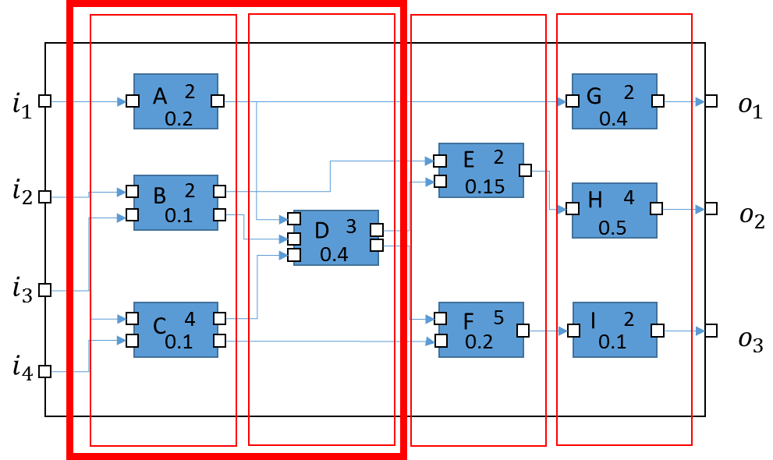

Slide 12







$$i_{1}$$
A
2
G
2
$$o_{1}$$
0.2
0.4
E
2
$$i_{2}$$
B
2
0.15
H
4
runnable2
0.1
3
0.5
$$o_{2}$$
D
0.4
runnable1
runnable4
$$i_{3}$$
runnable2
C
4
F
5
I
2
$$o_{3}$$
0.1
0.2
0.1
$$i_{4}$$
runnable1
runnable3
runnable4
runnable3

Slide 13






$$v_{0}$$
$$v_{1}$$
$$v_{2}$$
$$v_{3}$$
Base period : 1
$$v_{0}$$
$$v_{1}$$
Base period : 2

Slide 14
block A
block B

Slide 15







$$i_{1}$$
A
2
G
2
$$o_{1}$$
0.2
0.4
E
2
$$i_{2}$$
B
2
0.15
0.1
H
4
$$o_{2}$$
D
3
runnable3
0.5
0.4
$$i_{3}$$
runnable2
C
4
F
5
I
2
$$o_{3}$$
$$i_{4}$$
0.1
0.2
0.1
runnable1
runnable4

Slide 16





$$i_{1}$$
A
2
G
2
$$o_{1}$$
0.2
0.4
E
2
$$i_{2}$$
B
2
0.15
H
4
runnable2
0.1
3
runnable3
0.5
$$o_{2}$$
D
0.4
$$i_{3}$$
runnable2
runnable1
runnable4
I
2
$$o_{3}$$
C
4
F
5
0.1
$$i_{4}$$
0.1
0.2
runnable1
runnable4
runnable3

