Slide 1
Single-cell analysis for blood cells
Feng Tian
9/28/2018
Notes:
大家好，今天我总结一下目前的一些进展。

Slide 2
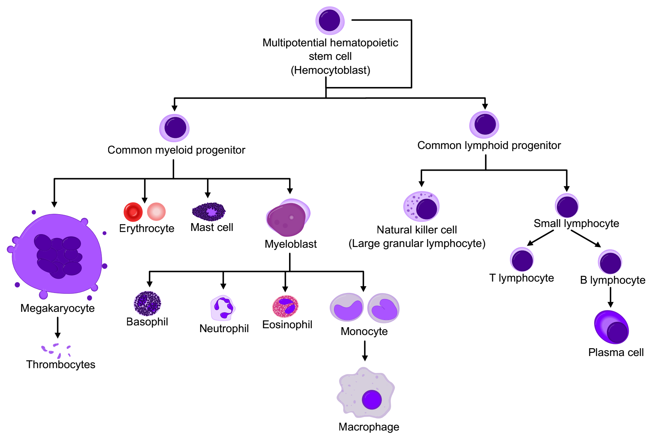
Background
Image from https://en.wikipedia.org/wiki/Blood_cell

Slide 3
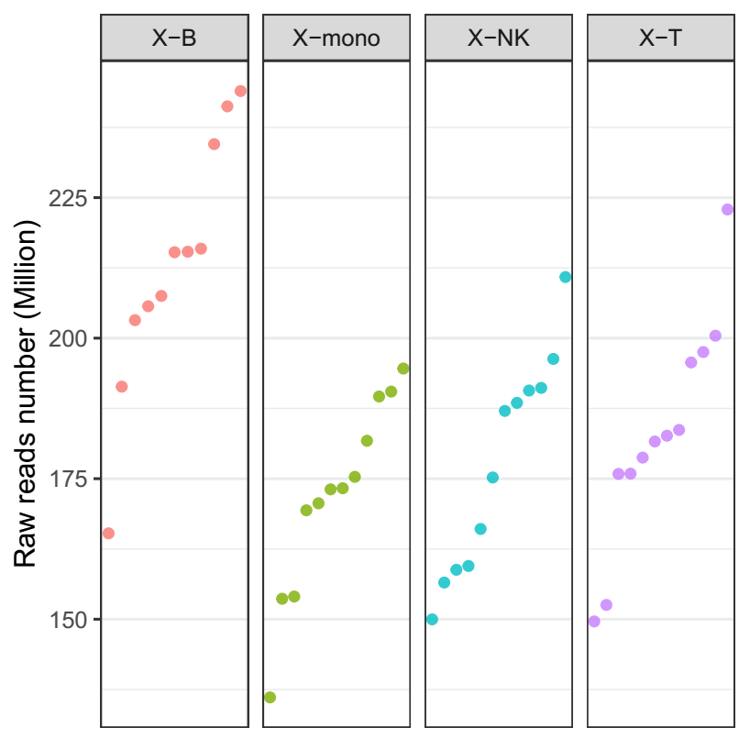
Data
 | Date | Total | Remaining | Ratio | Marker | Marker ratio
X-B | 2018/9/10 | 1056 | 922 | 87.31% | PTPRC, CD19 | 75.27%
X-mono | 2018/7/25 | 1152 | 265 | 23.00% | PTPRC, CD14 | 63.02%
X-NK | 2018/7/25 | 1152 | 365 | 31.68% | PTPRC, NCAM1 | 91.51%
X-T | 2018/7/25 | 1152 | 987 | 85.68% | PTPRC, CD3D | 99.19%
Total | - | 4512 | 2539 | 56.27% | - | -
X-B-1 ?

Slide 4
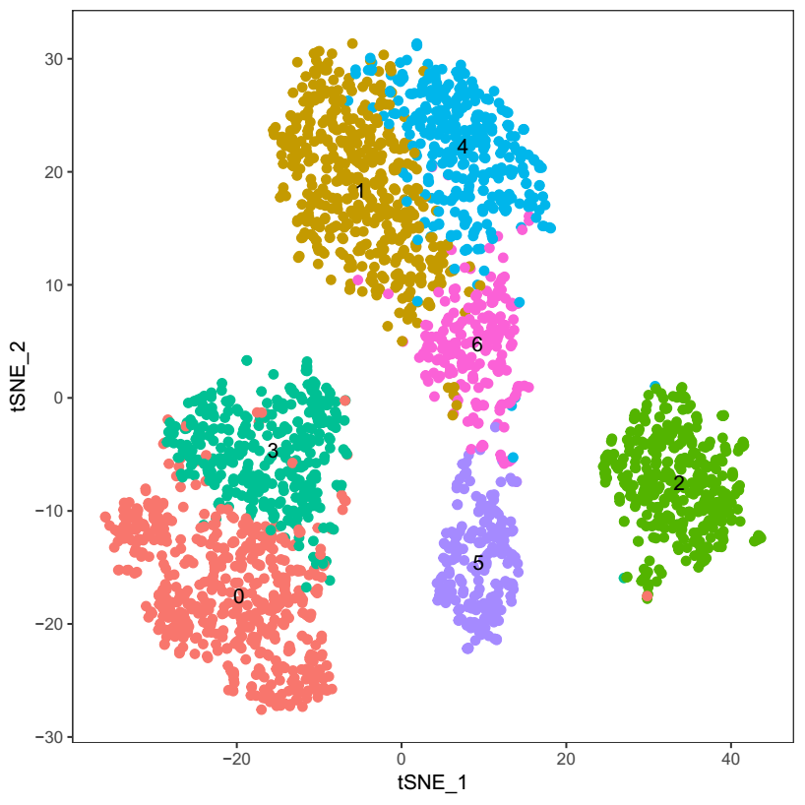
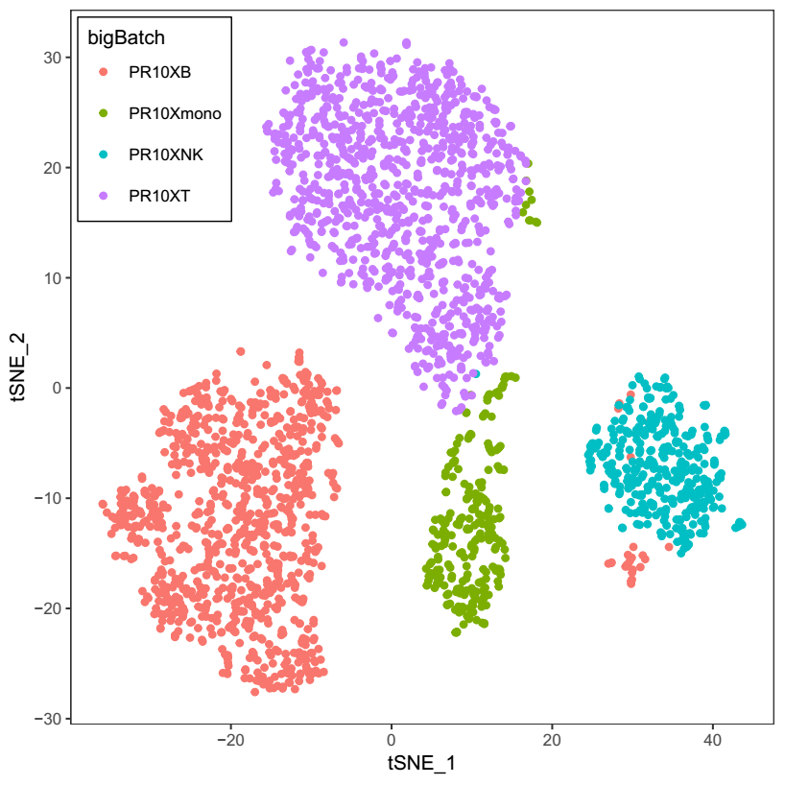
Cell clustering

Slide 5
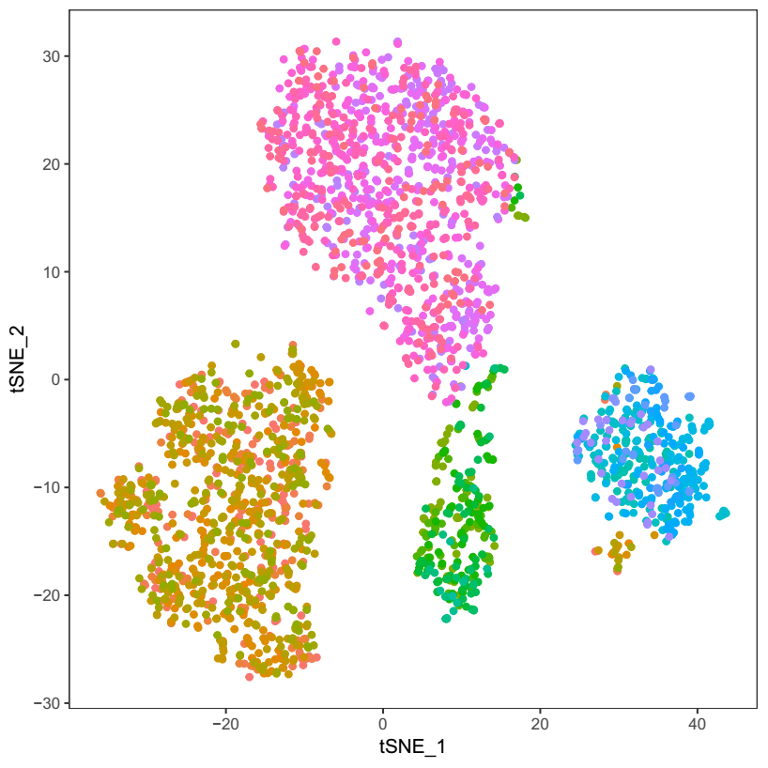
Cell clustering

Slide 6
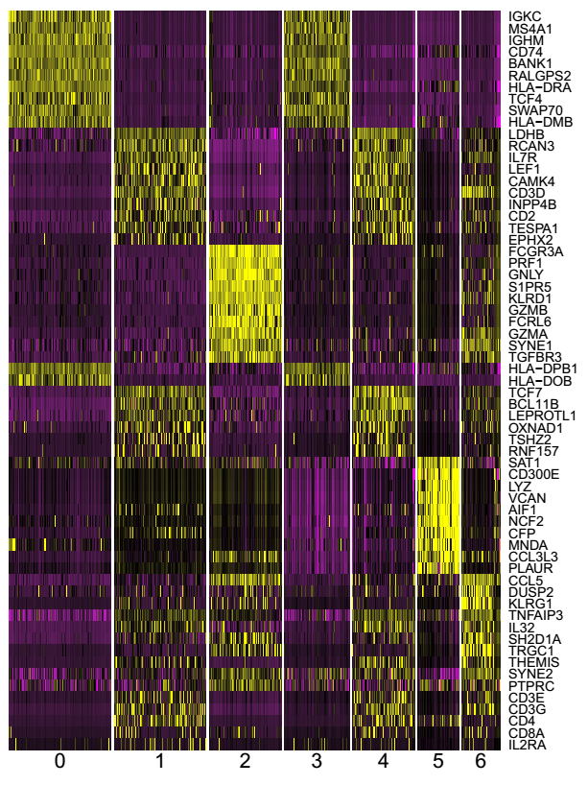
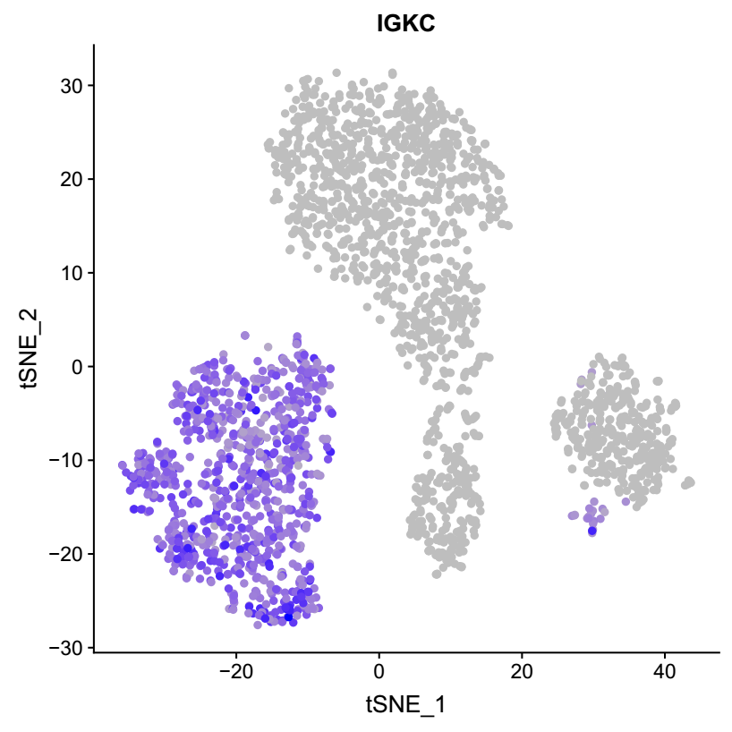
Marker genes
(Only top 10 genes were shown)

Slide 7
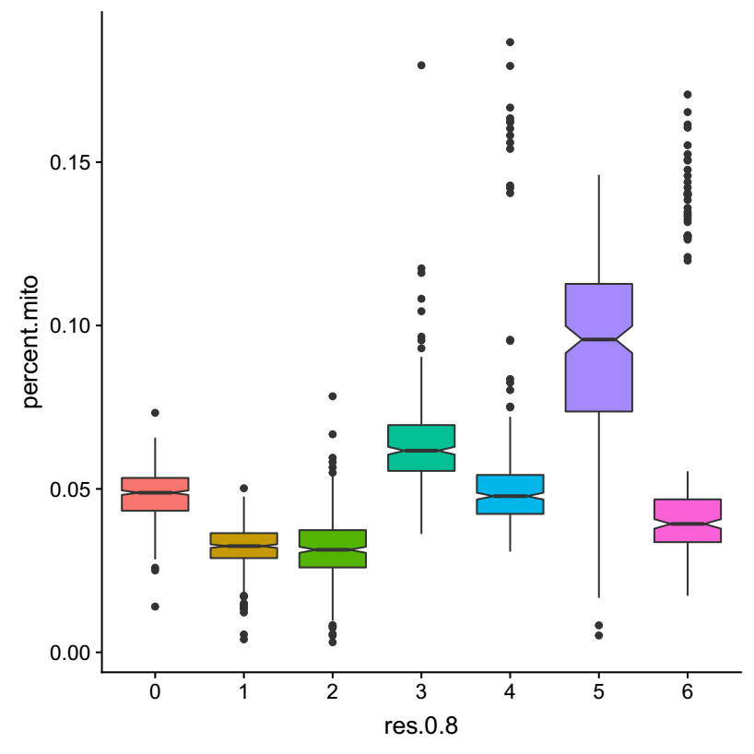
Mito-gene ratio (B cell)
MT-RNR2
MTRNR2L12
MT-ND1
MT-ND5
MT-CYB
MT-ND4

Slide 8
Mito-gene ratio

Slide 9
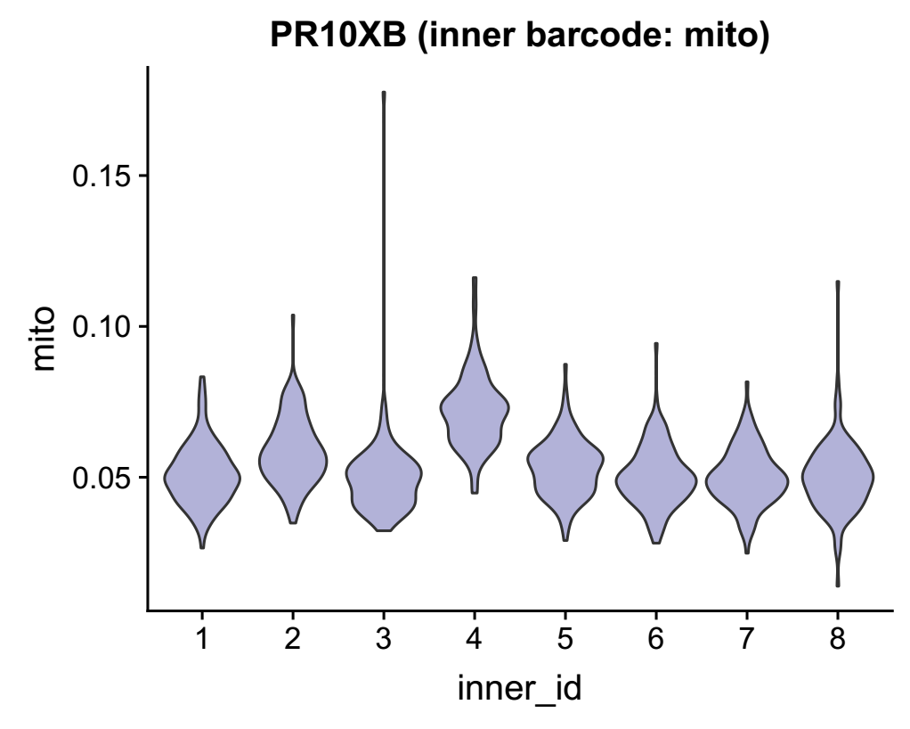
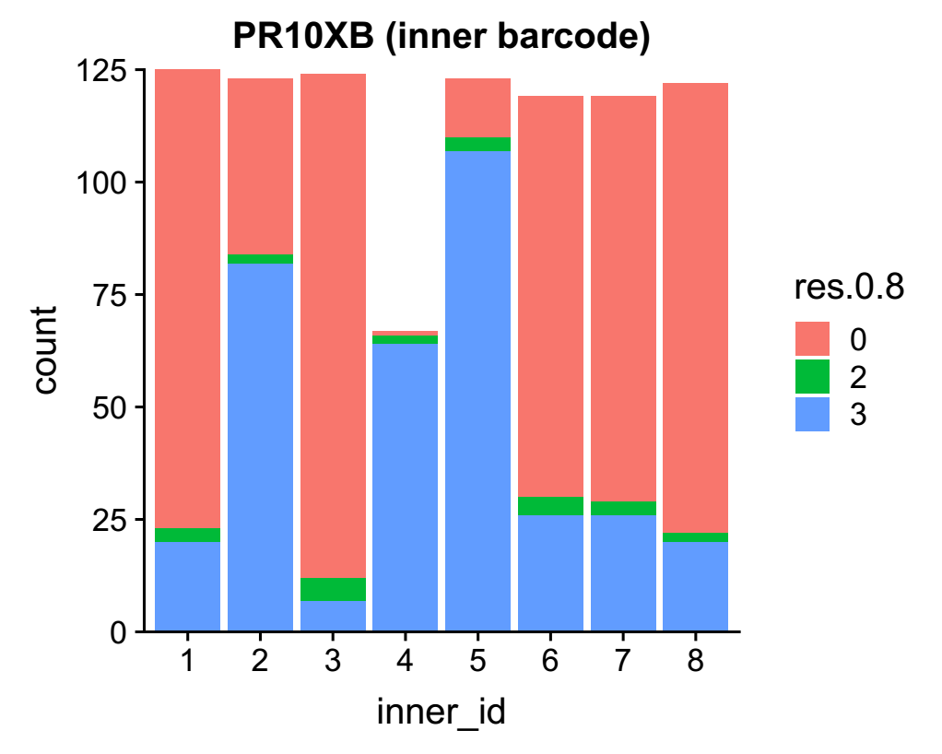
Mito-gene ratio (B cell)

Slide 10
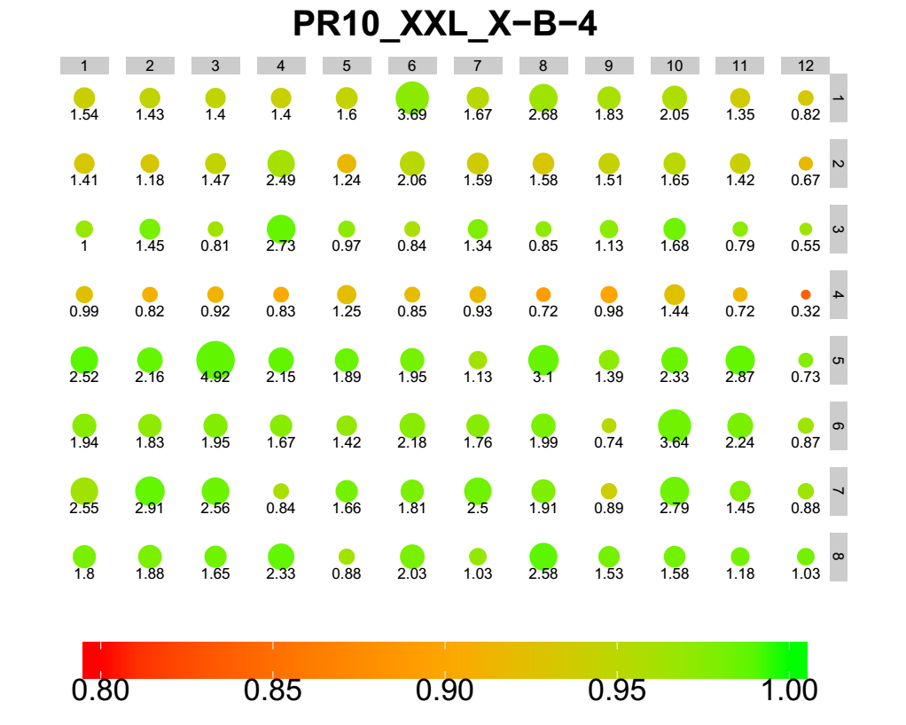
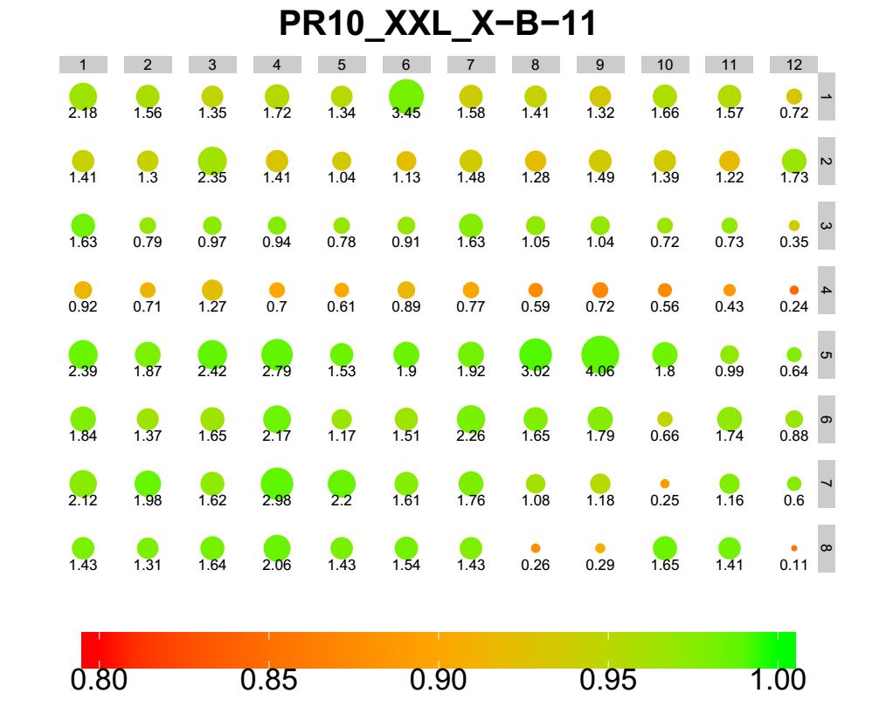
Mito-gene ratio (B cell)

Slide 11
Mito-gene ratio (T cell)
MT-RNR2
MTRNR2L12
MT-CYB
MT-ND5
RPL19
MT-ATP6
MT-ND4
MT-ND1
MT-ND2
MT-ND6

Slide 12
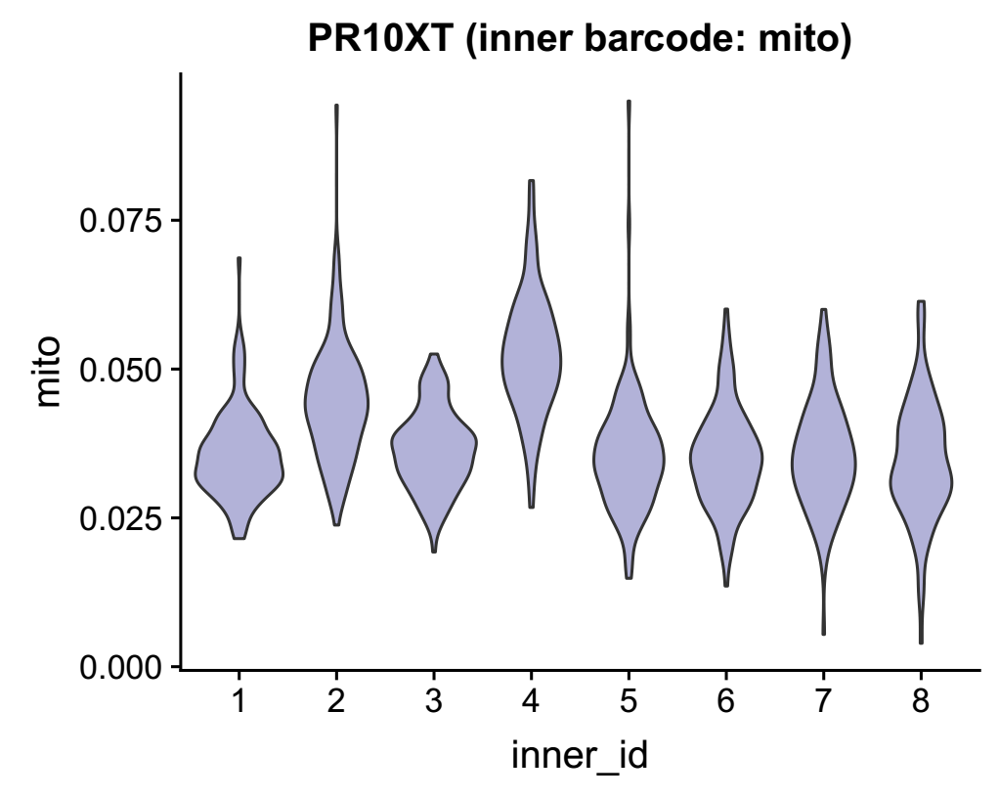
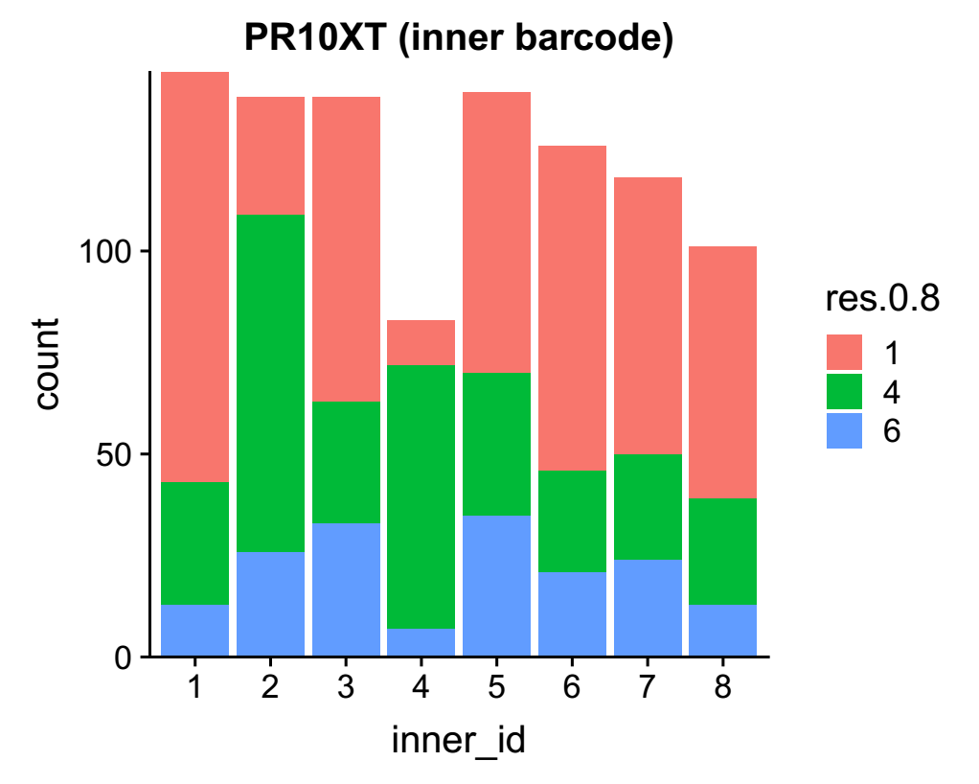
Mito-gene ratio (T cell)

Slide 13
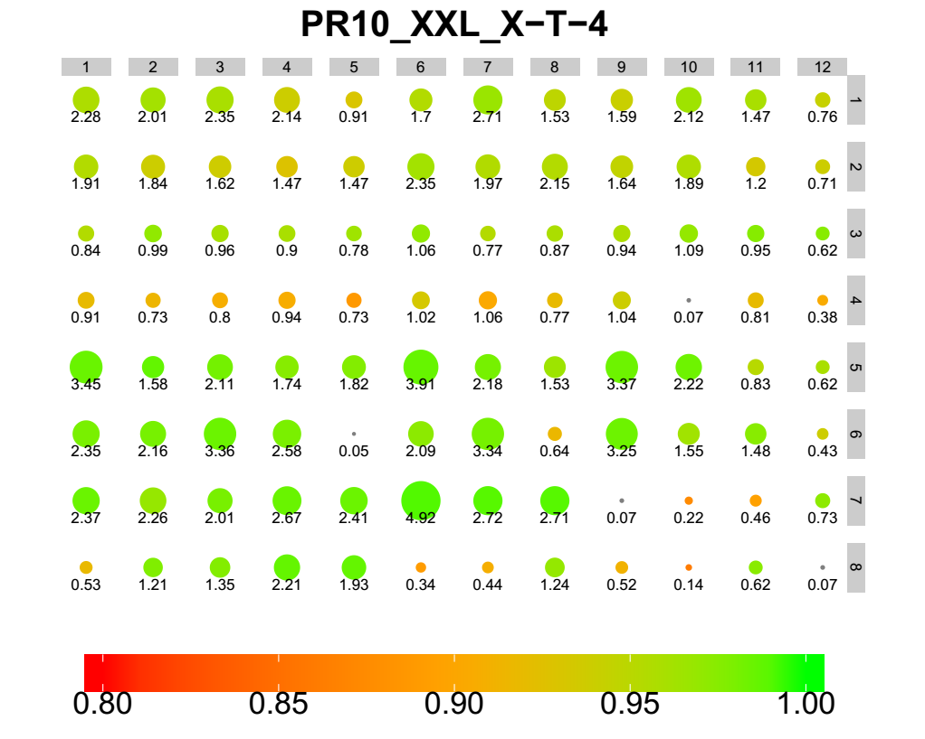
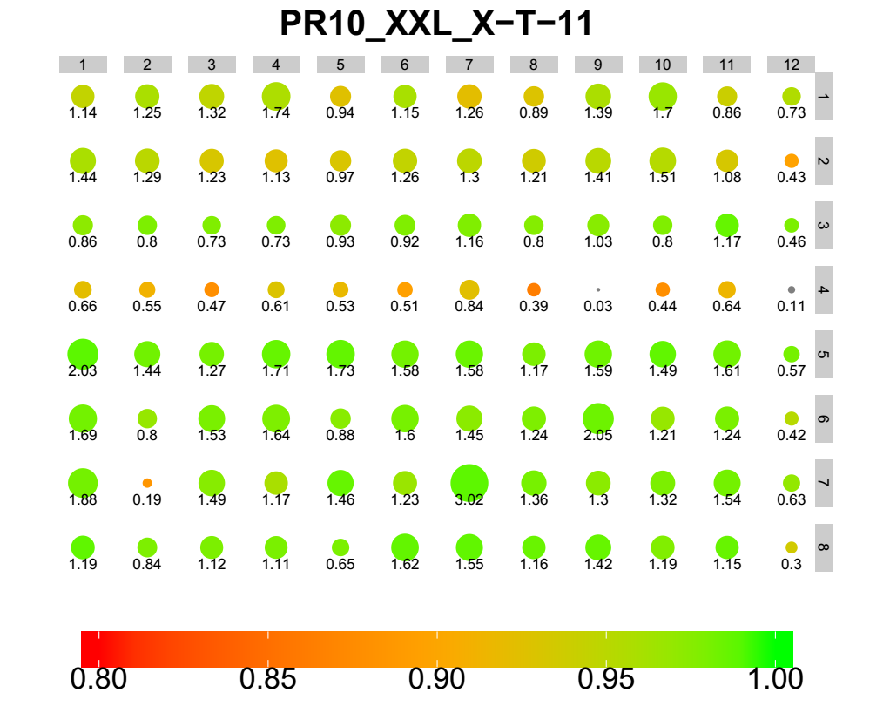
Mito-gene ratio (T cell)

Slide 14
Checklist
PCR
Robot
Cell barcode efficiency

Slide 15
Thanks
Notes:
http://www.nature.com/news/the-human-cell-atlas-from-vision-to-reality-1.22854

