Slide 1
Single-cell analysis for blood (Mono) cells
Feng Tian
5/30/2018

Slide 2
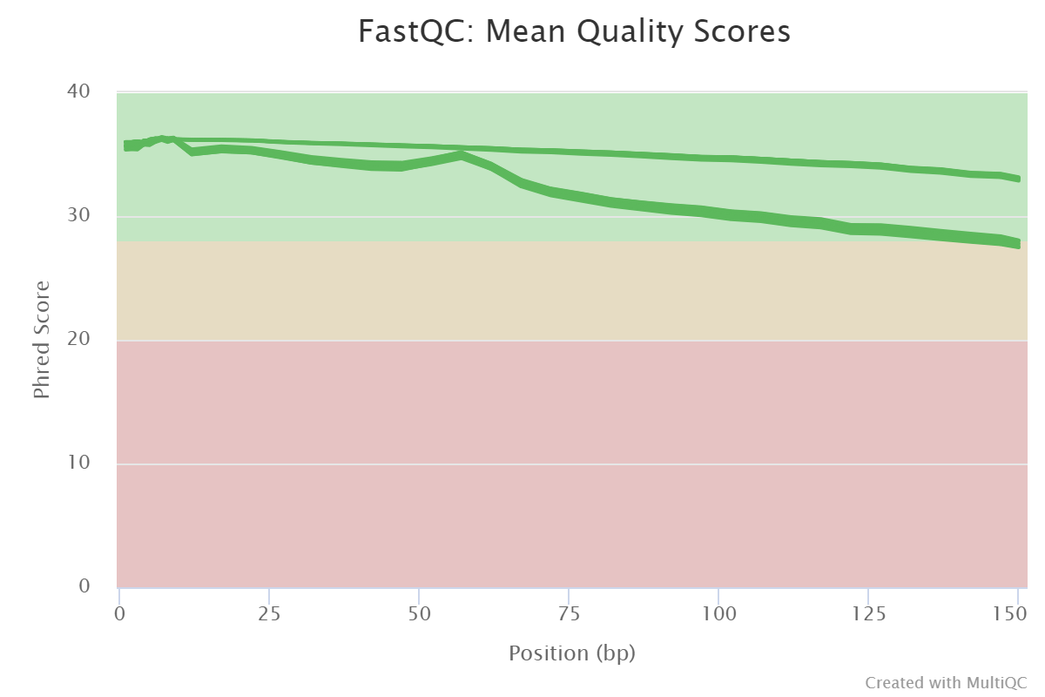
Reads quality
Improved by Phix sequences

Slide 3
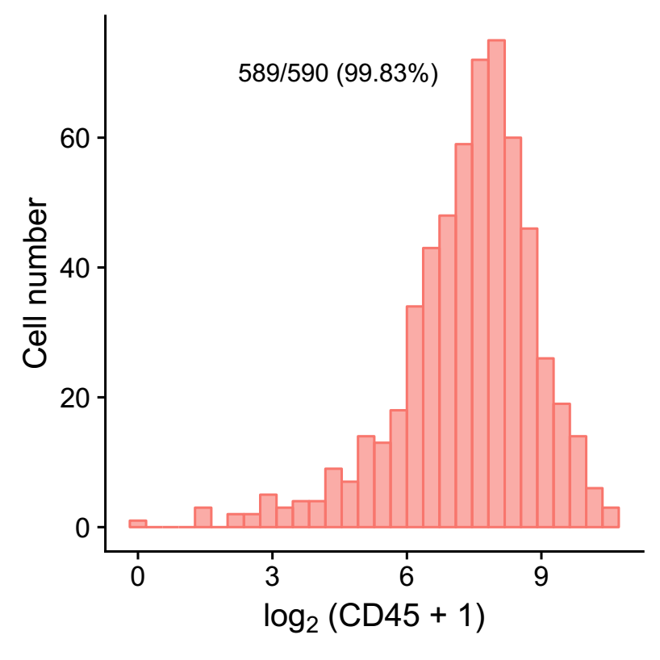
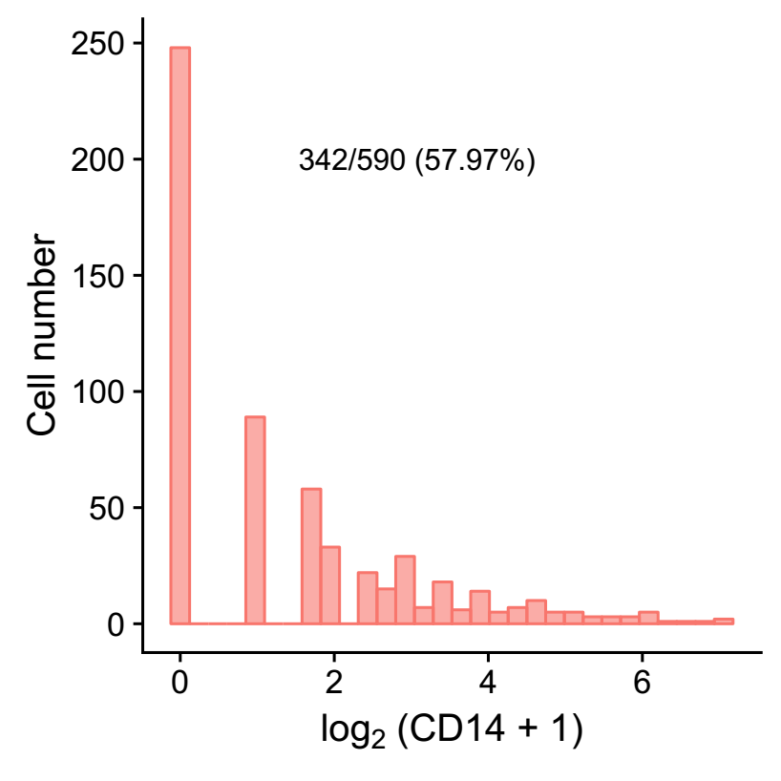
Check marker genes
CD45 (PTPRC) and CD14

Slide 4
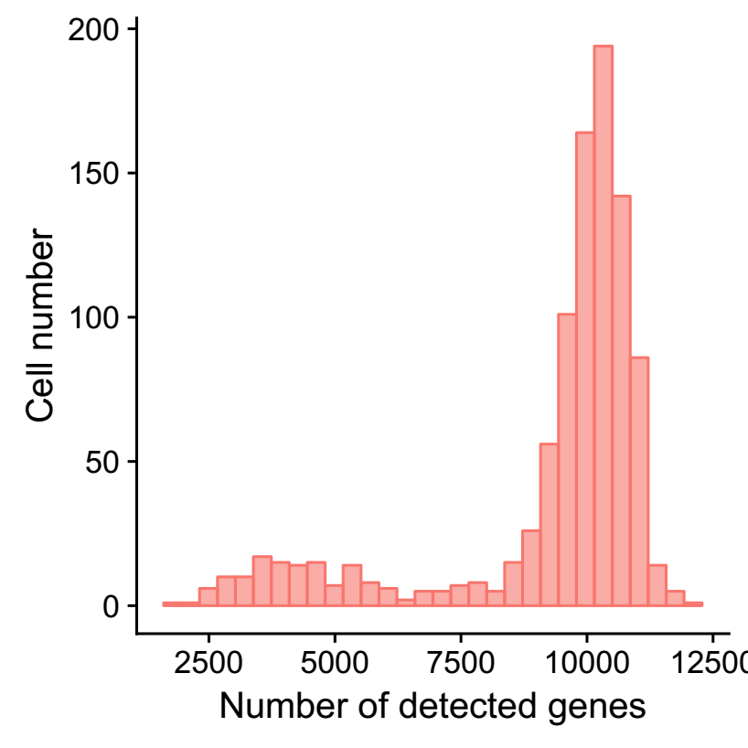
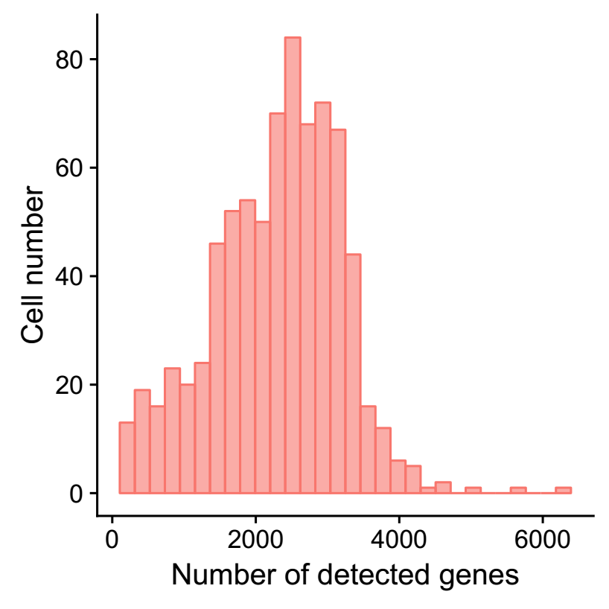
Difference between H3K293T-960 and Mono-767
1. Detected gene/UMI number
H3K293T-960
Mono-767

Slide 5
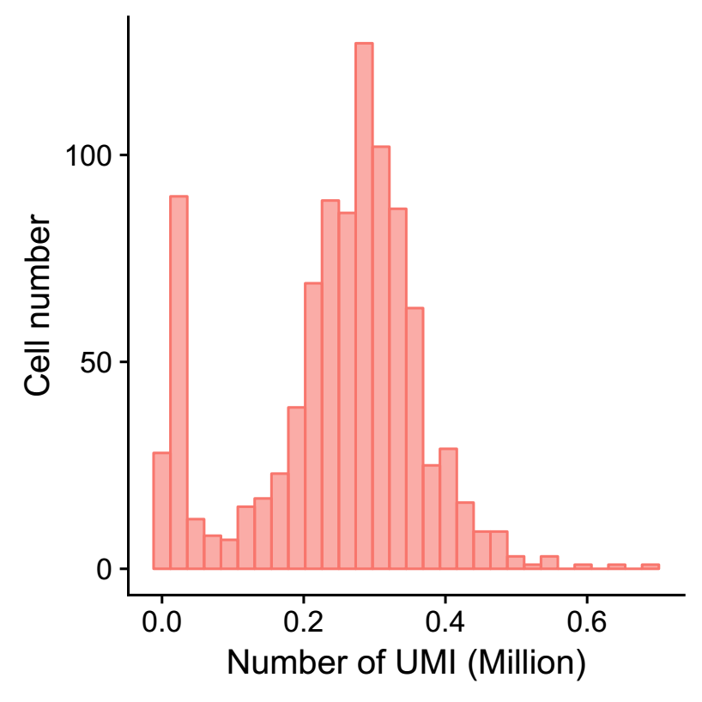
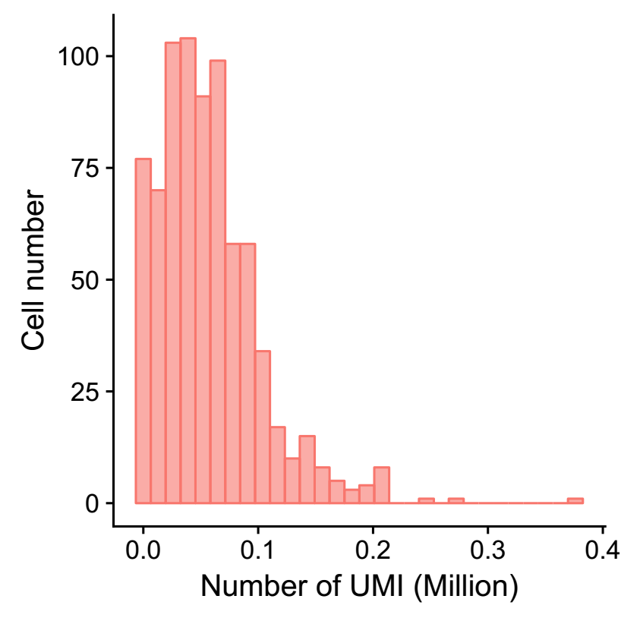
Difference between H3K293T-960 and Mono-767
1. Detected gene/UMI number
H3K293T-960
Mono-767

Slide 6
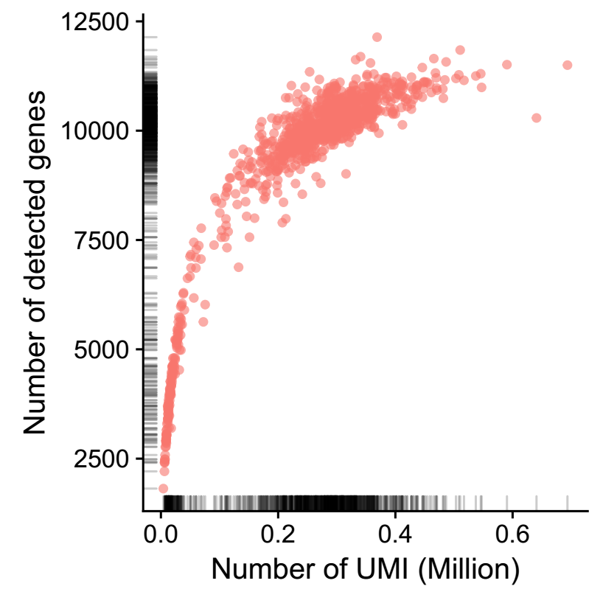
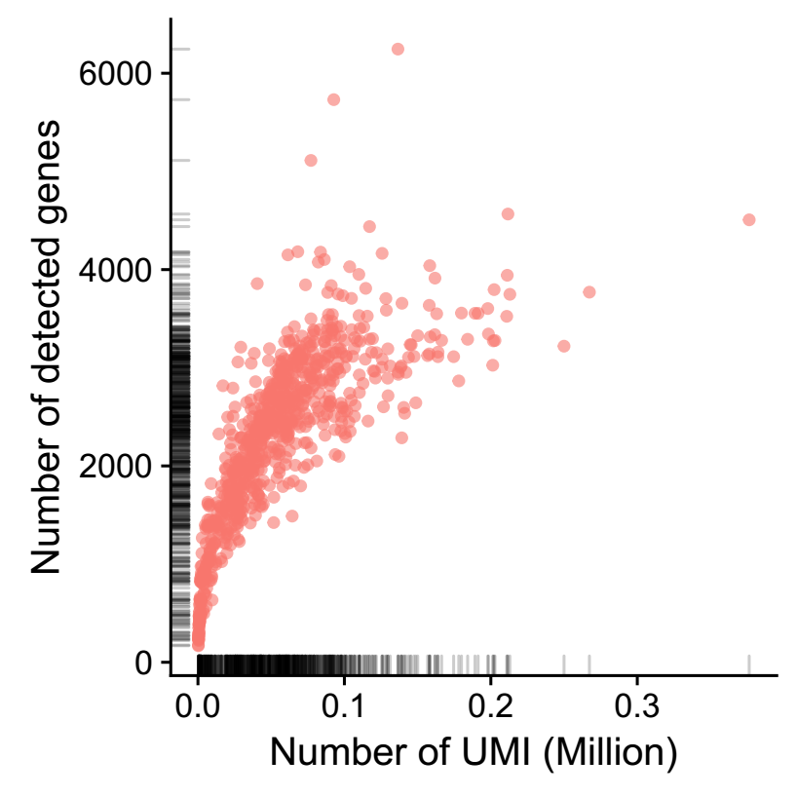
Difference between H3K293T-960 and Mono-767
1. Detected gene/UMI number
H3K293T-960
Mono-767

Slide 7
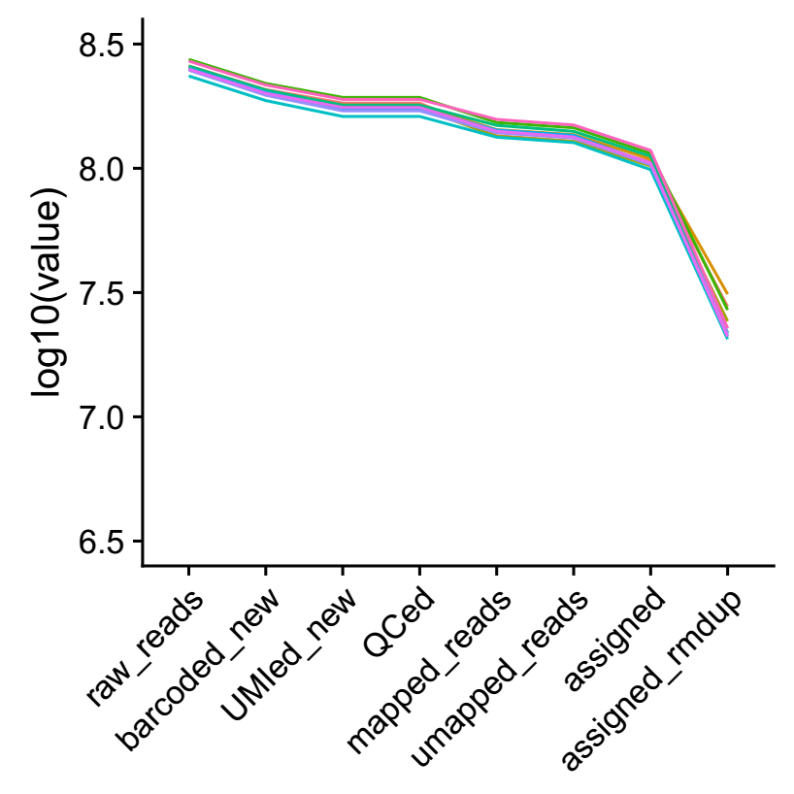
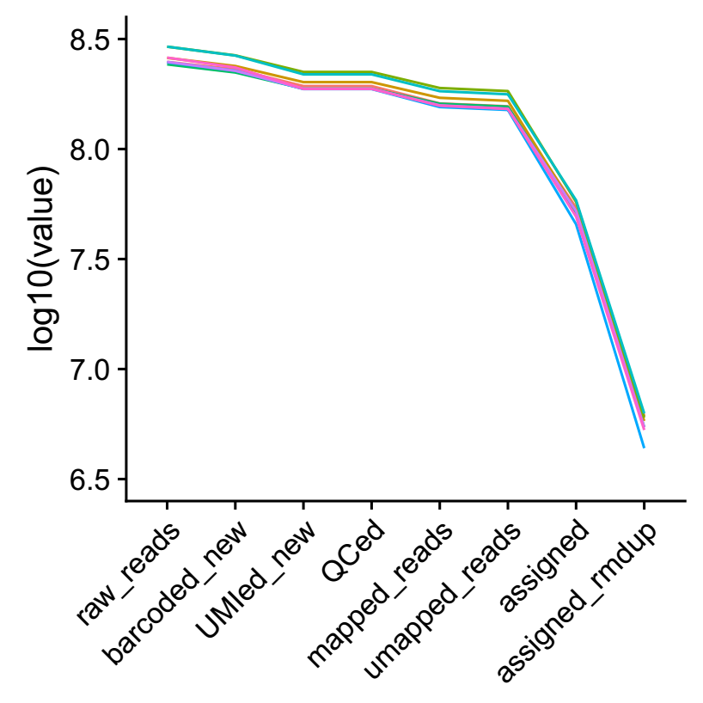
Difference between H3K293T-960 and Mono-767
1. Detected gene/UMI number
H3K293T-960
Mono-767

Slide 8
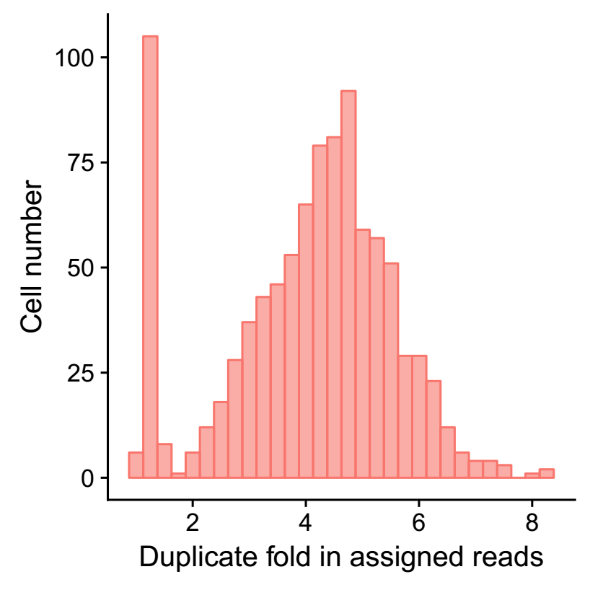
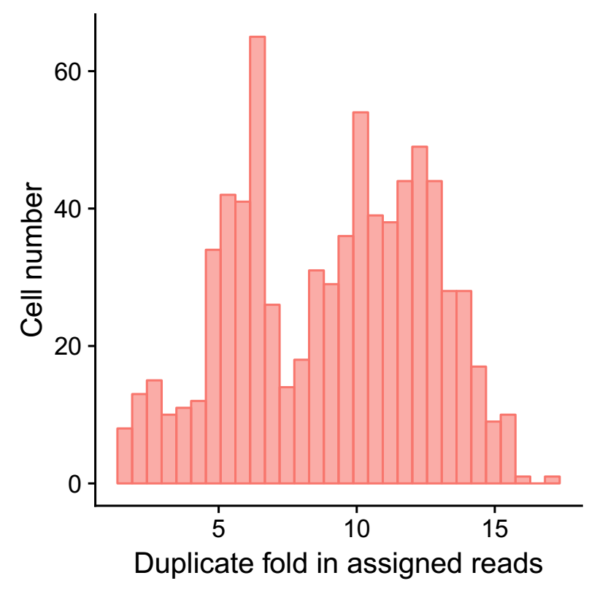
Difference between H3K293T-960 and Mono-767
2. Duplicate number
H3K293T-960
Mono-767

Slide 9
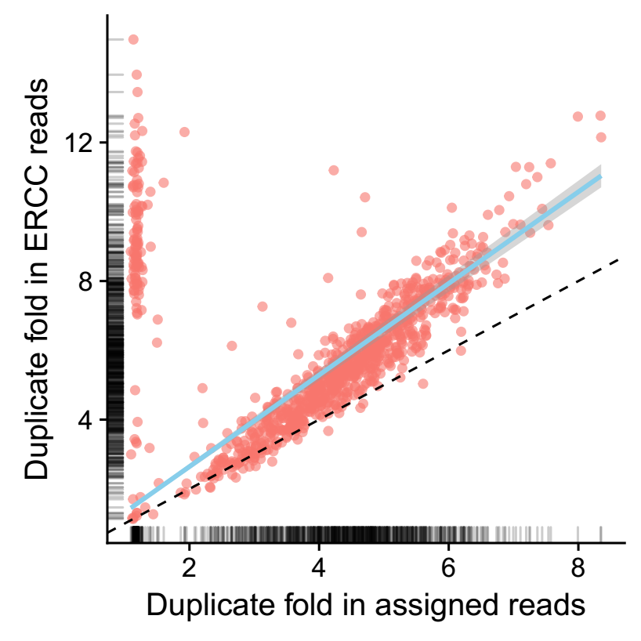
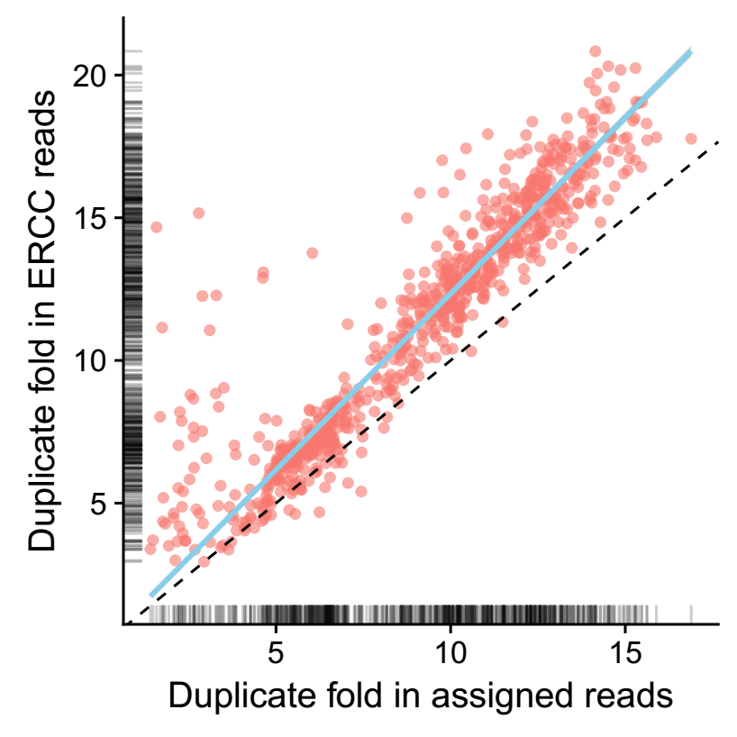
Difference between H3K293T-960 and Mono-767
2. Duplicate number
H3K293T-960
Mono-767

Slide 10
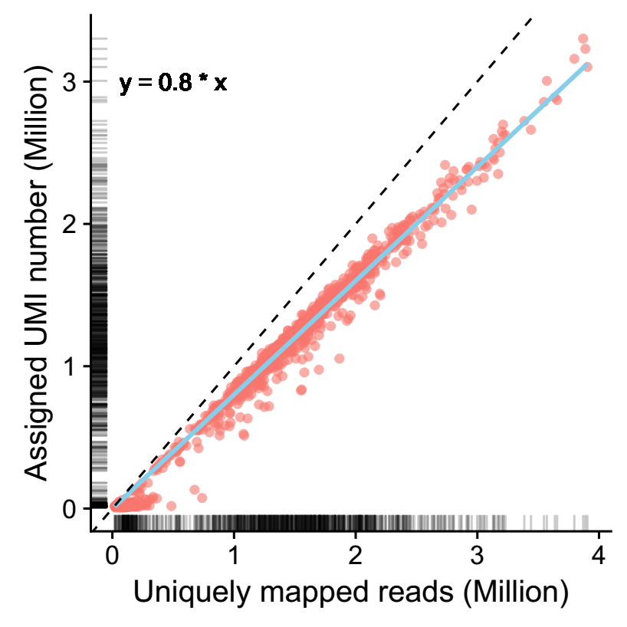
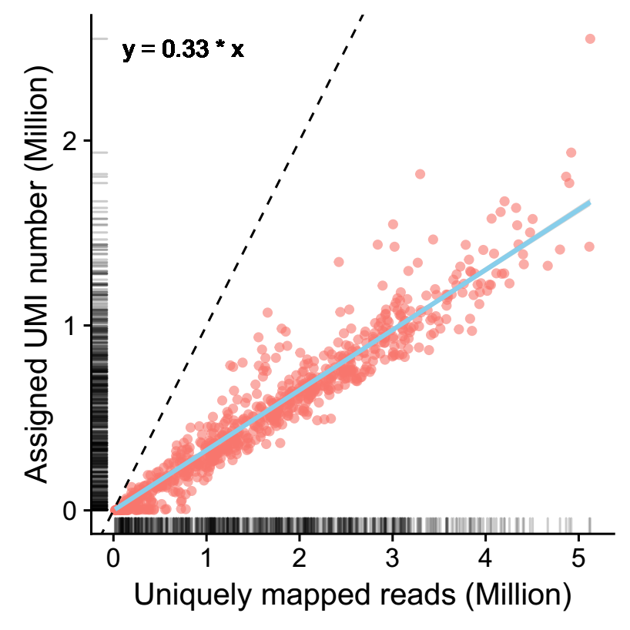
Difference between H3K293T-960 and Mono-767
3. Ratio of reads in gene locus (exons)
H3K293T-960
Mono-767

Slide 11
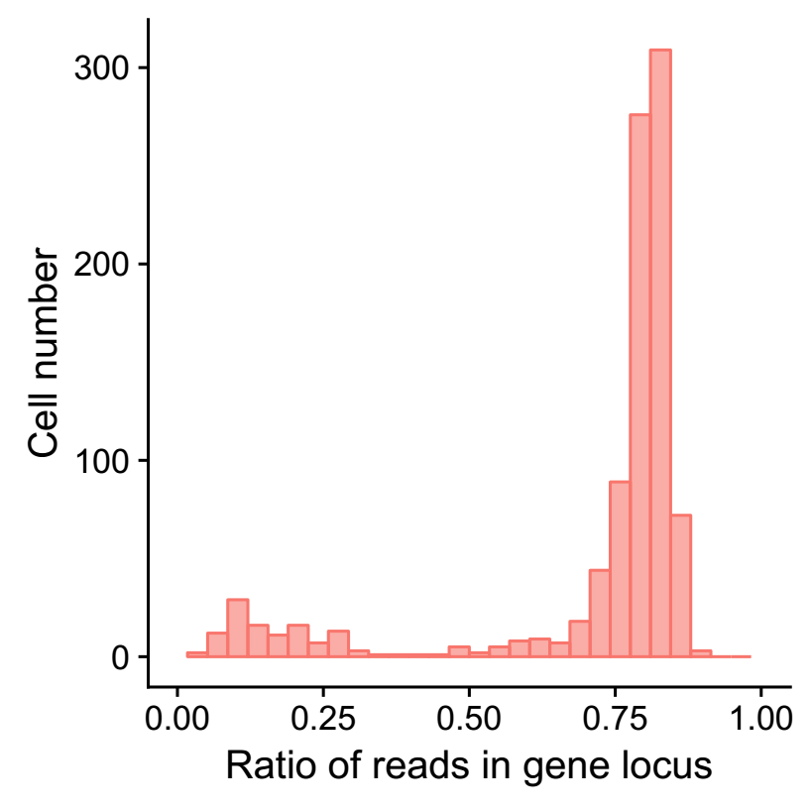
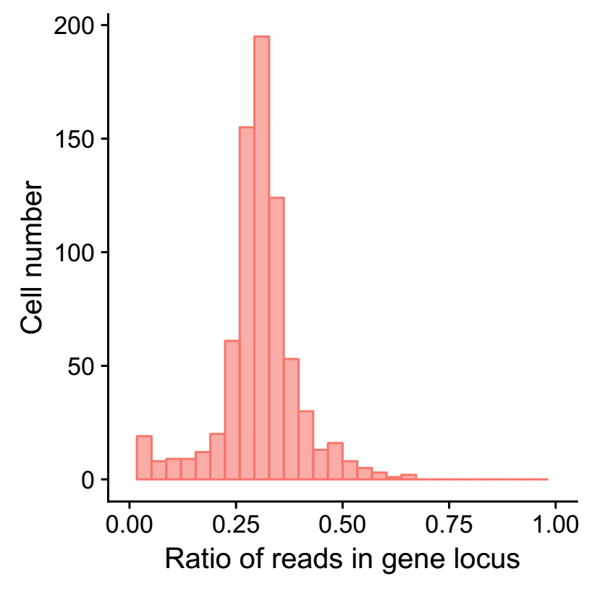
Difference between H3K293T-960 and Mono-767
3. Ratio of reads in gene locus (exons)
H3K293T-960
Mono-767

Slide 12
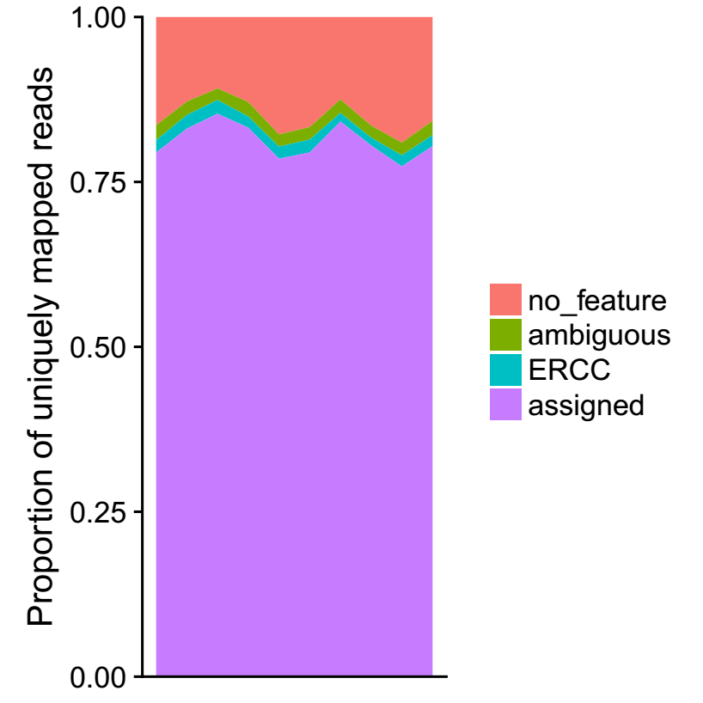
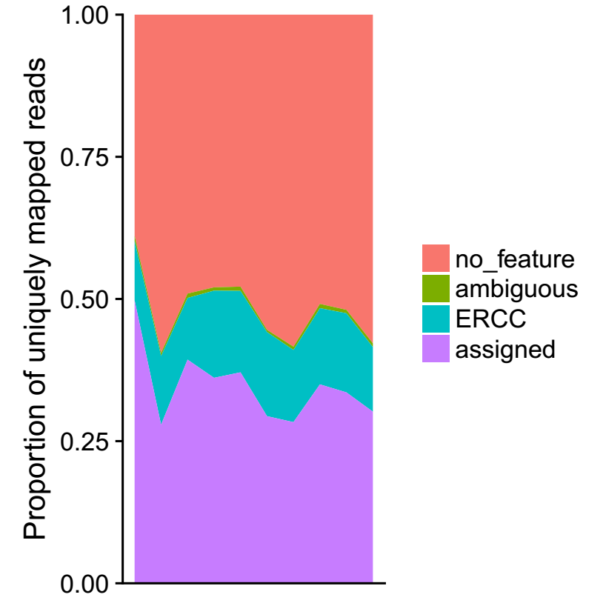
Difference between H3K293T-960 and Mono-767
3. Ratio of reads in gene locus
H3K293T-960
Mono-767

Slide 13
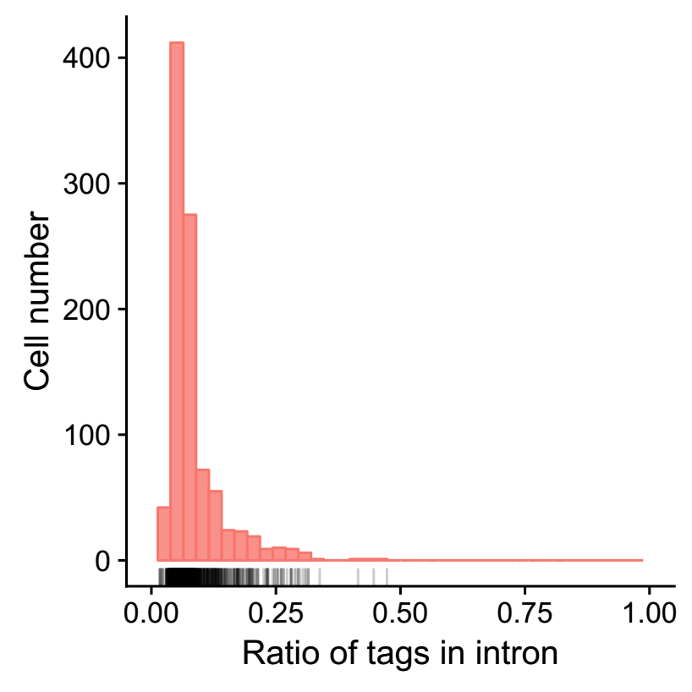
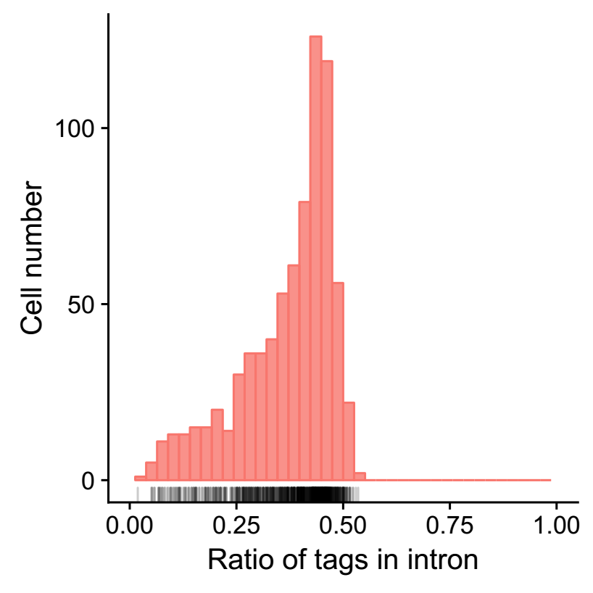
Difference between H3K293T-960 and Mono-767
3. Ratio of reads in introns
H3K293T-960
Mono-767

Slide 14
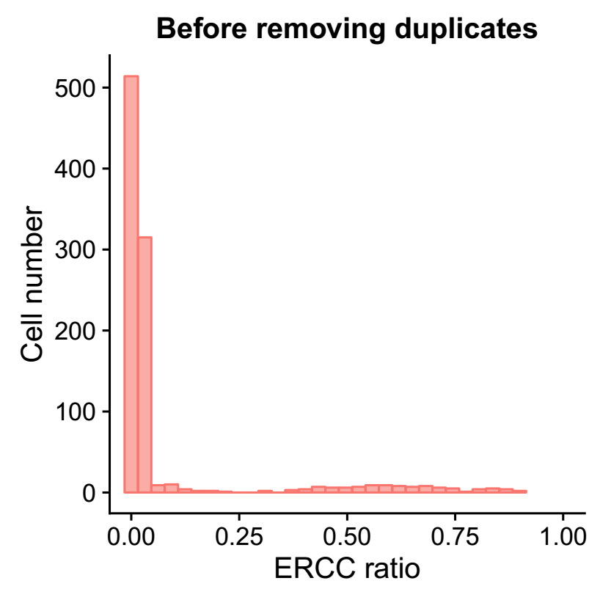
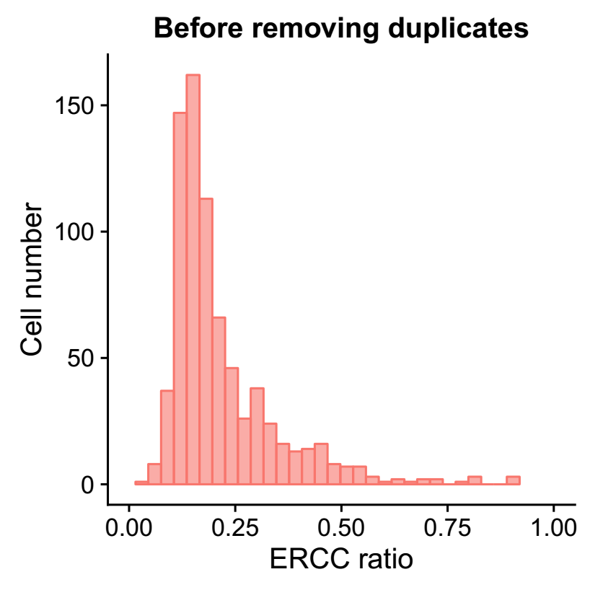
Difference between H3K293T-960 and Mono-767
4. Ratio of ERCC
H3K293T-960
Mono-767

Slide 15
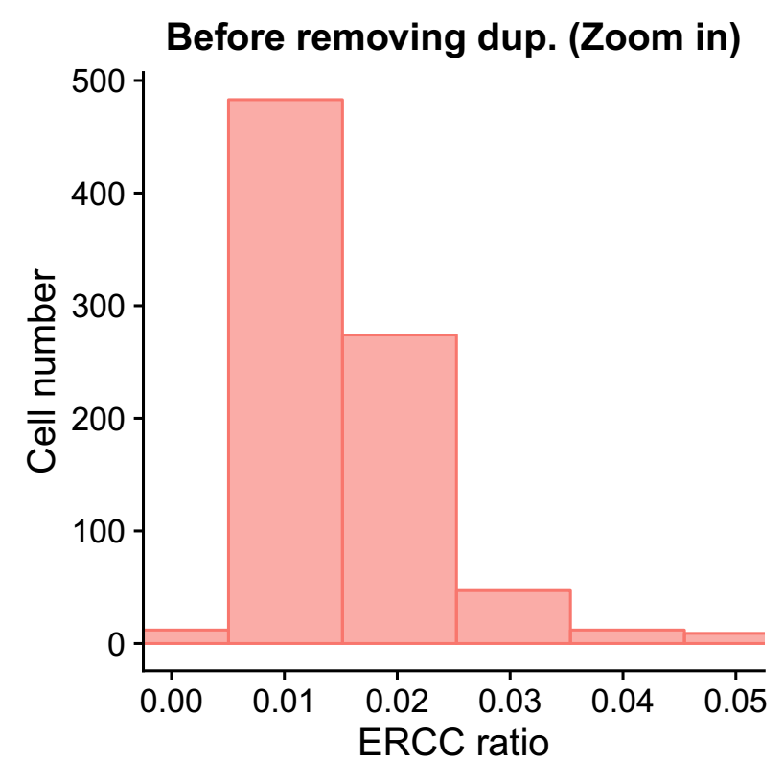
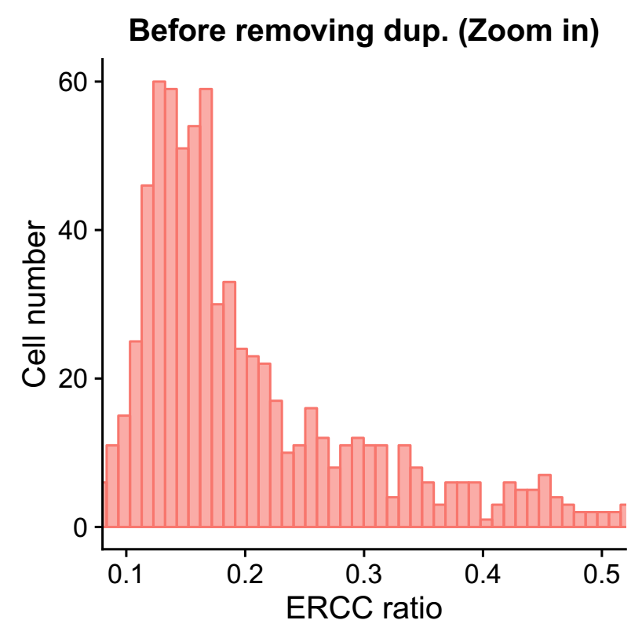
Difference between H3K293T-960 and Mono-767
4. Ratio of ERCC
H3K293T-960
Mono-767

Slide 16
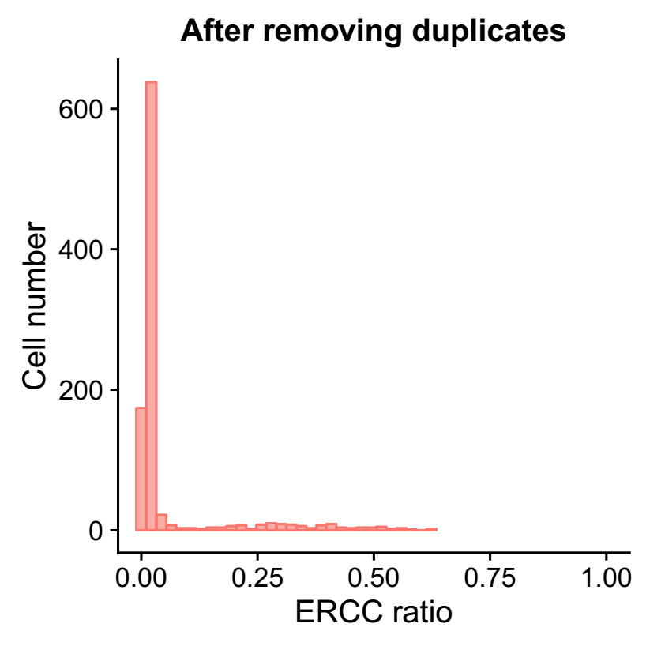
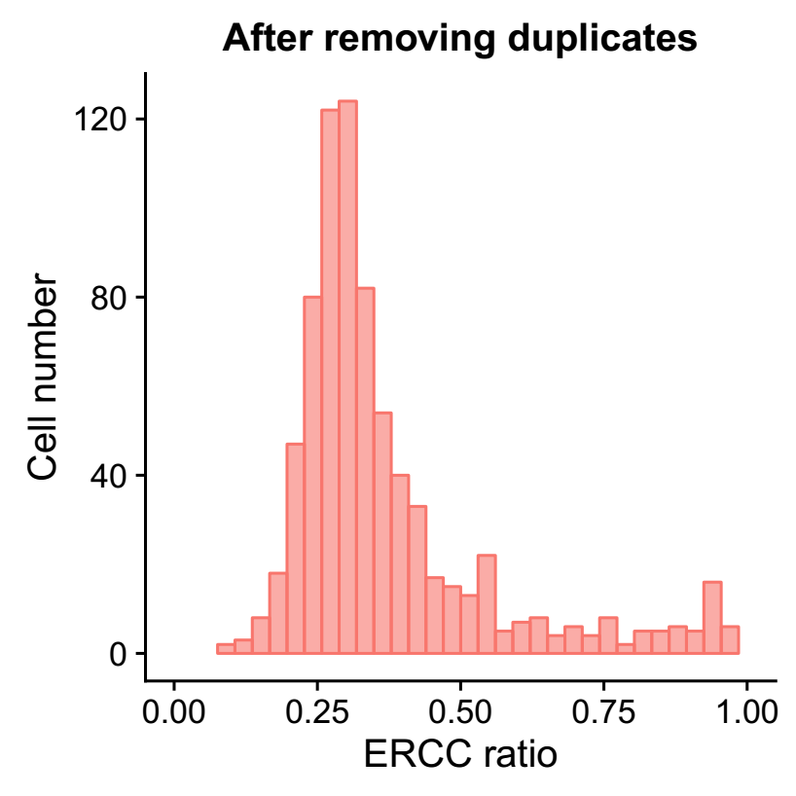
Difference between H3K293T-960 and Mono-767
4. Ratio of ERCC
H3K293T-960
Mono-767

Slide 17
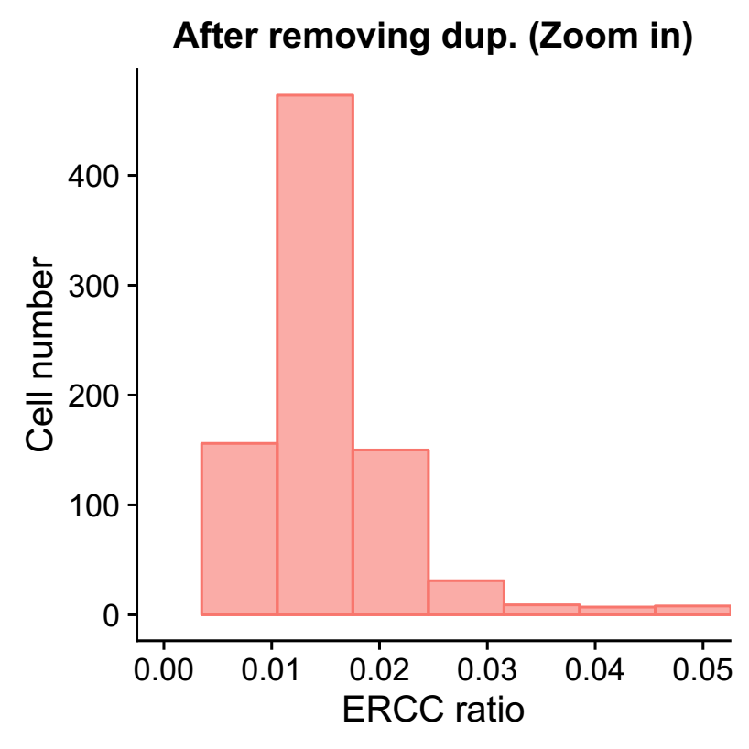
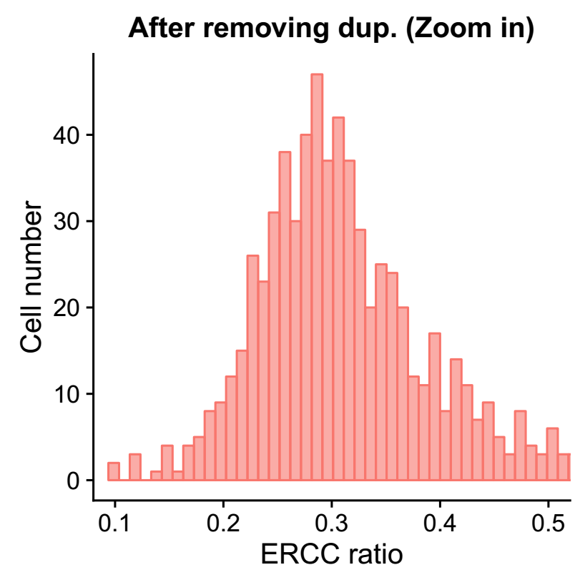
Difference between H3K293T-960 and Mono-767
4. Ratio of ERCC
H3K293T-960
Mono-767

Slide 18
Summary
Low UMI count:
Low ratio of non-ERCC reads in exons (DNA)
High ERCC ratio (~ 10 fold)
High duplicate number

Slide 19
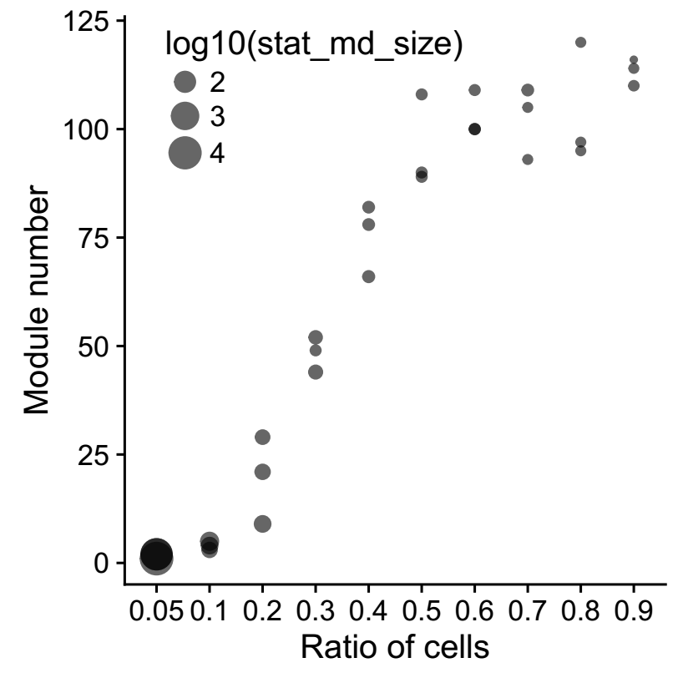
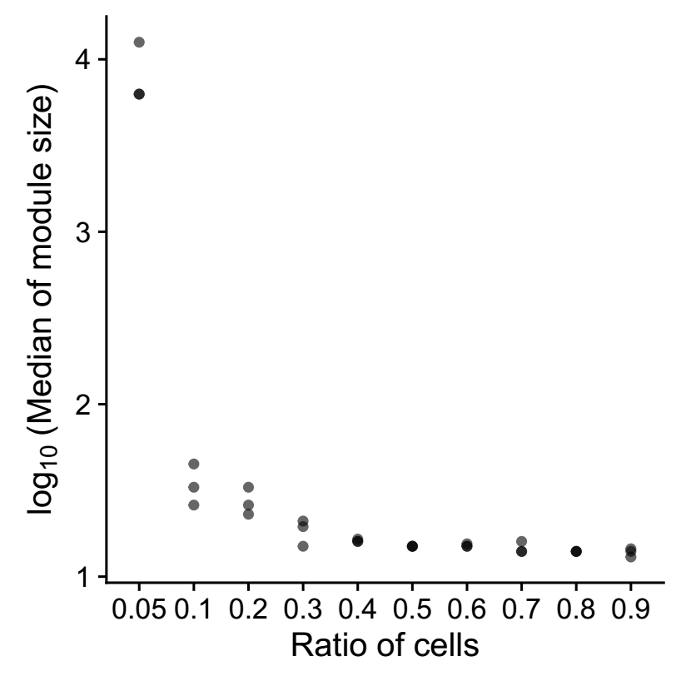
Modules after sub-sampling
Combine the expression matrix of HEK293T_384 and HEK293T_960

Slide 20
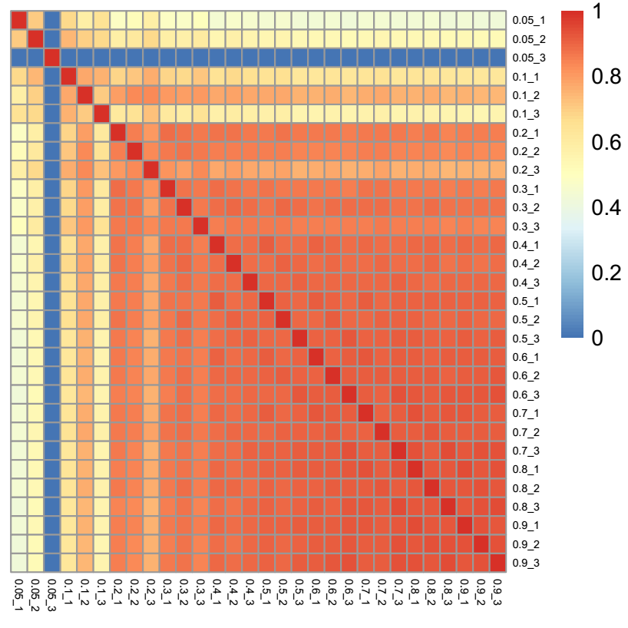
Modules after sub-sampling

Slide 21
Thanks

