Slide 1

Risk of death due to breast cancer
and its relation to malignant
Group 8:
Xiao Xia Bian
Jad Dimachkieh
Shuntaro Kino
Ruoxin Liu
Xian Qi
Jiawei Tian
1

Slide 2
Introduction
Breast cancer is the second most common type of cancer in North America. Mostly found among females. According to the National Cancer Institute, the proportion of male diagnosed with Breast cancer is only 1% of the total number of patients.
Moreover, Breast cancer incidence rates are decreasing due to new advance treatment. However, the US still is expecting to record 40,450 deaths due to breast cancer this year .
Reference:
http://www.cancer.gov/types/breast
http://www.breastcancer.org/symptoms/understand_bc/statistics
2

Slide 3
Questions of interest
Questions of interest that might be asked are:
1) Is the presence of malignant associated with an increased risk of death due to Breast cancer?
2) Are older patients more likely to die than younger ones ?
3) Is there a relation between malignant and the age group patients belongs to ?
3
Notes:
The study recorded 290 independent patients diagnosed with breast cancer for more then three years. Each of them were separated in different age groups. Moreover patients were also differentiated if they suffered from malignant or not .
Data shows : the amount of Death/Survival for the different age groups
Therefore the following case study will explore the relation of malignant to breast cancer and also if different age group should threated differently.

Slide 4
About Data
Three factor tables
Survived = Yes
Survived = No
Malignant Age | Yes | No
<50 | 51 | 77
50-69 | 38 | 51
70+ | 6 | 7
Malignant Age | Yes | No
<50 | 13 | 10
50-69 | 11 | 20
70+ | 3 | 3
Total
151
120
19
Total(Malignant:Yes) = 122
Total(Survived:Yes) = 230
Total(Malignant:No) = 168
Total(Survived:No) = 60
Notes:
Can’t really estimate effect of age and malignancy from this table because of diff. numbers of people for each group

Slide 5
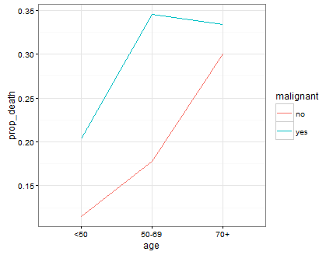
About Data
Plots

Slide 6
Methods used in the Analysis
Pearson Chi-Square Test of Independence
Multinomial Likelihood Ratio Test
Analysis 1 and 2 both check whether there is relationship between 2 variables.
Binomial Sampling
Fits data to a model that predicts odds (or probabilities) of death.
Poisson Regression
Fits data to a model that predicts mean number of death within a period of time.

Slide 7
Testing Dependency between Variables
Pearson Chi-Square Test of Independence
1. Age v.s. Malignancy
2. Survival v.s. Age
3. Survival v.s. Malignancy
P = 0.6080
P = 0.04858
P = 0.009557
Multinomial Likelihood Ratio Test
1. Age v.s. Malignancy
2. Survival v.s. Age
3. Survival v.s. Malignancy
P = 0.6079
P = 0.04942
P = 0.009638
Notes:
chi-sq test survival v.s. age might be inaccurate since age 70+ has small sample size = 19

Slide 8



Binomial Sampling
Model 1: with interaction
$$\log\left(\frac{π_{i}}{1−π_{i}}\right)=β_{0}+β_{1}I_{50−69,i}+β_{2}I_{70+,i}+β_{3}I_{MalY,i}$$
$+β_{4}(I_{50−69,i}×I_{MalY,i})+β_{5}(I_{70+,i}×I_{MalY,i})$
$$I_{70+,i}=\left\{\begin{aligned}1, if i belongs to 70+ \\ 0, otherwise \end{aligned}\right.$$
$$I_{MalY,j}=\left\{\begin{aligned}1, if i belongs to Malignant:Yes \\ 0, otherwise \end{aligned}\right.$$
$$π_{i}=probablity of death for group i$$
$$I_{50−69,i}=\left\{\begin{aligned}1, if i belongs to 50−69 \\ 0, otherwise \end{aligned}\right.$$

Slide 9

Binomial Sampling
Testing Significance of Interaction in Model 1
$$\log\left(\frac{π_{i}}{1−π_{i}}\right)=β_{0}+β_{1}I_{50−69,i}+β_{2}I_{70+,i}+β_{3}I_{MalY,i}$$
$+β_{4}(I_{50−69,i}×I_{MalY,i})+β_{5}(I_{70+,i}×I_{MalY,i})$
Analysis of Deviance
Factor | P
Age | 0.04942
Malignancy | 0.01316
Age x Malignancy | 0.7811
Notes:
P = Prob(

Slide 10
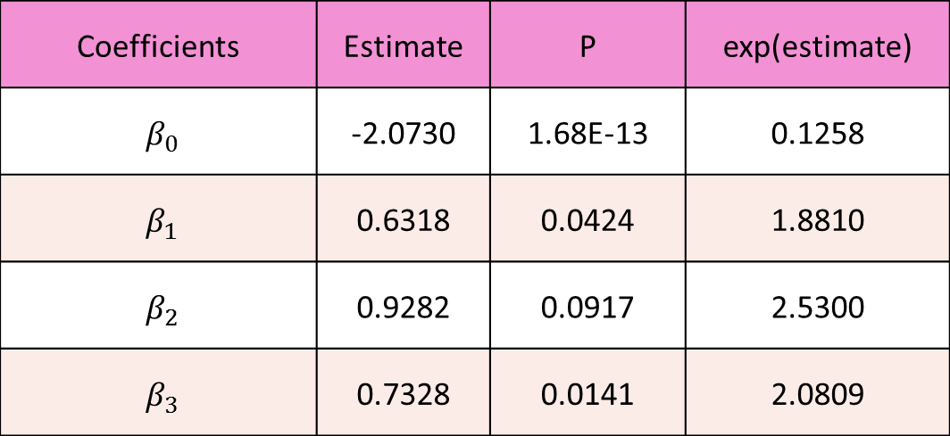

Binomial Sampling
Model 2: without interaction
$$\log\left(\frac{π_{i}}{1−π_{i}}\right)=β_{0}+β_{1}I_{50−69,i}+β_{2}I_{70+,i}+β_{3}I_{MalY,i}$$
Coefficients | Estimate | P | exp(estimate)
$β_{0}$ | -2.0730 | 1.68E-13 | 0.1258
$β_{1}$ | 0.6318 | 0.0424 | 1.8810
$β_{2}$ | 0.9282 | 0.0917 | 2.5300
$β_{3}$ | 0.7328 | 0.0141 | 2.0809

Slide 11
Binomial Sampling
Model 1 v.s. Model 2
AIC (Akaike’s Information Criterion)
Measures how well model fits the data
Smaller the better
AIC(Model 1) = 33.939 > 30.433 = AIC(Model 2)
Notes:
According to AIC, Model 2 is slightly better than Model 1

Slide 12
Binomial Sampling
Estimates for Probablity of Death
$$\log\left(\frac{π_{i}}{1−π_{i}}\right)=β_{0}+β_{1}I_{50−69,i}+β_{2}I_{70+,i}+β_{3}I_{MalY,i}$$
Age | Malignant No | Malignant Yes
<50 | 0.1117 | 0.2075
50-69 | 0.1914 | 0.3300
70+ | 0.2414 | 0.3984

Slide 13


Binomial Sampling
Diagnostics
$$\log\left(\frac{π_{i}}{1−π_{i}}\right)=β_{0}+β_{1}I_{50−69,i}+β_{2}I_{70+,i}+β_{3}I_{MalY,i}$$
$$π_{i}=probablity of death for group i$$
$$I_{50−69,i}=\left\{\begin{aligned}1, if i belongs to 50−69 \\ 0, otherwise \end{aligned}\right.$$
$$I_{70+,i}=\left\{\begin{aligned}1, if i belongs to 70+ \\ 0, otherwise \end{aligned}\right.$$
$$I_{MalY,j}=\left\{\begin{aligned}1, if i belongs to Malignant:Yes \\ 0, otherwise \end{aligned}\right.$$

Slide 14
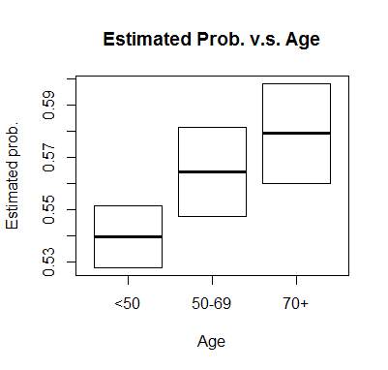
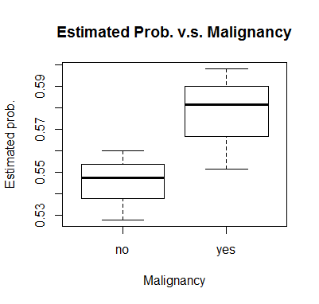
Binomial Sampling
Plots

Slide 15
Poisson Regression
Three factor tables
Survived = Yes
Survived = No
Malignant Age | Yes | No
<50 | 51 | 77
50-69 | 38 | 51
70+ | 6 | 7
Malignant Age | Yes | No
<50 | 13 | 10
50-69 | 11 | 20
70+ | 3 | 3
Notes:
Can’t really estimate effect of age and malignancy from this table because of diff. numbers of people for each group

Slide 16



Poisson Regression
Model 1: with 3 – way interaction
$$\log\left(λ_{i,j,k}\right)=β_{0}+β_{1}I_{50−69,i}+β_{2}I_{70+,i}+β_{3}I_{MalY,j}+β_{4}I_{SurN,k}+β_{5}\left(I_{50−69,i}×I_{SurN,k}\right)+β_{6}\left(I_{70+,i}×I_{SurN,k}\right)+β_{7}\left(I_{MalY,j}×I_{SurN,k}\right)+{β_{7}\left(I_{MalY,j}×I_{SurN,k}\right)+β}_{8}\left(I_{50−69,i}×I_{MalY,j}×I_{SurN,k}\right)+β_{9}\left(I_{70+,i}×I_{MalY,j}×I_{SurN,k}\right)$$
$$λ_{i,j,k}=expected counts in \left(i,j,k\right)th cell$$
$$I_{50−69,i}=\left\{\begin{aligned}1, if i belongs to 50−69 \\ 0, otherwise \end{aligned}\right.$$
$$I_{70+,i}=\left\{\begin{aligned}1, if i belongs to 70+ \\ 0, otherwise \end{aligned}\right.$$
$$I_{MalY,j}=\left\{\begin{aligned}1, if j belongs to Malignant:Yes \\ 0, otherwise \end{aligned}\right.$$
$$I_{SurN,k}=\left\{\begin{aligned}1, if k belongs to Survived:No \\ 0, otherwise \end{aligned}\right.$$

Slide 17

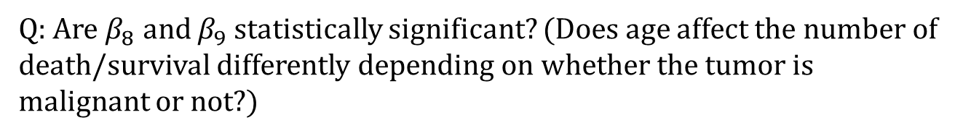
Poisson Regression
Model 1: with 3 – way interaction
$$\log\left(λ_{i,j,k}\right)=β_{0}+β_{1}I_{50−69,i}+β_{2}I_{70+,i}+β_{3}I_{MalY,j}+β_{4}I_{SurN,k}+β_{5}\left(I_{50−69,i}×I_{SurN,k}\right)+β_{6}\left(I_{70+,i}×I_{SurN,k}\right)+β_{7}\left(I_{MalY,j}×I_{SurN,k}\right)+β_{8}\left(I_{50−69,i}×I_{MalY,j}×I_{SurN,k}\right)+β_{9}\left(I_{70+,i}×I_{MalY,j}×I_{SurN,k}\right)$$
Q: Are $β_{8}$ and $β_{9}$ statistically significant? (Does age affect the number of death/survival differently depending on whether the tumor is malignant or not?)
Yes!
No…
I don’t know.
Factor | P
Age x Malignancy | 0.6080
Age x Survival | 0.0494
Malignancy x Survival | 0.0132
Age x Survival x Malignancy | 0.7811
Notes:
Hint: There was no interaction between age and malignant according to the three analyses we did previously.

Slide 18

Poisson Regression
Model 1: with 3 – way interaction
$$\log\left(λ_{i,j,k}\right)=β_{0}+β_{1}I_{50−69,i}+β_{2}I_{70+,i}+β_{3}I_{MalY,j}+β_{4}I_{SurN,k}+β_{5}\left(I_{50−69,i}×I_{SurN,k}\right)+β_{6}\left(I_{70+,i}×I_{SurN,k}\right)+β_{7}\left(I_{MalY,j}×I_{SurN,k}\right)+β_{8}\left(I_{50−69,i}×I_{MalY,j}×I_{SurN,k}\right)+β_{9}\left(I_{70+,i}×I_{MalY,j}×I_{SurN,k}\right)$$
Testing Significance with Analysis of Deviance
Factor | P
Age x Malignancy | 0.6080
Age x Survival | 0.0494
Malignancy x Survival | 0.0132
Age x Survival x Malignancy | 0.7811

Slide 19

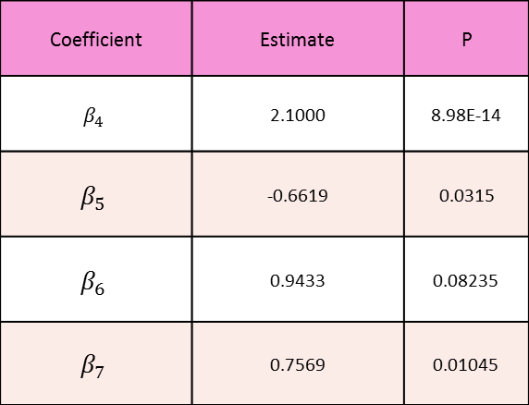
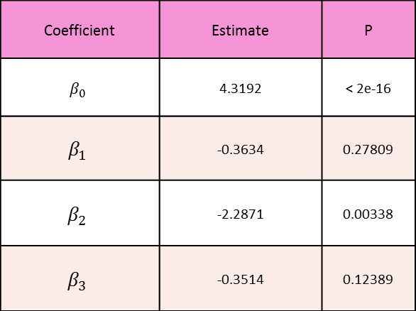
Poisson Regression
Model 2: without 3 – way interaction
$$\log\left(λ_{i,j,k}\right)=β_{0}+β_{1}I_{50−69,i}+β_{2}I_{70+,i}+β_{3}I_{MalY,j}+β_{4}I_{SurN,k}+β_{5}\left(I_{50−69,i}×I_{SurN,k}\right)+β_{6}\left(I_{70+,i}×I_{SurN,k}\right)+β_{7}\left(I_{MalY,j}×I_{SurN,k}\right)$$
Coefficient | Estimate | P
$β_{0}$ | 4.3192 | < 2e-16
$β_{1}$ | -0.3634 | 0.27809
$$β_{2}$$ | -2.2871 | 0.00338
$$β_{3}$$ | -0.3514 | 0.12389
Coefficient | Estimate | P
$β_{4}$ | 2.1000 | 8.98E-14
$$β_{5}$$ | -0.6619 | 0.0315
$$β_{6}$$ | 0.9433 | 0.08235
$β_{7}$ | 0.7569 | 0.01045

Slide 20
Poisson Regression
Model 1 v.s. Model 2
AIC (Akaike’s Information Criterion)
Measures how well model fits the data
Smaller the better
AIC(Model 1) = 74.633 > 71.26 = AIC(Model 2)
Notes:
According to AIC, Model 2 is slightly better than Model 1

Slide 21
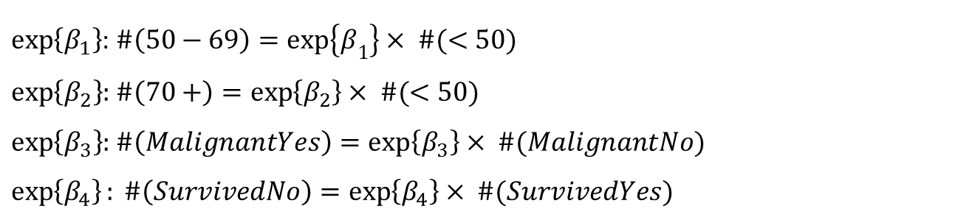
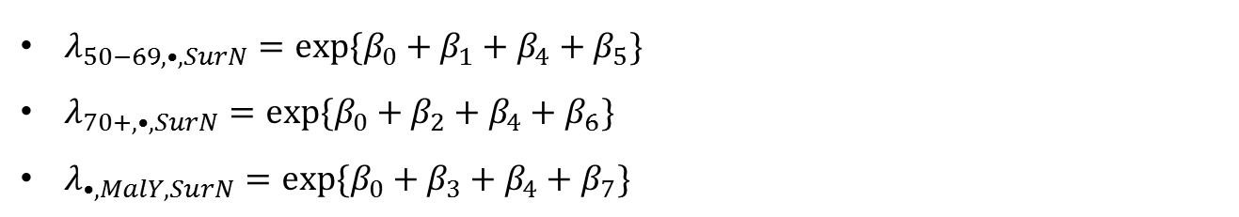


Poisson Regression
Interpreting Estimates of$β^{′}s$
$$\log\left(λ_{i,j,k}\right)=β_{0}+β_{1}I_{50−69,i}+β_{2}I_{70+,i}+β_{3}I_{MalY,j}+β_{4}I_{SurN,k}+β_{5}\left(I_{50−69,i}×I_{SurN,k}\right)+β_{6}\left(I_{70+,i}×I_{SurN,k}\right)+β_{7}\left(I_{MalY,j}×I_{SurN,k}\right)$$
$λ_{50−69,•,SurN}=exp\{β_{0}+β_{1}+β_{4}+β_{5}\}$
$λ_{70+,•,SurN}=exp\{β_{0}+β_{2}+β_{4}+β_{6}\}$
$λ_{•,MalY,SurN}=exp\{β_{0}+β_{3}+β_{4}+β_{7}\}$
$\exp\left\{β_{1}\right\}$: $\#\left(50−69\right)=\exp\left\{β_{1}\right\}× \#(<50)$
$\exp\left\{β_{2}\right\}$: $\#\left(70+\right)=\exp\left\{β_{2}\right\}× \#(<50)$
$\exp\left\{β_{3}\right\}$: $\#\left(MalignantYes\right)=\exp\left\{β_{3}\right\}× \#(MalignantNo)$
$$\exp\left\{β_{4}\right\}: \#\left(SurvivedNo\right)=\exp\left\{β_{4}\right\}× \#(SurvivedYes)$$
Notes:
If data is balanced within each factor, then B1, B2, B3, B4 = 0

Slide 22


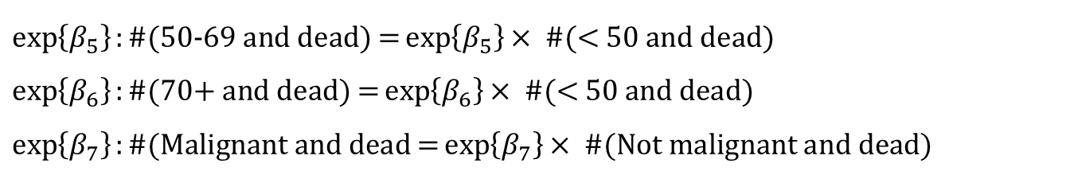
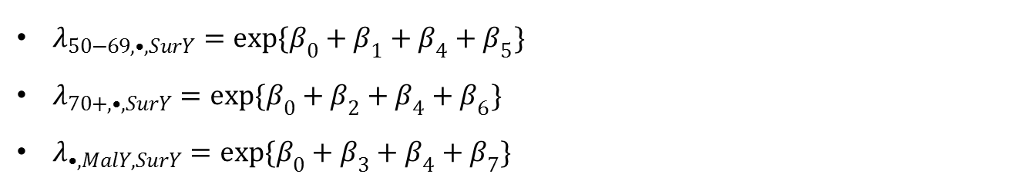
Poisson Regression
Interpreting Estimates of$β^{′}s$
If data was balanced within each factor, then $β_{1}= β_{2}=β_{3}=0$
$λ_{50−69,•,SurY}=exp\{β_{0}+β_{1}+β_{4}+β_{5}\}$
$λ_{70+,•,SurY}=exp\{β_{0}+β_{2}+β_{4}+β_{6}\}$
$λ_{•,MalY,SurY}=exp\{β_{0}+β_{3}+β_{4}+β_{7}\}$
$$exp\{β_{0}+β_{4}+β_{5}\}$$
$$exp\left\{β_{0}+{β_{4}+β}_{6}\right\}$$
$$exp\{β_{0}+β_{4}+β_{7}\}$$
If N(<50) = N(50-69) = N(70+) and N(MalignantYes) = N(MalignantNo),
$$\exp\left\{β_{5}\right\}:\text{\#(50−69 }\text{and} \text{dead}\text{) =}\exp\left\{β_{5}\right\}×\text{ \#(< 50 }\text{and} \text{dead}\text{) }$$
$$\exp\left\{β_{6}\right\}:\text{\#(}\text{70+} \text{and} \text{dead}\text{) =}\exp\left\{β_{6}\right\}×\text{ \#(< 50 }\text{and} \text{dead}\text{) }$$
$$\exp\left\{β_{7}\right\}:\text{\#(}\text{Malignant} \text{and} \text{dead}\text{ =}\exp\left\{β_{7}\right\}×\text{ \#(}\text{Not} \text{malignant} \text{and} \text{dead}\text{) }$$

Slide 23
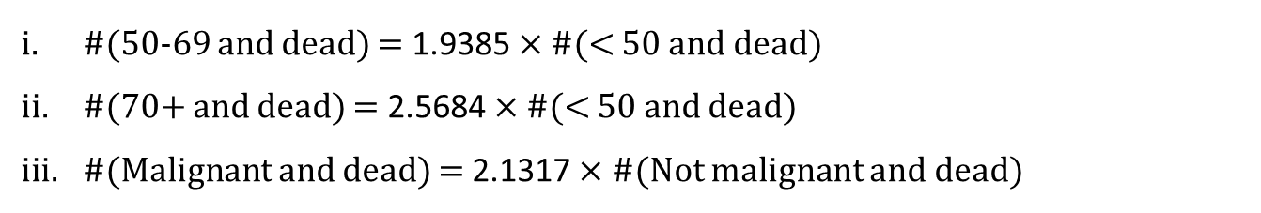
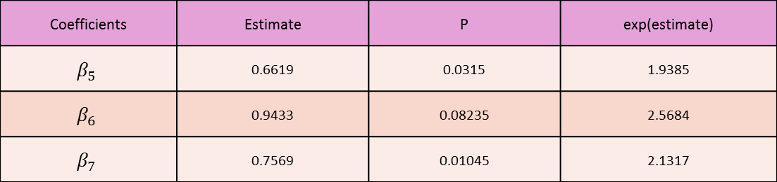

Poisson Regression
Interpreting Estimates of $λ_{i,j,k}$
$$\log\left(λ_{i,j,k}\right)=β_{0}+β_{1}I_{50−69,i}+β_{2}I_{70+,i}+β_{3}I_{MalY,j}+β_{4}I_{SurN,k}+β_{5}\left(I_{50−69,i}×I_{SurN,k}\right)+β_{6}\left(I_{70+,i}×I_{SurN,k}\right)+β_{7}\left(I_{MalY,j}×I_{SurN,k}\right)$$
Coefficients | Estimate | P | exp(estimate)
$$β_{5}$$ | 0.6619 | 0.0315 | 1.9385
$$β_{6}$$ | 0.9433 | 0.08235 | 2.5684
$β_{7}$ | 0.7569 | 0.01045 | 2.1317
i.
ii.
iii.
If N(<50) = N(50-69) = N(70+) and N(MalignantYes) = N(MalignantNo),
#(50-69 and dead) = 1.9385 $×$ #(< 50 and dead)
#(70+ and dead) = 2.5684 $×$#(< 50 and dead)
#(Malignant and dead) = 2.1317 $×$ #(Not malignant and dead)
Notes:
But P(B6) is 0.08235, so it is not significant. The number of 70+ people were only 19. If we had more we might have a significant result.
- Controlling for malignancy of cancer, the estimated number of breast cancer patients who would die within 3 years is 1.9385 times greater for patients in age 50 to 69 compared to patients under 50.
- Controlling for age, the estimated number of breast cancer patients who would die within 3 years is 2.1317 times greater for patients with a malignant tumor compared to patients without.

Slide 24
Binomial Sampling v.s. Poisson Regression
GOF (Goodness of Fit) Test
Measures Prob(Model is appropriate given data)
Bigger the better
GOF(Poisson Model 2) = 0.9194 > 0.7811 = GOF(Binom Model 2)
Poisson Model is more appropriate!!!

Slide 25
Analysis Summary
Methods used
Pearson Chi-Square Test of Independence
Multinomial Likelihood Ratio Test
Analysis 1 and 2 both check whether there is relationship between 2 variables.
Binomial Sampling
Fits data to a model that predicts odds (or probabilities) of death.
Poisson Regression
Fits data to a model that predicts mean number of death within a period of time.

Slide 26
Analysis Summary
There is no evidence about interaction effect between age and malignancy of cancer on death/survival of breast cancer patients within 3 years.
By analyses 1, 2, 3, 4.
There is some evidence that age is associated to death/survival of breast cancer patients within 3 years.
By analyses 1, 2, 3, 4.
There is a strong evidence that malignancy of cancer is associated to death/survival of breast cancer patients within 3 years.
By analyses 1, 2, 3, 4

Slide 27
Analysis Summary
There is some evidence that breast cancer patients in age 50 – 69 have higher risk of death within 3 years compared to patients under 50. (Odds of death is 1.88 times higher).
By analyses 3.
There is not enough evidence that breast cancer patients who are 70 and over have higher risk of death within 3 years compared to patients under 50.
By analyses 3.
There is a strong evidence that presence of malignant tumor is associated to higher risk of death within 3 years for breast cancer patients. (Odds of death is 2.08 times greater).
By analyses 3.

Slide 28
Analysis Summary
There is some evidence that expected number of death within 3 years for breast cancer patients in age 50 – 69 is greater compared to patients under 50. (1.94 times greater).
By analyses 4.
There is not enough evidence that expected number of death within 3 years for breast cancer patients who are 70 and over is greater compared to patients under 50.
By analyses 4.
There is a strong evidence that presence of malignant tumor is associated to more expected number of death within 3 years for breast cancer patients. (2.13 times greater)
By analyses 4.
Notes:
We have similar results from Bin. Sampling and Poisson Reg., but Poisson Regression is better than Binomial Sampling for explaining this data or making estimates based on the data.

Slide 29

Questions of Interest: Answers
Which factors are associated to death/survival of breast cancer patients?
Age (under 50, 50-69), Malignancy of cancer
No observed effect from age (70 and over)
Effect of age does not depend on malignancy of cancer or vice versa.
What effect does each factor have?
#(50-69 and dead) = 1.94 $×$ #(< 50 and dead)
#(70+ and dead) = 2.57 $×$#(< 50 and dead)
#(Malignant and dead) = 2.13 $×$ #(Not malignant and dead)
Which types of patients have higher mortality rates?
Older patients are more likely to die than younger patients
Patients with malignant tumor are more likely to die than patients without
#(70+, malignant and dead) = 5.48 $×$ #(< 50, not malignant and dead)
Notes:
Estimates are made based on assumption of balanced data. This is to make comparison

Slide 30
Notable Limitations
Small sample size for age group 70 and up.
N(<50) = 151, N(50-69) = 120, N(70+) = 19
This limits us from having a statistically significant result on the relationship between age and death of cancer patients.
Possible fix
Make sure to collect enough samples for all age groups for similar research.
Treat 50-69 and 70 and up as one group.
Possible confounding variable
Higher age is usually associated with higher number of death due to causes other than breast cancer.
So we possibly overestimate the association between breast cancer and death.
Possible fix
Collect data for causes of death.
Look at other studies and compare our results with the relationship between age and general cause of death.

Slide 31
Conclusion

Slide 32
I-clicker Question 3
Which model discussed best illustrate the difference of risk of death among all groups.
The odds of death
The probability of death
The expected number of death
None of the above
We can then conclude from the result that the model that fits best this particular research is the comparison of death probability .
19

Slide 33
Conclusion for Question of Interest
1) Is the presence of malignant associated with an increased risk of death due to Breast cancer?
Strong evidence shows that patients that suffer from malignant have higher risk to death due to breast cancer .
2) Are older patients more likely to die than younger ones ?
According to the study there is enough evidence to confirm that older patients have on average twice the risk of death then a younger patient.
3) Is there a relation between malignant and the age group patients belongs to ?
According to the tests there is no relation between the age group and the malignant status of a patient
Finally it is safe to say that no matter what age group a patient belongs to he or she would have a bigger risk of death if they suffer from malignant.
20
Notes:
Lesson learned: breast cancers kills more for older people and people with severe tumors. In other words, people survive more when they are young or when tumor is not serious yet. So, it’s better for people to find cancer early so they can get treated when they are young and before tumor gets serious.

