Slide 1


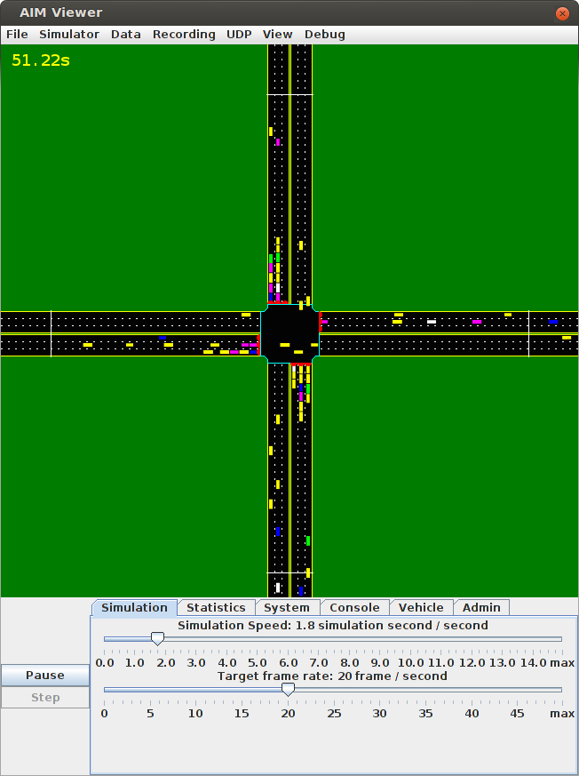
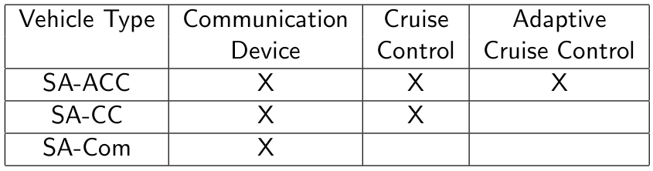
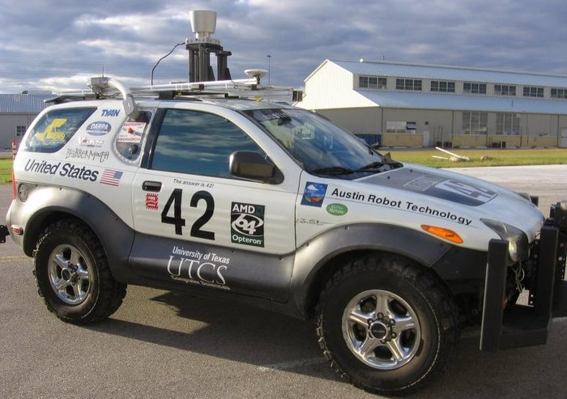
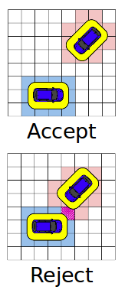
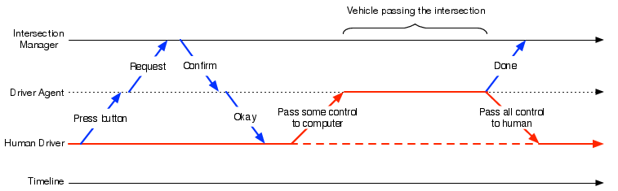
Semi-Autonomous Intersection Management
Tsz-Chiu Au, Shun Zhang, and Peter Stone
Full Paper in
ARMS 2014!
Previous Work: Autonomous Intersection Management (AIM)
Semi-Autonomous Vehicles
The AIM protocol
A fine control of autonomous vehicles.
More vehicles simultaneously to cross an intersection.
Effectively reducing the delay of vehicles.
General enough to accept reservation requests from any semi-autonomous vehicles.
We focus on the three types of semi-auto vehicles.
Our
Autonomous
Vehicle!
Constraint-Based Reservation
Intention: The direction in which the vehicle intends to move.
Vehicle Type: The type of vehicle.
Entry Condition: The condition under which the vehicle will enter the intersection.
Acceleration Profile List: The list of possible acceleration schedules from among which the vehicle will choose one to follow during the traversal of the intersection.
Limitations of AIM
Designed for the time when vehicles are autonomous.
A long transition period during which most vehicles have limited capabilities.
New term: semi-autonomous vehicles
Vehicles with limited autonomous driving and wireless communication capabilities.
Experiment settings:
Intersection: 3 lanes on each road.
Traffic: 360 vehicles/hour/lane.
Type of vehicles: Fully Autonomous, Adaptive Cruise Control, Cruise Control, Communication Device and Traditional Human-driven
Interaction Model
Experiment results:
the performance of semi-autonomous vehicles is very similar to fully autonomous vehicles when the ratio to human-driven vehicles is below 40%. Beyond 40%, fully autonomous vehicles increasingly outperform semi-autonomous vehicles
Conclusion
The first multiagent protocol to enable smooth interactions between human-driven, fully autonomous, and semi-autonomous vehicles.
Showed that our system can greatly decrease traffic delay when most vehicles are semi-autonomous.
References
[1] DARPA. DARPA Urban Challenge.
http://www.darpa.mil/grandchallenge, 2007.
[2] K. Dresner and P. Stone. Sharing the road: Autonomous vehicles meet human drivers. In IJCAI, 2007.
[3] K. Dresner and P. Stone. A multiagent approach to
autonomous intersection management. Journal of Artificial Intelligence Research (JAIR), March 2008
Etc.

