Slide 1

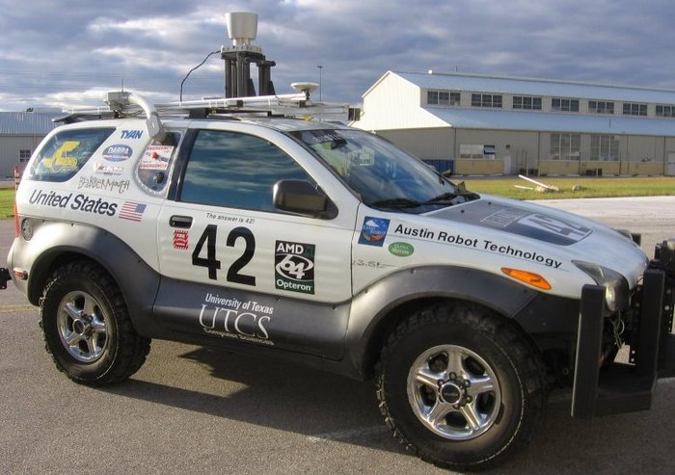
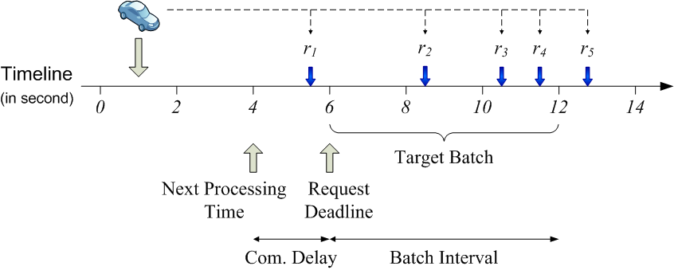

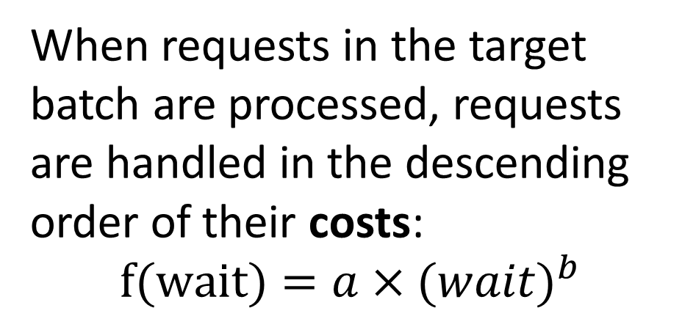


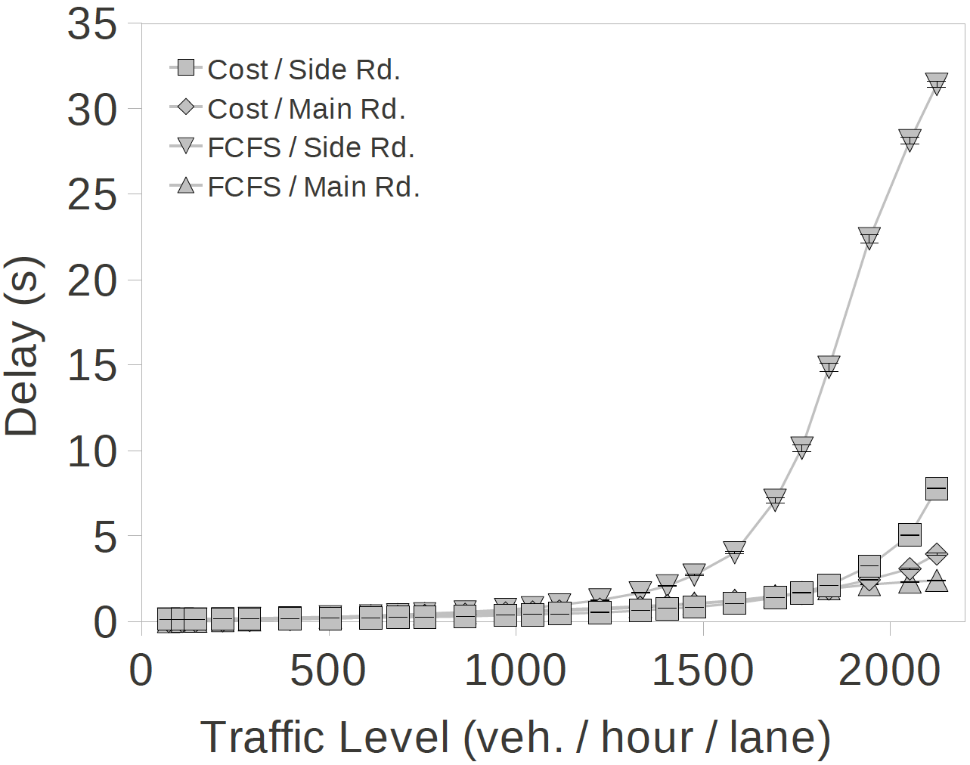
Semi-Autonomous Intersection Management
Shun Zhang, Tsz-Chiu Au, and Peter Stone
Department of Computer Science
Will also be presented at AAMAS 2014!
THE UNIVERSITY OF TEXAS AT AUSTIN
Goal: utilize the capacity of autonomous vehicles to make transportation infrastructure much more efficient.
Our autonomous vehicle:
How the Batch Policy works:
A request is a 4-tuple: (tarrival, varrival, larrival, lexit)
The Reservation Idea:
Requests are temporarily stored in a queue, sorted by the proposed arrival times.
AIM is more efficient than traffic signals and stop signs.
Requests on the queue are partitioned into batches by a fixed time interval (batch interval tbatch).
Requests in the next target batch are processed at once at the next processing time.
Time 4
When requests in the target batch are processed, requests are handled in the descending order of their costs:
When a request is handled, either
a reservation is granted, or
a rejection message is sent to the vehicle.
Time 3
First Come, First Serves (FCFS): reservation requests are handled in the order of arrival.
Time 2
In this paper, we introduce the Batch policy that is better than FCFS under unbalanced traffic.
After all requests in the target batch are handled, the next processing time is increased by tbatch, and the next target batch advances to the next one.
Time 1
Unbalanced traffic: the traffic in one direction is much heavier than the traffic in the other direction.
Experiment settings:
Intersection: 3 lanes on each road.
Main street traffic: 540 veh/hour/lane.
Side road traffic: 72-2200 veh/hour/lane.
Cost function: (waiting time)2
Batch Interval tbatch = 3 seconds
Delay = the traversal time of a vehicle minus the traversal time without traffic and intersection control.
Vehicles from the side road cannot easily get reservations to enter the intersection due to the heavy traffic on the main street.
Side Road
Main Street
FCFS cannot handle unbalanced traffic because it does not prioritize reservations according to the vehicles’ waiting times.
Results:
Under FCFS, the average delay of vehicles on the side road increases rapidly as the traffic level on the main street increases.
Under the batch policy, the delay of the vehicles on the side road is reduced tremendously, at the cost of a very small increase on the main street.
In the worst case, it can cause starvation―vehicles on the side road cannot enter the intersection indefinitely.
Unbalanced traffic is very common as many intersections in cities are junctions connecting side roads to main streets.
The batch policy groups several reservation requests together and applies a prioritization scheme to reorder the requests.
Prioritization schemes: a vehicle from the low traffic road will be given a high priority for reservations if its movement has been blocked for too long.
Conclusions: the batch policy outperforms FCFS, the best autonomous intersection control policy in the literature, in unbalanced traffic.

