Slide 1


Intersection Management with Constraint-based Reservation System
Tsz-Chiu Au, Shun Zhang, Peter Stone
Department of Computer Science
The University of Texas at Austin
Department of Computer Science
The University of Texas at Austin
Notes:
<number>

Slide 2
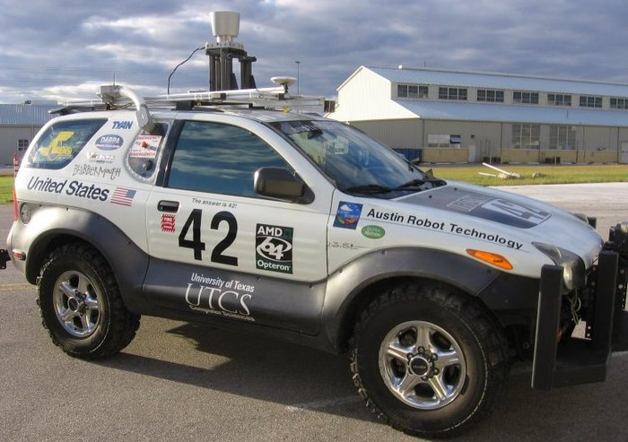
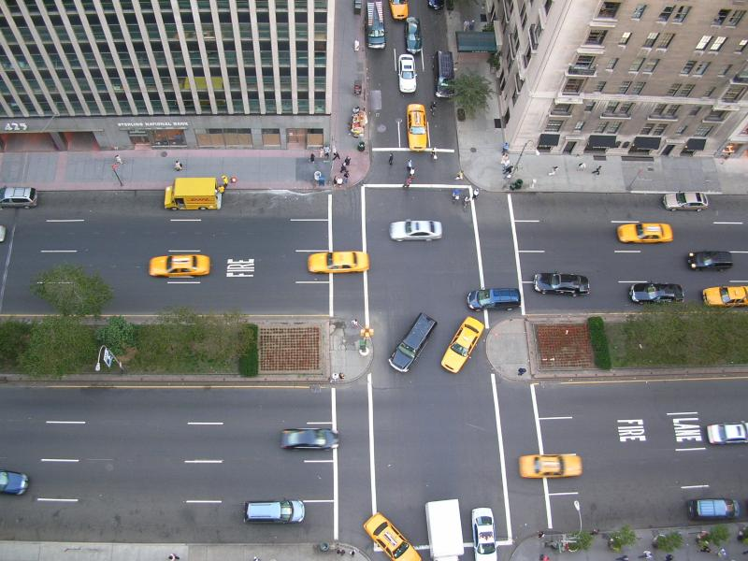
Transportation Infrastructure: Present and Future
Today’s transportation infrastructure is designed for human drivers.
In the future: Autonomous Traffic Management
Utilize the capacity of autonomous vehicles to improve traffic in transportation systems.
Highly Efficient
➔ Less fuel consumption
➔ Less emissions
➔ Sustainable society
Notes:
<number>

Slide 3
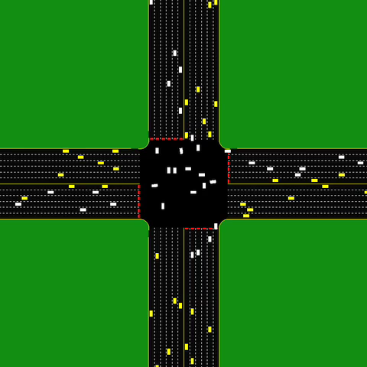
Autonomous Intersection Management
Dramatically reduce the traffic delay.
Reduce the overhead of fuel consumption by approximately two thirds.
Kurt Dresner and Peter Stone. A Multiagent Approach to Autonomous Intersection Management. JAIR 2008.
D. Fajardo, T.-C. Au, S. T. Waller, P. Stone, and D. Yang. Automated Intersection Control: Performance of a Future Innovation Versus Current Traffic Signal Control. In Transportation Research Record : Journal of the Transportation Research Board, 2011.
Notes:
Explain what is buffer. New video with buffer shown.
emphasize the *difference* from India video
- autonomous vehicles -> no accident
<number>

Slide 4

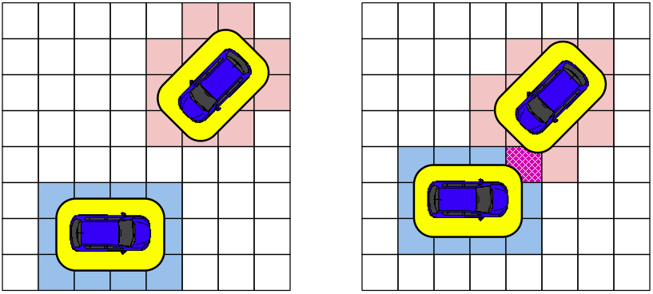
Grid-Based Collision Detection
Time 4
Time 3
Time 2
Time 1
Accept
Reject

Slide 5
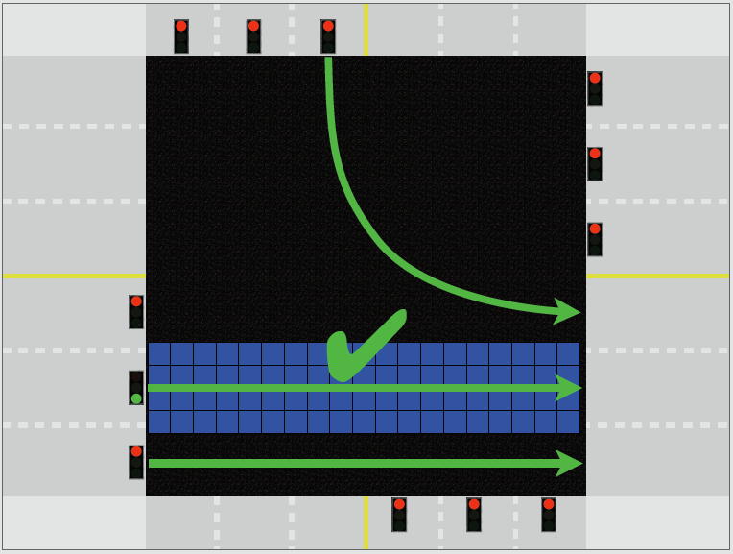
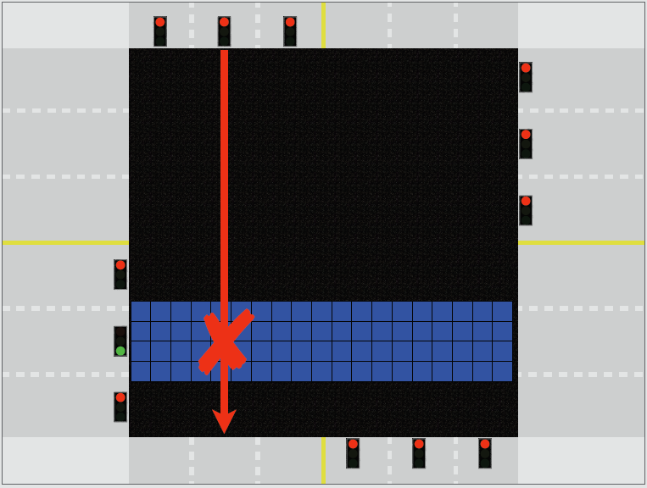
Sharing the Road with Human Drivers
Autonomous vehicles won’t displace manual-controlled vehicles in one day.
Some people enjoy driving.
FCFS-signal = First-Come, First-Served Policy + Traffic Signals

Slide 6
Outline
Introduction to Autonomous Intersection Management (AIM)
Mixed Reality Simulation Platform
Part 1: Control of Autonomous Vehicles
Analysis of the efficiency of AIM
Motion planning algorithms
Part 2: Liveness of Transportation Systems
Unbalanced Traffic
Conditions of liveness in a simplified road networks

Slide 7
Conclusions

Slide 8
Conclusions and Future Work
Implemented a mixed reality platform for real autonomous vehicles to interact with the virtual vehicles in the simulator.
Realistically evaluated the AIM protocol.
Identified realistic simulation parameters for real autonomous vehicles to safely traverse an intersection.
Proposed methods to compensate for the decrease of the throughput due to the use of realistic simulation parameters.
Little’s Law: Prevent stopping before intersections and increase acceleration
Motion planning techniques to prevent stopping before intersections.
Conducted experiments to evaluate the planning-based controllers and the acceleration
In the future, conduct mixed reality experiments with multiple real autonomous vehicles and devise better controllers.
Notes:
Need an agenda slide.
you'll probably have to spend less time on this slide
Need related work
<number>

