Slide 1

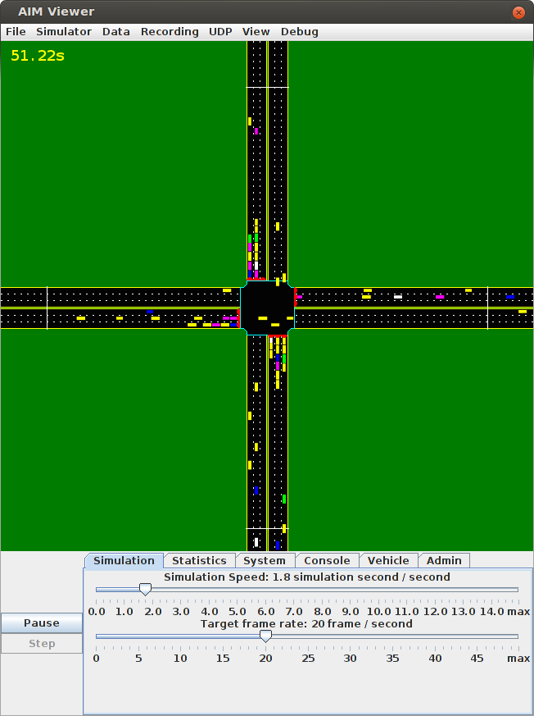
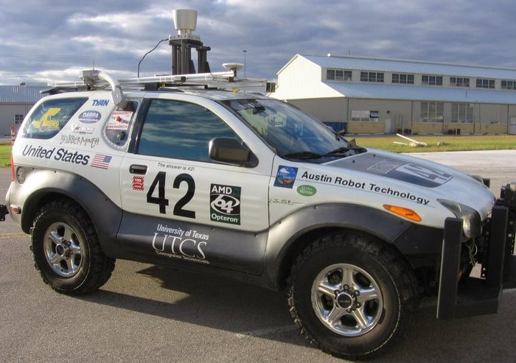
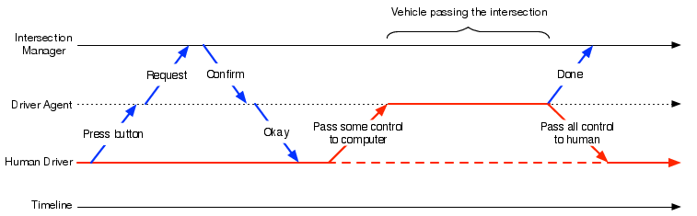
Semi-Autonomous Intersection Management
Tsz-Chiu Au, Shun Zhang, and Peter Stone
Will be presented again at
AAMAS 2014!
Department of Computer Science
THE UNIVERSITY OF TEXAS AT AUSTIN
Previous Work: Autonomous Intersection Management (AIM)
Semi-Autonomous Vehicles
The AIM protocol exploits the fine control of autonomous vehicles to allow more vehicles simultaneously to cross an intersection, thus effectively reducing the delay of vehicles by orders of magnitude compared to traffic signals.
Our proposed reservation system is general enough to accept reservation requests from any semi-autonomous vehicles that are capable of following some trajectories and communicating with the IM. We currently focus on the types of semi-auto vehicles on the right.
Vehicle Types | Communication Device | Cruise Control | Adaptive Cruise Control
SA-ACC | X | X | X
SA-CC | X | X
SA-Com | X
Our
Autonomous
Vehicle!
Interaction Model
Drawbacks of AIM
AIM is designed for the time when vehicles are autonomous. There will be a long transition period during which most vehicles have some but not all capabilities of fully autonomous vehicles.
We use the term semi-autonomous vehicles to refer to vehicles with limited autonomous driving and wireless communication capabilities.
Experiment settings:
*.Intersection: 3 lanes on each road.
*.Traffic: 360 veh/hour/lane
*.Type of vehicles: Fully Autonomous, Adaptive Cruise Control, Cruise Control, Communication Device and Traditional Human-driven
Conclusion
This poster introduces SemiAIM, a new multiagent constraint-based autonomous intersection management system that enables human-driven vehicles and semi-autonomous vehicles, in addition to fully autonomous vehicles, to make reservations and enter an intersection within the AIM paradigm.
Our initial experiment showed that our system can greatly decrease traffic delay when most vehicles are semi-autonomous, even when few (if any) are fully autonomous
Acknowledgement
References
This work has taken place in the ART Lab at UNIST and LARG
at UT Austin. ART research is supported by UNIST research fund
(1.120038.01). LARG research is supported in part by NSF (CNS-
1330072, CNS-1305287) and ONR (21C184-01).
[1] DARPA. DARPA Urban Challenge.
http://www.darpa.mil/grandchallenge, 2007.
[2] K. Dresner and P. Stone. Sharing the road: Autonomous vehicles meet human drivers. In IJCAI, 2007.
[3] K. Dresner and P. Stone. A multiagent approach to
autonomous intersection management. Journal of Artificial Intelligence Research (JAIR), March 2008
Etc.
Experiment results:
the performance of semi-autonomous vehicles is very similar to fully autonomous vehicles when the ratio to human-driven vehicles is below 40%. Beyond 40%, fully autonomous vehicles increasingly outperform semi-autonomous vehicles

