Slide 1


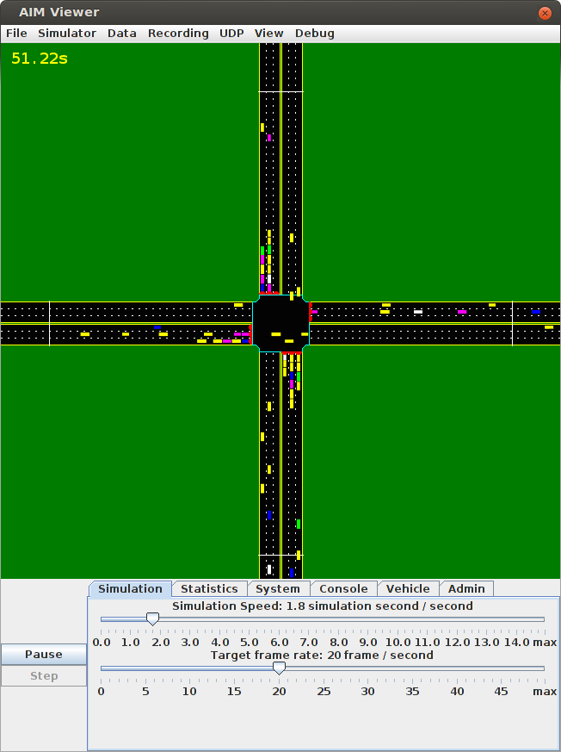
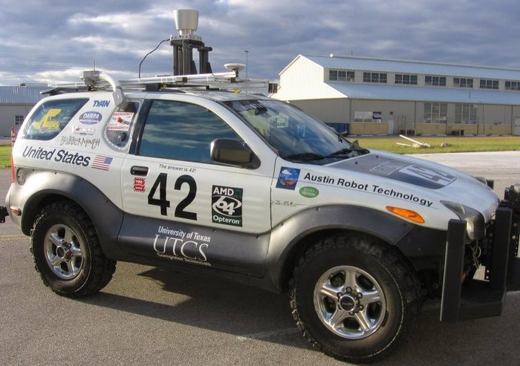
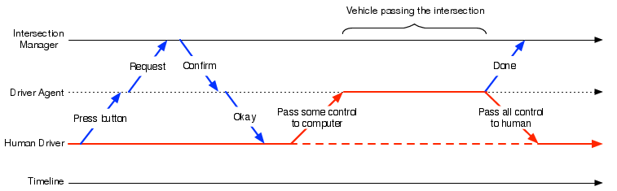
Semi-Autonomous Intersection Management
Tsz-Chiu Au, Shun Zhang, and Peter Stone
Previous Work: Autonomous Intersection Management (AIM)
Semi-Autonomous Vehicles
Vehicle Types | Communication Device | Cruise Control | Adaptive Cruise Control
SA-ACC | X | X | X
SA-CC | X | X
SA-Com | X
The AIM protocol
A fine control of autonomous vehicles.
More vehicles simultaneously to cross an intersection.
Effectively reducing the delay of vehicles.
Our proposed reservation system is general enough to accept reservation requests from any semi-autonomous vehicles that are capable of following some trajectories and communicating with the IM. We currently focus on the types of semi-auto vehicles on the right.
Our
Autonomous
Vehicle!
Limitations of AIM
AIM is designed for the time when vehicles are autonomous. There will be a long transition period during which most vehicles have some but not all capabilities of fully autonomous vehicles.
We use the term semi-autonomous vehicles to refer to vehicles with limited autonomous driving and wireless communication capabilities.
Experiment settings:
Intersection: 3 lanes on each road.
Traffic: 360 vehicles/hour/lane.
Type of vehicles: Fully Autonomous, Adaptive Cruise Control, Cruise Control, Communication Device and Traditional Human-driven
Interaction Model
Experiment results:
the performance of semi-autonomous vehicles is very similar to fully autonomous vehicles when the ratio to human-driven vehicles is below 40%. Beyond 40%, fully autonomous vehicles increasingly outperform semi-autonomous vehicles
Conclusion
The first multiagent protocol to enable smooth interactions between human-driven, fully autonomous, and semi-autonomous vehicles.
Showed that our system can greatly decrease traffic delay when most vehicles are semi-autonomous.
References
[1] DARPA. DARPA Urban Challenge.
http://www.darpa.mil/grandchallenge, 2007.
[2] K. Dresner and P. Stone. Sharing the road: Autonomous vehicles meet human drivers. In IJCAI, 2007.
[3] K. Dresner and P. Stone. A multiagent approach to
autonomous intersection management. Journal of Artificial Intelligence Research (JAIR), March 2008
Etc.

