Slide 1

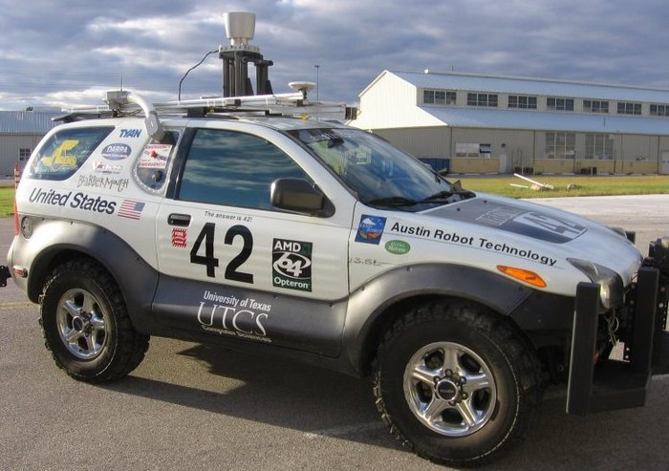

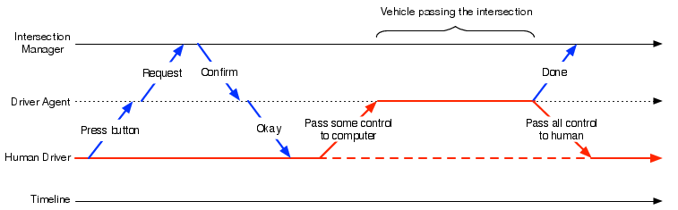
Semi-Autonomous Intersection Management
Shun Zhang, Tsz-Chiu Au, and Peter Stone
Department of Computer Science
Will also be presented at AAMAS 2014!
THE UNIVERSITY OF TEXAS AT AUSTIN
Our autonomous vehicle:
Features of Vehicles
Our proposed reservation system is general enough to accept reservation requests from any semi-autonomous vehicles that are capable of following some trajectories and communicating with the IM. We currently focus on the types on the right.
Vehicle Types | Communication Device | Cruise Control | Adaptive Cruise Control
SA-ACC | X | X | X
SA-CC | X | X
SA-Com | X
The Reservation Idea:
AIM is more efficient than traffic signals and stop signs.
Interaction Model
First Come, First Serves (FCFS): reservation requests are handled in the order of arrival.
Experiment settings:
Intersection: 3 lanes on each road.
Main street traffic: 360 veh/hour/lane.
Type of vehicles: Fully Autonomous, Adaptive Cruise Control, Cruise Control, Communication Device and Traditional Human-driven
Experiment results: the performance of semi-autonomous vehicles is very similar to fully autonomous vehicles when the ratio to human-driven vehicles is below 40%. Beyond 40%, fully autonomous vehicles increasingly outperform semi-autonomous vehicles
Conclusions: the batch policy outperforms FCFS, the best autonomous intersection control policy in the literature, in unbalanced traffic.

