Slide 1
Deep Learning Framework for Package Routing

Slide 2
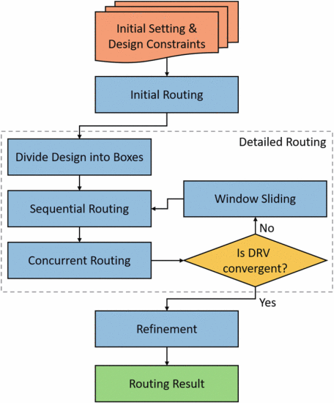
Framework

Slide 3
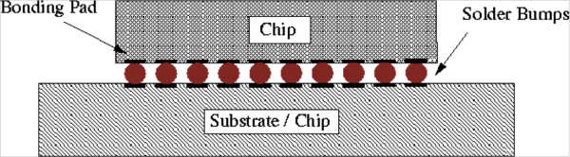
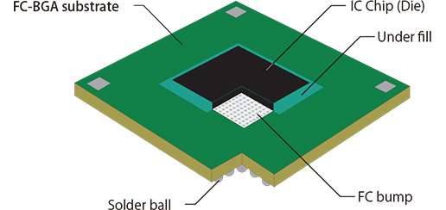
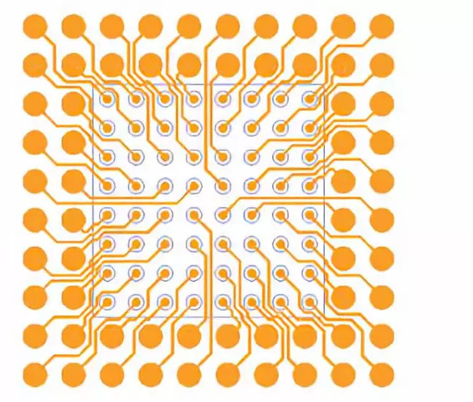
Initial Setting
Die pad(ball)
bump pad
Ref:https://www.palomartechnologies.com/blog/bid/28476/Solder-Bump-Bonding-Ball-Bumps-and-Wire-Bonds
Ref:https://pcbmake.com/chip-substrate-material/
Ref:https://www.strongfirst.com.cn/en/news_detail-136-65.html

Slide 4
Initial Routing

Slide 5
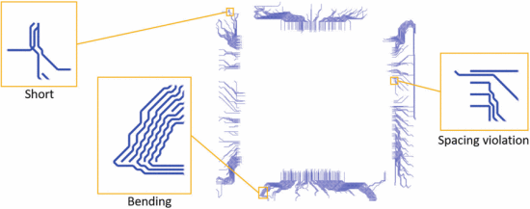
heuristic algorithm

Slide 6
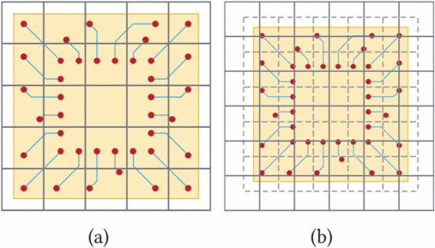
Divide Desing Into Box

Slide 7
Divide Desing Into Box

Slide 8
Divide Desing Into Box

Slide 9
Divide Desing Into Box

